Slide 1
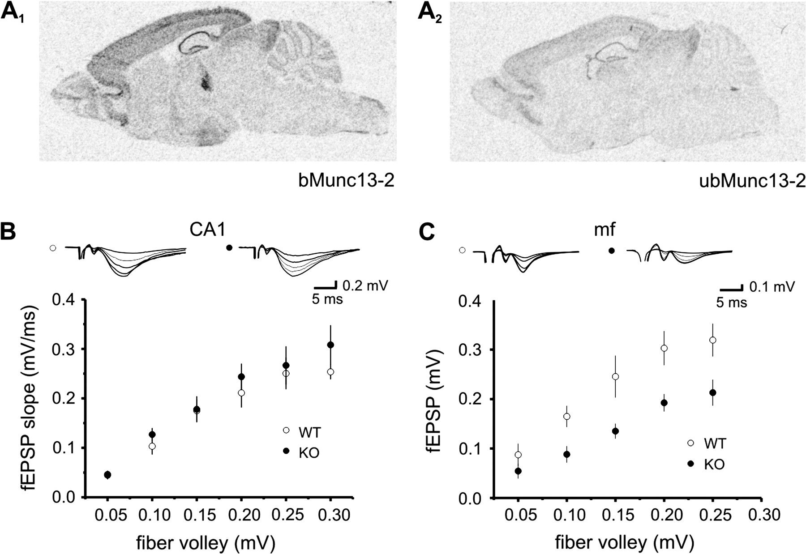
Figure 1. Impaired synaptic transmission at mossy fiber synapses in the absence of Munc13-2. (A_{1,2}) mRNAs ...
Notes:
Figure 1. Impaired synaptic transmission at mossy fiber synapses in the absence of Munc13-2. (A1,2) mRNAs for the brain specific (bMunc13-2, A1) and ubiquitously distributed (ubMunc13-2, A2) Munc13-2 splice variants are widely expressed in hippocampal neurons. (B) Field potential recordings of the input–output relationship of synaptic transmission of Schaffer-collateral synapses recorded in stratum radiatum of area CA1. Plotting the slope of the fEPSP against the corresponding fiber-volley amplitude shows no difference between WT (open circles) and Munc13-2 KO mice (filled circles). (C) At mossy fiber synapses, recording in stratum lucidum of area CA3, the input–output curve is reduced by 40% in Munc13-2 KO mice compared with control animals. In this case, the amplitude of the fEPSP was plotted against the amplitude of the fiber volley. Traces in (B) and (C) above the graphs are averages of 3–5 consecutive responses each.
Unless provided in the caption above, the following copyright applies to the content of this slide: © The Author 2009. Published by Oxford University Press. All rights reserved. For permissions, please e-mail: journals.permissions@oxfordjournals.org

Slide 2
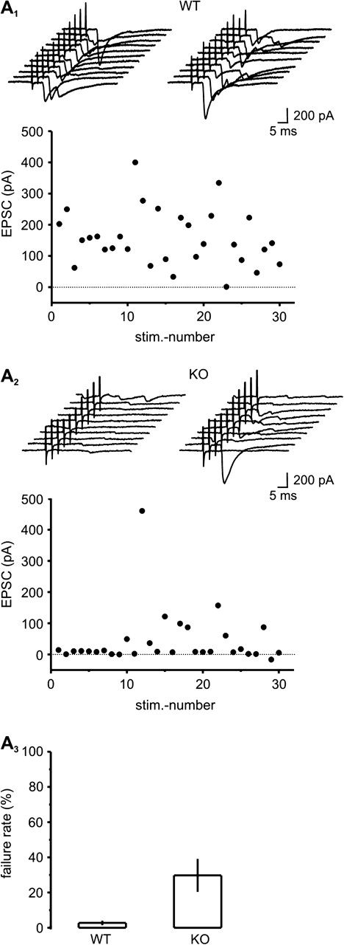
Figure 2. Loss of Munc13-2 leads to increased failures in mossy fiber synaptic transmission. (A_{1,2}) Depicted ...
Notes:
Figure 2. Loss of Munc13-2 leads to increased failures in mossy fiber synaptic transmission. (A1,2) Depicted are exemplary whole-cell recordings of mossy fiber responses in CA3 pyramidal neurons. Stimulating every 10 s, a higher incidence in transmission failures was apparent in Munc13-2 KO mice (A2) compared with WT (A1). Twenty individual responses are displayed on top of each graph, corresponding to stimulus numbers 1–20. (A3) The bar graph summarizes the average failure rate in WT (n = 10 cells) and KO mice (n = 10 cells).
Unless provided in the caption above, the following copyright applies to the content of this slide: © The Author 2009. Published by Oxford University Press. All rights reserved. For permissions, please e-mail: journals.permissions@oxfordjournals.org

Slide 3
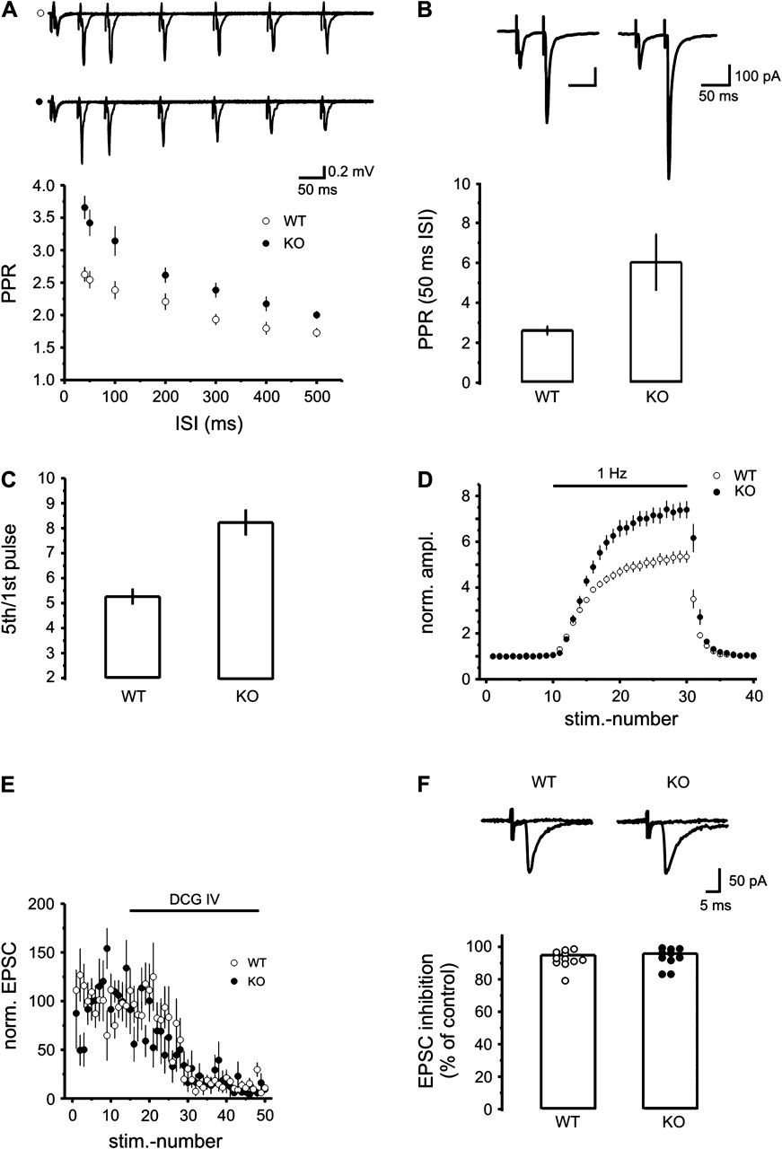
Figure 3. Mossy fiber short-term plasticity is increased in the absence of Munc13-2. (A) The graph displays the average ...
Notes:
Figure 3. Mossy fiber short-term plasticity is increased in the absence of Munc13-2. (A) The graph displays the average paired-pulse ratio of mossy fiber fEPSPs for interstimulus intervals of 40, 50, and 100–500 ms. In Munc13-2 KO mice, this ratio is significantly increased for all intervals. Traces above the graph are overlaid averages of 5 responses for interstimulus intervals between 50 and 500 ms. (B) Paired-pulse ratio in whole-cell recording of mossy fiber EPSCs at an interstimulus interval of 50 ms. The summary graph shows the increased ratio in KO mice. Sample traces are averages of 10 consecutive sweeps. (C) Summary bar graph of fEPSP responses elicited with a stimulation paradigm consisting of 5 pulses delivered at 25 Hz. The amplitude of the fifth response is normalized to the first in the train. (D) The graph shows the averaged time course of frequency facilitation for WT and Munc13-2 KO mice. Starting with a baseline stimulation rate of 0.05 Hz for 10 stimuli, the stimulation frequency was raised to 1 Hz for 20 pulses (numbers 11–30) and afterwards returned to the baseline frequency. A more pronounced increase in frequency facilitation can be observed in slices from KO animals. (E) The averaged time course of inhibition of mossy fiber EPSCs by the group II metabotropic glutamate receptor agonist DCG IV (1 μM) for n = 11 (WT) and n = 10 (Munc13-2 KO) cells. (F) The bar graph summarizes the maximum suppression of EPSC amplitudes by application of DCG IV for both genotypes. Traces above the graph are averages of 5 sweeps from representative experiments showing responses in control condition and in the presence of DCG IV, respectively.
Unless provided in the caption above, the following copyright applies to the content of this slide: © The Author 2009. Published by Oxford University Press. All rights reserved. For permissions, please e-mail: journals.permissions@oxfordjournals.org

Slide 4
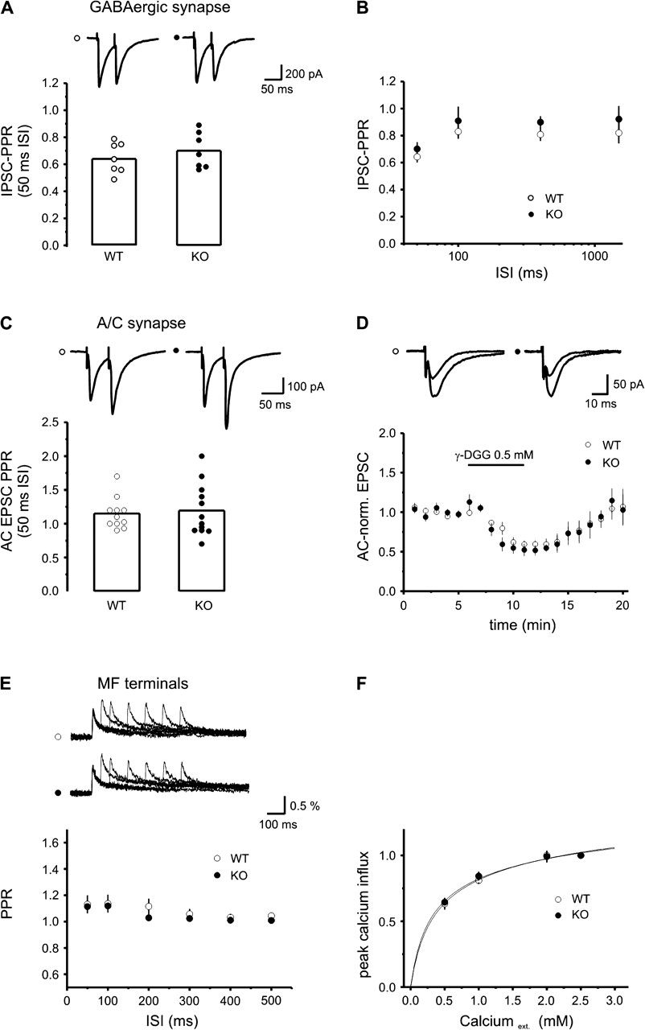
Figure 4. Short-term plasticity of GABAergic and AC synapses onto CA3 pyramidal cells as well as presynaptic calcium ...
Notes:
Figure 4. Short-term plasticity of GABAergic and AC synapses onto CA3 pyramidal cells as well as presynaptic calcium influx into mossy fiber terminals is normal in the absence of Munc13-2. (A) Whole-cell recording of stimulus-evoked IPSCs in CA3 pyramidal neurons. The bar graph shows the average paired-pulse depression at an interstimulus interval of 50 ms. Traces above the graph are averages of 5 sweeps for WT (left) and Munc13-2 KO (right). (B) The graph plots the IPSC paired pulse ratio for interstimulus intervals of 50, 100, 400, and 1500 ms for WT (n = 7 to 4 cells, open circles) and Munc13-2 KO (n = 7 to 5 cells, black circles). There is no statistically significant difference for any interstimulus interval. Please note the logarithmic time-axis. (C) The bar graph summarizes the paired-pulse facilitation of AC-evoked EPSCs in CA3 pyramidal neurons for WT (n = 11 cells, open circles) and Munc13-2 KO mice (n = 12 cells, black circles) for 50-ms interstimulus interval. Traces on top are averages of 5 sweeps each. (D) Application of the low-affinity AMPA receptor antagonist γ-DGG leads to a decrease in EPSC amplitude at AC synapses. The decrease in amplitude was not significantly different in WT and Munc13-2 KO experiments as seen in this summary plot of n = 4 experiments each. Representative traces on top depict overlays of averages of 5 traces each during control and γ-DGG conditions. (E) Single photodiode recordings of calcium transients in mossy fiber terminals. The graph depicts the paired-pulse ratio for calcium transients in WT (n = 5 slices, open circles) and Munc13-2 KO mice (n = 7 slices, black circles) for interstimulus intervals of 50–500 ms. Facilitation of Ca2+ transients was determined by subtracting a single-pulse from the paired-pulse experiment. No difference between the genotypes could be observed. (F) Reduction of the external calcium concentration led to a relative inhibition of calcium transients in mossy fiber terminals, which was not significantly different in WT (n = 3 slices) and Munc13-2 KO (n = 4 slices) animals. Peak calcium influx was normalized to the standard extracellular calcium concentration of 2.5 mM. Curves were fitted according to a double-exponential binding reaction (see Methods).
Unless provided in the caption above, the following copyright applies to the content of this slide: © The Author 2009. Published by Oxford University Press. All rights reserved. For permissions, please e-mail: journals.permissions@oxfordjournals.org

Slide 5
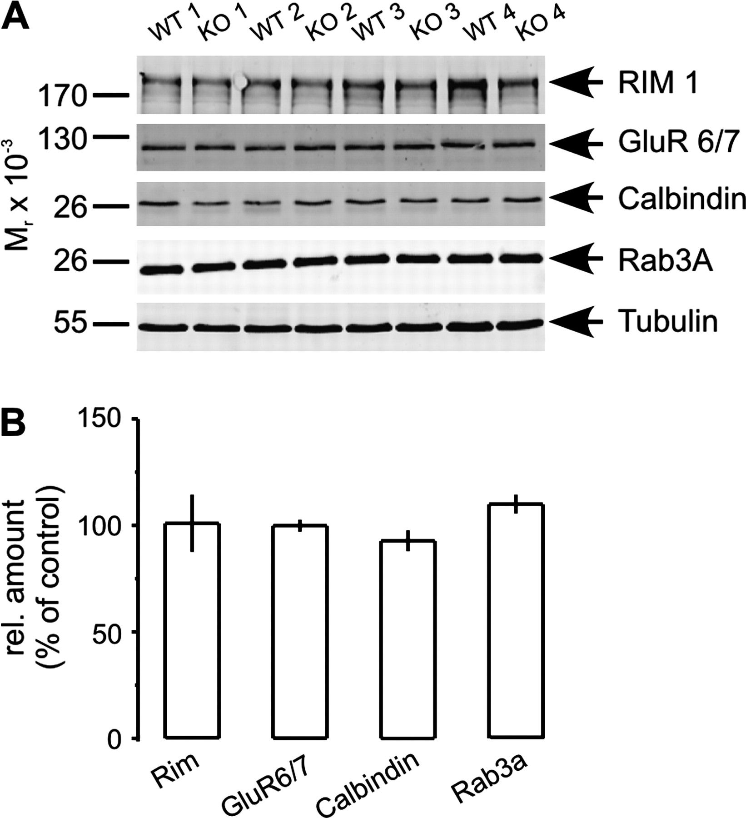
Figure 5. Protein levels of important synaptic proteins are normal in Munc13-2−/− mice. (A) The immunoblot analysis of ...
Notes:
Figure 5. Protein levels of important synaptic proteins are normal in Munc13-2−/− mice. (A) The immunoblot analysis of hippocampal extracts demonstrates that the protein levels of Rim1α, GluR 6/7, Calbindin, and Rab3A are unaltered in Munc13-2 KO mice. Tubulin served as a loading control. (B) The bar graph summarizes the amount of the respective proteins in Munc13-2 KO mice relative to WT controls (n = 4). There were no statistically significant differences.
Unless provided in the caption above, the following copyright applies to the content of this slide: © The Author 2009. Published by Oxford University Press. All rights reserved. For permissions, please e-mail: journals.permissions@oxfordjournals.org

Slide 6
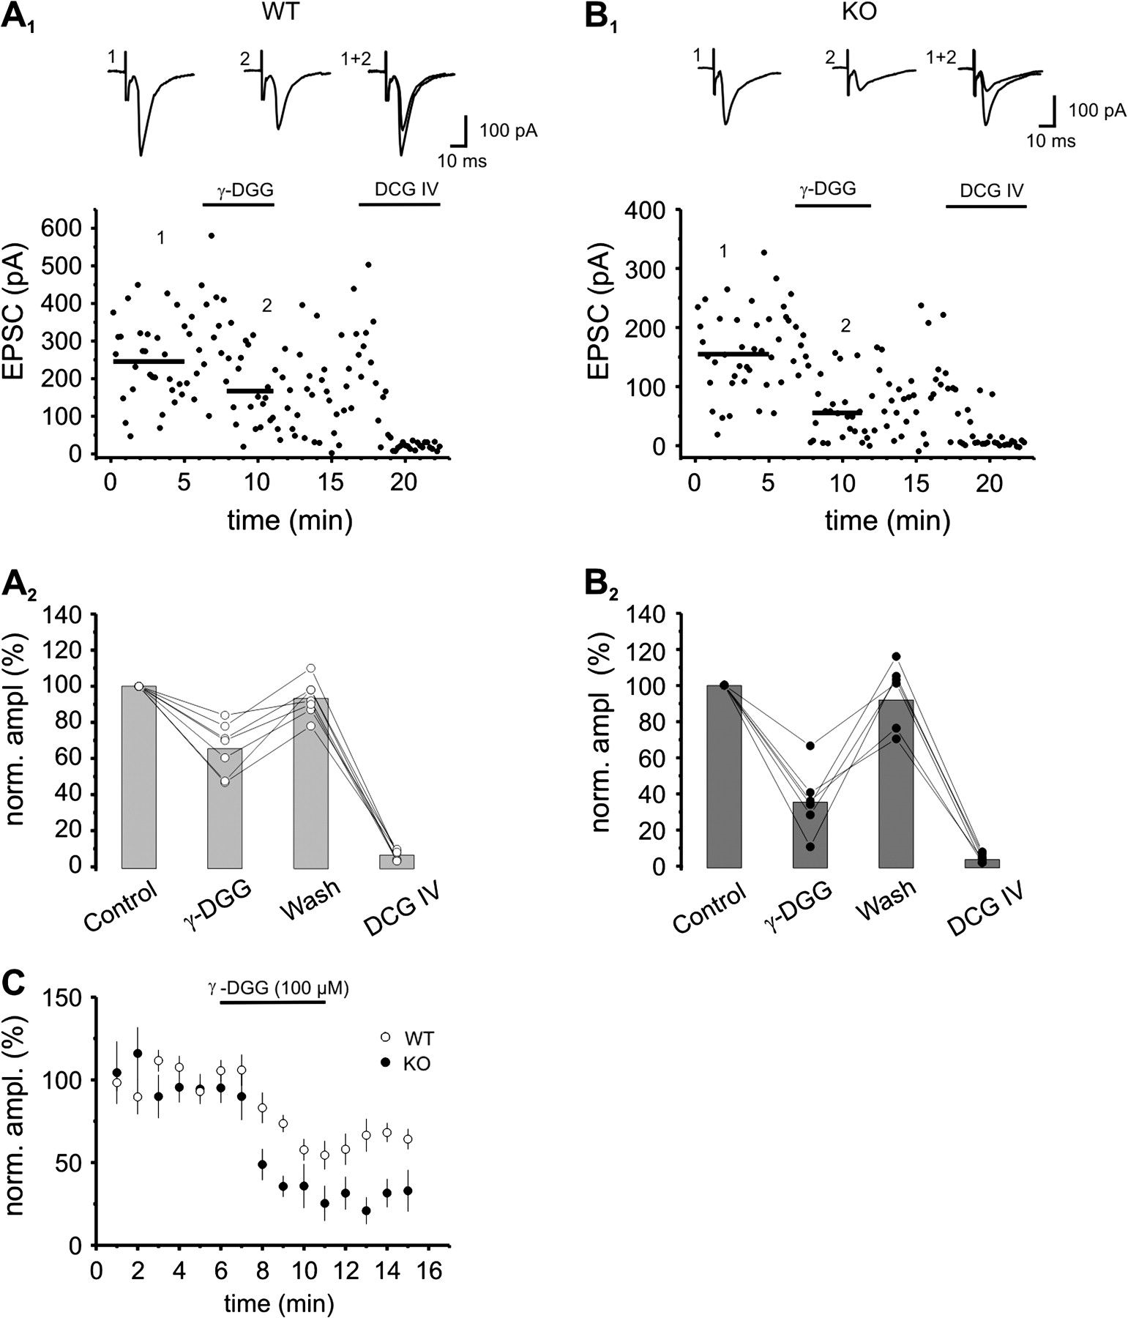
Figure 6. Loss of Munc13-2 leads to a reduction in release probability at mossy fiber synapses. (A₁, ...
Notes:
Figure 6. Loss of Munc13-2 leads to a reduction in release probability at mossy fiber synapses. (A1, B1) Time course of 2 representative experiments demonstrating the differential effect of the low affinity AMPA receptor antagonist γ-DGG (100 μM) on mossy fiber EPSCs in whole-cell recordings of CA3 pyramidal neurons in WT (A1) and Munc13-2 KO (B1) cells. The drug was applied for 5 min and then washed out again. Mossy fiber origin of EPSCs was verified by application of the group II metabotropic glutamate receptor agonist DCG IV (1 μM) at the end of experiments. The solid lines in the plots indicate the mean EPSC amplitude over 5 min before and the 3 last minutes during drug application. Traces on top are averages of 5 sweeps and were taken at the time points indicated by the numbers in the graphs below. (A2, B2) The bar graphs summarize the reversible reduction of EPSCs by γ-DGG (100 μM) in WT (65% of control, n = 7 cells, (A2)) and Munc13-2 KO mice (35% of control, n = 6 cells, (B2)). Lines connect data points from individual experiments. (C) The graph displays the summary time plot of the effect of γ-DGG (100 μM) on EPSC amplitudes for n = 7 cells in WT (open circles) and n = 6 cells in Munc13-2 KO mice (black circles).
Unless provided in the caption above, the following copyright applies to the content of this slide: © The Author 2009. Published by Oxford University Press. All rights reserved. For permissions, please e-mail: journals.permissions@oxfordjournals.org

Slide 7
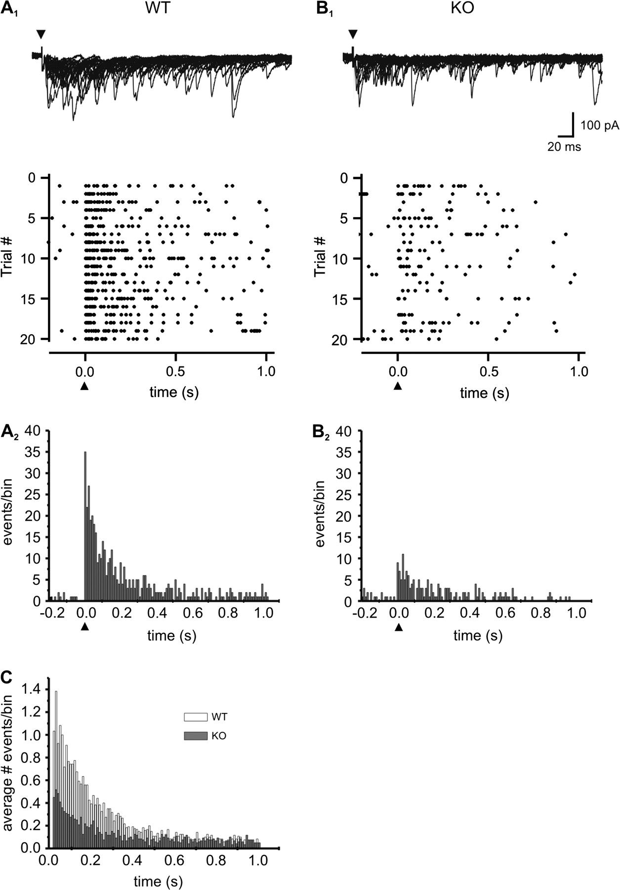
Figure 7. Strontium-induced mossy fiber–specific asynchronous release events are reduced in the absence of Munc13-2. ...
Notes:
Figure 7. Strontium-induced mossy fiber–specific asynchronous release events are reduced in the absence of Munc13-2. (A1, B1) Raster plots showing asynchronous release at mossy fiber synapses, with extracellular calcium replaced by 8 mM strontium, for a cell recorded from a WT (A1) and a Munc13-2 KO mouse (B1). Twenty consecutive trials are plotted in the diagram and each dot represents the latency of a detected release event in a trial with respect to the stimulation time point (0.0, also indicated by the black triangle below the graph). Dots before stimulation correspond to spontaneous release events in strontium. Traces above the plots are overlays of the 20 sweeps from which the raster plots were constructed. Stimulation artifacts are truncated for clarity (indicated by black triangles) and the first 200 ms of the sweeps are shown. (A2, B2) Displayed are latency histograms for the single experiments shown above. Event latencies were binned into 10-ms segments and the number of detected events was summed in each bin for 20 trials. (C) Summary latency histogram for WT (n = 6 cells, open bars) and Munc13-2 KO mice (n = 6 cells, black bars). For comparison the average number of detected events per trial and cell was computed for each 10-ms bin. The first 10-ms bin after stimulation is omitted from the histogram.
Unless provided in the caption above, the following copyright applies to the content of this slide: © The Author 2009. Published by Oxford University Press. All rights reserved. For permissions, please e-mail: journals.permissions@oxfordjournals.org

Slide 8
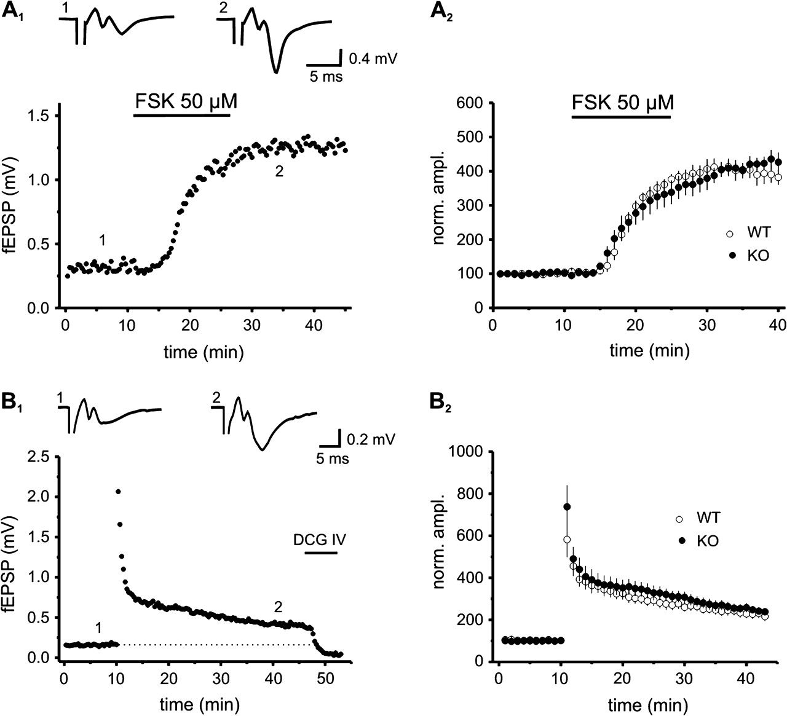
Figure 8. Munc13-2 is not necessary for long-term plasticity at mossy fiber synapses. (A₁) Single example ...
Notes:
Figure 8. Munc13-2 is not necessary for long-term plasticity at mossy fiber synapses. (A1) Single example experiment showing chemically induced long-term potentiation with the adenylate-cyclase activator forskolin (FSK) in mossy fiber field potential recordings of a Munc13-2 KO slice. Traces on top of the graph are averages of 5 consecutive sweeps taken from the time points indicated by the numbers in the plot. Stimulation artifacts are truncated for clarity. (A2) Summary plot of FSK induced long-term potentiation in WT (n = 5 slices) and Munc13-2 KO mice (n = 4 slices). Values are normalized to the 10-min period prior to application. No significant difference in the magnitude of potentiation was detectable. (B1) Depicted is a single representative experiment of long-term potentiation in a field recording from a Munc13-2 KO slice. LTP was induced by a tetanic stimulus consisting of 3 × 125 pulses at 25 Hz given in a 20-s interval. Traces correspond to numbers in the plot. (B2) Summary diagram of n = 4 (WT) and n = 5 (KO) such experiments. The magnitude of long-term potentiation was the same for both genotypes.
Unless provided in the caption above, the following copyright applies to the content of this slide: © The Author 2009. Published by Oxford University Press. All rights reserved. For permissions, please e-mail: journals.permissions@oxfordjournals.org

