Slide 1
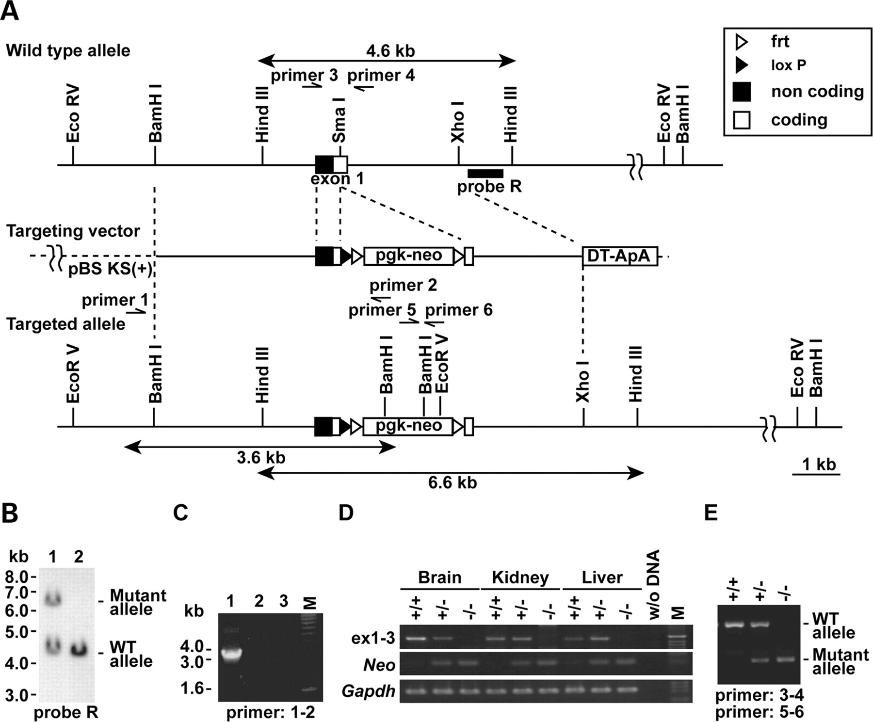
Figure 1. Generation of Efhc1-deficient mice. (A) Schematic diagram of Efhc1 genomic sequence (top), targeting ...
Notes:
Figure 1. Generation of Efhc1-deficient mice. (A) Schematic diagram of Efhc1 genomic sequence (top), targeting construct (middle) and targeted Efhc1 allele (bottom). The coding (white box) and non-coding (blackened box) regions of exon 1 are shown. Relative position of the 3′ external probe (probe R) used to detect the targeted allele is shown under the wild-type allele. The predicted size of the wild-type (4.6 kb) and targeted (6.6 kb) alleles that probe R would detect in HindIII digests is shown. (B) Southern blot analysis of HindIII-digested genomic DNA from mouse ES cells. Probe R identified expected size fragments of wild-type and targeted mutant alleles. Lane 1 is targeted ES cell and lane 2 is wild-type ES cell. (C) Homologous recombination of left arm was confirmed by PCR. The PCR analysis, performed on genomic DNA derived from ES cells, resulted in the amplification of the expected size fragment in the homologous recombinant ES cell (lane 1), but not in the wild-type sample (lane 2). Lane 3 refers to the reaction without a template. (D) RT–PCR analysis for Efhc1 mRNA expression in mutant mice. Primers on Efhc1 cDNA (exon-connection PCR primer pair exon 1F/exon 3R) or on pgk-neo (Neo) cDNA (primer pair primer 5/primer 6) were designed to amplify 462 bp fragment from the Efhc1 cDNA or 152 bp fragment from the Neo cDNA. The RT–PCR analysis, performed on cDNAs derived from brain, kidney and liver total RNA, resulted in amplification of the expected size Efhc1 exons 1–3 fragment in the wild-type (+/+) and heterozygous (+/−) but not in the homozygous null mutant (−/−) sample. Conversely, −/− and +/−, but not +/+, cDNAs were amplified by primer pair for Neo. Lane (w/o DNA) refers to the reaction without a template. Control amplification for the glyceraldehyde 3-phosphate dehydrogenase gene (Gapdh) confirms the quality of the cDNA made. (E) PCR genotyping of mouse tail DNA. The PCR analysis, performed on genomic DNAs derived from +/+, +/− and −/−, resulted in the amplification of the expected size fragment of wild-type allele (442 bp, upper band) in +/+ and +/− or targeted allele (152 bp, lower band) in +/− and −/−. The positions of primers are indicated in (A). M, DNA size standard.
Unless provided in the caption above, the following copyright applies to the content of this slide: © The Author 2009. Published by Oxford University Press. All rights reserved. For Permissions, please email: journals.permissions@oxfordjournals.org

Slide 2
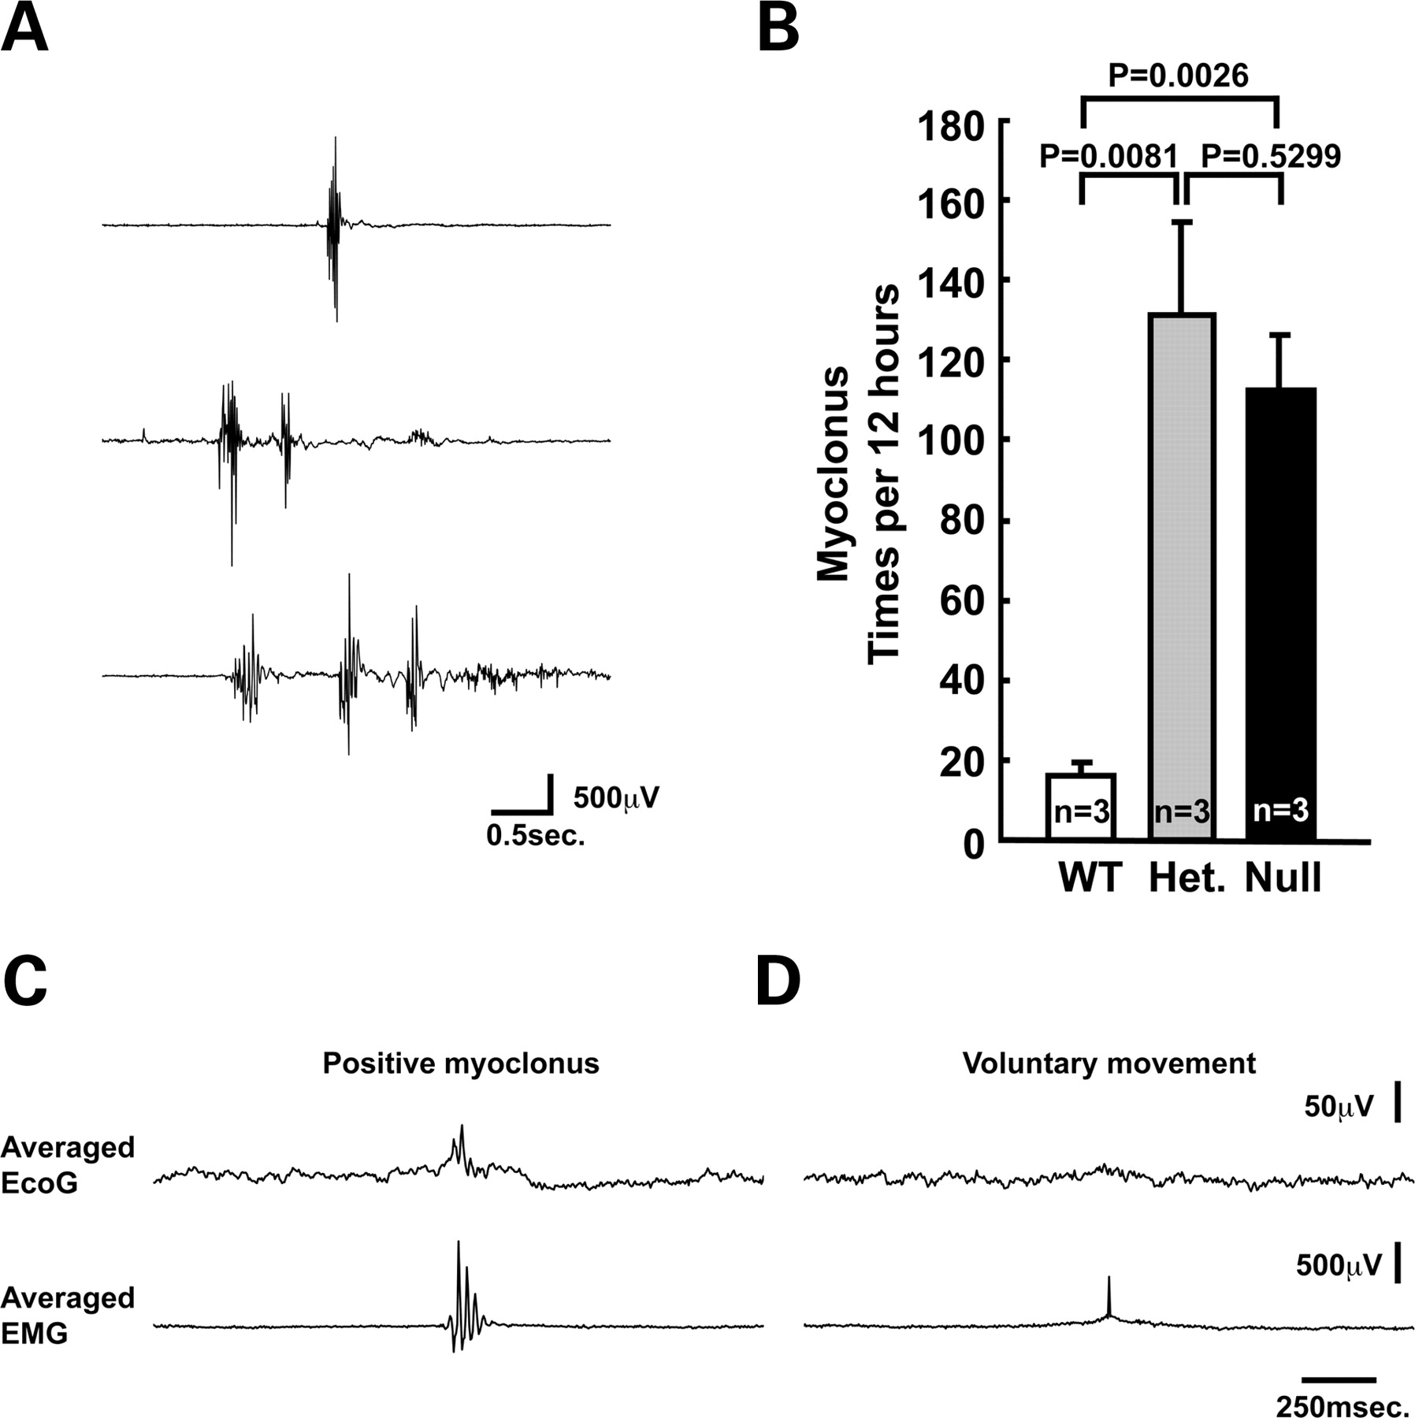
Figure 2. Increased spontaneous myoclonus in both heterozygous and null Efhc1-deficient mice. (A) Three examples of EMG ...
Notes:
Figure 2. Increased spontaneous myoclonus in both heterozygous and null Efhc1-deficient mice. (A) Three examples of EMG recorded in null mutant mice. Quick (within 200 ms per episode) high amplitude multispikes were observed in EMG of heterozygous and null mutant mice at 7–8 months. See Supplementary Material, Video S1. (B) The frequency of myoclonus during 12 h in the wild-type, heterozygous and null mutant mice. The frequency of involuntary movement was seven to eight times higher in the heterozygous (131 ± 23.3 per 12 h, P = 0.0081) and null mutants (112.3 ± 14.1 per 12 h, P=0.0026), compared with the background level count of wild-type littermates (16.3 ± 3.0 per 12 h). EcoG-EMG back-averaging showed abnormal potential at spontaneous myocloni (C; n = 93) but not at voluntary movements (D; n = 116). Het, heterozygous.
Unless provided in the caption above, the following copyright applies to the content of this slide: © The Author 2009. Published by Oxford University Press. All rights reserved. For Permissions, please email: journals.permissions@oxfordjournals.org

Slide 3
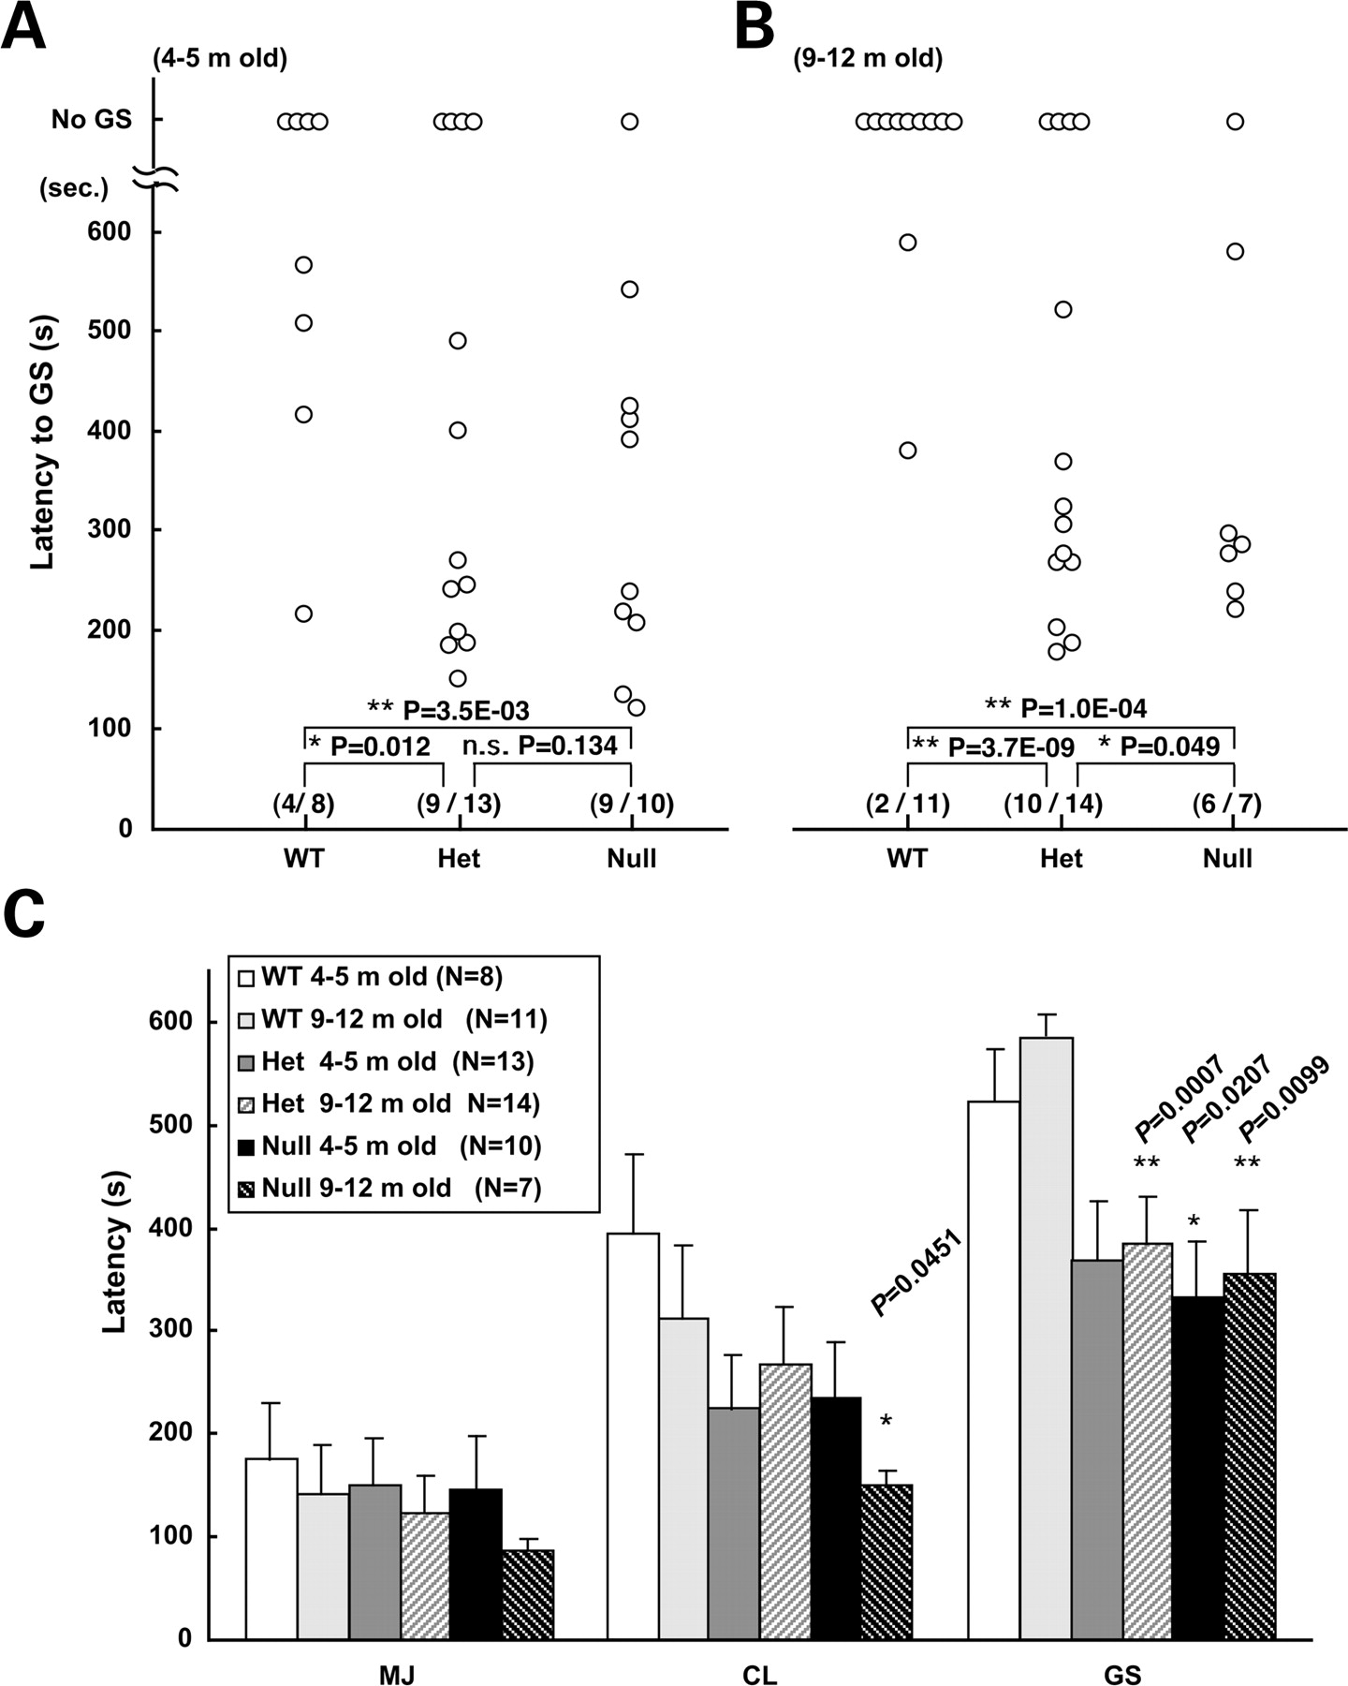
Figure 3. Increased seizure susceptibility in both heterozygous and null Efhc1-deficient mice. Seizure events after ...
Notes:
Figure 3. Increased seizure susceptibility in both heterozygous and null Efhc1-deficient mice. Seizure events after i.p. application of 50 mg/kg body weight of PTZ were counted. (A and B) At 4–5 months (A), percentage of animals exhibiting generalized convulsive seizures (GS) was significantly increased in heterozygous and null mutant mice. Nine of 13 (69.2%) heterozygous and 9 of 10 (90%) null mutants showed GS, whereas only 4 of 8 (50%) wild-type mice did (n = 8–13 per genotype). In 9–12-month-old mice (B), the percentage of animals exhibiting GS was also significantly increased in heterozygous and null mice. Ten of 14 (71.4%) heterozygous and 6 of 7 (85.7%) null mutants showed GS, whereas only 2 of 11 (18.2%) wild-type mice did (n = 7∼14 per genotype). In both developmental stages, the latencies are also significantly decreased in the heterozygous and null mutants [see the histogram in (C)]. Open circles represent individual mice. Observation time was 600 s after drug application, and mice without GS were plotted at no GS. The numbers in round brackets indicate how many showed GS in animals tested. *P < 0.05, **P < 0.01. n.s., not significant. (C) Histogram of latencies for MJ, CL and GS in 4–5- or 9–12-month-old wild-type, heterozygous and null mutant mice with PTZ treatment (n = 7–14 per genotype) (see Supplementary Material, Fig. S1 for the counting of MJ and CL). For the calculation of latency periods, 600 s was temporarily assigned for the mice without seizures. In 4–5-month-old mice, the latency until onset of GS was significantly reduced in the null mutant mice (328.2 ± 53.2 s; P = 0.0207) compared with wild-type (512.9 ± 48.5 s). In 9–12-month-old mice, the latency until onset of GS was significantly reduced in the heterozygous (378.1 ± 45.1 s; P = 0.0007) and null mutant (356.4 ± 70.0 s; P = 0.0099) compared with wild-type (578.7 ± 20.0 s); 9–12-month-old null mice (149.6 ± 13.5 s; P = 0.0451) had significantly shorter latency to CL compared with wild-type (312.5 ± 70.5 s). Mean values ± SEM are shown. *P < 0.05 and **P < 0.01. Het, heterozygous.
Unless provided in the caption above, the following copyright applies to the content of this slide: © The Author 2009. Published by Oxford University Press. All rights reserved. For Permissions, please email: journals.permissions@oxfordjournals.org

Slide 4
Figure 4. Increased PSA-NCAM in hippocampal dentate gyri of Efhc1-deficient mice. Coronal brain sections from ...
Notes:
Figure 4. Increased PSA-NCAM in hippocampal dentate gyri of Efhc1-deficient mice. Coronal brain sections from 2-month-old mice were stained with anti-PSA-NCAM monoclonal antibody and with DAB. The expression level of PSA-NCAM in SGZ of dentate gyrus (DG) increased in the heterozygous and null mutants compared with wild-type mice. Results were reproduced in three to five mice per genotype. Het, heterozygous.
Unless provided in the caption above, the following copyright applies to the content of this slide: © The Author 2009. Published by Oxford University Press. All rights reserved. For Permissions, please email: journals.permissions@oxfordjournals.org

Slide 5
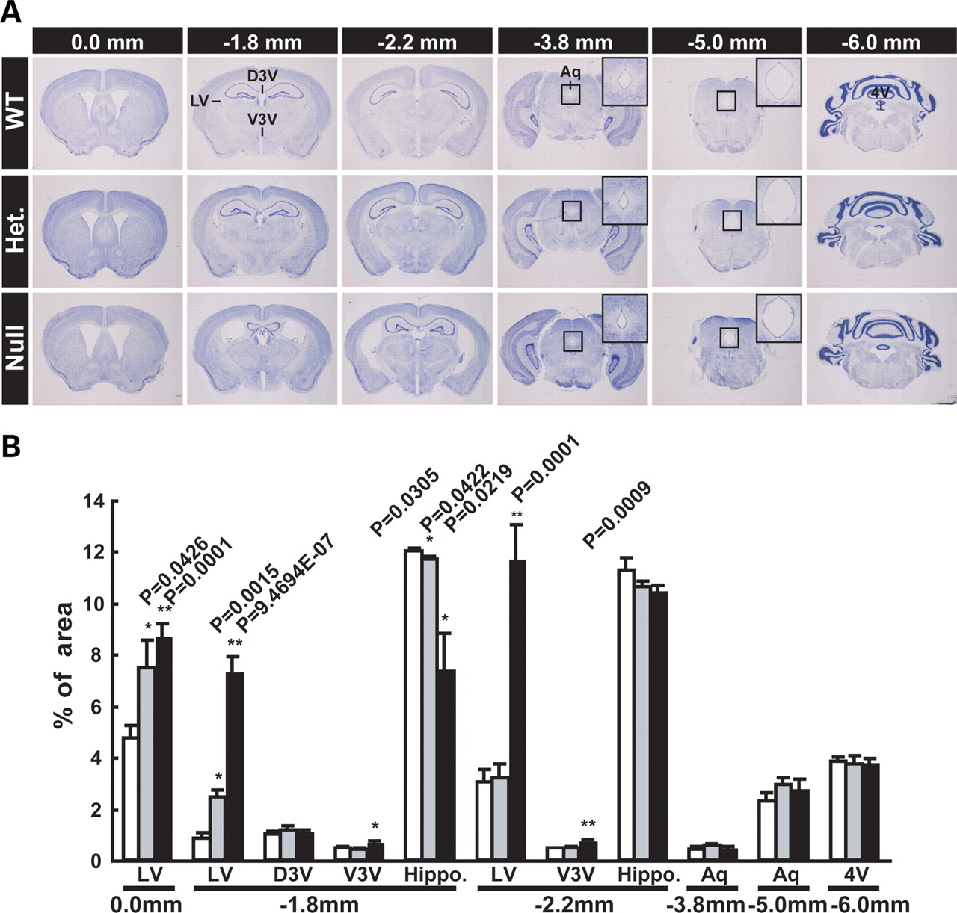
Figure 5. Enlarged brain ventricles in Efhc1 null mutants but not in heterozygotes. (A) Nissl staining of serial ...
Notes:
Figure 5. Enlarged brain ventricles in Efhc1 null mutants but not in heterozygotes. (A) Nissl staining of serial coronal sections of brains from 12-month-old mice. Distances from bregma are shown above. Insets are higher magnifications of aqueducts. Het, heterozygous. (B) The sizes of the ventricle and hippocampal areas on the Nissl-stained sections were calculated by the NIH image software (n = 3 per genotype). Significant enlargement of lateral ventricles (LV) and decreased volume of hippocampus were observed in the null mutants compared with wild-type littermates (P = 9.4694E−07–0.0001 at 0.0 to −2.2 mm from bregma). The third ventricle was also significantly enlarged in the null mutants (−1.8 to −2.2 mm from bregma). Enlargement of the ventricles in the heterozygotes was very mild (LV at 0.0 and −1.8 mm) or mostly not observed (LV at −2.2 mm). The sections from heterozygous and null mice did not show noticeable abnormalities at the aqueduct and fourth ventricle (−3.8 to −6.0 mm from bregma). LV, lateral ventricle; D3V, dorsal third ventricle; V3V, ventral third ventricle; Aq, aqueduct; 4V, fourth ventricle. White bars, wild-type; grey bars, heterozygotes; blackened bars, null mutants.
Unless provided in the caption above, the following copyright applies to the content of this slide: © The Author 2009. Published by Oxford University Press. All rights reserved. For Permissions, please email: journals.permissions@oxfordjournals.org

Slide 6
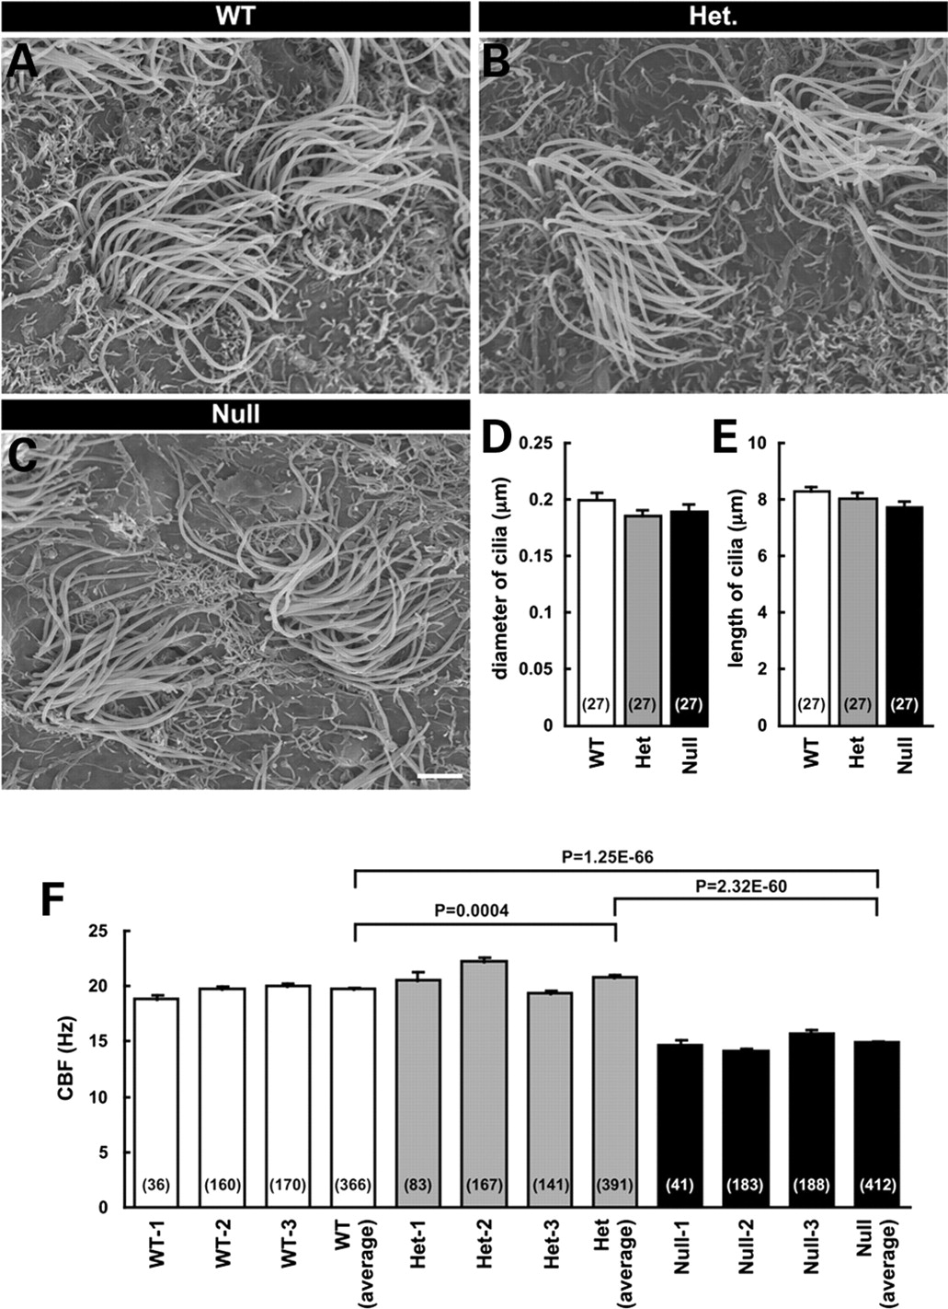
Figure 6. Unaffected morphology but affected motility of ependymal cilia in Efhc1-deficient mice. (A–C) Electron ...
Notes:
Figure 6. Unaffected morphology but affected motility of ependymal cilia in Efhc1-deficient mice. (A–C) Electron microscopic images of ependymal cilia on the lateral ventricle walls of the wild-type, heterozygous and null mutant mice at 3 months. No significant difference was observed in the diameter (D) and length (E) of the cilia (means ± SEM) among genotypes. Scale bar: 2 µm. (F) The CBF in the null mutant mice was significantly low (14.90 ± 0.21 Hz) compared with that of heterozygous (20.85 ± 0.26 Hz) and wild-type (19.80 ± 0.15 Hz). CBFs were measured in 412 cells from three null mutants, 391 cells from three heterozygous and 366 cells from three wild-type mice at 8–13 months. See Supplementary Material, Videos S2 and S3. The numbers in round brackets indicate how many cilia (D, E) and cells (F) were measured. Het, heterozygous.
Unless provided in the caption above, the following copyright applies to the content of this slide: © The Author 2009. Published by Oxford University Press. All rights reserved. For Permissions, please email: journals.permissions@oxfordjournals.org

