Slide 1
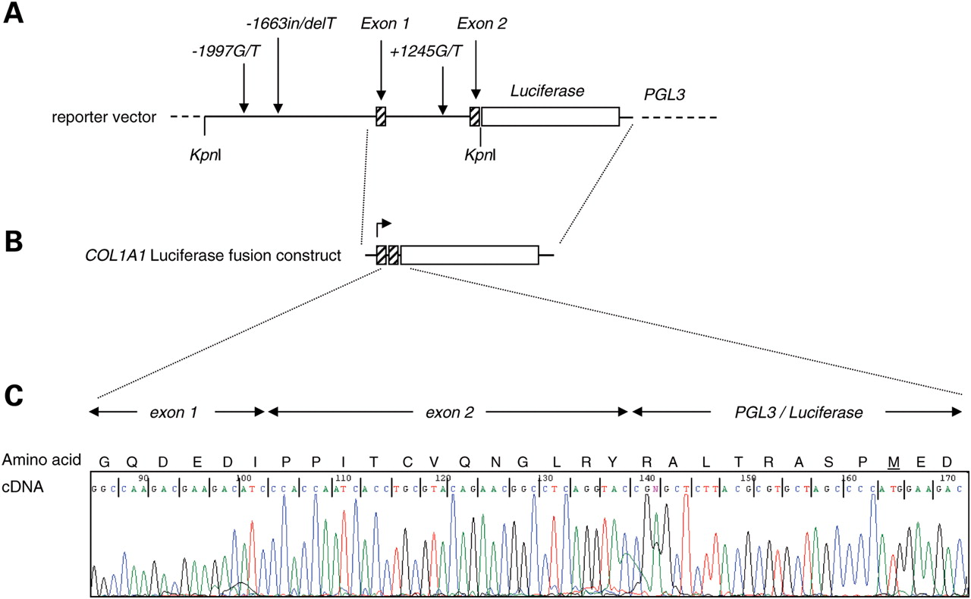
Figure 1. Structure of the COL1A1–luciferase reporter vector. (A) A ∼4 kb fragment comprising the human COL1A1 ...
Notes:
Figure 1. Structure of the COL1A1–luciferase reporter vector. (A) A ∼4 kb fragment comprising the human COL1A1 promoter, exon 1, intron 1 and part of exon 2 was generated by PCR and cloned into the KpnI site of a modified pGL-3 basic vector. The polymorphic variants (−1997G/T, −1663ins/delT and +1245G/T) encoding all possible haplotypes were subsequently generated by site-directed mutagenesis. (B) Diagrammatic representation of the predicted COL1A1–luciferase fusion protein, consisting of COL1A1 exon 1, part of exon 2 and the PGL3 vector. (C) Sequencing of cDNA extracted from TE-85 cells transfected with the reporter vector demonstrating that exons 1 and 2 had been inserted in frame with luciferase. The boundaries between COL1A1 exons 1, exon 2 and PGL3 are indicated. The predicted amino acid sequence of the fusion protein is shown and the start codon of luciferase is underlined.
Unless provided in the caption above, the following copyright applies to the content of this slide: © The Author 2009. Published by Oxford University Press. All rights reserved. For Permissions, please email: journals.permissions@oxfordjournals.org

Slide 2
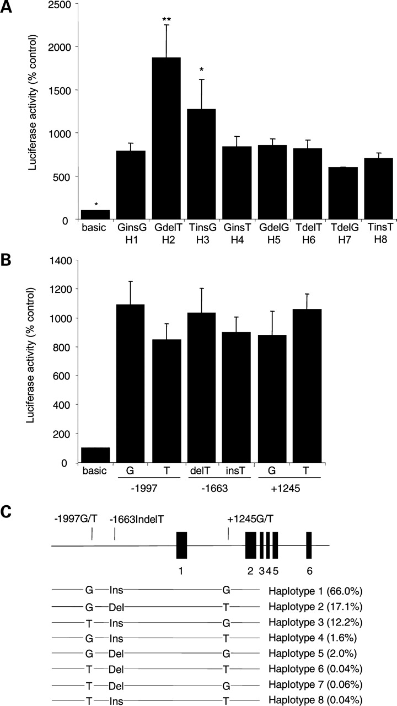
Figure 2. Regulation of reporter gene transcription by COL1A1 haplotypes. (A) Luciferase expression of COL1A1 ...
Notes:
Figure 2. Regulation of reporter gene transcription by COL1A1 haplotypes. (A) Luciferase expression of COL1A1 haplotypes H1-H8, corrected for transfection efficiency. Values are expressed as the percent change relative to the pGL-3 basic vector which is set at 100%. (B) Effect of individual polymorphisms on luciferase expression, analysed by categorizing vectors into series according to the allelic differences at each polymorphism. No significant difference was observed between alleles at the individual sites. The data shown in A and B are derived from four independent experiments. The columns are means and bars are SEM. **P < 0.01; *P < 0.05 from other vectors. (C) A schematic representation of the haplotypes studied and their frequency in APOSS population. The position of the polymorphisms is shown in relation to exons 1–6 of COL1A1 which are indicated by black bars.
Unless provided in the caption above, the following copyright applies to the content of this slide: © The Author 2009. Published by Oxford University Press. All rights reserved. For Permissions, please email: journals.permissions@oxfordjournals.org

Slide 3
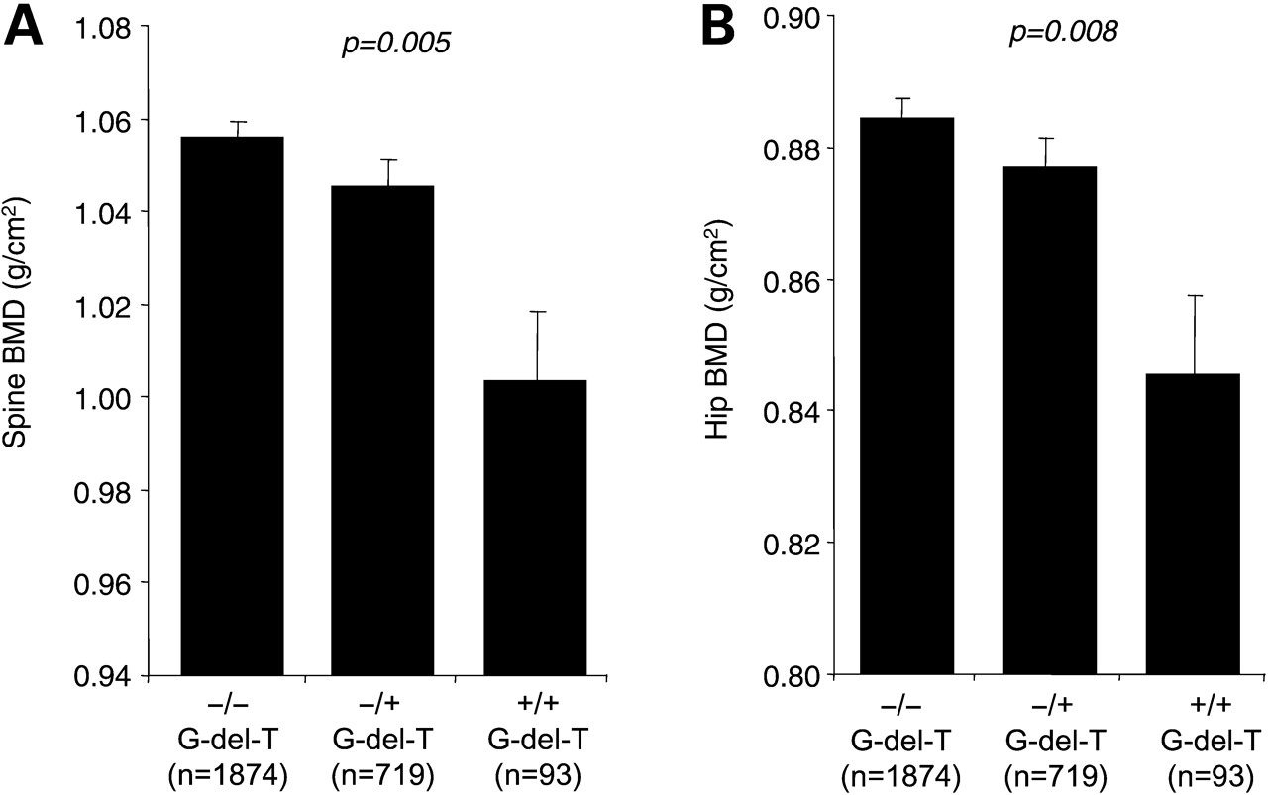
Figure 3. Relationship between BMD and carriage of haplotype 2. (A) Bone mineral density values at the lumbar spine in ...
Notes:
Figure 3. Relationship between BMD and carriage of haplotype 2. (A) Bone mineral density values at the lumbar spine in the APOSS study population in relation to carriage of the G-del-T haplotype which had the highest luciferase expression in vitro. (B) Bone mineral density values at the femoral neck in the APOSS study population in relation to carriage of the G-del-T haplotype. +/+ homozygotes for G-del-T; +/− heterozygotes for G-del-T; −/− non-carriers of G-del-T. The columns are means and bars are SEM. The P-values are derived from ANOVA analysis across the three haplotype groups.
Unless provided in the caption above, the following copyright applies to the content of this slide: © The Author 2009. Published by Oxford University Press. All rights reserved. For Permissions, please email: journals.permissions@oxfordjournals.org

Slide 4
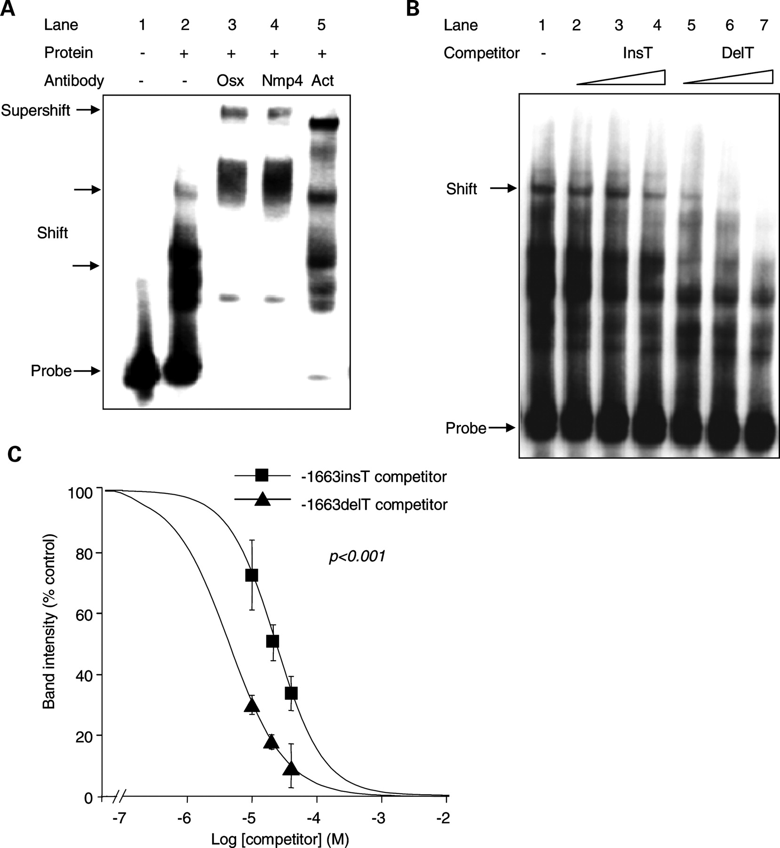
Figure 4. Nuclear protein binding to the region surrounding −1663 insdelT site. (A) The EMSA were performed with a ...
Notes:
Figure 4. Nuclear protein binding to the region surrounding −1663 insdelT site. (A) The EMSA were performed with a biotin-labelled −1663delT probe and nuclear extract from TE85 cells. The gel shift representing the DNA–protein complex is indicated by arrows. Addition of anti-Nmp4, Osterix (Osx) and β-actin (Act) antibodies further shifted the DNA–protein complexes (Lanes 3–5). (B) Competition assay performed with a biotin labelled −1663delT probe and unlabelled competitors at various concentrations (250-fold, 500-fold and 1000-fold excess). The −1663delT allele had higher binding affinity for nuclear proteins as reflected by attenuation of the DNA–protein complex more rapidly with increasing concentrations of the unlabelled delT competitor (Lanes 5–7) compared with the unlabelled insT competitor (Lanes 2–4). (C) Quantitative analysis of binding curves for the −1663insT and −1663delT competitor probes. Band intensities at three concentrations derived from three experiments were plotted as a percentage of band intensity in the absence of competitor for each competitor concentration. Symbols are means and bars are SEM. There was significant difference (P < 0.001) between the alleles.
Unless provided in the caption above, the following copyright applies to the content of this slide: © The Author 2009. Published by Oxford University Press. All rights reserved. For Permissions, please email: journals.permissions@oxfordjournals.org

Slide 5
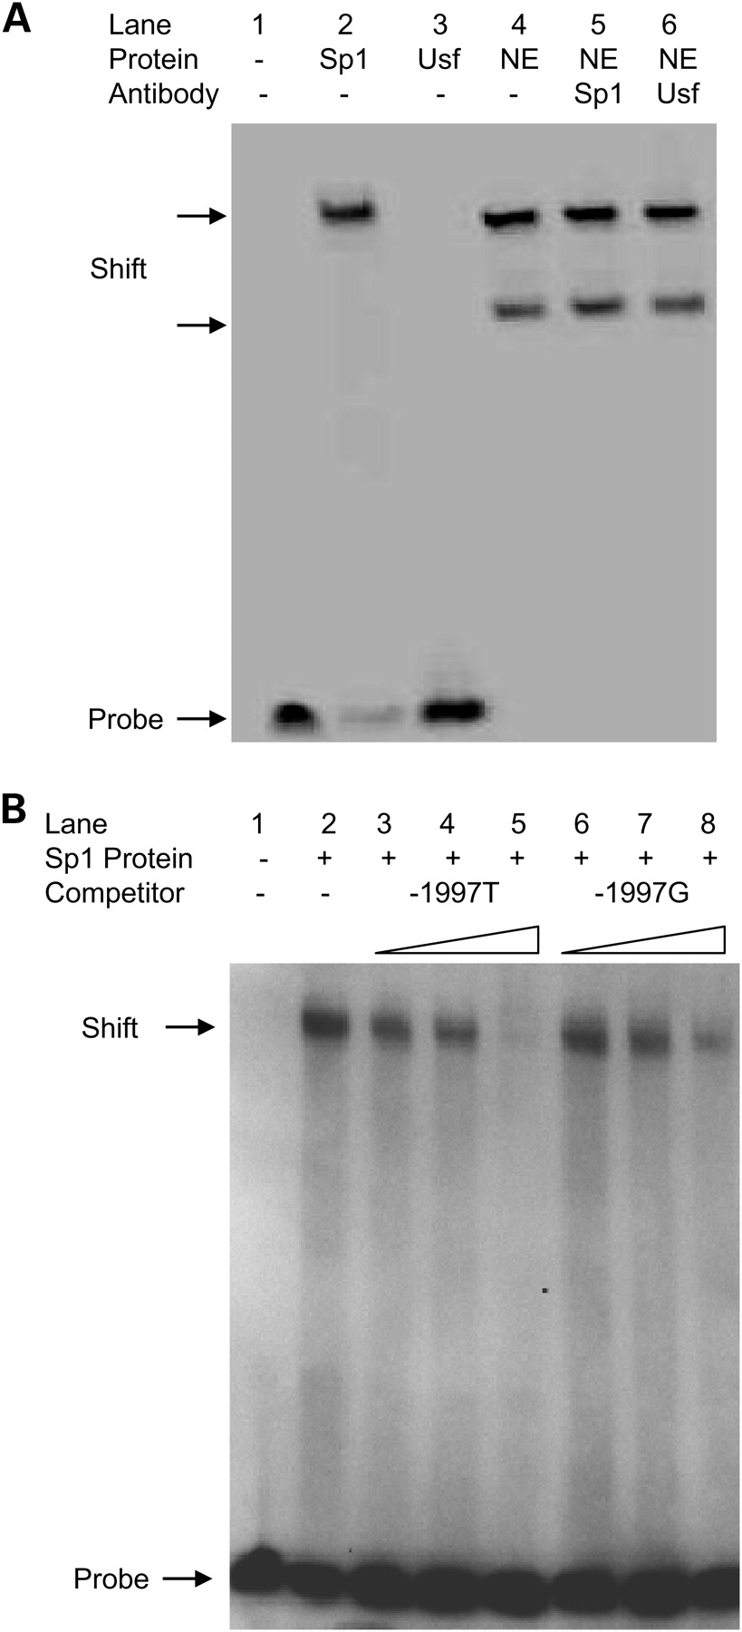
Figure 5. Nuclear protein binding to the region surrounding the −1997G/T site. (A) EMSA was performed with a labelled ...
Notes:
Figure 5. Nuclear protein binding to the region surrounding the −1997G/T site. (A) EMSA was performed with a labelled −1997T probe and recombinant Sp1 (Lane 2), Usf (Lane 3) or TE85 nuclear extracts (Lanes 4–6). Addition of anti-Sp1 and Usf antibodies did not cause further shifts (Lanes 5 and 6) when compared with Lane 4. (B) Competition assay performed with a biotin labelled −1997G probe and unlabelled competitors at various concentrations (3-fold, 5-fold and 10-fold excess). The −1997T allele had higher binding affinity for Sp1 as reflected by attenuation of the DNA–protein complex more rapidly with increasing concentrations of the unlabelled −1997T competitor (Lanes 3–5) compared with the unlabelled −1997G competitor (Lanes 6–8). Quantitative analysis of three separate experiments showed that this was a significant difference (P = 0.009; data not shown). NE, nuclear extract; Sp1, recombinant Sp1 protein; Usf, recombinant Usf protein. The experiments shown are representative of three independent experiments performed under the same conditions.
Unless provided in the caption above, the following copyright applies to the content of this slide: © The Author 2009. Published by Oxford University Press. All rights reserved. For Permissions, please email: journals.permissions@oxfordjournals.org

Slide 6
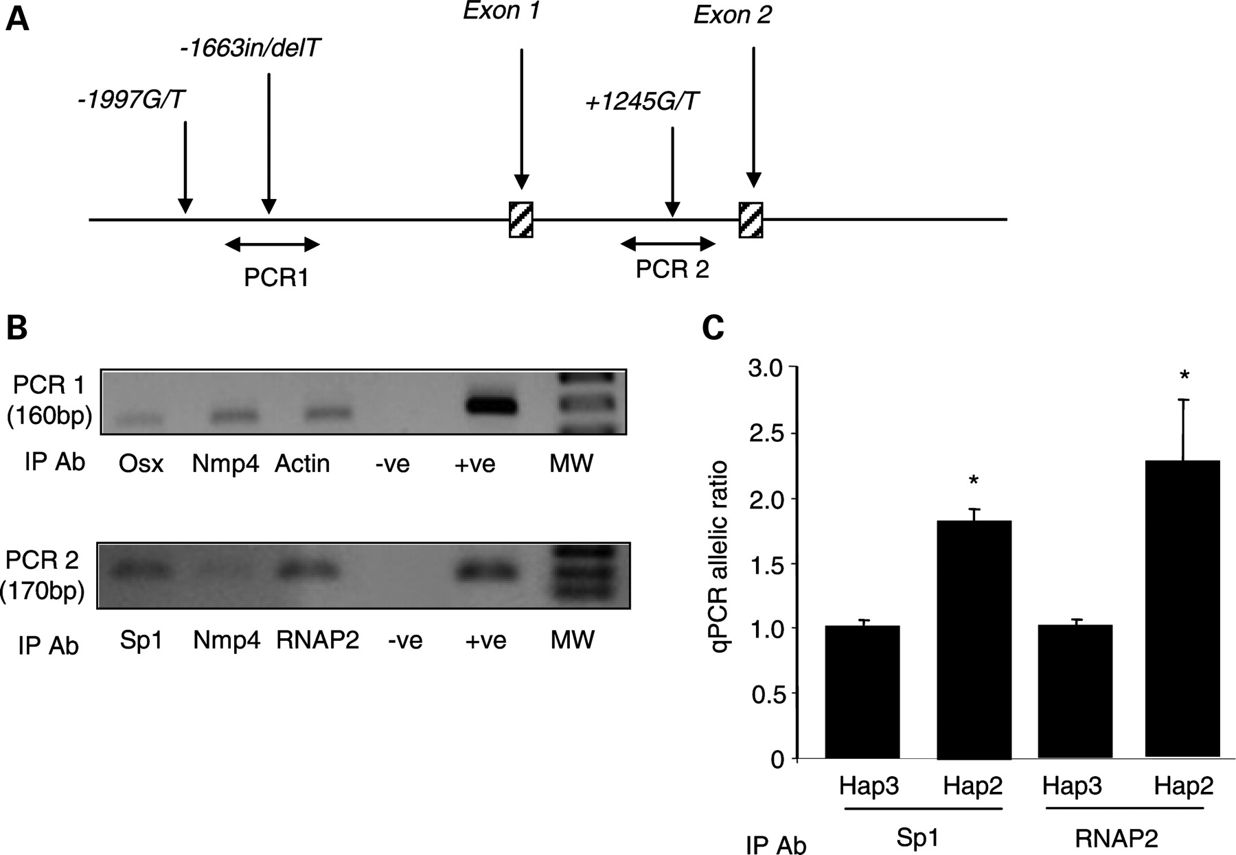
Figure 6. Chromatin immunoprecipitation assays show that haplotype 2 is associated with increased transcription in ...
Notes:
Figure 6. Chromatin immunoprecipitation assays show that haplotype 2 is associated with increased transcription in vivo. (A) Diagrammatic representation of the region under study, showing position of the PCR products used in the ChIP assays. (B) Representative agarose gel electrophoresis of the two PCR products generated from samples immunoprecipitated with different antibodies. A negative control (−ve; mouse IgG) and a positive control (+ve; genomic DNA) are shown for each assay. The gels shown are representative of three independent experiments. (C) Quantification of haplotype-specific transcription in MG63 cells which are heterozygous for haplotypes 2 and 3. The normalized ratio of binding of Sp1 to the +1245T allele when compared with the G allele is shown as is the ratio of RNA polymerase II (RNAP2) binding. Values are mean ± SEM of triplicate assays. *P < 0.05 haplotype 2 compared with haplotype 3.
Unless provided in the caption above, the following copyright applies to the content of this slide: © The Author 2009. Published by Oxford University Press. All rights reserved. For Permissions, please email: journals.permissions@oxfordjournals.org

Slide 7
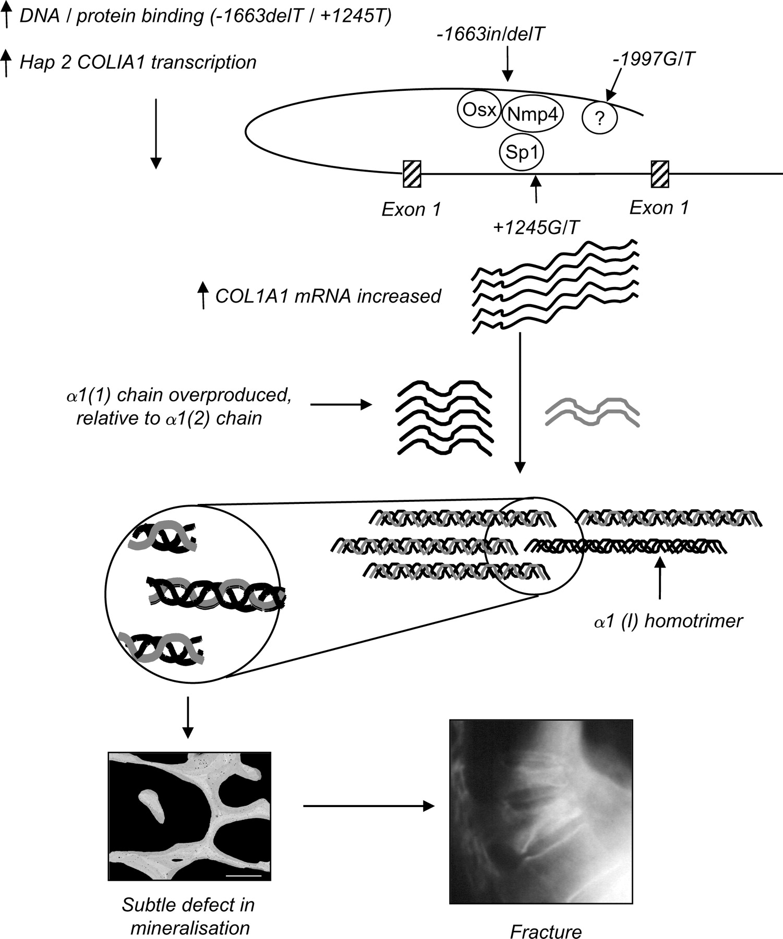
Figure 7. Suggested mechanism of osteoporosis associated with polymorphisms in the 5′ flank of COL1A1. Polymorphisms in ...
Notes:
Figure 7. Suggested mechanism of osteoporosis associated with polymorphisms in the 5′ flank of COL1A1. Polymorphisms in the 5′ flank of COL1A regulate binding affinity of several critical nuclear binding proteins including Nmp4, Osterix and Sp1. This increases transcription of haplotype 2 which causes increased expression of COL1A1 mRNA, and over production of the alpha 1 chain relative to alpha 2, such that a proportion of collagen produced by osteoblasts is in the form of alpha 1 homotrimers. This adversely affects mineralization of bone, resulting in reduced BMD and an increased risk of fracture.
Unless provided in the caption above, the following copyright applies to the content of this slide: © The Author 2009. Published by Oxford University Press. All rights reserved. For Permissions, please email: journals.permissions@oxfordjournals.org

