Slide 1
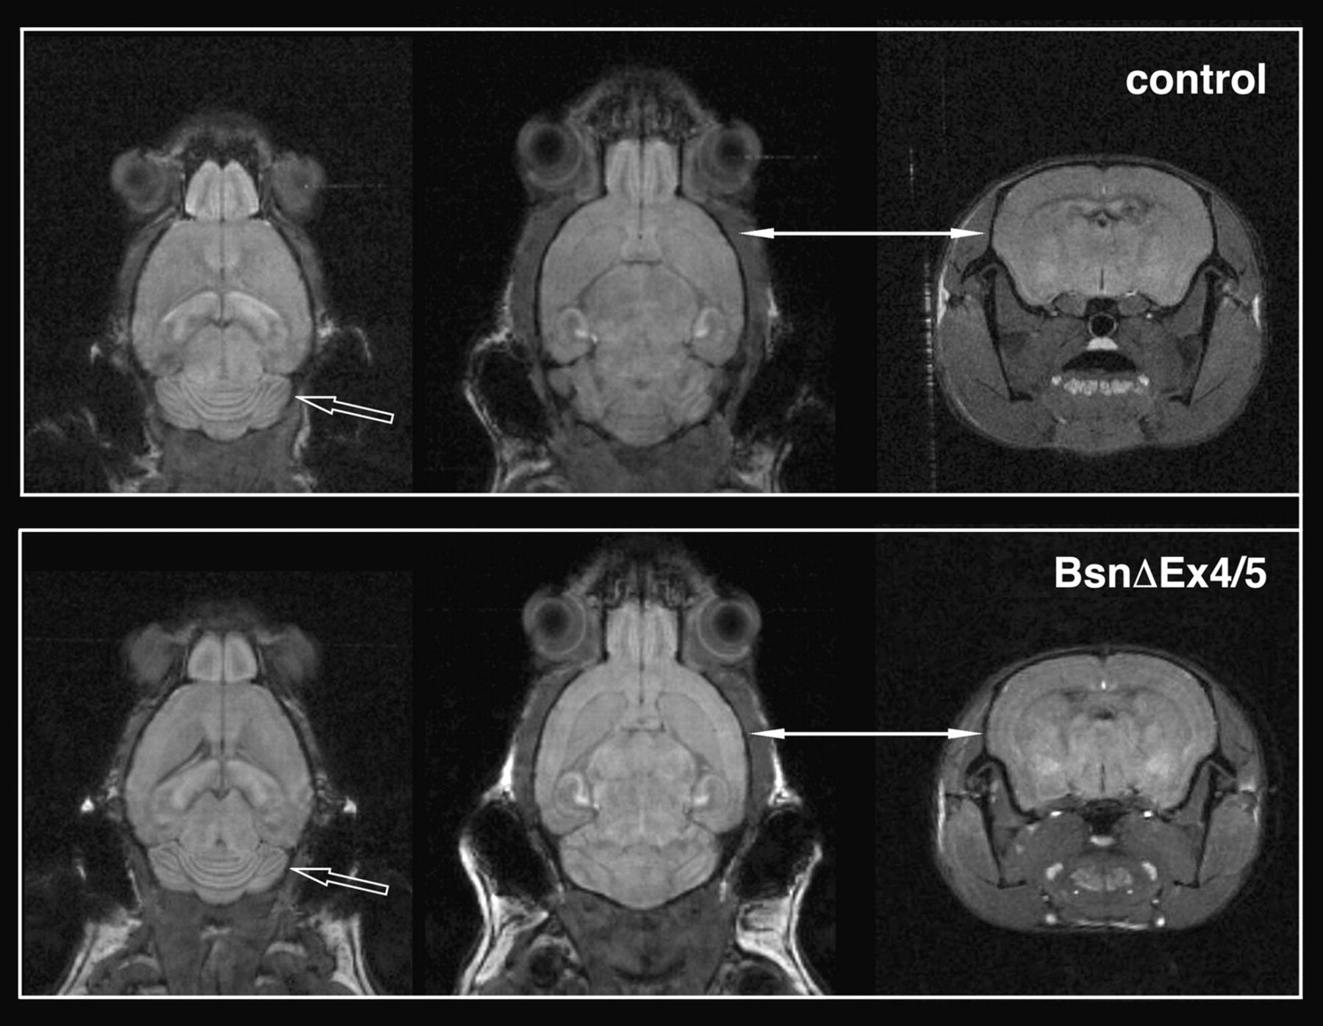
Figure 1. Manganese accumulation within cortical layers differs between wild-type and Bassoon-mutant mice. Two days ...
Notes:
Figure 1. Manganese accumulation within cortical layers differs between wild-type and Bassoon-mutant mice. Two days after subcutaneous application of 1 μmol/g MnCl2, ME-MRI depicts a laminar-dependent distribution of manganese within the cortex of Bassoon-mutant mice, which is not so pronounced in wild-type littermates (solid arrows, see also Angenstein et al. 2007). In contrast, manganese accumulation within the cerebellum was indistinguishable between control and BsnΔEx4/5 mice (open arrows).
Unless provided in the caption above, the following copyright applies to the content of this slide: © The Author 2007. Published by Oxford University Press. All rights reserved. For permissions, please e-mail: journals.permissions@oxfordjournals.org

Slide 2
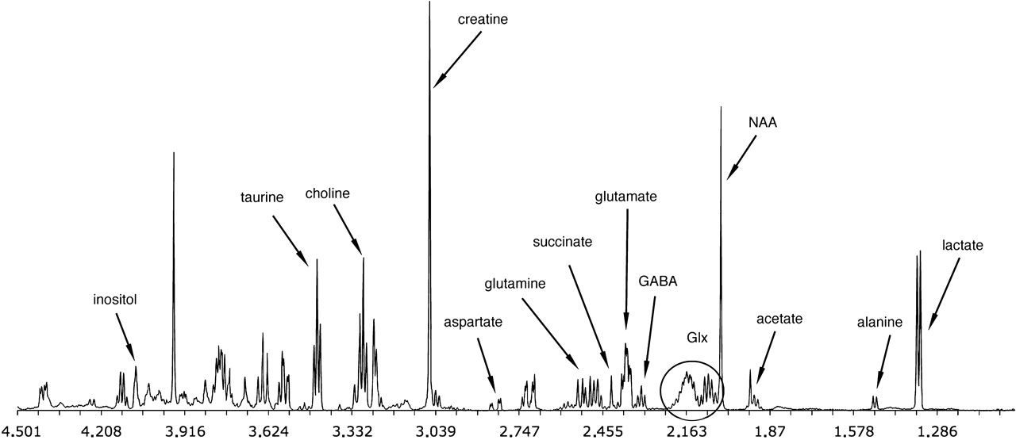
Figure 2. Spectroscopic determination of neurotransmitter metabolites in wild-type and Bassoon-mutant mice. ...
Notes:
Figure 2. Spectroscopic determination of neurotransmitter metabolites in wild-type and Bassoon-mutant mice. Representative high-field and high-resolution 1H-NMR spectra of perchloric acid extracts of one wild-type mouse cortex is shown. Relevant resonance signals for the metabolites quantified in our study are labeled. The chemical shift is expressed in parts per million (ppm). NAA, N-acetyl aspartate; Glx, glutamine + glutamate.
Unless provided in the caption above, the following copyright applies to the content of this slide: © The Author 2007. Published by Oxford University Press. All rights reserved. For permissions, please e-mail: journals.permissions@oxfordjournals.org

Slide 3
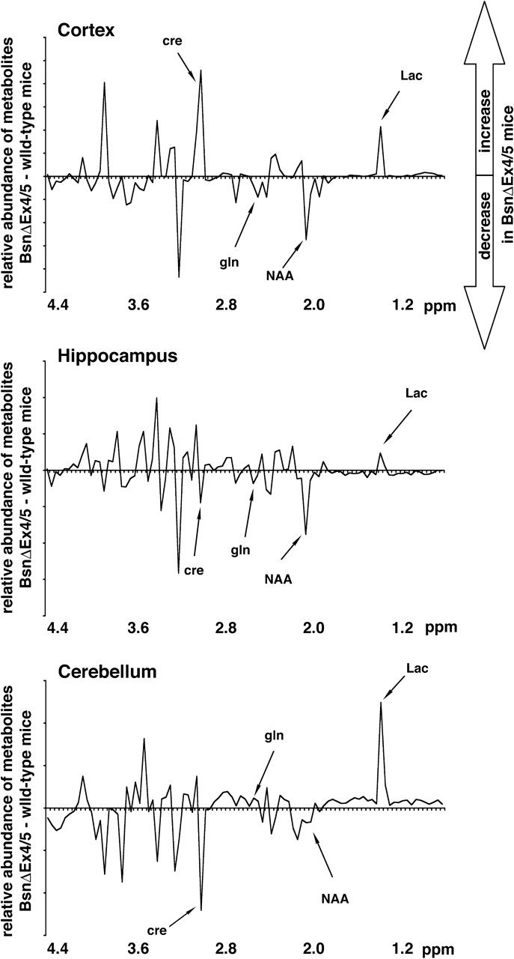
Figure 3. Comparison of the averaged ¹H-NMR spectra between Bassoon-mutant mice and wild-type age-matched ...
Notes:
Figure 3. Comparison of the averaged 1H-NMR spectra between Bassoon-mutant mice and wild-type age-matched littermates. To compare the entire metabolic composition within the 3 brain structures, each spectrum (see Fig. 2) was first normalized to the total integral region (total integral = 1.00), so that each individual integral represents its relative amount to the total amount of all low molecular weight metabolites contributing to the entire spectrum. Thereupon, the average of all 8 individual spectra of each group was formed and compared. For the following PCA, the spectra were integrated between 0.8 and 4.5 ppm over a series of 0.04-ppm integral regions. The differences between the resulting spectra (after normalization and integration) reveal only relative small variations in the entire metabolic composition in each investigated brain region. Region-specific changes are labeled. Note, because in this graphical presentation the amount of each metabolite is related to the amount of all measured metabolites, significant variations in low abundant molecules (e.g., glutamine) therefore appear only as small deviations in the graph. Lac, lactate; NAA, N-acetyl aspartate; Cre, creatine; Gln, glutamine).
Unless provided in the caption above, the following copyright applies to the content of this slide: © The Author 2007. Published by Oxford University Press. All rights reserved. For permissions, please e-mail: journals.permissions@oxfordjournals.org

Slide 4
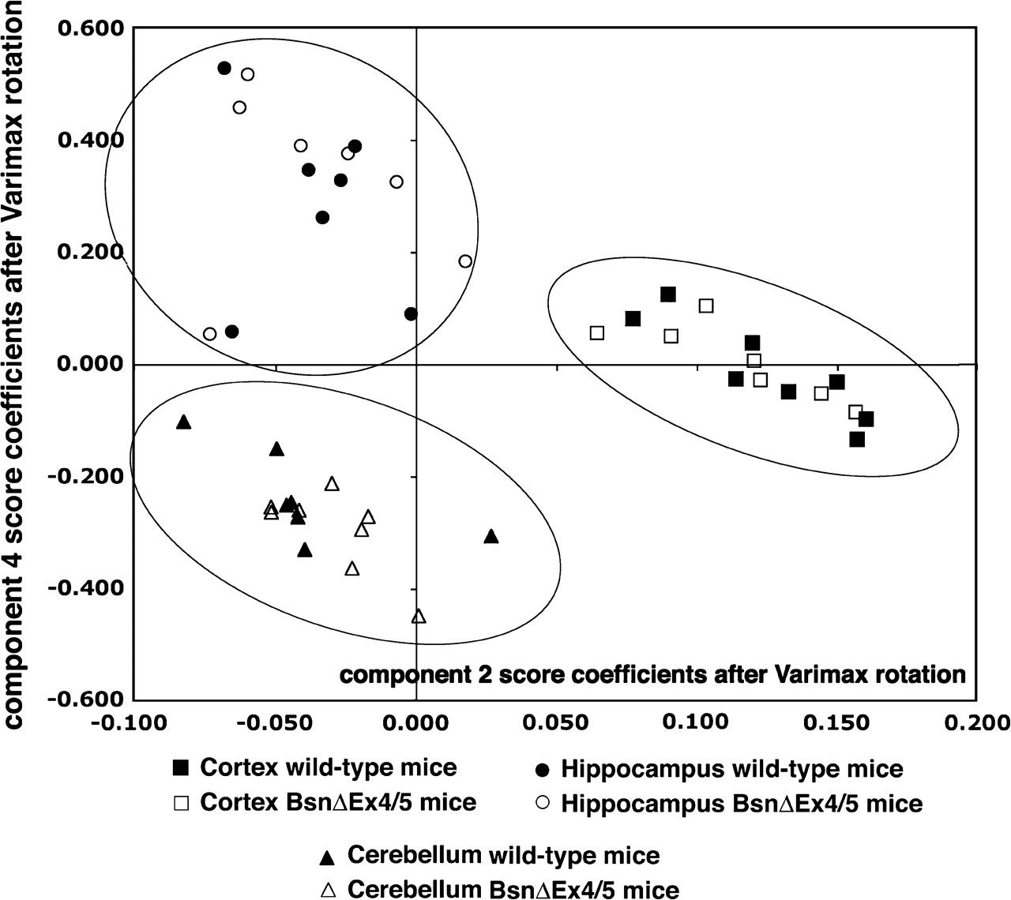
Figure 4. Pattern recognition model of general metabolic differences across various brain structures of BsnΔEx4/5 mice ...
Notes:
Figure 4. Pattern recognition model of general metabolic differences across various brain structures of BsnΔEx4/5 mice and wild-type mice. Component score plot distinguishes clearly the metabolic profiles derived from all studied brain regions (squares—cortex, circles—hippocampus, and triangles—cerebellum). However, within each brain structure, there was no separation of the 1H-NMR spectra deriving from Bassoon-mutant and wild-type mice (full symbols—control mice and open symbols—BsnΔEx4/5 mice).
Unless provided in the caption above, the following copyright applies to the content of this slide: © The Author 2007. Published by Oxford University Press. All rights reserved. For permissions, please e-mail: journals.permissions@oxfordjournals.org

Slide 5
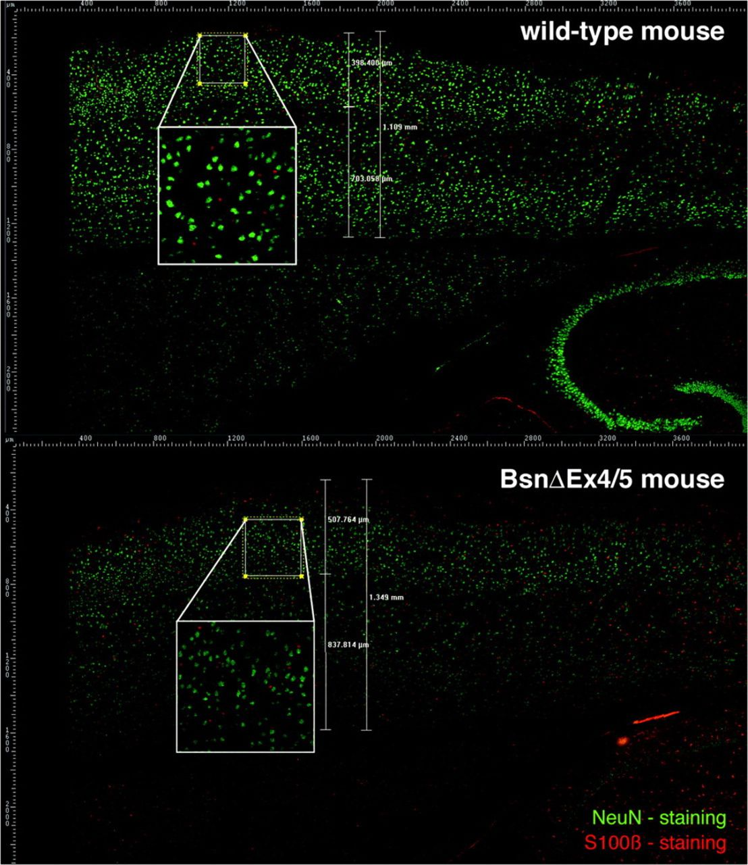
Figure 5. Analyzing the cortical cytoarchitecture of Bassoon-mutant and wild-type mice by immunocytochemistry. ...
Notes:
Figure 5. Analyzing the cortical cytoarchitecture of Bassoon-mutant and wild-type mice by immunocytochemistry. Horizontal sections were used to identify neurons by staining the neuronal nuclear protein NeuN (green) and glia cells by staining the glia-specific protein S100β. NeuN- and S100β-immunoreactive cell bodies (showing a nucleus) were counted within rectangles laid over the different cortical layers (supragranular layers: II/III, granular layer: IV, and infragranular layers: Va/Vb and VI) of the immunostained sections (see Materials and Methods).
Unless provided in the caption above, the following copyright applies to the content of this slide: © The Author 2007. Published by Oxford University Press. All rights reserved. For permissions, please e-mail: journals.permissions@oxfordjournals.org

