Slide 1
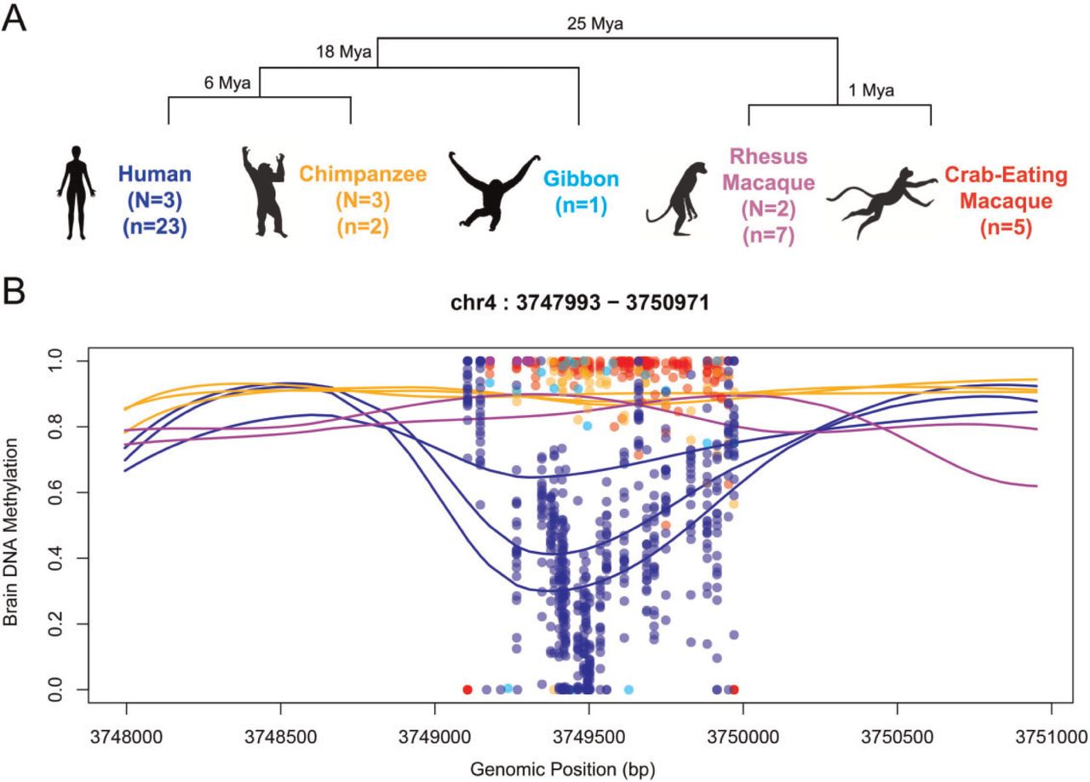
Fig. 1 DMR identification. (A) Phylogenetic tree of the species analyzed in this study. Sample sizes are shown for ...
Notes:
Fig. 1 DMR identification. (A) Phylogenetic tree of the species analyzed in this study. Sample sizes are shown for whole-genome bisulfite and targeted bisulfite sequencing (N and n, respectively). (B) Example of a DMR located 19 kb upstream of the promoter of Alpha-2C adrenergic receptor (ADRA2C). Lines indicate smoothed methylation values from whole-genome bisulfite and each dot represents raw methylation values of each CpG site in the targeted validation dataset at high coverage. Genomic coordinates correspond to the hg19.
Unless provided in the caption above, the following copyright applies to the content of this slide: © The Author 2016. Published by Oxford University Press on behalf of the Society for Molecular Biology and Evolution.This is an Open Access article distributed under the terms of the Creative Commons Attribution Non-Commercial License (http://creativecommons.org/licenses/by-nc/4.0/), which permits non-commercial re-use, distribution, and reproduction in any medium, provided the original work is properly cited. For commercial re-use, please contact journals.permissions@oup.com

Slide 2
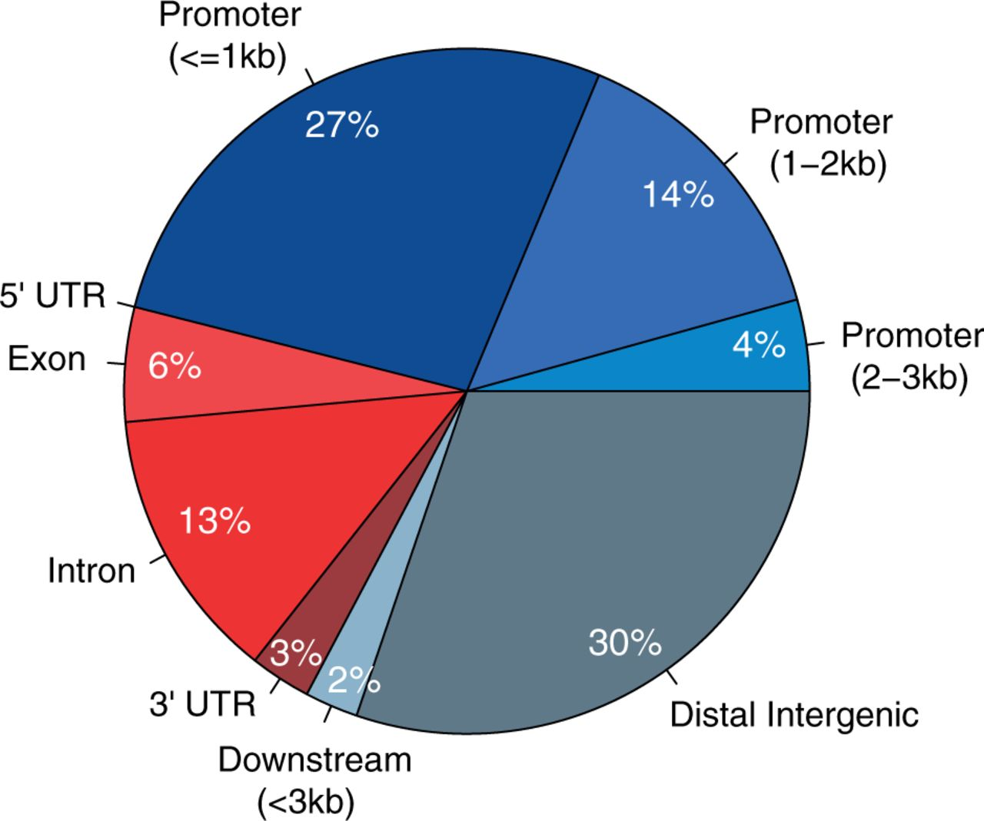
Fig. 2 Genic annotation of DMRs. Annotation of DMRs with respect to known genes. Promoter region is divided into ...
Notes:
Fig. 2 Genic annotation of DMRs. Annotation of DMRs with respect to known genes. Promoter region is divided into three according to distance to the TSS (3 kb away from any gene.
Unless provided in the caption above, the following copyright applies to the content of this slide: © The Author 2016. Published by Oxford University Press on behalf of the Society for Molecular Biology and Evolution.This is an Open Access article distributed under the terms of the Creative Commons Attribution Non-Commercial License (http://creativecommons.org/licenses/by-nc/4.0/), which permits non-commercial re-use, distribution, and reproduction in any medium, provided the original work is properly cited. For commercial re-use, please contact journals.permissions@oup.com

Slide 3
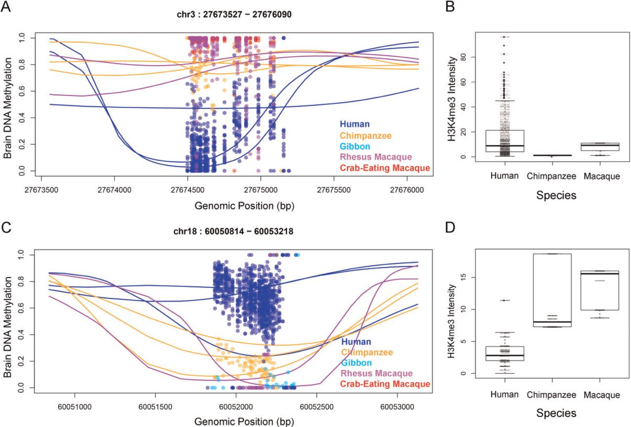
Fig. 3 Coordinated epigenetic changes at DMRs (A) Example of human-hypomethylated DMR in human prefrontal cortex ...
Notes:
Fig. 3 Coordinated epigenetic changes at DMRs (A) Example of human-hypomethylated DMR in human prefrontal cortex (hg19-based coordinates). (B) The region in panel A co-localizes with a human-specific H3K4me3 peak in cell sorted neurons. (C) Human-specific hyper-methylation of a DMR. (D) The region in panel C overlaps with a human-specific depletion of H3K4me3 histone mark, whereas chimpanzee and macaque show significant enrichment. Additional examples shown in supplementary figure S1.
Unless provided in the caption above, the following copyright applies to the content of this slide: © The Author 2016. Published by Oxford University Press on behalf of the Society for Molecular Biology and Evolution.This is an Open Access article distributed under the terms of the Creative Commons Attribution Non-Commercial License (http://creativecommons.org/licenses/by-nc/4.0/), which permits non-commercial re-use, distribution, and reproduction in any medium, provided the original work is properly cited. For commercial re-use, please contact journals.permissions@oup.com

Slide 4
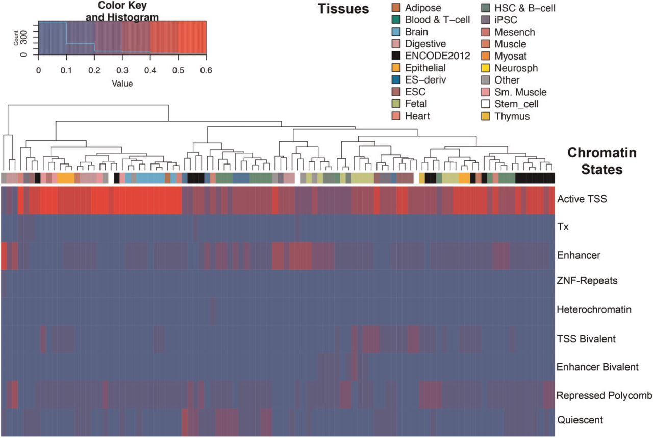
Fig. 4 Chromatin states at human hypo-methylated DMRs. Heatmap of the fraction of DMRs exhibiting distinctive ...
Notes:
Fig. 4 Chromatin states at human hypo-methylated DMRs. Heatmap of the fraction of DMRs exhibiting distinctive chromatin states (rows) in different tissues (columns). Each cell of the heatmap indicates the proportion of DMRs classified as that specific chromatin state in a given tissue type.
Unless provided in the caption above, the following copyright applies to the content of this slide: © The Author 2016. Published by Oxford University Press on behalf of the Society for Molecular Biology and Evolution.This is an Open Access article distributed under the terms of the Creative Commons Attribution Non-Commercial License (http://creativecommons.org/licenses/by-nc/4.0/), which permits non-commercial re-use, distribution, and reproduction in any medium, provided the original work is properly cited. For commercial re-use, please contact journals.permissions@oup.com

Slide 5
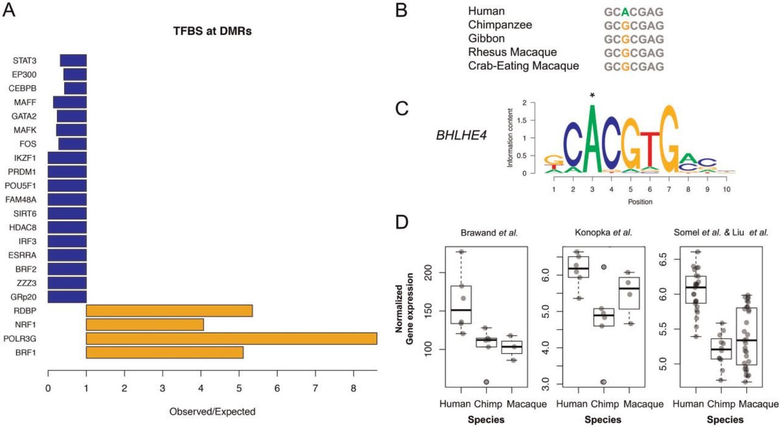
Fig. 5 Transcription factor binding sites at DMRs. (A) Transcription factors significantly enriched or depleted at ...
Notes:
Fig. 5 Transcription factor binding sites at DMRs. (A) Transcription factors significantly enriched or depleted at DMRs. (B–C) Human-specific nucleotide change in position 3 of the binding site by transcription factor BHLHE4. This position is 1.1 kbp upstream of a human hypo-methylated DMR in the promoter of PSMB2 gene compared to chimpanzee and macaque. (D) Human-specific expression increase of PSMB2 gene observed in three different data sets.
Unless provided in the caption above, the following copyright applies to the content of this slide: © The Author 2016. Published by Oxford University Press on behalf of the Society for Molecular Biology and Evolution.This is an Open Access article distributed under the terms of the Creative Commons Attribution Non-Commercial License (http://creativecommons.org/licenses/by-nc/4.0/), which permits non-commercial re-use, distribution, and reproduction in any medium, provided the original work is properly cited. For commercial re-use, please contact journals.permissions@oup.com

