Slide 1
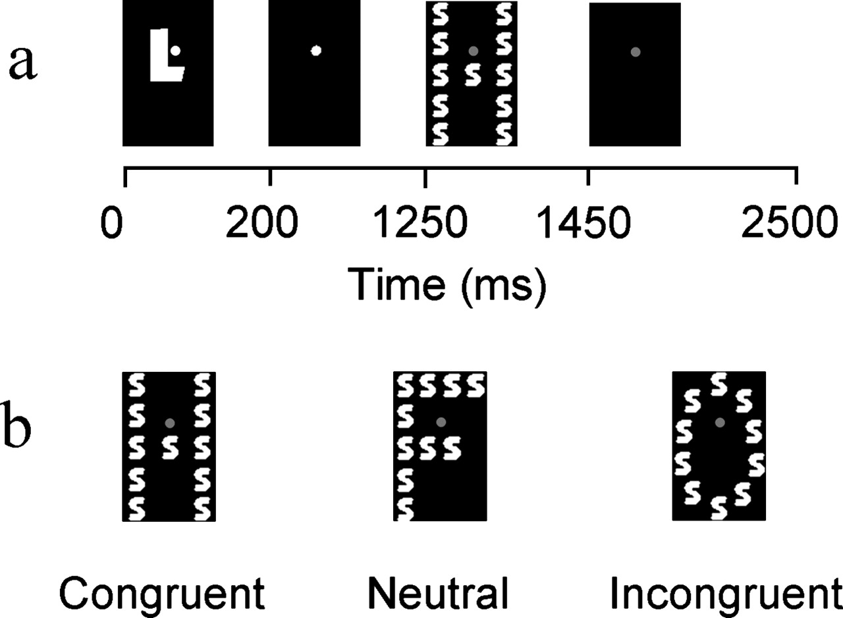
Figure 1. The experimental task used in the present study. (a) The sequence and timing of events in cue-plus-target ...
Notes:
Figure 1. The experimental task used in the present study. (a) The sequence and timing of events in cue-plus-target trials. In each trial, participants were cued to attend to and identify either the global ‘G’ or the local ‘L’ letter of an upcoming hierarchical stimulus, by pressing one response key if the cued letter was either H or S and another if it was either X or O. Pictured is a sample local cue-plus-target trial. In the actual experiment, cues were sized midway between the size of the global and local letters to prevent reflexive orienting to either level (see Materials and Methods). (b) Sample congruent, neutral, and incongruent hierarchical stimuli for the local task. Given the stimulus–response mappings described above, we were able to vary the relationship between responses primed by the relevant and irrelevant letters in each trial, while holding constant the fact that these letters were always perceptually distinct. For example, in the local task, the irrelevant global letter could be mapped to the same response as the relevant local letter (e.g. a large, global H made up of small local Ss; congruent trials), to no response (e.g. a global F made up of local Ss; neutral trials), or to a conflicting response (e.g. a global O made up of local Ss; incongruent trials).
Unless provided in the caption above, the following copyright applies to the content of this slide: Cerebral Cortex V 15 N 2 © Oxford University Press 2005; all rights reserved

Slide 2
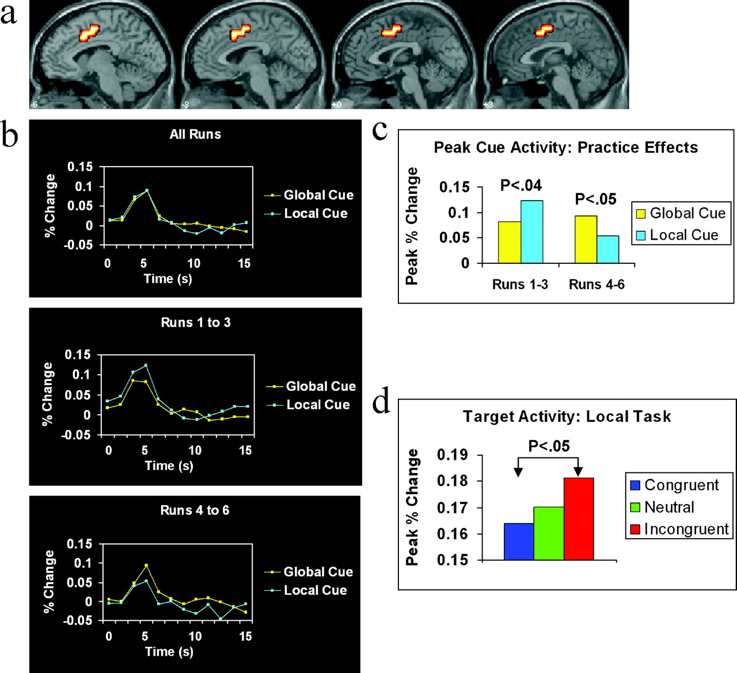
Figure 2. Region of interest analyses of neural activity in dorsal/caudal anterior cingulate cortex (dACC). (a) Region ...
Notes:
Figure 2. Region of interest analyses of neural activity in dorsal/caudal anterior cingulate cortex (dACC). (a) Region of interest in dACC overlaid on the canonical MNI normalized anatomical template provided by SPM'99. This region comprised 63 voxels whose geographic center of mass in Talairach space was located at x = −2, y = 5, z = 43. Anatomical slices range from x = −6 mm (top left) to x = 3 mm (top right). (b) The BOLD response in dACC for global and local attention-directing cues averaged across all six runs of the experiment (top), for runs 1–3 only (middle) and for runs 4–6 only (bottom). There were no differences in peak cue activity when data were averaged across the entire experiment (top), but local cues evoked significantly greater activity than global cues in runs 1–3, P < 0.04 (middle), while global cues evoked significantly greater activity than local cues in runs 4–6, P < 0.05 (bottom), which resulted in a significant interaction between Block (runs 1–3, runs 4–6) and Task (global, local), P < 0.05. (c) Peak activity for global and local cues in dACC plotted separately for runs 1–3 and runs 4–6. Practice significantly reduced activity associated with local cues, P 0.30. (d) Peak activity for congruent, neutral, and incongruent targets in dACC for the local task, averaged across all six runs of the experiment. Significantly greater activity was observed for incongruent than for congruent targets, P < 0.05, in the same region of dACC that exhibited differential cue activity.
Unless provided in the caption above, the following copyright applies to the content of this slide: Cerebral Cortex V 15 N 2 © Oxford University Press 2005; all rights reserved

