Slide 1
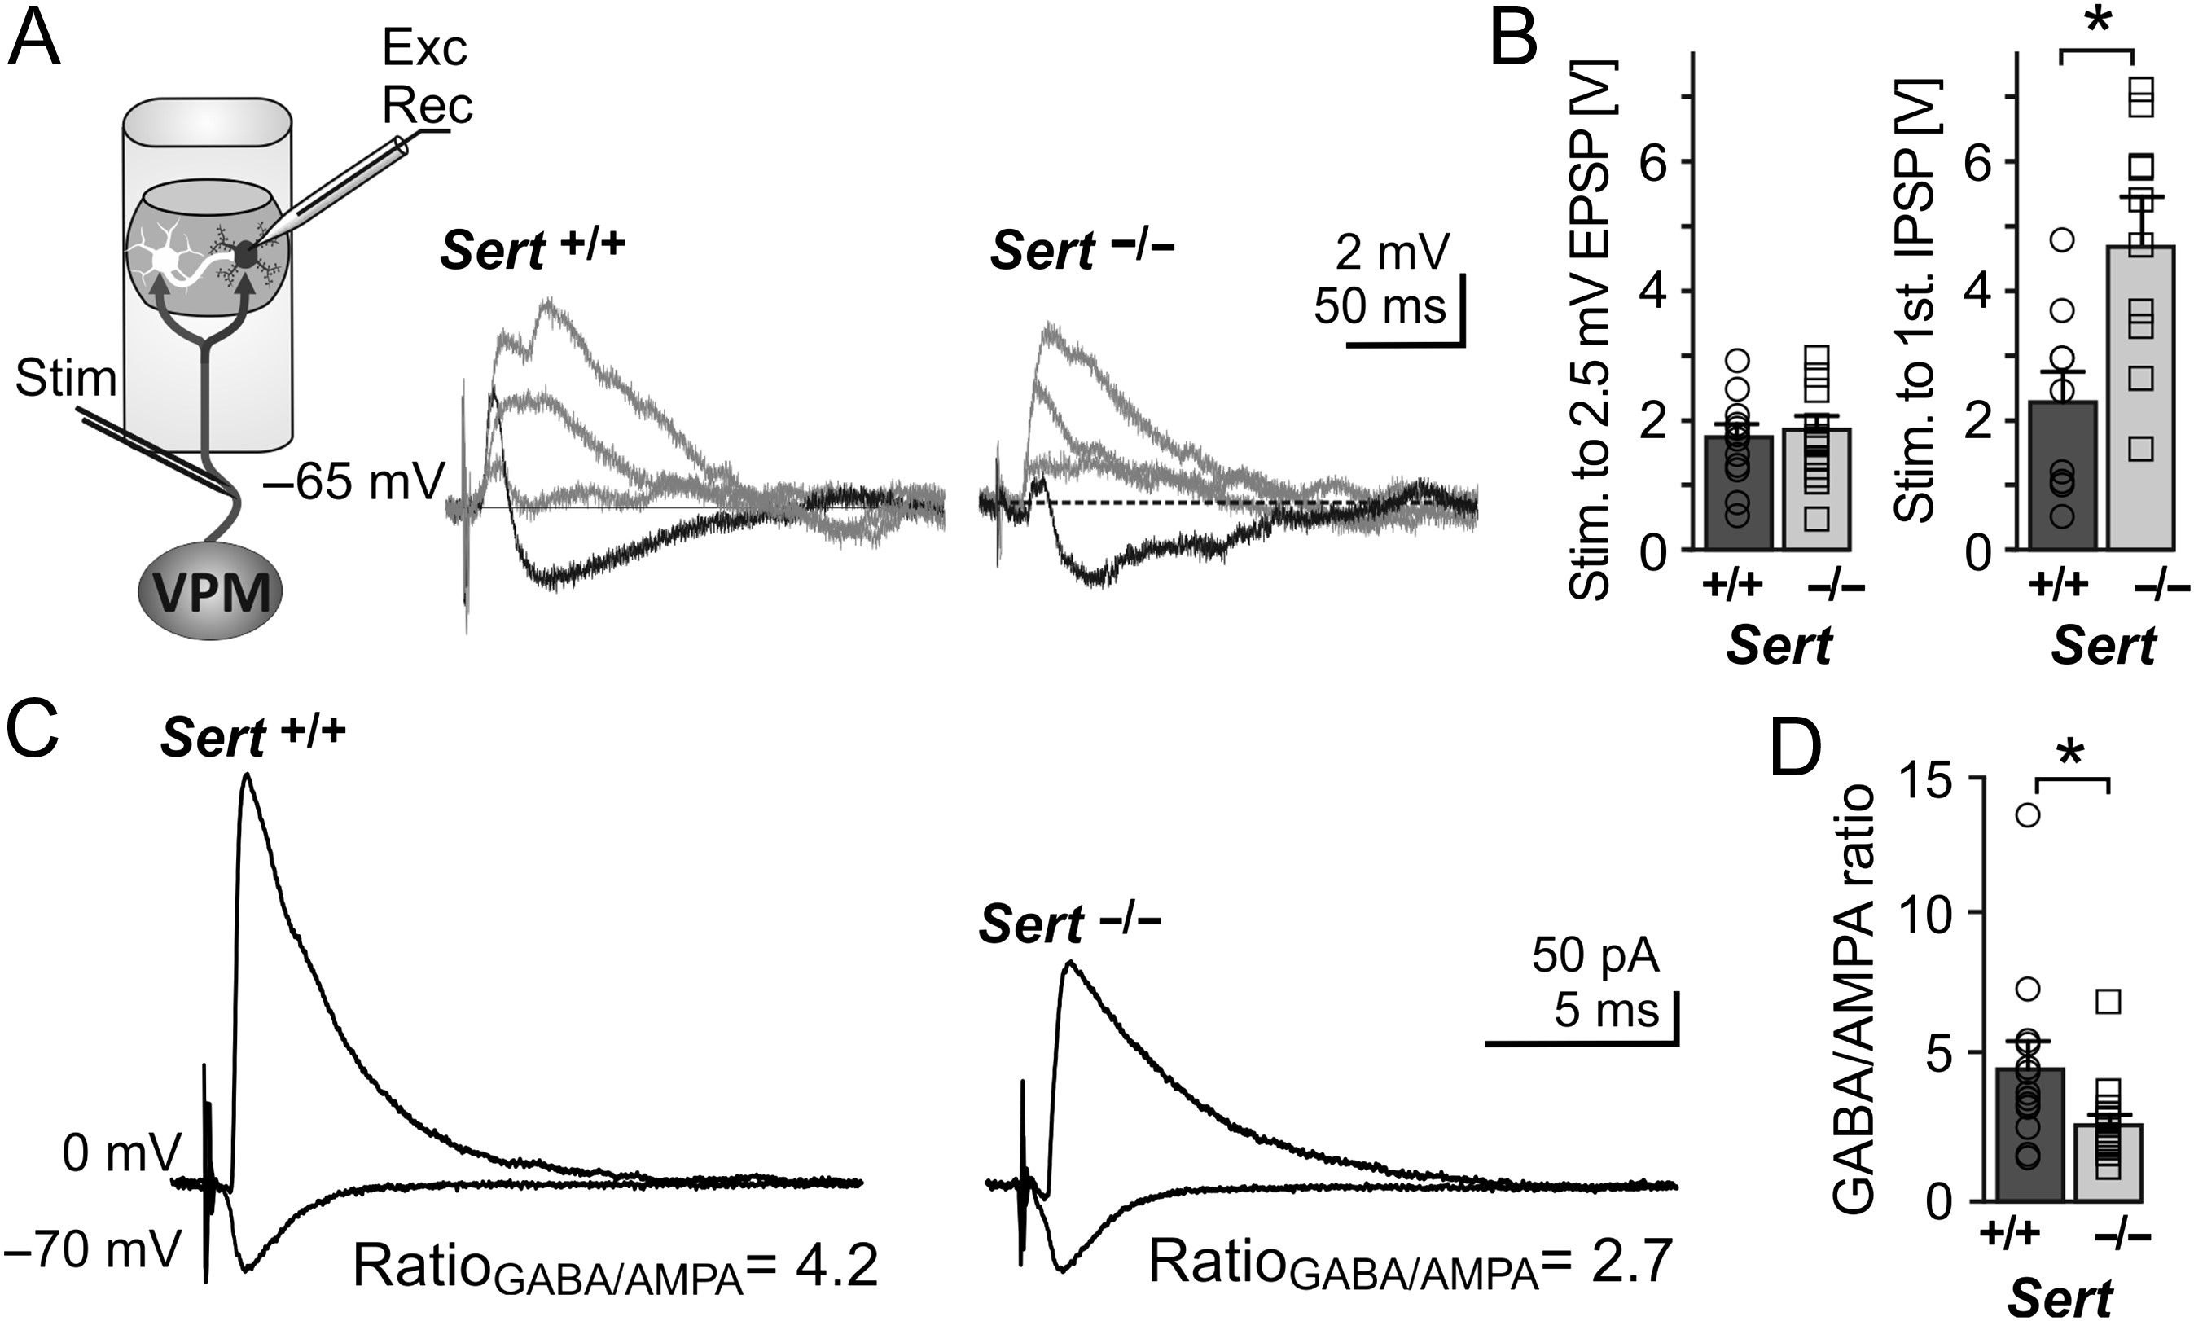
Figure 1. Sert^{−/−} rats show reduced FFI onto LIV excitatory neurons (A) Left, schematic of the recording ...
Notes:
Figure 1. Sert−/− rats show reduced FFI onto LIV excitatory neurons (A) Left, schematic of the recording depicting bipolar stimulation in the TCAs originating from the VPM with whole cell recording of a monosynaptic excitatory input and disynaptic inhibitory input onto an excitatory neuron within a LIV barrel. Middle, example current clamp recording showing input onto a LIV excitatory neuron following TCA stimulation with increasing stimulation strength (response to strongest stimulation resulting is given in black). Strongest stimulation resulted in truncation of the EPSP by disynaptic IPSP in both Sert+/+ and Sert−/−. (B) Histograms showing the TCA stimulation strength (as voltage pulses) needed to evoke an EPSP of 2.5 mV (left, Sert+/+: n = 1, Sert−/−: n = 14) and strength needed to induce the first IPSP (right, Sert+/+: n = 10, Sert−/−: n = 13) LIV excitatory neurons. (C) Representative voltage clamp recordings depicting approximate mean of Sert+/+ and Sert−/− GABA currents at Vh = 0 mV and AMPA currents at Vh = −70 mV. (D) Histogram of mean GABA/AMPA ratio of Sert+/+ (n = 13) and Sert−/− (n = 17) rats recorded in voltage clamp. Data are represented as mean ± SEM, *P < 0.05 (t-test). Electrophysiological properties of LIV excitatory and FS interneurons Regular spikingIntrinsically burstingFast spikingSert+/+Sert−/−Sert+/+Sert−/−Sert+/+Sert−/−Propertiesn = 21n = 27n = 19n = 18n = 6n = 6Passive intrinsic Vrmp [mV]−69.5 ± 1.5−67.8 ± 1.4−70.1 ± 1.0−71.6 ± 3.5−79.8 ± 1.3−75.4 ± 3.0 Rm [MΩ]156.6 ± 13.0131.1 ± 13.2149.2 ± 14.0140.9 ± 15.2182.3 ± 41.8182.2 ± 48.5 τm [ms]20.5 ± 1.918.9 ± 1.817.2 ± 1.817.5 ± 1.911.0 ± 1.311.5 ± 1.8Active intrinsic AP threshold [mV]a−37.8 ± 1.1−36.7 ± 1.1−35.0 ± 1.1−38.4 ± 2.0−39.8 ± 1.0−41.3 ± 1.2 AP amplitude [mV]79.2 ± 1.673.6 ± 5.973.2 ± 3.277.4 ± 4.768.2 ± 3.659.5 ± 5.0 AP halfwidth [ms]1.3 ± 0.11.5 ± 0.11.4 ± 0.11.3 ± 0.10.8 ± 0.10.8 ± 0.1 First ISI [ms]a45.7 ± 6.652.8 ± 7.410.5 ± 2.57.5 ± 2.520.8 ± 3.130.8 ± 4.0 Third ISI [ms]b44.8 ± 2.346.2 ± 3.139.7 ± 1.441.4 ± 2.523.4 ± 3.130.4 ± 3.6 Ninth ISI [ms]b62.1 ± 2.059.0 ± 1.666.5 ± 2.867.2 ± 4.423.3 ± 2.929.8 ± 3.1 Ninth/Third ISI ratio1.2 ± 0.11. 5 ± 0.11.7 ± 0.12.3 ± 0.11.0 ± 0.11.0 ± 0.0 fAHP [mV]13.8 ± 2.313.4 ± 2.1aActive properties were measured by just suprathreshold stimulation, eliciting 2–4 APs. bActive properties were measured by stronger depolarizing current injection, eliciting 10–14 APs. No significant differences were found between regular spiking, intrinsically bursting or FS interneurons across both genotypes. Data are means ± SEM. ISI, interstimulus interval; fAHP, fast hyperpolarizing potential.
Unless provided in the caption above, the following copyright applies to the content of this slide: © The Author 2017. Published by Oxford University Press.This is an Open Access article distributed under the terms of the Creative Commons Attribution Non-Commercial License (http://creativecommons.org/licenses/by-nc/4.0/), which permits non-commercial re-use, distribution, and reproduction in any medium, provided the original work is properly cited. For commercial re-use, please contact journals.permissions@oup.com

Slide 2
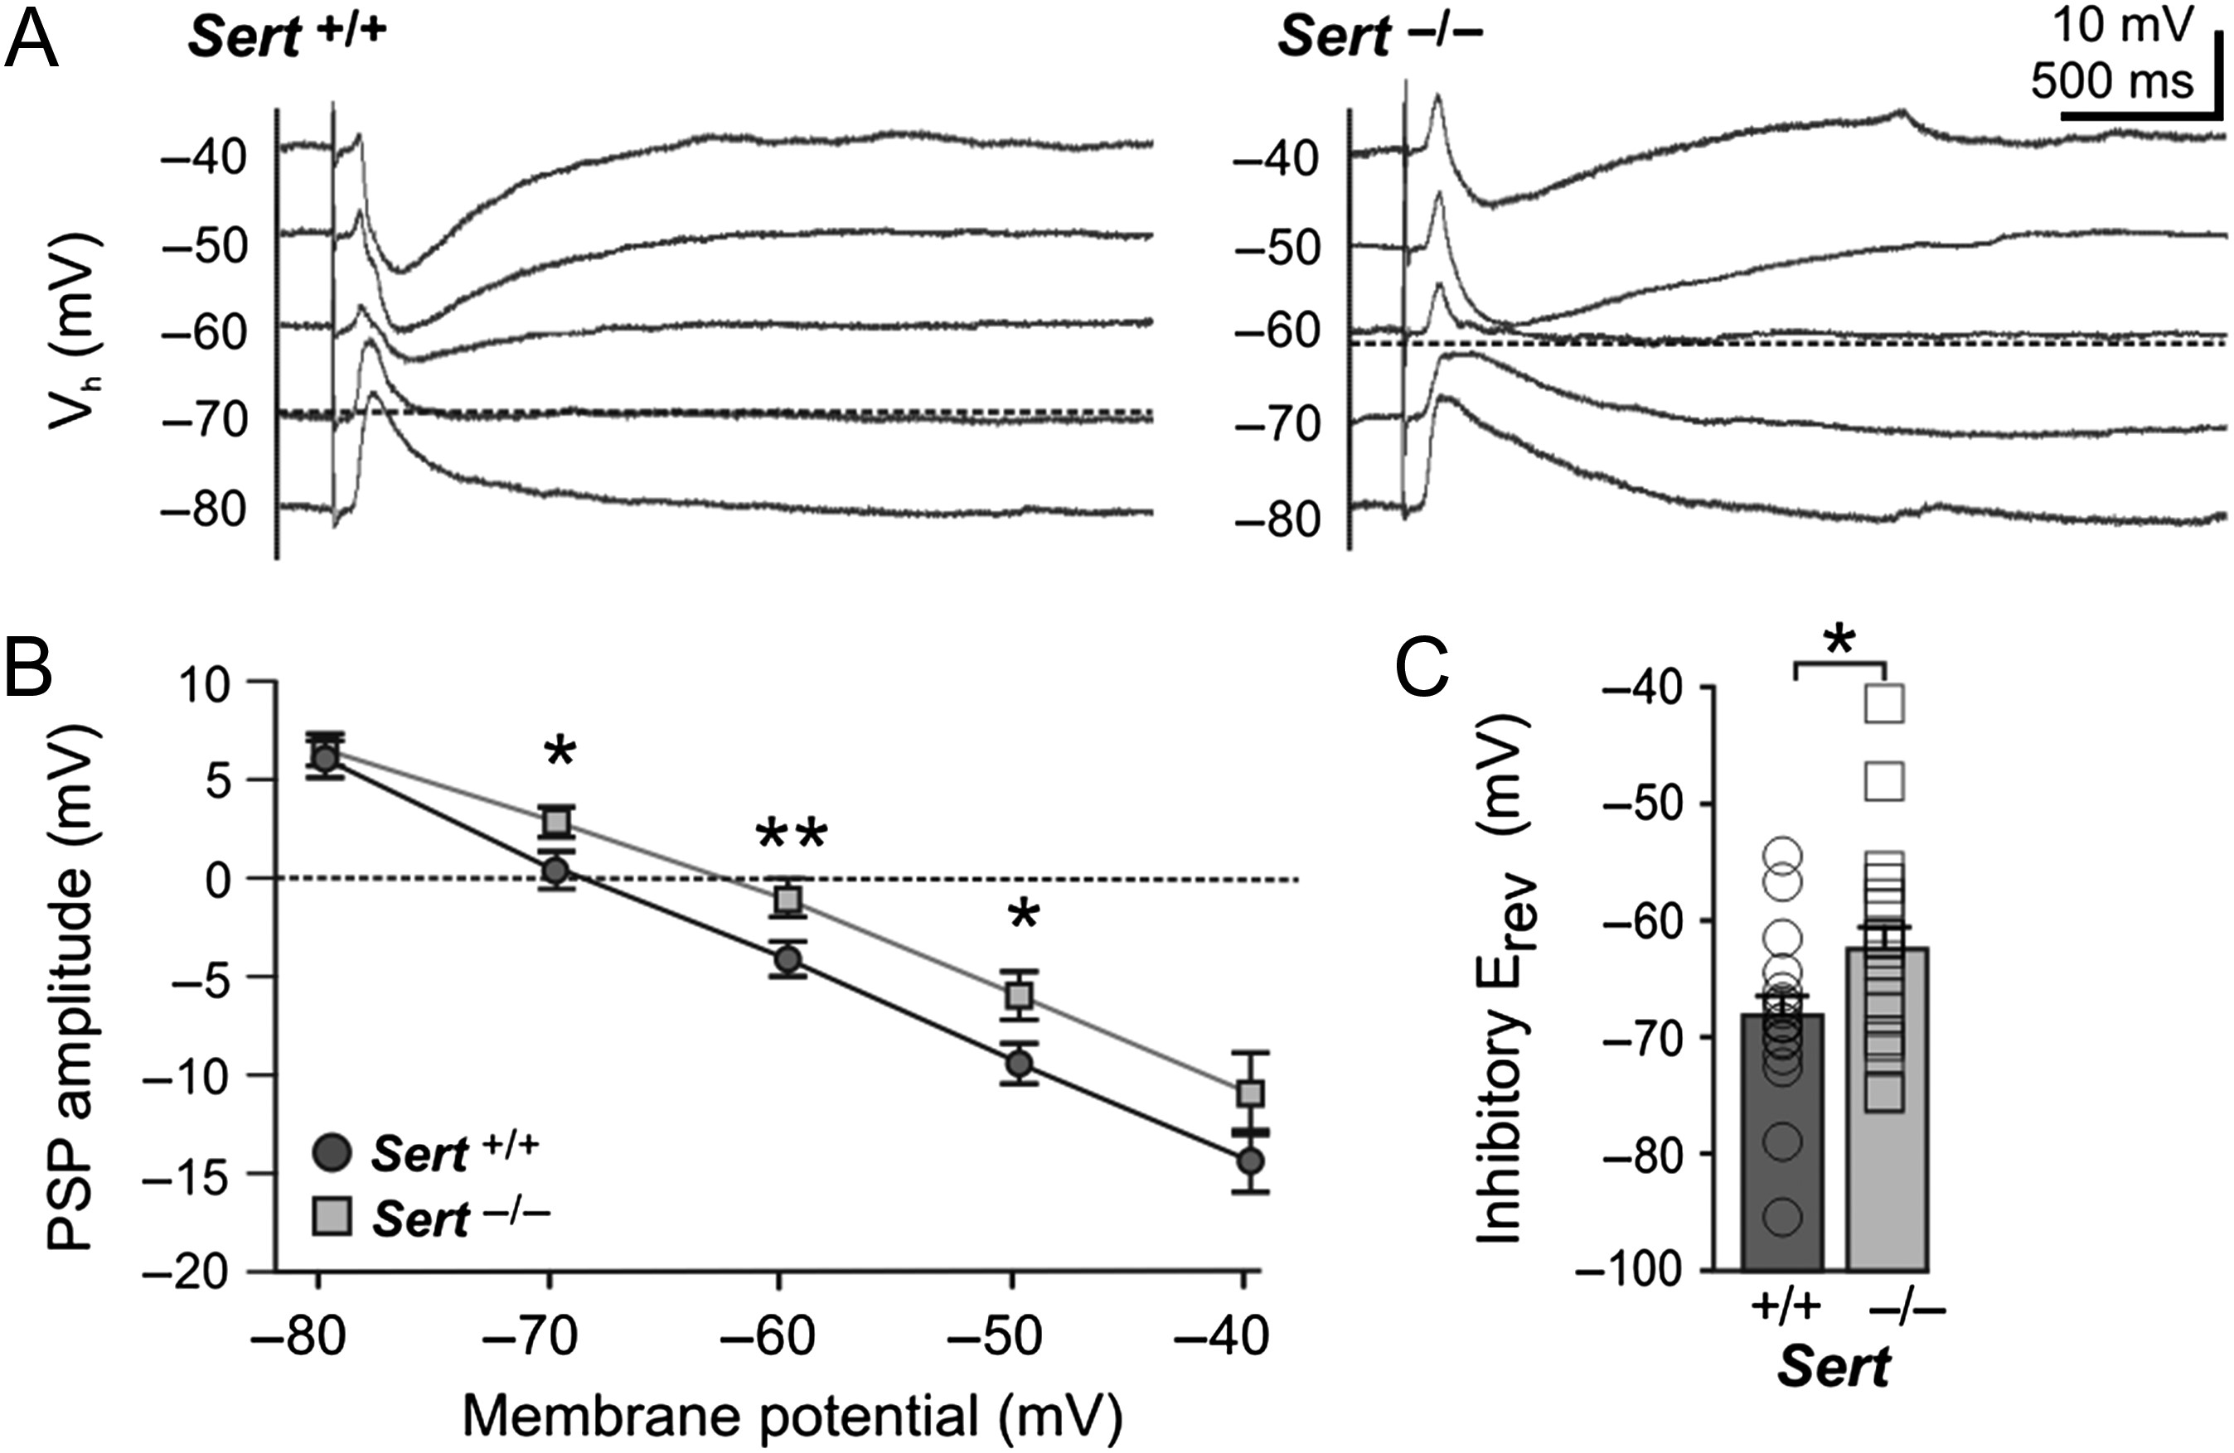
Figure 2. Sert^{−/−} rats show a depolarized inhibitory reversal potential in LIV excitatory neurons. (A) ...
Notes:
Figure 2. Sert−/− rats show a depolarized inhibitory reversal potential in LIV excitatory neurons. (A) Example current clamp traces of postsynaptic responses recorded in LIV excitatory neurons at different membrane potentials in (−80 to −40 mV) following maximal bipolar stimulation (2 × stimulation intensity for eliciting a first truncating IPSP) of TCAs of Sert+/+ and Sert−/−. (B) Plot of postsynaptic potential amplitudes at different holding potentials in Sert+/+ (n = 18) and Sert−/− (n = 19). (C) Histogram of mean reversal potential in Sert+/+ and Sert−/− rats, which was determined at x-intercept and averaged. Data are presented as mean ± SEM, *P < 0.05 (t-test).
Unless provided in the caption above, the following copyright applies to the content of this slide: © The Author 2017. Published by Oxford University Press.This is an Open Access article distributed under the terms of the Creative Commons Attribution Non-Commercial License (http://creativecommons.org/licenses/by-nc/4.0/), which permits non-commercial re-use, distribution, and reproduction in any medium, provided the original work is properly cited. For commercial re-use, please contact journals.permissions@oup.com

Slide 3
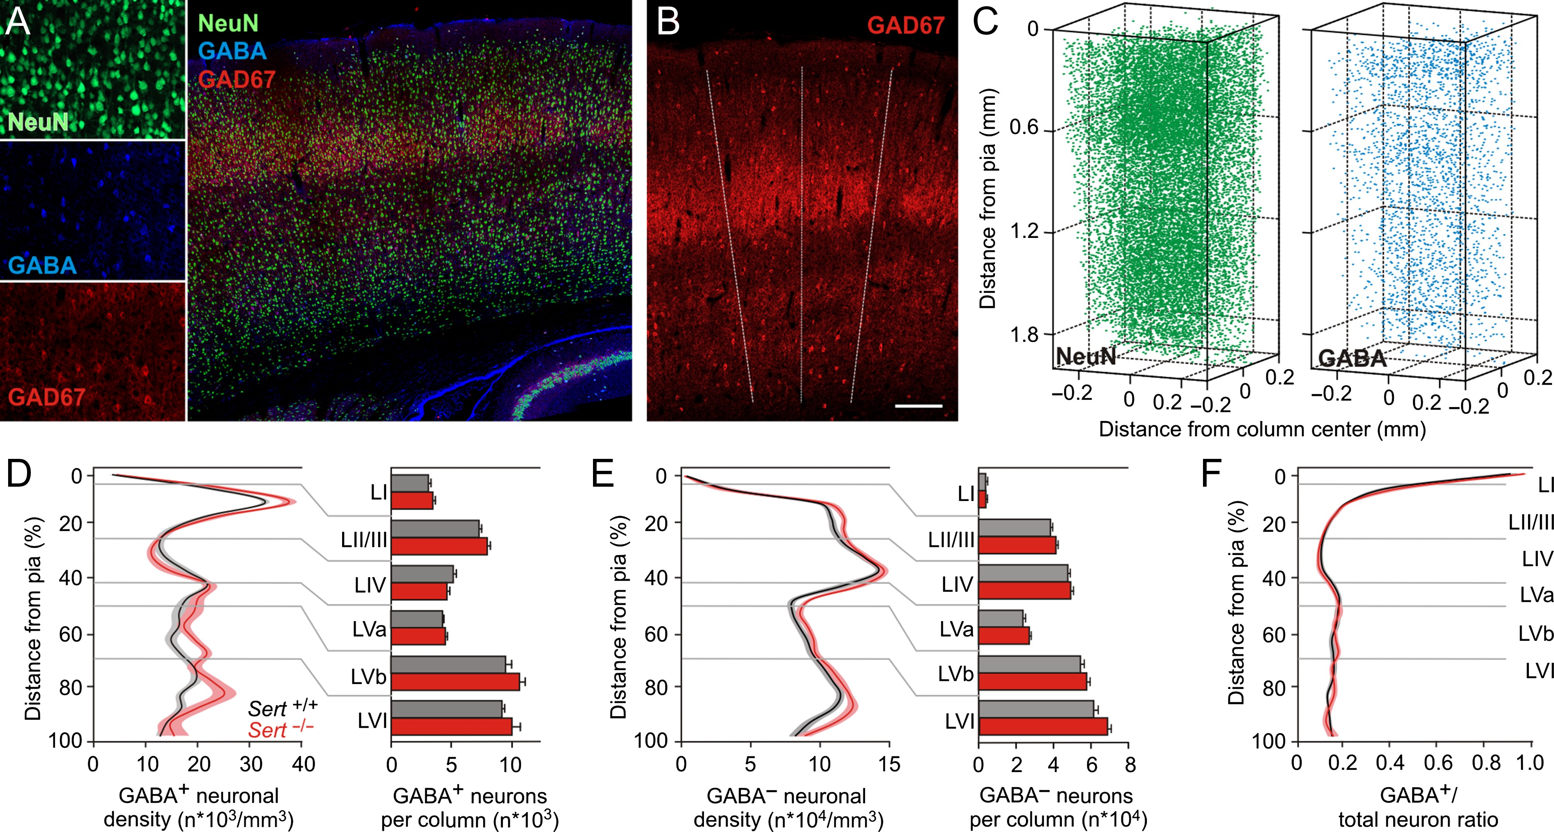
Figure 3. Reduction in inhibitory control in Sert^{−/−} rat is not due to changes in density or laminar ...
Notes:
Figure 3. Reduction in inhibitory control in Sert−/− rat is not due to changes in density or laminar distribution of inhibitory neurons within a cortical column. (A) Left, photomicrographs of single fluorescence channels for all neuron identification (NeuN), interneuron identification (GABA), and barrel identification (GAD67). Right, photomicrograph showing merged immunolabeling of one TC slice (60 µm) with GAD67, NeuN and GABA positive neurons. (B) The limits of barrel borders were determined from the GAD67 labeling in LIV and extrapolated to all layers (dashed lines). (C) Excitatory and inhibitory neurons distribution were quantified from 6 subsequent slices (total 360 µm). Left, NeuN+ neuron density distribution and right, GABA+ neuron distribution were used to identify excitatory (NeuN+, GABA− somata) and inhibitory (GABA+ somata) neuron distribution across a barrel column. (D,E) Normalized (from Pia to white matter) distribution of excitatory and inhibitory neuronal densities along a cortical column and histogram of layer quantifications (Sert+/+ 13 barrels in 5 animals; Sert−/− 10 barrels in 5 animals) shows no significant changes in the density and laminar distribution of neuronal populations in Sert−/− rats. (F) GABA+ to total neuron ratio show absence of difference in Sert−/− rat. Two-way ANOVA with Bonferroni correction was used for data in D, E, and F. All data are presented as mean ± SEM.
Unless provided in the caption above, the following copyright applies to the content of this slide: © The Author 2017. Published by Oxford University Press.This is an Open Access article distributed under the terms of the Creative Commons Attribution Non-Commercial License (http://creativecommons.org/licenses/by-nc/4.0/), which permits non-commercial re-use, distribution, and reproduction in any medium, provided the original work is properly cited. For commercial re-use, please contact journals.permissions@oup.com

Slide 4
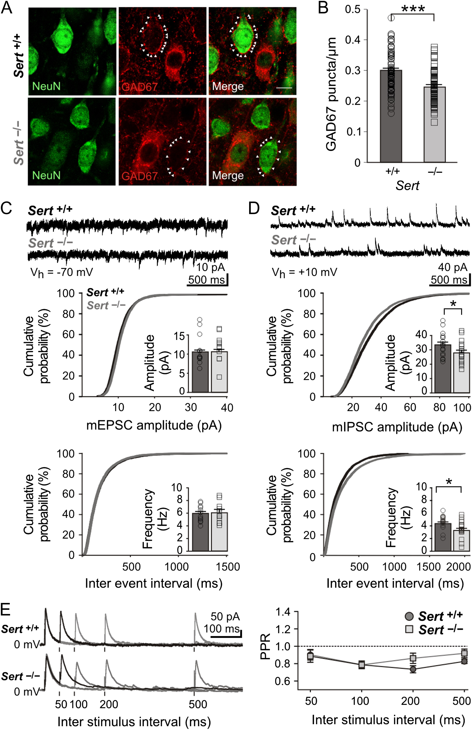
Figure 4. Sert^{−/−} rats show a reduced number of perisomatic inhibitory boutons onto excitatory LIV neurons. ...
Notes:
Figure 4. Sert−/− rats show a reduced number of perisomatic inhibitory boutons onto excitatory LIV neurons. (A) Fluorescent photomicrographs of LIV excitatory neurons (NeuN+/Gad67−) used for quantification of perisomatic GAD67 puncta/µm in Sert+/+ and Sert−/− rats. White arrows mark puncta onto a representative soma of a pyramidal cell. (B) The number of GAD67-positive perisomatic varicosities was normalized against the diameter of each presumed excitatory neuron. Histogram shows the plot of mean number of perisomatic boutons per cell (normalized to cell diameter, puncta/µm) in Sert+/+ (n = 82) and Sert−/− (n = 91) neurons. (C) Top, example voltage clamp trace of mEPSCs recorded in excitatory LIV neurons of both Sert+/+ and Sert−/− rats at Vh = −70 mV. Bottom, cumulative probability distributions and histograms of amplitude and frequency of mEPSCs in Sert+/+ (n = 12) and Sert−/− (n = 11). (D) Top, example voltage clamp trace of mIPSCs recorded in excitatory LIV neurons of both Sert+/+ and Sert−/− rats at Vh = +10 mV. Bottom, cumulative probability distributions and histograms of amplitude and frequency of mIPSCs in Sert+/+ (n = 17) and Sert−/− rats (n = 16). (E) Left, example voltage clamp trace of evoked IPSCs onto LIV excitatory neurons within a barrel at different ISI (50, 100, 200, and 500 ms) at Vh = +10 mV in the presence of AMPA/NMDA blockers. Right, line plot depicting PPR Amp2/Amp1 at varying ISIs in Sert+/+ (n = 8) and Sert−/− rats (n = 9). Data are represented as mean ± SEM, *P < 0.05 and ***P < 0.001 (t-test).
Unless provided in the caption above, the following copyright applies to the content of this slide: © The Author 2017. Published by Oxford University Press.This is an Open Access article distributed under the terms of the Creative Commons Attribution Non-Commercial License (http://creativecommons.org/licenses/by-nc/4.0/), which permits non-commercial re-use, distribution, and reproduction in any medium, provided the original work is properly cited. For commercial re-use, please contact journals.permissions@oup.com

Slide 5
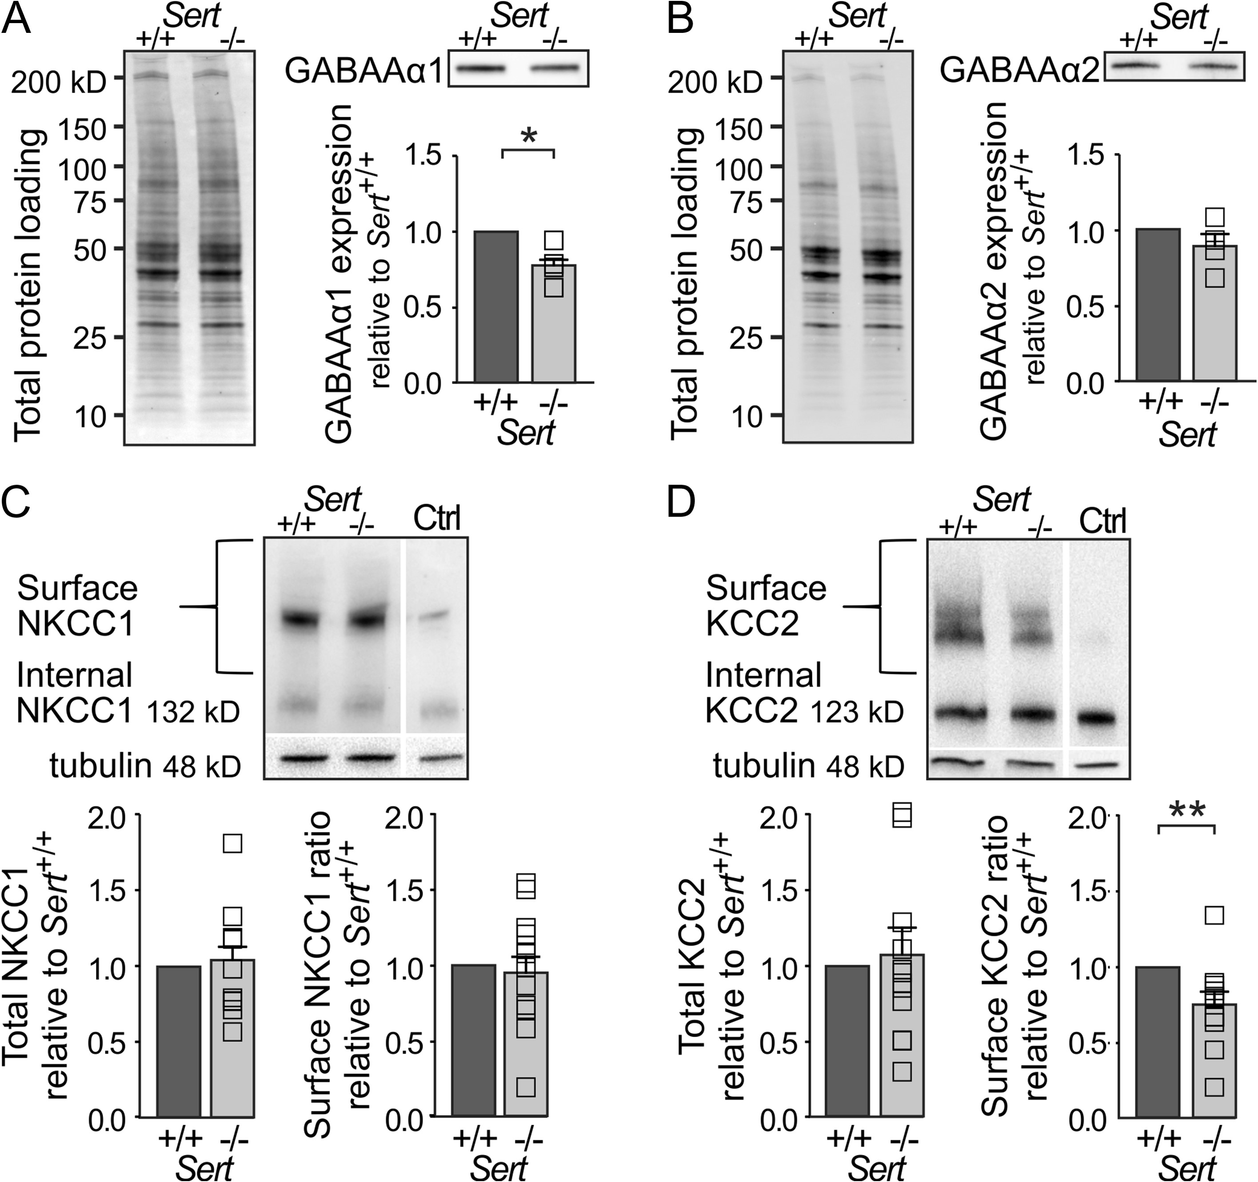
Figure 5. Reduced inhibitory drive in Sert^{−/−} rats is associated with a decrease in GABAA α1 subunit ...
Notes:
Figure 5. Reduced inhibitory drive in Sert−/− rats is associated with a decrease in GABAA α1 subunit expression as well as a reduced KCC2 chloride extruder protein expression within S1. (A) Western blot analysis of GABAA α1 subunit expression in S1 total protein lysates of Sert+/+ (n = 4) and Sert−/− rats (n = 4). Left, loading control. Right, western blot and histogram showing total GABAA α1 receptor subunit expression normalized to Sert+/+. (B) Western blot analysis of GABAA α2 receptor subunit expression in S1 total protein lysates of Sert+/+ (n = 4) and Sert−/− rats (n = 4). Left, loading control. Right, western blot and histogram showing total GABAA α2 subunit expression normalized to Sert+/+. (C) Left, surface and internal NKCC1 protein levels were determined by BS3 cross-linking method using S1 protein lysates of Sert+/+ and Sert−/− rats with non-crosslinked control (Ctrl). Right, histograms showing quantification of total NKCC1 expression normalized to γ-tubulin and surface NKCC1 expression normalized to internal expression in Sert+/+ (n = 12) and Sert−/− (n = 12) rats. (D) Left, surface and internal KCC2 protein levels were determined by BS3 cross-linking method using S1 protein lysates of Sert+/+ and Sert−/− rats with non-crosslinked control (Ctrl). Right, histograms showing quantification of total KCC2 expression normalized to γ-tubulin and surface KCC2 expression normalized to internal expression in Sert+/+ (n = 12) and Sert−/− rats (n = 12). All data are presented as mean ± SEM, *P < 0.05 and **P < 0.01 (t-test).
Unless provided in the caption above, the following copyright applies to the content of this slide: © The Author 2017. Published by Oxford University Press.This is an Open Access article distributed under the terms of the Creative Commons Attribution Non-Commercial License (http://creativecommons.org/licenses/by-nc/4.0/), which permits non-commercial re-use, distribution, and reproduction in any medium, provided the original work is properly cited. For commercial re-use, please contact journals.permissions@oup.com

Slide 6
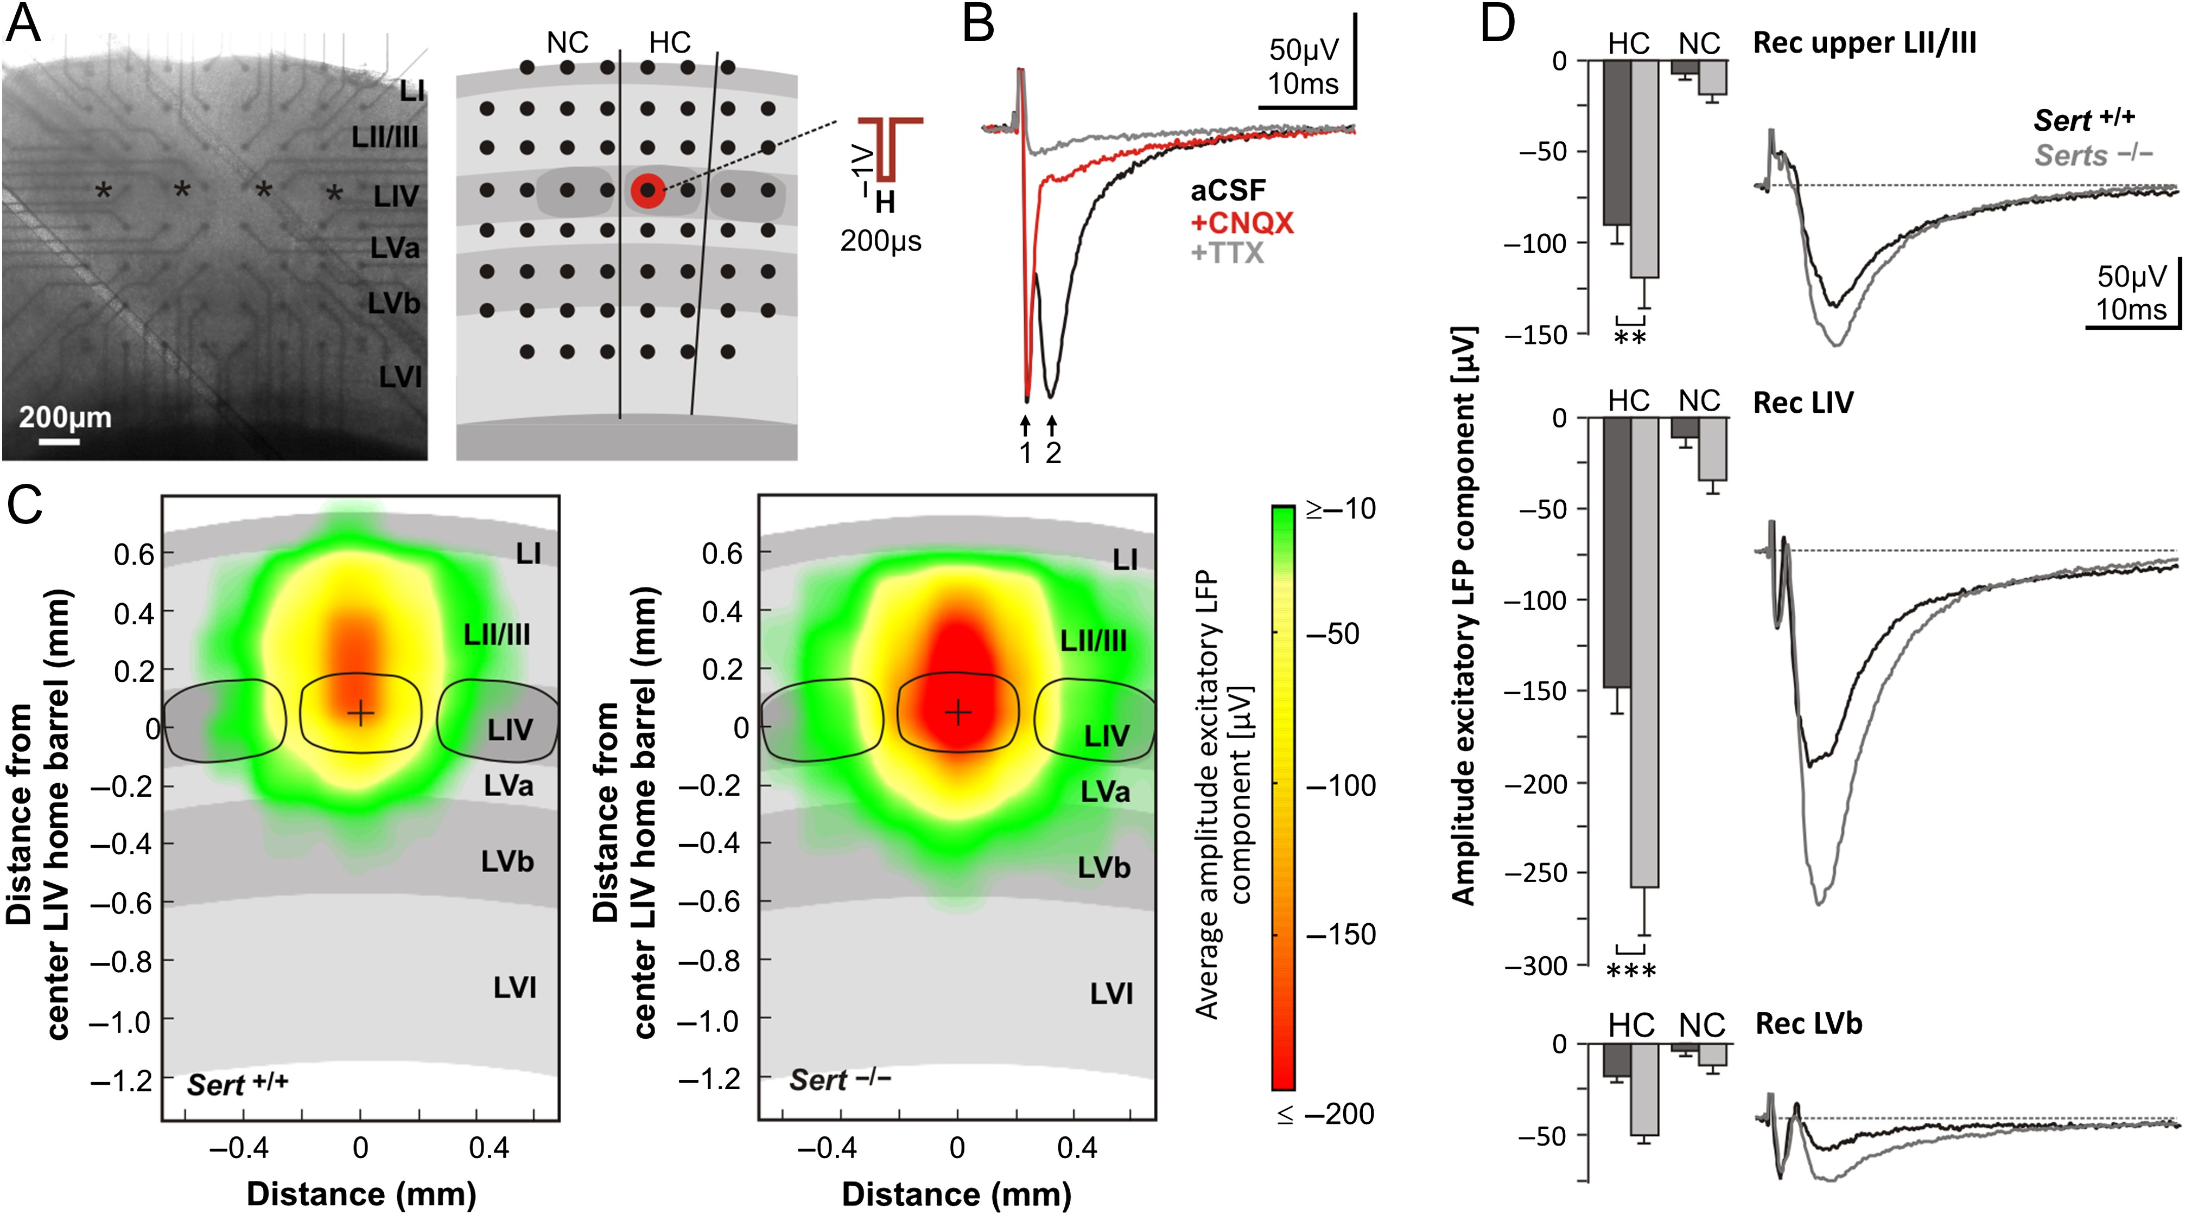
Figure 6. Intracortical excitatory signal propagation following activation of LIV networks is increased in ...
Notes:
Figure 6. Intracortical excitatory signal propagation following activation of LIV networks is increased in Sert−/− rats. (A) Photograph of an acute brain slice mounted on a MEA chip and schematic representation of slice positioning relative to electrode positions (black dots). Electrical stimulation of LIV networks was applied by a block voltage pulse through a MEA electrode positioned in a LIV barrel (red dot). HC, (stimulated) home column; NC, neighboring column. (B) Pharmacological identification of main components of evoked LFPs. Representative LFP response in LIV first under 1) ACSF condition (black trace), showing a fast action potential volley (arrow 1) and a slow AMPA mediated synaptic component (arrow 2), 2) After 30 min under 5 µM CNQX (red trace) and 3) After 30 min under 5 µM CNQX + 1 µM TTX (gray trace). (C) Averaged maps of excitatory signal propagation, constructed by linearly transforming individual maps (Sert+/+: n = 15; Sert−/−: n = 15) to the cortical template shown as gray background centered to one LIV barrel center (black dot). The maps illustrate the averaged amplitude of excitatory synaptic LFP responses with confidence levels ≥68.3%. (D) Average negative (excitatory) synaptic peak amplitudes of LFPs following LIV stimulation for Sert+/+ (n = 20) and Sert−/− rats (n = 20). Data were obtained from the electrode delivering the strongest LFP response in each of the 3 layers of interest (upper LII/III = second electrode row; LIV = fourth electrode row; LVb = sixth electrode row) separately for HC and NC. Traces show representative averaged LFP recordings at the respective laminar positions in the HC. Data are means ± SEM. Asterisks indicate significant differences between the 2 genotypes. Two-way ANOVA with Bonferroni correction was used. Data are represented as mean ± SEM, **P < 0.01 and ***P < 0.001. See Supplementary Fig. 3 for maps of confidence levels of the excitatory response.
Unless provided in the caption above, the following copyright applies to the content of this slide: © The Author 2017. Published by Oxford University Press.This is an Open Access article distributed under the terms of the Creative Commons Attribution Non-Commercial License (http://creativecommons.org/licenses/by-nc/4.0/), which permits non-commercial re-use, distribution, and reproduction in any medium, provided the original work is properly cited. For commercial re-use, please contact journals.permissions@oup.com

Slide 7
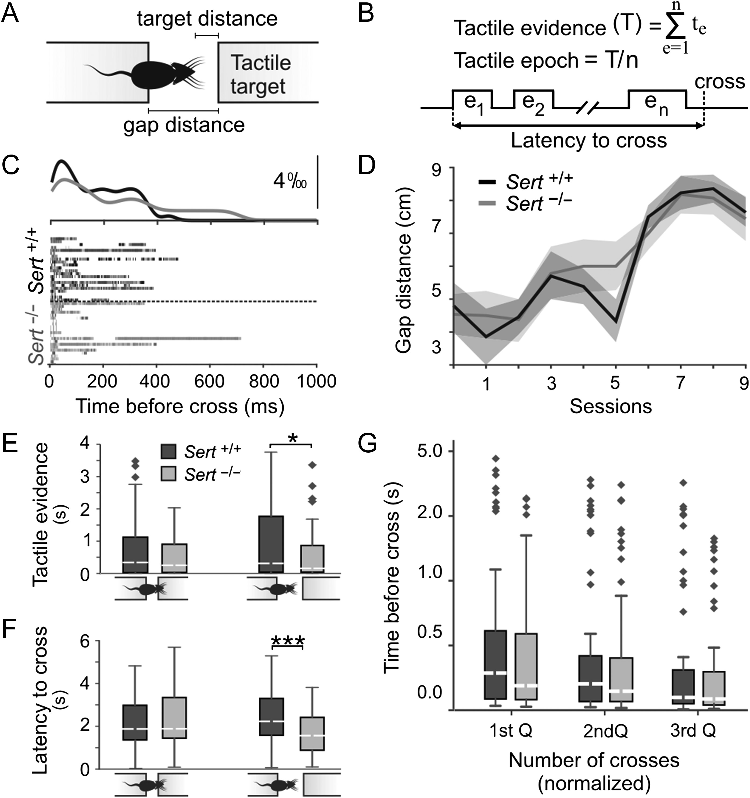
Figure 7. Sert^{−/−} rats show faster decision-making during tactile object localization. (A) Cartoon ...
Notes:
Figure 7. Sert−/− rats show faster decision-making during tactile object localization. (A) Cartoon representation of the behavioral task. (B) Schematic representation of temporal distribution of tactile exploration on a given trial and key independent parameters extracted for the quantification of tactile exploration. (C) Temporal distribution of whisker contacts onto target prior to successful object localization. Twenty-five randomly chosen trials at whisker distances in each genotype were plotted after aligning the trials at gap-cross. Peri-contact time histograms (top) were normalized to the sum of all contacts on each trial. (D) Learning curves described as the maximum distance animals could successfully locate the target across sessions (Sert−/−n = 8; Sert+/+n = 8 animals). (E) Histogram showing total duration of exploration prior to successful object localization when the object was located either at “nose” distances in Sert+/+ (n = 60 trials) and Sert−/− (n = 39 trials) rats, or at “whisker” distance (Sert+/+n = 60; Sert−/−n = 51 trials). (F) Histogram showing the latency between the first contact and the successful object localization with target locations at nose distance in Sert+/+ (n = 60 trials) and Sert−/− (n = 39 trials) rats, or at whisker distance (Sert+/+n = 60 trials; Sert−/−n = 51 trials). (G) Temporal distribution of whisker contacts was comparable across genotypes. Diamonds denote outliers *P < 0.05 and ***P < 0.001 (2-way ANOVA and t-test). See Supplementary Fig. 4 for temporal distribution of whisker contacts.
Unless provided in the caption above, the following copyright applies to the content of this slide: © The Author 2017. Published by Oxford University Press.This is an Open Access article distributed under the terms of the Creative Commons Attribution Non-Commercial License (http://creativecommons.org/licenses/by-nc/4.0/), which permits non-commercial re-use, distribution, and reproduction in any medium, provided the original work is properly cited. For commercial re-use, please contact journals.permissions@oup.com

