Slide 1
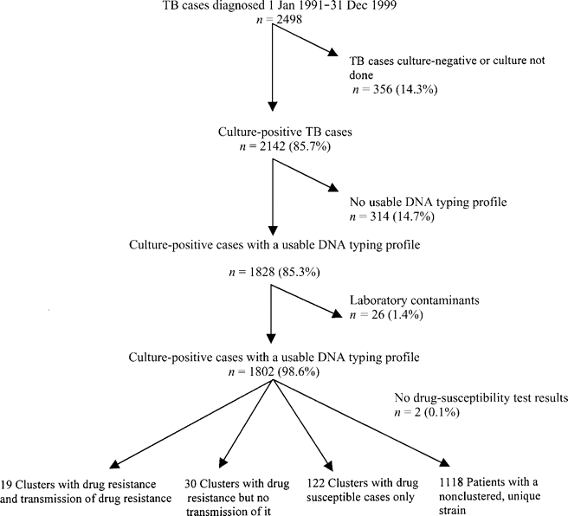
Figure 1 Derivation of the study population, San Francisco, 1991–1999. TB, tuberculosis
Notes:
Figure 1 Derivation of the study population, San Francisco, 1991–1999. TB, tuberculosis
Unless provided in the caption above, the following copyright applies to the content of this slide: © 2003 by the Infectious Diseases Society of America

Slide 2
Figure 2 Examples of 3 prototypical tuberculosis clusters. ○, Drug-susceptible cases; •, drug-resistant cases. In ...
Notes:
Figure 2 Examples of 3 prototypical tuberculosis clusters. ○, Drug-susceptible cases; •, drug-resistant cases. In cluster type A, a drug-susceptible Mycobacterium tuberculosis strain was transmitted from 1 patient to another. There were 122 such clusters. In cluster type B, at least 1 patient had a strain resistant to ⩾1 first-line drug, but there was no documented secondary case with the drug-resistant strain. There were 30 such clusters. In cluster type C, there were both drug-resistant and drug-susceptible isolates and ⩾1 secondary cases of drug-resistant tuberculosis. In these 19 clusters, there were only 42 secondary cases from a drug-resistant strain
Unless provided in the caption above, the following copyright applies to the content of this slide: © 2003 by the Infectious Diseases Society of America

Slide 3
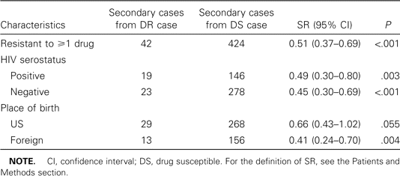
Table 1 Secondary case rate ratio (SR) of drug-resistant (DR) strains, by human immunodeficiency virus (HIV) ...
Notes:
Table 1 Secondary case rate ratio (SR) of drug-resistant (DR) strains, by human immunodeficiency virus (HIV) serostatus and place of birth
Unless provided in the caption above, the following copyright applies to the content of this slide: © 2003 by the Infectious Diseases Society of America

Slide 4
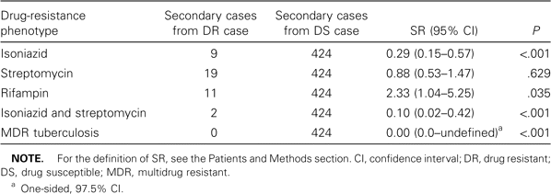
Table 2 Secondary-case rate ratio (SR), by initial drug-resistance phenotype
Notes:
Table 2 Secondary-case rate ratio (SR), by initial drug-resistance phenotype
Unless provided in the caption above, the following copyright applies to the content of this slide: © 2003 by the Infectious Diseases Society of America

