Slide 1
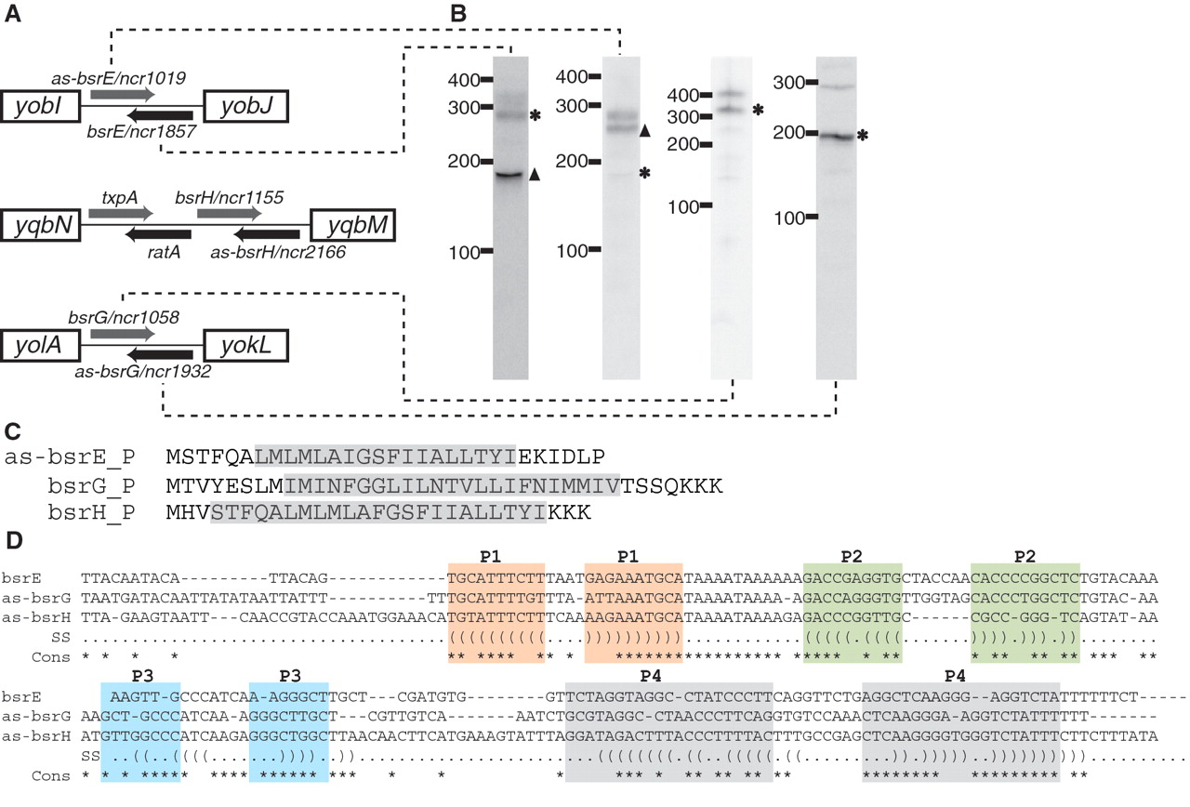
Figure 6. Novel TA systems predicted by deep sequencing analysis. ( A ) Genomic locus of three new TA systems in B. ...
Notes:
Figure 6. Novel TA systems predicted by deep sequencing analysis. ( A ) Genomic locus of three new TA systems in B. subtilis . The toxic protein (gray arrow) and the RNA antitoxin (black arrow) are all arranged in tail-to-tail configuration. Note that the txpA and ratA system had been previously characterized ( 46 ). ( B ) Northern blotting of the toxin and antitoxin RNAs. ‘Asterisk’ indicates that the size of the sRNA as predicted by northern blot is in agreement with sequencing data. ‘Filled triangle’ denotes sRNA with different predicted size (e.g. due to processing or termination events). The expression level for bsrH and as-bsrH were too low to be detected by northern blotting in our analysis. ( C ) Putative sequences for as-bsrE , bsrG and bsrH toxins. Predicted membrane spanning regions are highlighted in gray. ( D ) Sequence alignment of the bsrE , as-bsrG and as-bsrH RNA antitoxins. Regions with base-pairing potentials are shown with different colors and labeled as P1–P4.
Unless provided in the caption above, the following copyright applies to the content of this slide: © The Author(s) 2010. Published by Oxford University Press.This is an Open Access article distributed under the terms of the Creative Commons Attribution Non-Commercial License (http://creativecommons.org/licenses/by-nc/2.5), which permits unrestricted non-commercial use, distribution, and reproduction in any medium, provided the original work is properly cited.

Slide 2
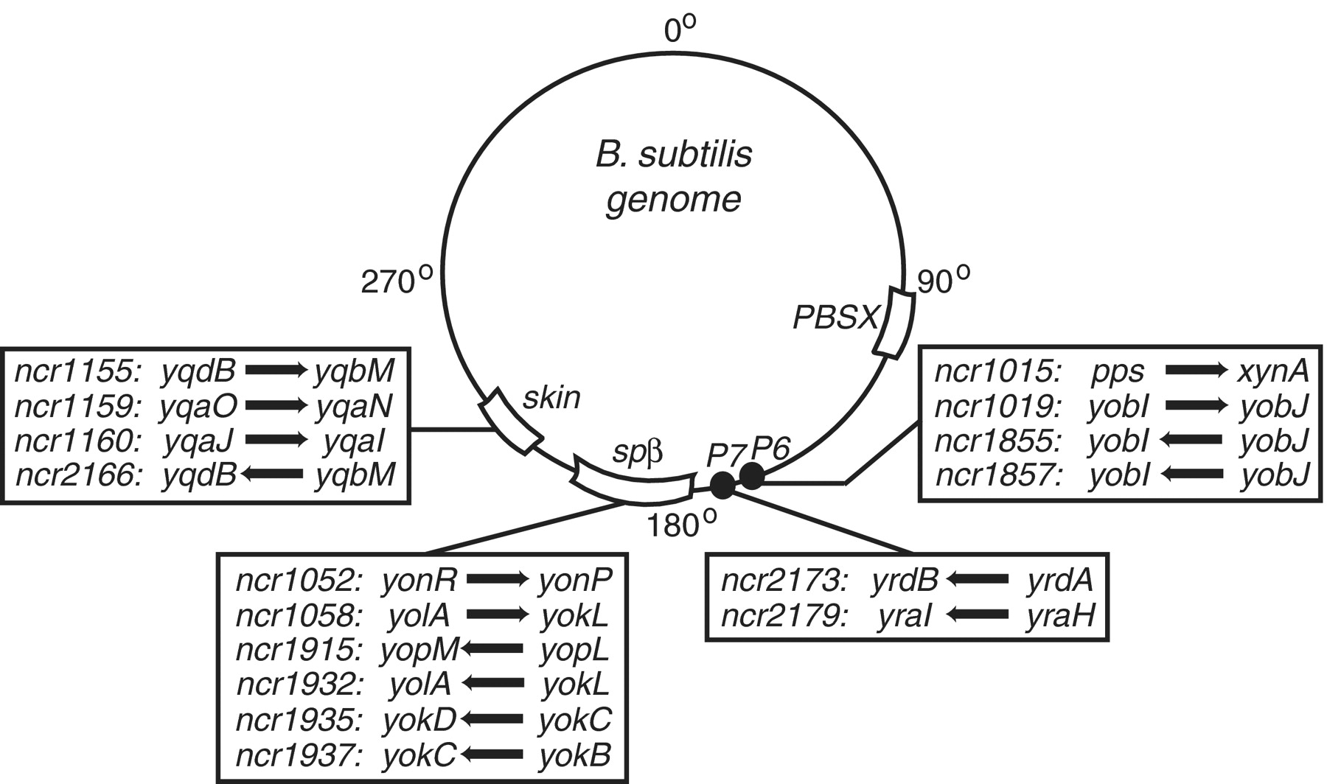
Figure 5. Putative sRNAs encoded within prophage regions. 16 sRNA candidates (denoted by arrow) originated from ...
Notes:
Figure 5. Putative sRNAs encoded within prophage regions. 16 sRNA candidates (denoted by arrow) originated from prophage or prophage-like regions ( SPβ , skin , P6 , P7 ) and are shown relative to their genomic location. Genes immediately upstream and downstream of the sRNA are also listed.
Unless provided in the caption above, the following copyright applies to the content of this slide: © The Author(s) 2010. Published by Oxford University Press.This is an Open Access article distributed under the terms of the Creative Commons Attribution Non-Commercial License (http://creativecommons.org/licenses/by-nc/2.5), which permits unrestricted non-commercial use, distribution, and reproduction in any medium, provided the original work is properly cited.

Slide 3
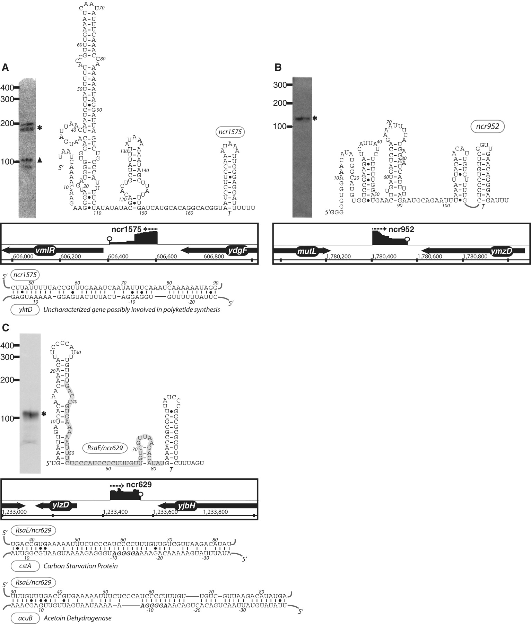
Figure 4. The expression, predicted secondary structure, and genomic context of B. subtilis sRNA candidates: ncr1575 ( ...
Notes:
Figure 4. The expression, predicted secondary structure, and genomic context of B. subtilis sRNA candidates: ncr1575 ( A ), ncr952 ( B ) and RsaE/ncr629 ( C ). For each of these RNAs, the expression level was assessed by northern blotting using total samples obtained from stationary phase cells cultured in minimal media. ‘Asterisk’ indicates that the size of sRNA detected by northern blotting is in agreement with the size of the putative sRNA as predicted by the sequencing data. ‘Filled triangle’ denotes a sRNA with a different predicted size (e.g. due to processing or termination events). The genomic locus of each sRNA is shown with its enriched cDNA hits and the two flanking genes. The transcriptional unit is indicated by an arrow. An open circle denotes a potential intrinsic terminator. Candidate mRNA targets, as predicted by TargetRNA software, for are also included in the figure. The region of the sRNA predicted to associate with the target mRNA is highlighted in gray.
Unless provided in the caption above, the following copyright applies to the content of this slide: © The Author(s) 2010. Published by Oxford University Press.This is an Open Access article distributed under the terms of the Creative Commons Attribution Non-Commercial License (http://creativecommons.org/licenses/by-nc/2.5), which permits unrestricted non-commercial use, distribution, and reproduction in any medium, provided the original work is properly cited.

Slide 4
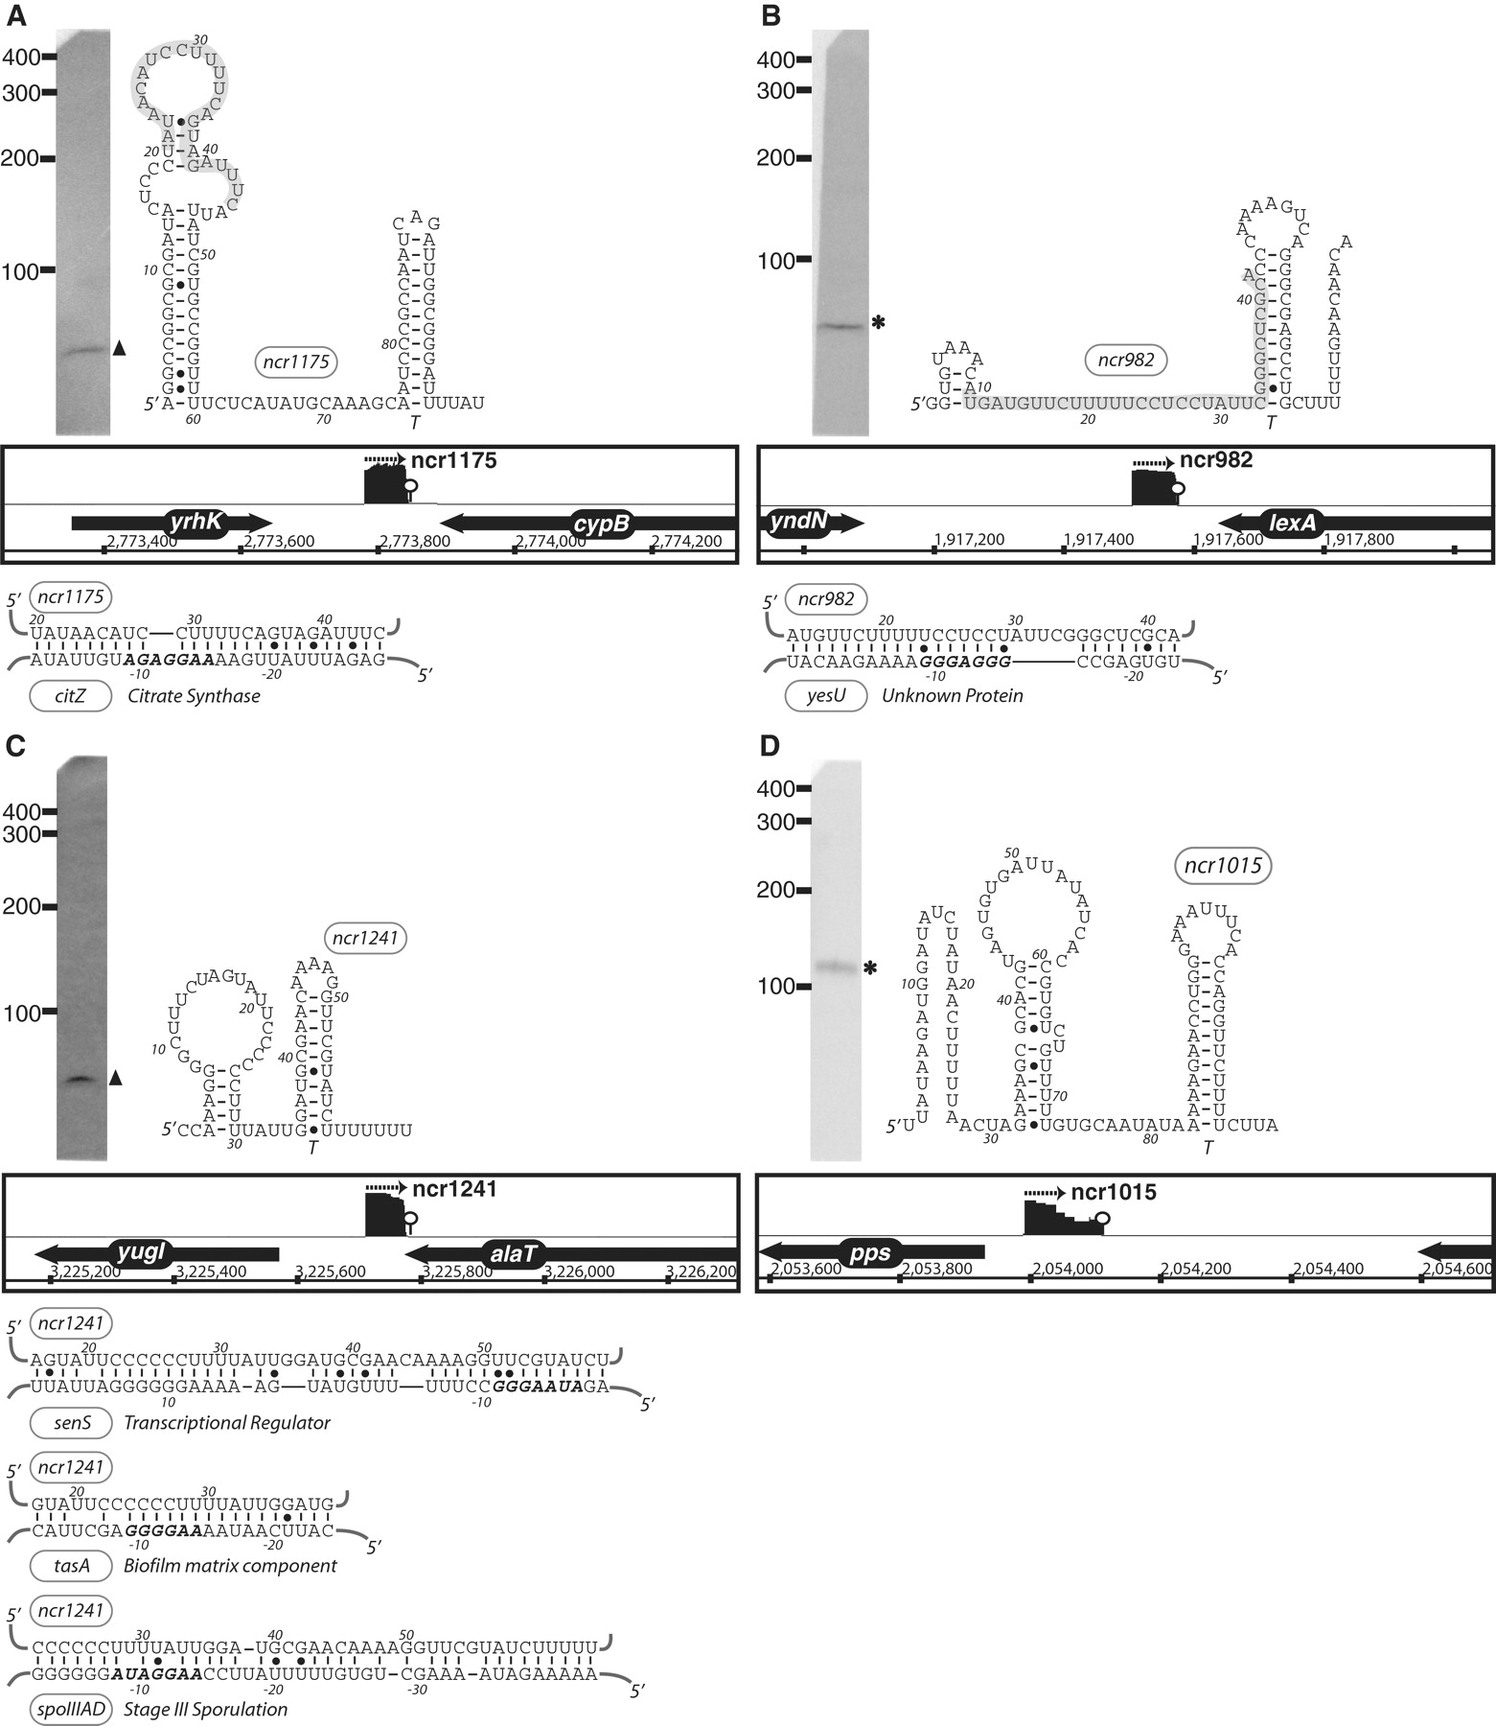
Figure 3. The expression, predicted secondary structure, and genomic context of B. subtilis sRNA candidates: ncr1175 ( ...
Notes:
Figure 3. The expression, predicted secondary structure, and genomic context of B. subtilis sRNA candidates: ncr1175 ( A ), ncr982 ( B ), ncr1241 ( C ) and ncr1015 ( D ). For each of these RNAs, the expression level was assessed by northern blotting using total samples obtained from stationary phase cells cultured in minimal media. ‘Asterisk’ indicates that the size of sRNA detected by northern blotting is in agreement with the size of the putative sRNA as predicted by sequencing data. ‘Filled triangle’ denotes a sRNA with a different predicted size (e.g. due to processing or termination events). The genomic locus of each sRNA is shown with its enriched cDNA hits and the two flanking genes. The transcriptional unit is indicated by an arrow. An open circle denotes a potential intrinsic terminator. Candidate mRNA targets, as predicted by TargetRNA software, for are also included in the figure. The region of the sRNA predicted to associate with the target mRNA is highlighted in gray. Secondary structures were predicted using RNAfold and RNAz software.
Unless provided in the caption above, the following copyright applies to the content of this slide: © The Author(s) 2010. Published by Oxford University Press.This is an Open Access article distributed under the terms of the Creative Commons Attribution Non-Commercial License (http://creativecommons.org/licenses/by-nc/2.5), which permits unrestricted non-commercial use, distribution, and reproduction in any medium, provided the original work is properly cited.

Slide 5
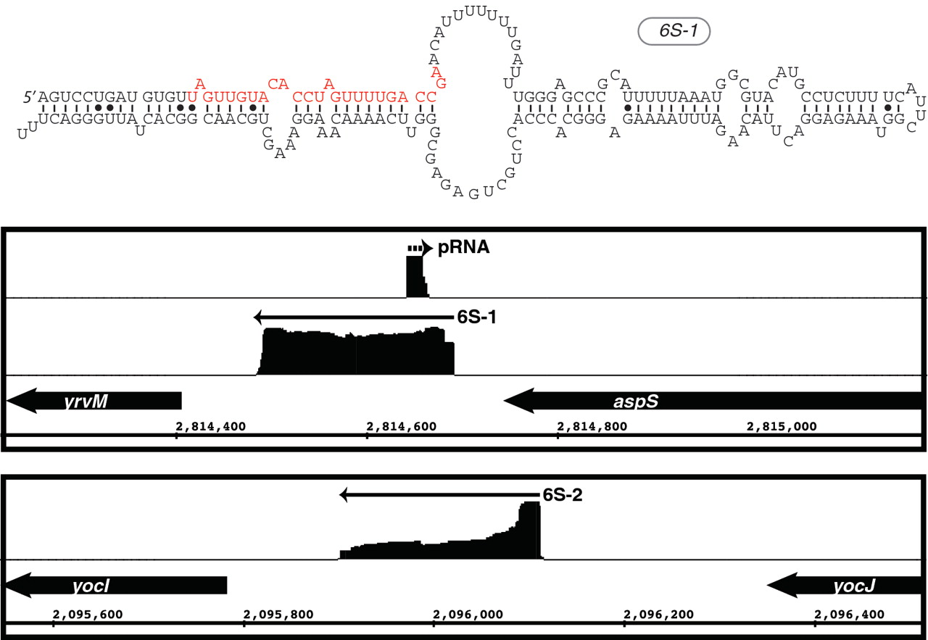
Figure 2. Visualization of enriched cDNA reads for B. subtilis 6S RNAs. The upper panel shows the sequence and ...
Notes:
Figure 2. Visualization of enriched cDNA reads for B. subtilis 6S RNAs. The upper panel shows the sequence and predicted secondary structure for 6S-1. Denoted in red is the sequence, which is transcribed by RNAP from 6S as an RNA template into the short product RNA (pRNA). The bottom panel shows the genomic context and the distribution of cDNA reads mapped to both 6S-1 and 6S-2 loci. Arrows denote the direction of transcription. The cDNA reads for 6S-1 and 6S-2 are shown in the same relative scale. In contrast, the cDNA reads corresponding to the pRNA are approximately 10-fold less abundant compared to the 6S and, thus, are shown as a close-up for visualization purposes.
Unless provided in the caption above, the following copyright applies to the content of this slide: © The Author(s) 2010. Published by Oxford University Press.This is an Open Access article distributed under the terms of the Creative Commons Attribution Non-Commercial License (http://creativecommons.org/licenses/by-nc/2.5), which permits unrestricted non-commercial use, distribution, and reproduction in any medium, provided the original work is properly cited.

Slide 6
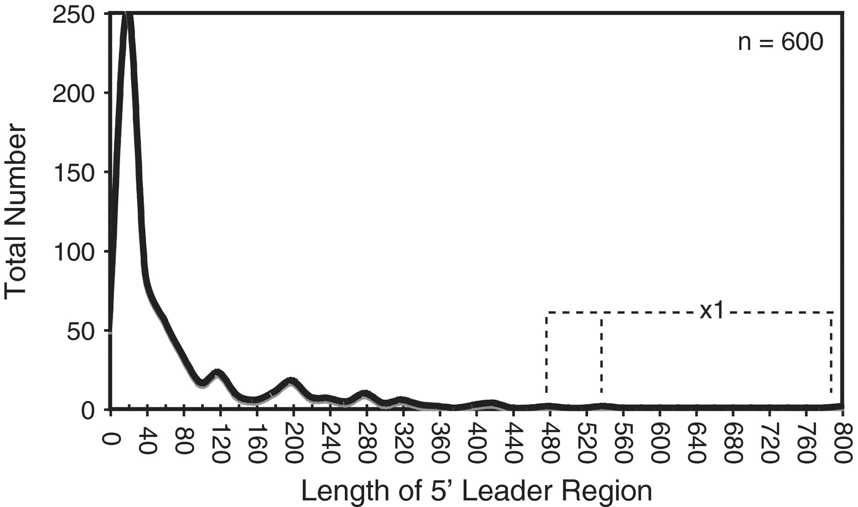
Figure 1. Length distribution of B. subtilis 5′-leader regions . In total, 600 TSSs were identified based on the ...
Notes:
Figure 1. Length distribution of B. subtilis 5′-leader regions . In total, 600 TSSs were identified based on the dRNA-seq analysis ( Supplementary Table S1 ). The length of putative leader regions was calculated as the distance from the start of the cDNA reads to the start of the downstream coding region. The data is presented as a histogram with bin width = 20. Three individual leader regions longer than 450 nt (‘x1′) are denoted with the dashed line.
Unless provided in the caption above, the following copyright applies to the content of this slide: © The Author(s) 2010. Published by Oxford University Press.This is an Open Access article distributed under the terms of the Creative Commons Attribution Non-Commercial License (http://creativecommons.org/licenses/by-nc/2.5), which permits unrestricted non-commercial use, distribution, and reproduction in any medium, provided the original work is properly cited.

Slide 7
Figure 7. Novel arrangement of an antisense RNA predicted to base pair with the bglP 5′ leader region, which includes ...
Notes:
Figure 7. Novel arrangement of an antisense RNA predicted to base pair with the bglP 5′ leader region, which includes a cis -acting regulatory RNA. IGB representation of enriched cDNA reads corresponding to ncr1430 (top) and bglP UTR (bottom). Each transcriptional unit is represented by an arrow and the potential intrinsic terminator region is shown by a circle. ncr1430 RNA is predicted to base-paired with the ribosomal binding site of bglP (denoted by gray box).
Unless provided in the caption above, the following copyright applies to the content of this slide: © The Author(s) 2010. Published by Oxford University Press.This is an Open Access article distributed under the terms of the Creative Commons Attribution Non-Commercial License (http://creativecommons.org/licenses/by-nc/2.5), which permits unrestricted non-commercial use, distribution, and reproduction in any medium, provided the original work is properly cited.

