Slide 1
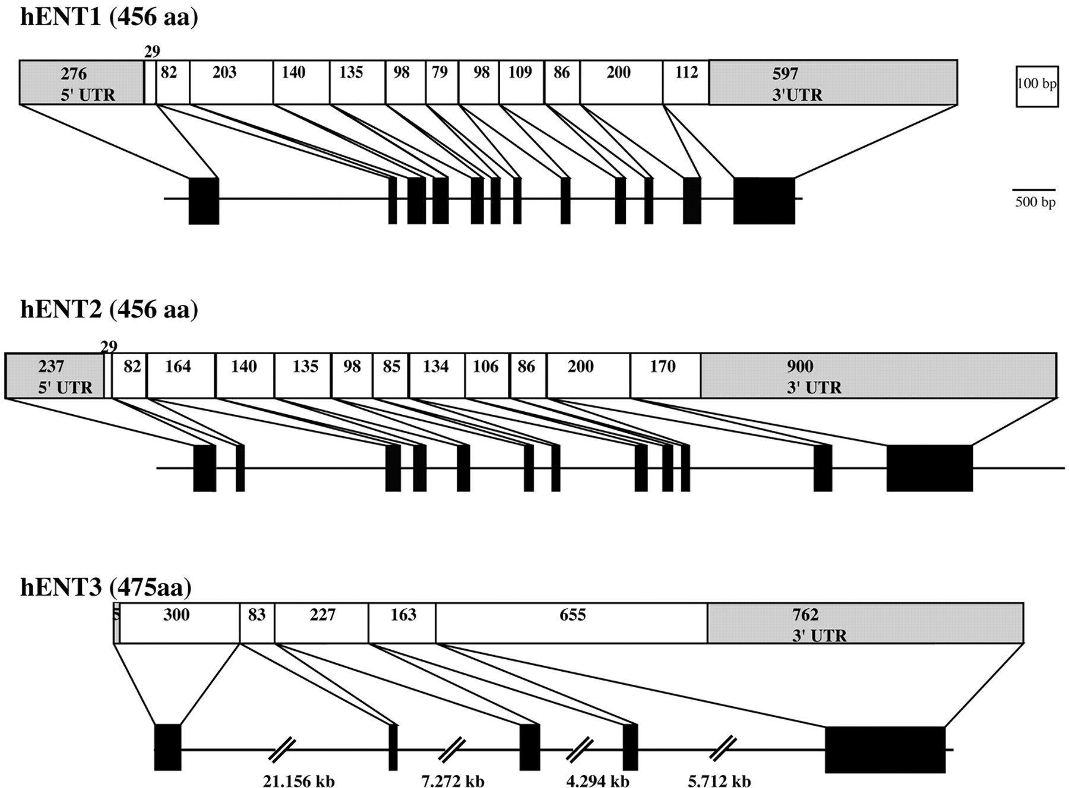
Figure 1. Gene structure of the human ENTs. Filled black boxes represent exons and thin lines represent ...
Notes:
Figure 1. Gene structure of the human ENTs. Filled black boxes represent exons and thin lines represent introns and flanking regions. Above each gene the spliced mRNA structure is shown. Clear boxes represent the ORF, grey boxes represent the UTR. Numbers inside the boxes represent the number of bases encoding each region.
Unless provided in the caption above, the following copyright applies to the content of this slide:

Slide 2
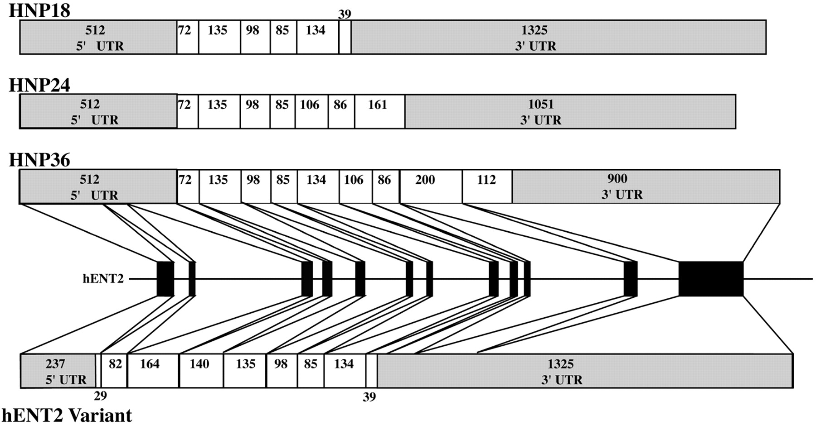
Figure 2. Structure of splice variants derived from the hENT2 gene. Layout is as described for Figure 1. The ...
Notes:
Figure 2. Structure of splice variants derived from the hENT2 gene. Layout is as described for Figure 1. The HNP family consists of an extended 5′‐UTR and a truncated N‐terminal region of the ORF compared to hENT2. Each HNP family member has a different stop site resulting in variable C‐terminals. For hENT2v, transcriptional initiation is identical to hENT2 but the ORF of the transcript is truncated at the same site as HNP18.
Unless provided in the caption above, the following copyright applies to the content of this slide:

Slide 3
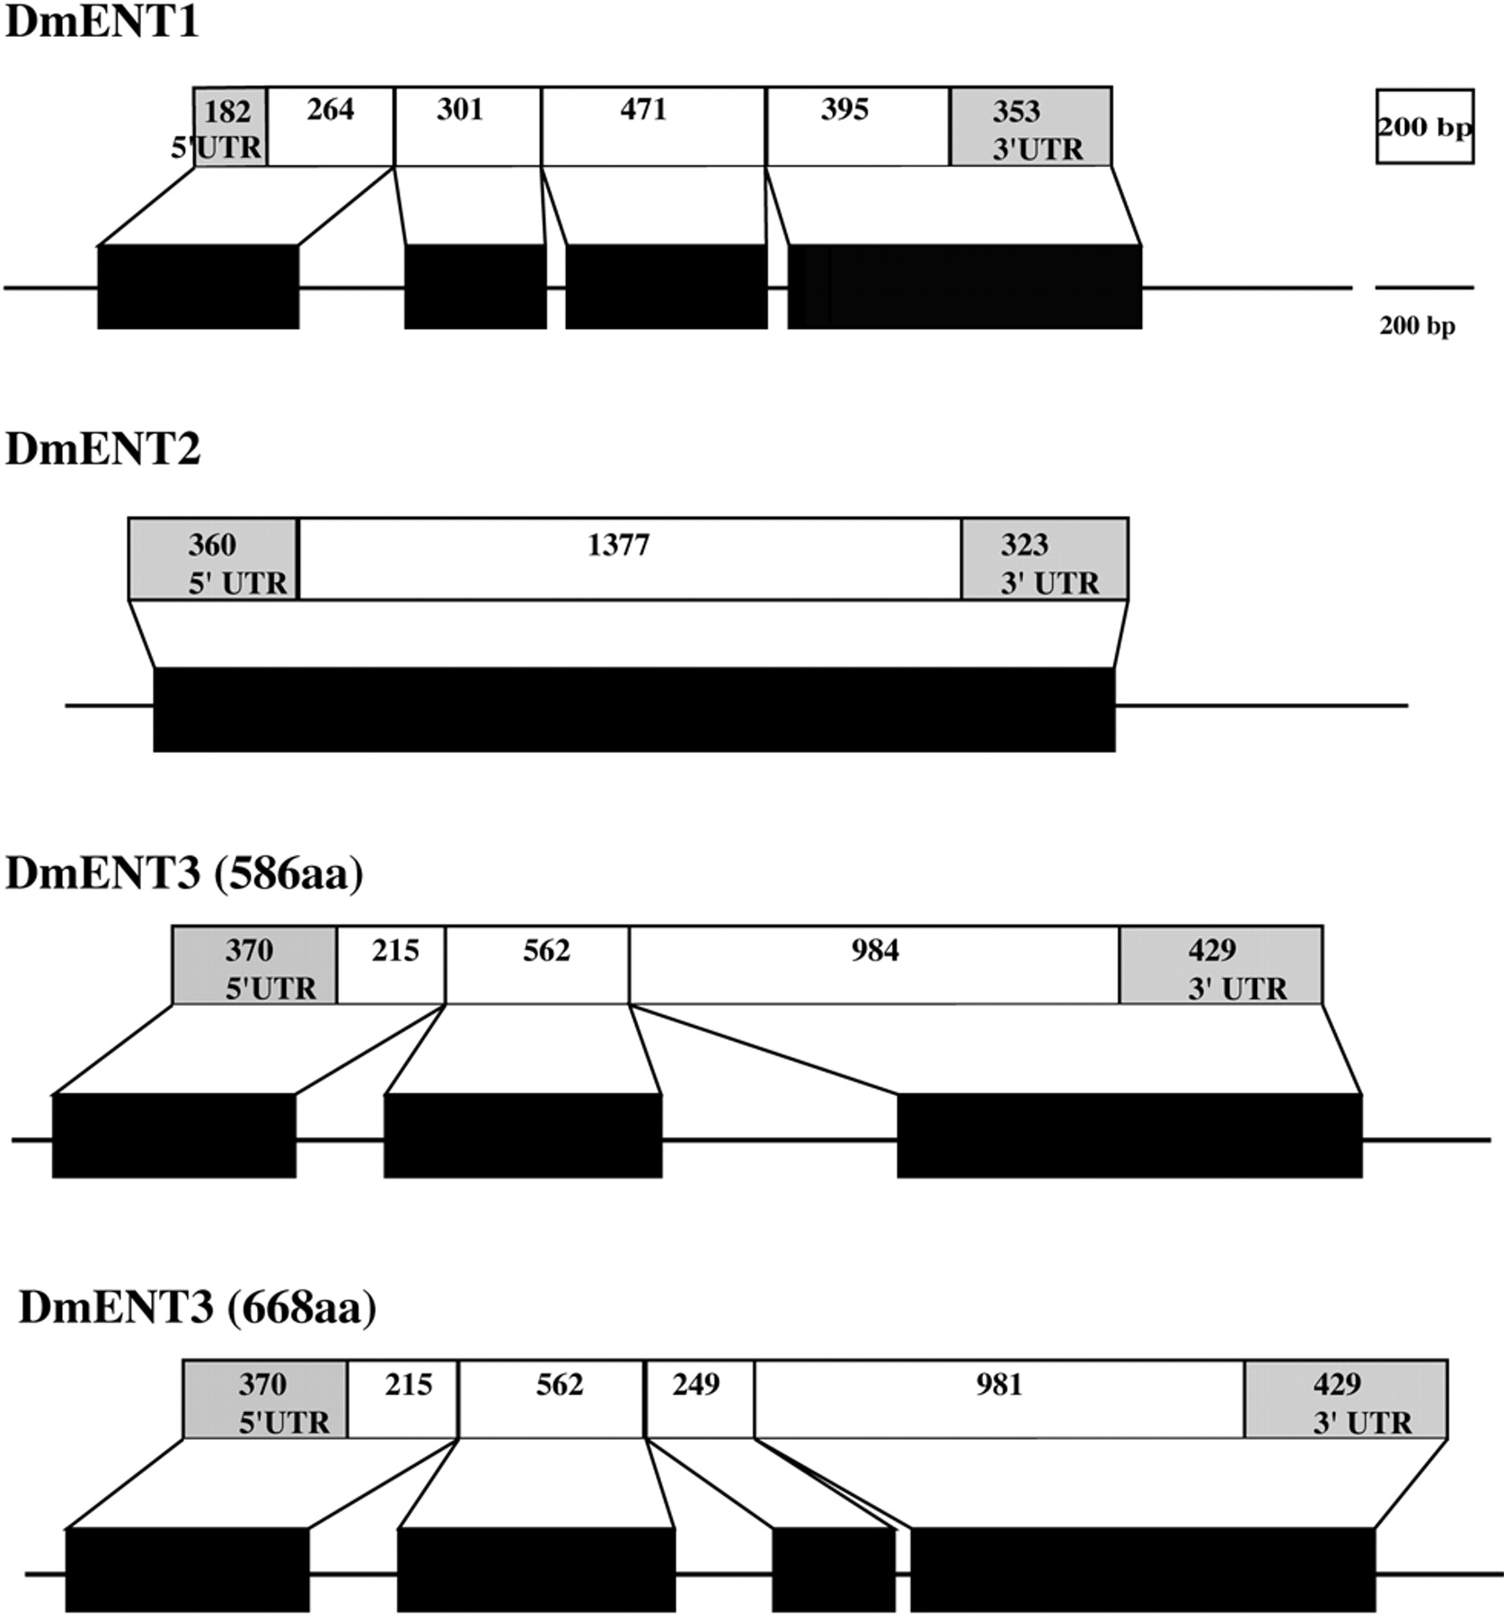
Figure 3. Gene structure of the Drosophila ENTs. Layout is as described for Figure 1.
Notes:
Figure 3. Gene structure of the Drosophila ENTs. Layout is as described for Figure 1.
Unless provided in the caption above, the following copyright applies to the content of this slide:

Slide 4
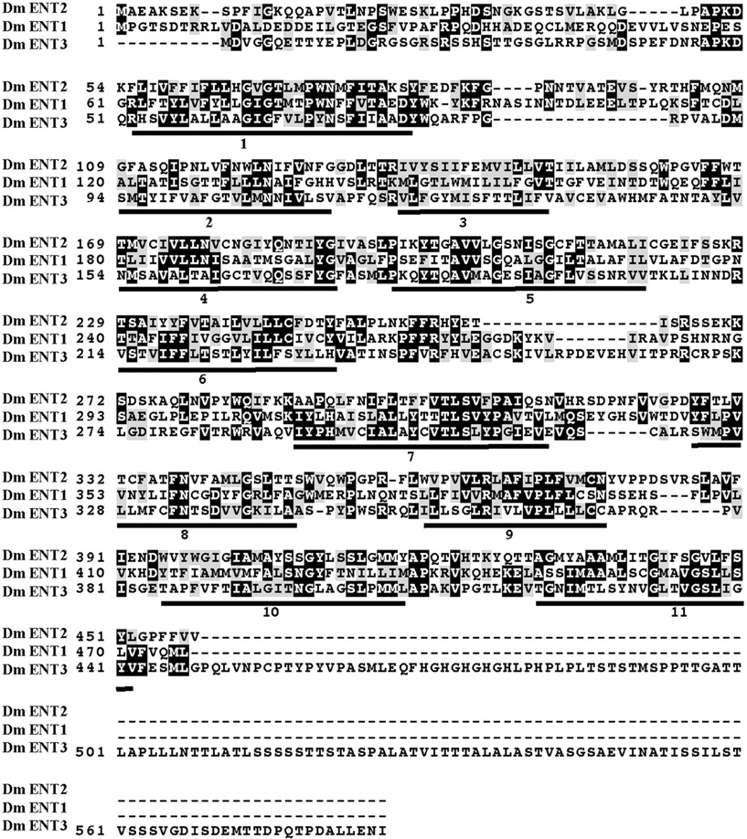
Figure 4. Alignment of three D.melanogaster ENT predicted proteins using Clustal X (v.1.8). Black shaded ...
Notes:
Figure 4. Alignment of three D.melanogaster ENT predicted proteins using Clustal X (v.1.8). Black shaded amino acids are conserved between proteins, grey shaded amino acids are similar (conservative substitutions). Numbered bars below sequences represent putative transmembrane domains.
Unless provided in the caption above, the following copyright applies to the content of this slide:

Slide 5
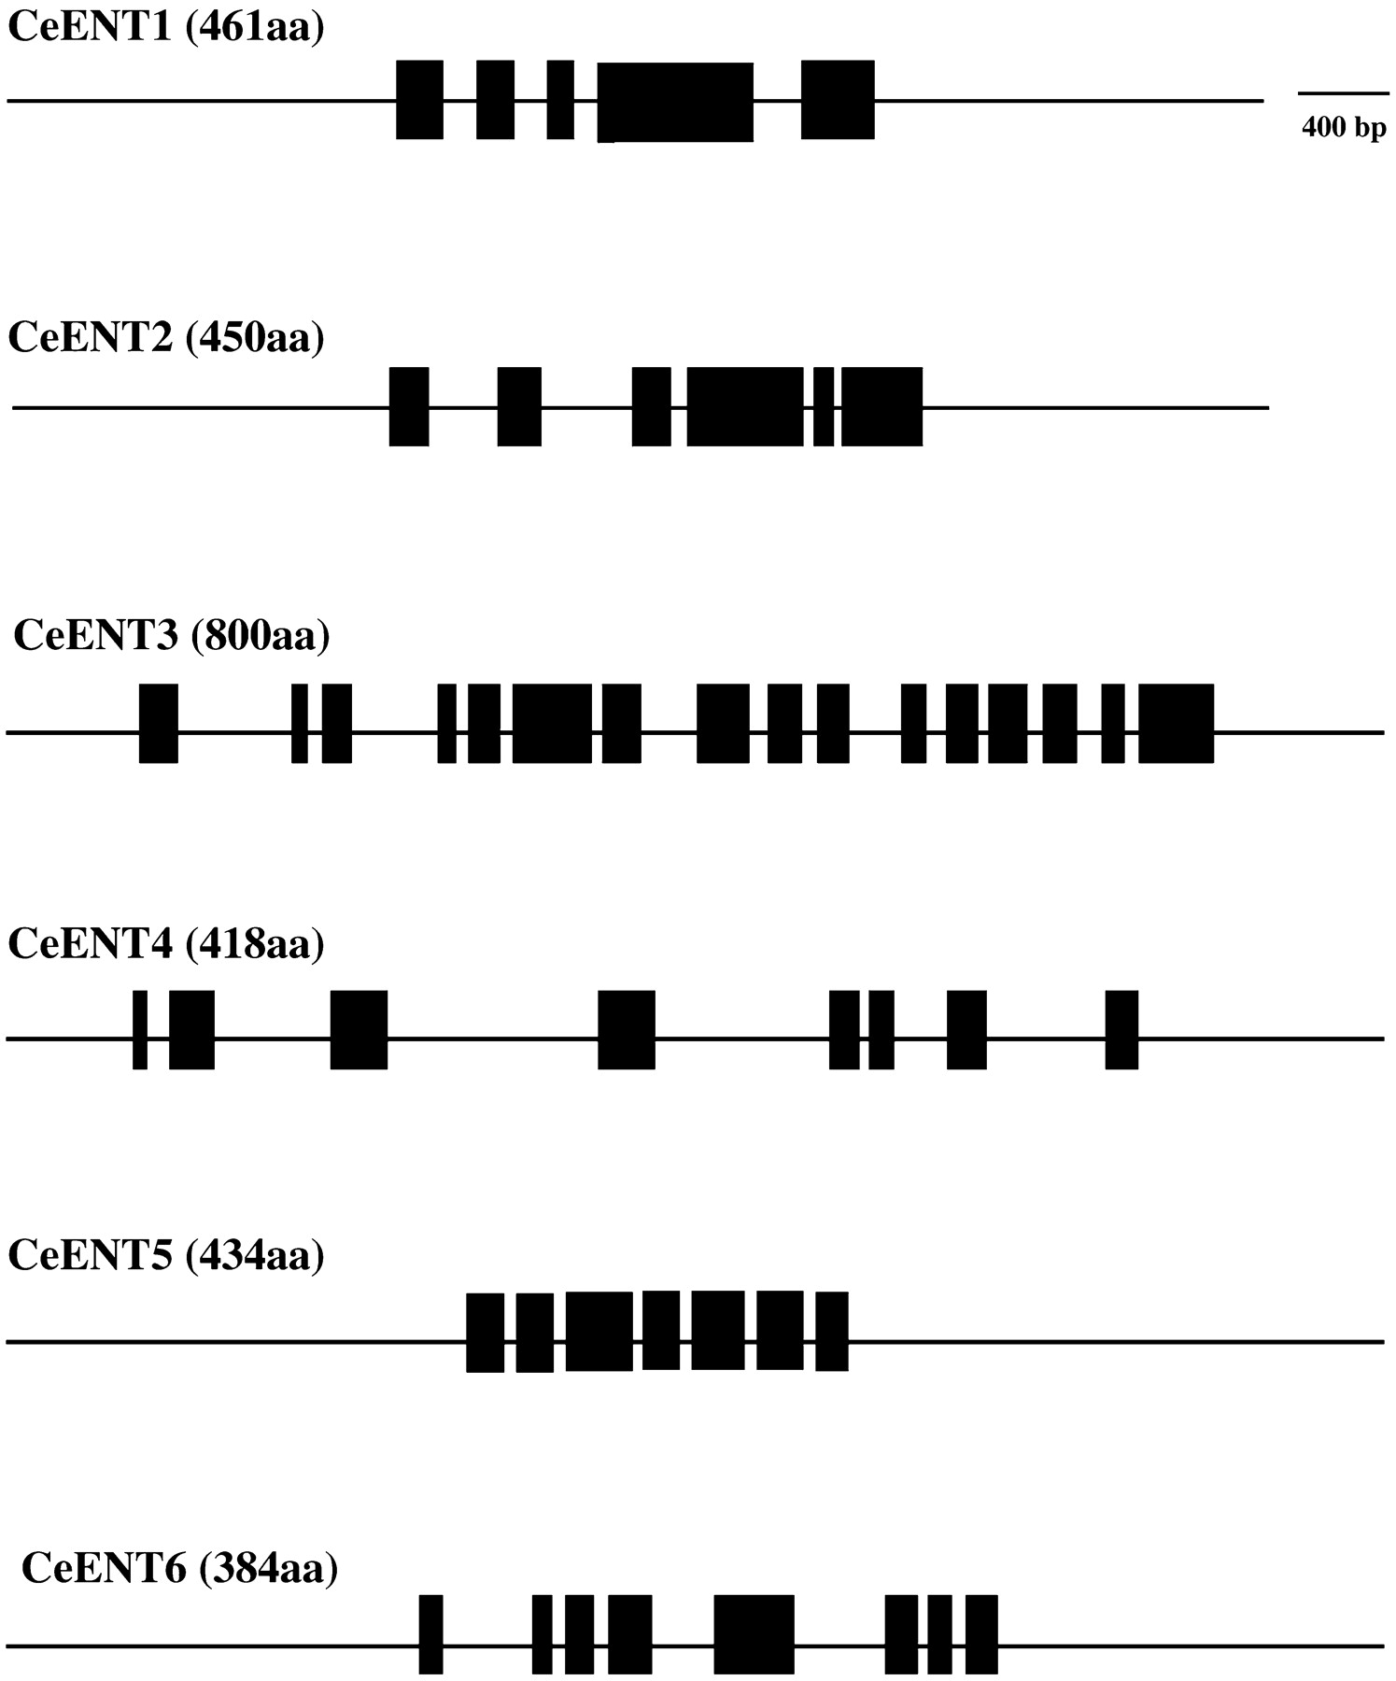
Figure 5. Gene structure of the C.elegans ENTs. Layout is as described in Figure 1. For clarity, predicted ...
Notes:
Figure 5. Gene structure of the C.elegans ENTs. Layout is as described in Figure 1. For clarity, predicted mRNA structures are not shown.
Unless provided in the caption above, the following copyright applies to the content of this slide:

Slide 6
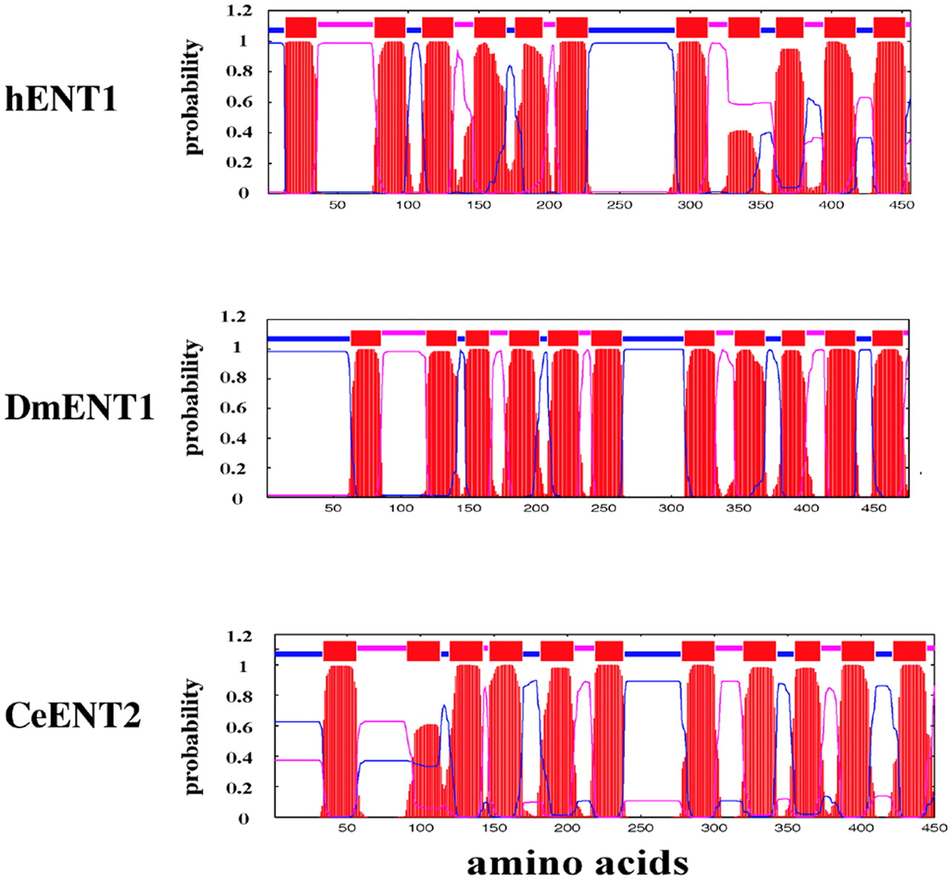
Figure 6. Predicted topologies for members of the human, D.melanogaster and C.elegans ENT families. The ...
Notes:
Figure 6. Predicted topologies for members of the human, D.melanogaster and C.elegans ENT families. The analysis is based on TMHMM 2.0 as described in Materials and Methods. Red bars and peaks represent putative transmembrane domains. Blue lines represent putative intracellular portions of the protein; pink lines represent putative extracellular portions of the protein.
Unless provided in the caption above, the following copyright applies to the content of this slide:

