Slide 1
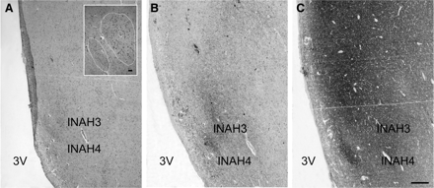
Fig. 1 Representative photomicrographs depicting the uncinate nucleus in a thionin (A), NPY (B) or SYN (C) staining. ...
Notes:
Fig. 1 Representative photomicrographs depicting the uncinate nucleus in a thionin (A), NPY (B) or SYN (C) staining. NBB (Netherlands Brain Bank) # 98169, man 49 years old, INAH3 and 4: interstitial nuclei of the anterior hypothalamus 3 and 4, 3V: third ventricle. Scale bar = 500 µm. The insert in (A) is indicating the INAH3 and INAH4 subdivisions (shown by dotted line) that are characterized by a denser NPY and SYN innervation in (B) and (C). Scale bar = 63 μm.
Unless provided in the caption above, the following copyright applies to the content of this slide: © The Author (2008). Published by Oxford University Press on behalf of the Guarantors of Brain. All rights reserved. For Permissions, please email: journals.permissions@oxfordjournals.org

Slide 2
Fig. 2 Representative immunocytochemical staining of the NPY innervation of the uncinate nucleus showing the three ...
Notes:
Fig. 2 Representative immunocytochemical staining of the NPY innervation of the uncinate nucleus showing the three different types: (A) typical horse-shoe shape, in which fornix fibers do not completely bisect the nucleus, (B) the two subdivisions of the Un clearly divided by fornix fibers, originally called INAH3 and INAH4 and (C) the nucleus as just one part, considered to be the INAH4 (A NBB # 98031 man 33 years old, B NBB # 98006 man 50 years old, C NBB # 91009 woman 36 years old. INAH3 and 4: interstitial nuclei of the anterior hypothalamus 3 and 4, 3V: third ventricle. Scale bar = 250 µm.
Unless provided in the caption above, the following copyright applies to the content of this slide: © The Author (2008). Published by Oxford University Press on behalf of the Guarantors of Brain. All rights reserved. For Permissions, please email: journals.permissions@oxfordjournals.org

Slide 3
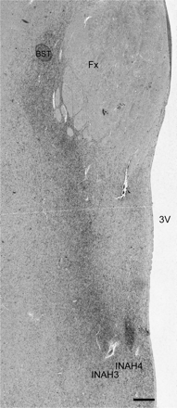
Fig. 3 Photomicrographs depicting the dense band of NPY fibers which connect the bed nucleus of the stria terminalis ...
Notes:
Fig. 3 Photomicrographs depicting the dense band of NPY fibers which connect the bed nucleus of the stria terminalis and the uncinate nucleus (A) NBB # 83004, virilized woman of 46 years of age with an adrenal tumour. Because the adrenal tumour was giving rise to high cortisol, androstendione and testosterone plasma levels, this patient was not included in the measurements. Fx = fornix, INAH3 and 4: interstitial nuclei of the anterior hypothalamus 3 and 4, 3V: third ventricle. Note the extra dense innervation of INAH3 and 4. Scale bar = 250 µm.
Unless provided in the caption above, the following copyright applies to the content of this slide: © The Author (2008). Published by Oxford University Press on behalf of the Guarantors of Brain. All rights reserved. For Permissions, please email: journals.permissions@oxfordjournals.org

Slide 4
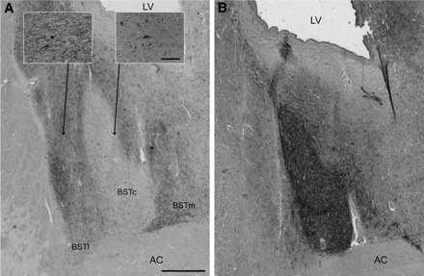
Fig. 4 Innervations of the different subdivisions of the BST by NPY (A) and somatostatin (B). Note that the two ...
Notes:
Fig. 4 Innervations of the different subdivisions of the BST by NPY (A) and somatostatin (B). Note that the two stainings are complementary. The two inserts in (A) show the difference in the density of NPY fibers and cells in lateral/medial BST and in central BST subdivision Scale bar = 50 μm. LV: lateral ventricle, AC = anterior commisure; BSTl, c, m = Bed nucleus of the stria terminalis lateral, central and medial subnucleus. Scale bars = 375 µm.
Unless provided in the caption above, the following copyright applies to the content of this slide: © The Author (2008). Published by Oxford University Press on behalf of the Guarantors of Brain. All rights reserved. For Permissions, please email: journals.permissions@oxfordjournals.org

Slide 5
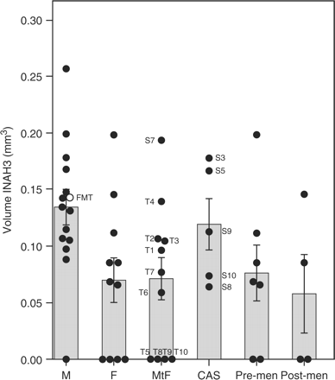
Fig. 5 INAH3 volume in thionin staining in different groups, according to their gender identity and hormonal changes ...
Notes:
Fig. 5 INAH3 volume in thionin staining in different groups, according to their gender identity and hormonal changes in adulthood. (M) control male group, (F) control female group, (MtF) male-to-female transsexual group, (CAS) castrated male group, (PreM) pre-menopausal women, (PostM) post-menopausal women. Bars represent means and standard errors of the mean (SEM). MtF and F groups were statistically different compared to the M group (P < 0.018 and P < 0.013, respectively). Hormonal changes in adulthood (CAS versus M and PreM versus PostM groups) showed no difference in INAH3 volume. Note that the volume of the female-to-male transsexual subject (FTM, in the male group, 51 years old) is in the male range. A gender dysphoric male-to-female patient who was not treated in any way (S7, in the MtF group, 84 years old) showed a male value for INAH3 volume.
Unless provided in the caption above, the following copyright applies to the content of this slide: © The Author (2008). Published by Oxford University Press on behalf of the Guarantors of Brain. All rights reserved. For Permissions, please email: journals.permissions@oxfordjournals.org

Slide 6
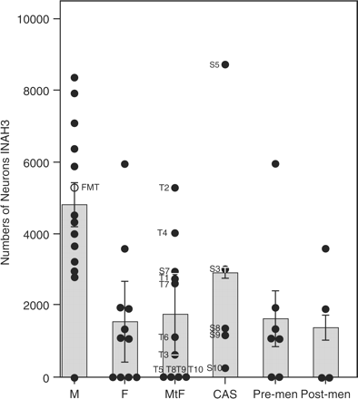
Fig. 6 INAH3 number of neurons. Distribution of the INAH3 number of neurons among different groups. (M) control male ...
Notes:
Fig. 6 INAH3 number of neurons. Distribution of the INAH3 number of neurons among different groups. (M) control male group, (F) control female group, (MtF) transsexual male-to-female group, (CAS) castrated male group, (PreM) pre-menopausal women, (PostM) post-menopausal women. Bars represent means and SEM. Statistically differences were found among men (M) and women (F) (P < 0.029) and among men (M) and male-to-female transsexual groups (P < 0.002). A female-to-male transsexual person (FMT, in the male group, 51 years old) had a masculine INAH3 number of neurons while the gender dysphoric non-treated patient (S7, in the MtF group, 84 years old) had a similar number of neurons to the other transsexuals examined.
Unless provided in the caption above, the following copyright applies to the content of this slide: © The Author (2008). Published by Oxford University Press on behalf of the Guarantors of Brain. All rights reserved. For Permissions, please email: journals.permissions@oxfordjournals.org

Slide 7
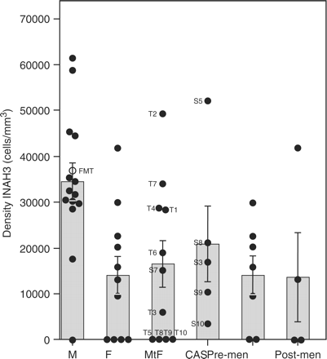
Fig. 7 Density of neurons in INAH3 in different groups: M = control male group; F = control female group; MtF = ...
Notes:
Fig. 7 Density of neurons in INAH3 in different groups: M = control male group; F = control female group; MtF = transsexual male-to-female group; CAScastrated male group; PreM = pre-menopausal women; PostM = post-menopausal women. Bars represent means and the SEM. A sex difference was found among men (M) and women (F) (P < 0.01) and any other difference was found. The female-to-male transsexual person (FMT, in male group, 51 years old) had a masculine density for the INAH3 while the gender dysphoric non-treated patient (S7, in the MtF group, 84 years old) had a similar value to the other transsexuals examined.
Unless provided in the caption above, the following copyright applies to the content of this slide: © The Author (2008). Published by Oxford University Press on behalf of the Guarantors of Brain. All rights reserved. For Permissions, please email: journals.permissions@oxfordjournals.org

Slide 8
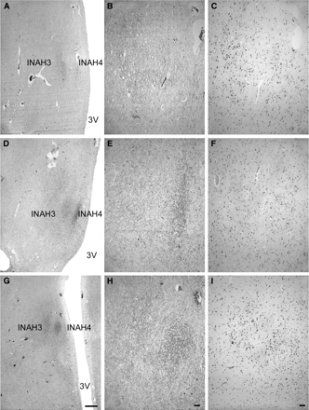
Fig. 8 Representative photomicrographs of the uncinate nucleus in three different groups in consecutive sections (A, ...
Notes:
Fig. 8 Representative photomicrographs of the uncinate nucleus in three different groups in consecutive sections (A, B and C: NBB # 00131 male 25 years old; D, E and F: NBB # 01011 female 46 years old; G, H and I: NBB # 84037 transsexual male-to-female 44 years old). A, D and G are low-power immunocytochemical stainings of NPY, INAH3 and 4: interstitial nucleus of the anterior hypothalamus 3 and 4, 3V: third ventricle. Scale bar = 500 µm. B, E and H: details of the innervation by NPY fibers and C, F and I: details of the thionin staining. Scale bar = 63 μm. Note that the male group shows a larger INAH3 and, in C, also a larger number of cells than the transsexual and female groups. The neuronal size is larger in INAH3 subdivision than in INAH4 (C, F and I). It is also noticeable how INAH3 contains more neurons and extension in the male group (C) than in the other two groups (F and I).
Unless provided in the caption above, the following copyright applies to the content of this slide: © The Author (2008). Published by Oxford University Press on behalf of the Guarantors of Brain. All rights reserved. For Permissions, please email: journals.permissions@oxfordjournals.org

