Slide 1
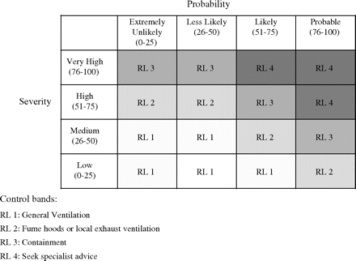
Fig. 1. RL matrix as a function of severity and probability. Control bands are based on overall RL.
Notes:
Fig. 1. RL matrix as a function of severity and probability. Control bands are based on overall RL.
Unless provided in the caption above, the following copyright applies to the content of this slide: © The Author 2008. Published by Oxford University Press on behalf of the British Occupational Hygiene Society

