Slide 1
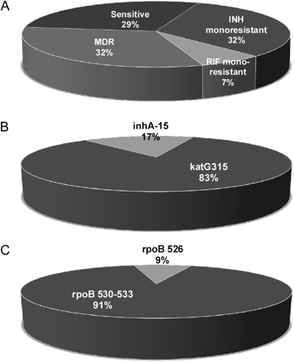
Figure 1. Phenotype and genotype of drug resistance in Mycobacterium tuberculosis isolates from patients with ...
Notes:
Figure 1. Phenotype and genotype of drug resistance in Mycobacterium tuberculosis isolates from patients with tuberculous meningitis (TBM). A total of 20 drug-resistant strains were detected in 30 cerebrospinal fluid samples from patients with TBM; the resistance is presented as the percentage of resistant isolates (A). Mutations in the kat315 and inhA genes were detected among 18 isoniazid (INH)–resistant strains; the frequencies of the 2 mutations are shown (B). Mutations in rpoB 530-533 and rpoB526 were detected among rifampicin (RIF)–resistant strains; the frequencies of the 2 mutations in rpoB gene are shown (C). MDR, multidrug-resistant.
Unless provided in the caption above, the following copyright applies to the content of this slide: © The Author 2011. Published by Oxford University Press on behalf of the Infectious Diseases Society of America. All rights reserved. For Permissions, please e-mail: journals.permissions@oup.com.

