Slide 1
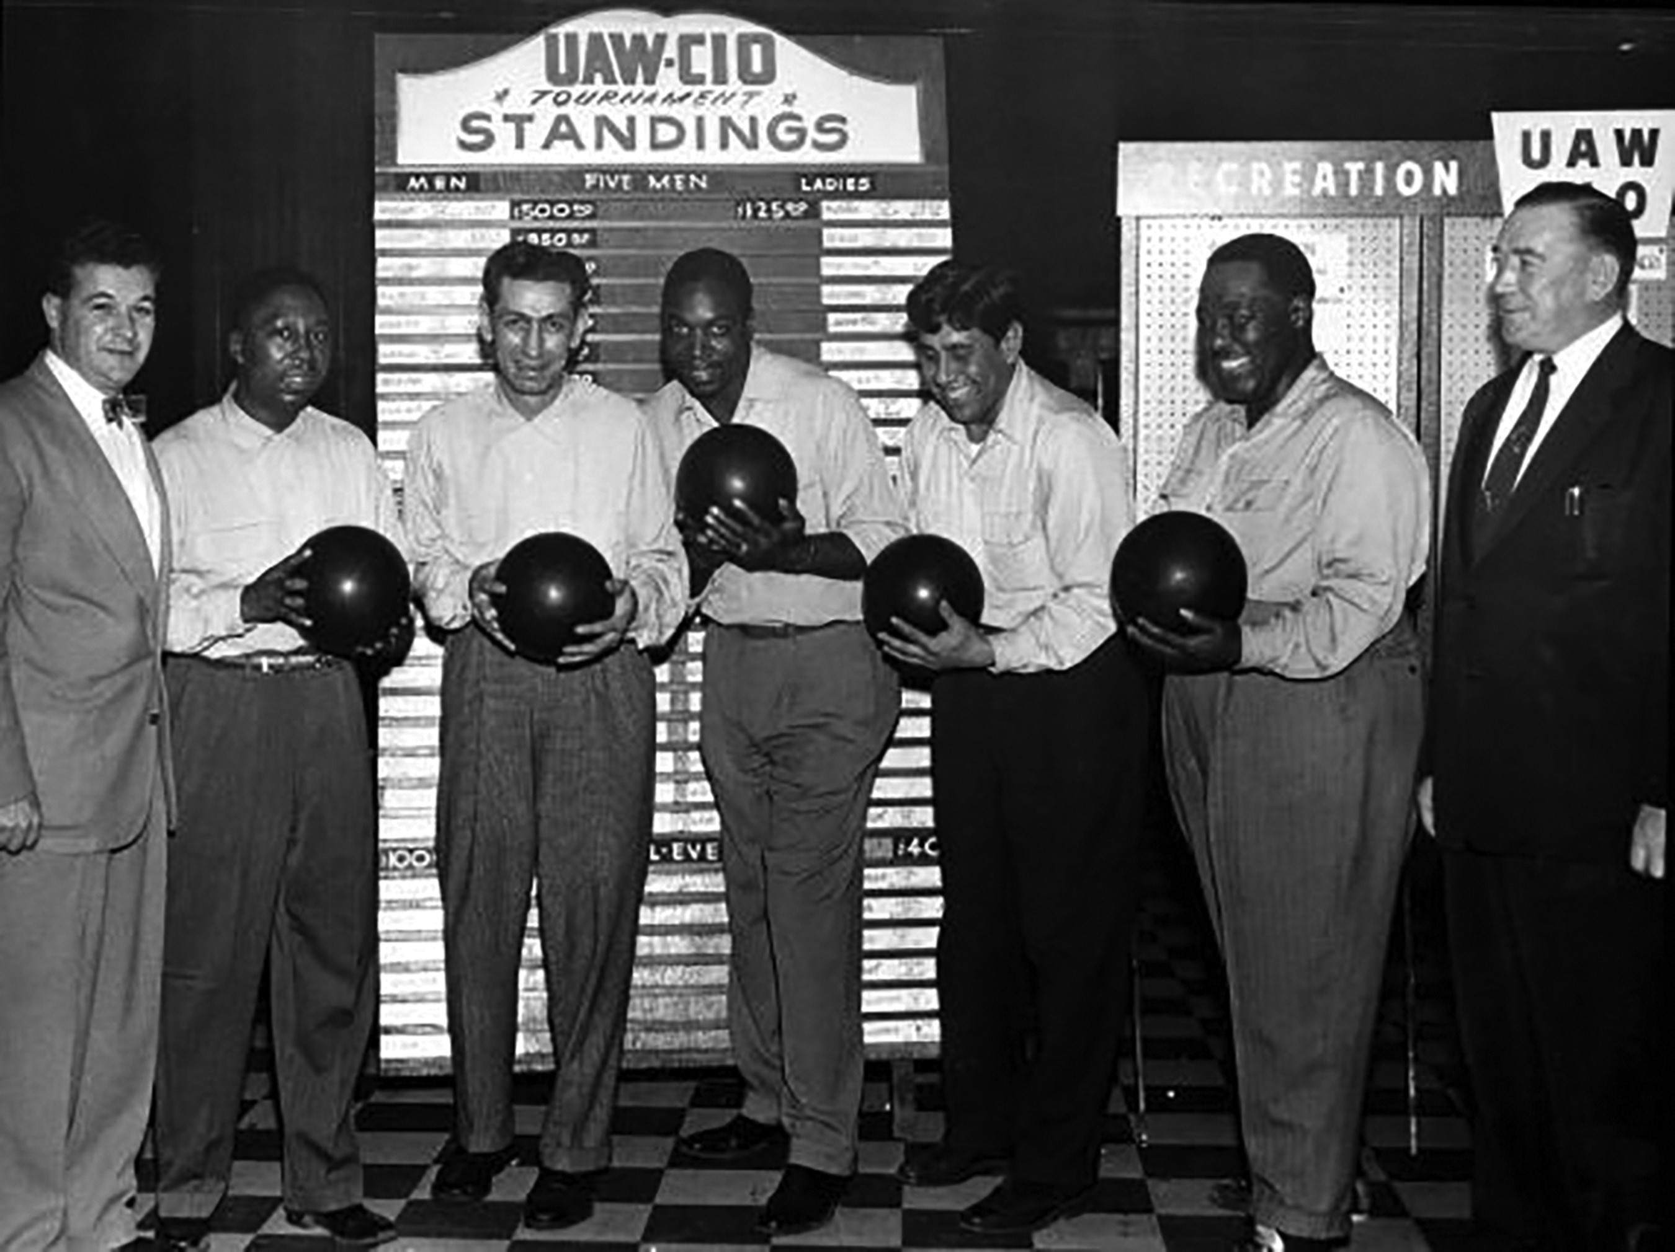
Image 1. UAW Annual Tournament, 1955. Source: “Recreation, Bowling Tournament, Detroit, Michigan,” February 12, 1955, ...
Notes:
Image 1. UAW Annual Tournament, 1955. Source: “Recreation, Bowling Tournament, Detroit, Michigan,” February 12, 1955, Photo ID: 364, Walter P. Reuther Library, Archive of Labor and Urban Affairs, Detroit, Michigan, Detroit, Michigan.
Unless provided in the caption above, the following copyright applies to the content of this slide: © The Author 2017. Published by Oxford University Press. All rights reserved. For permissions, please e-mail: journals.permissions@oup.comThis article is published and distributed under the terms of the Oxford University Press, Standard Journals Publication Model (https://academic.oup.com/journals/pages/about_us/legal/notices)

Slide 2
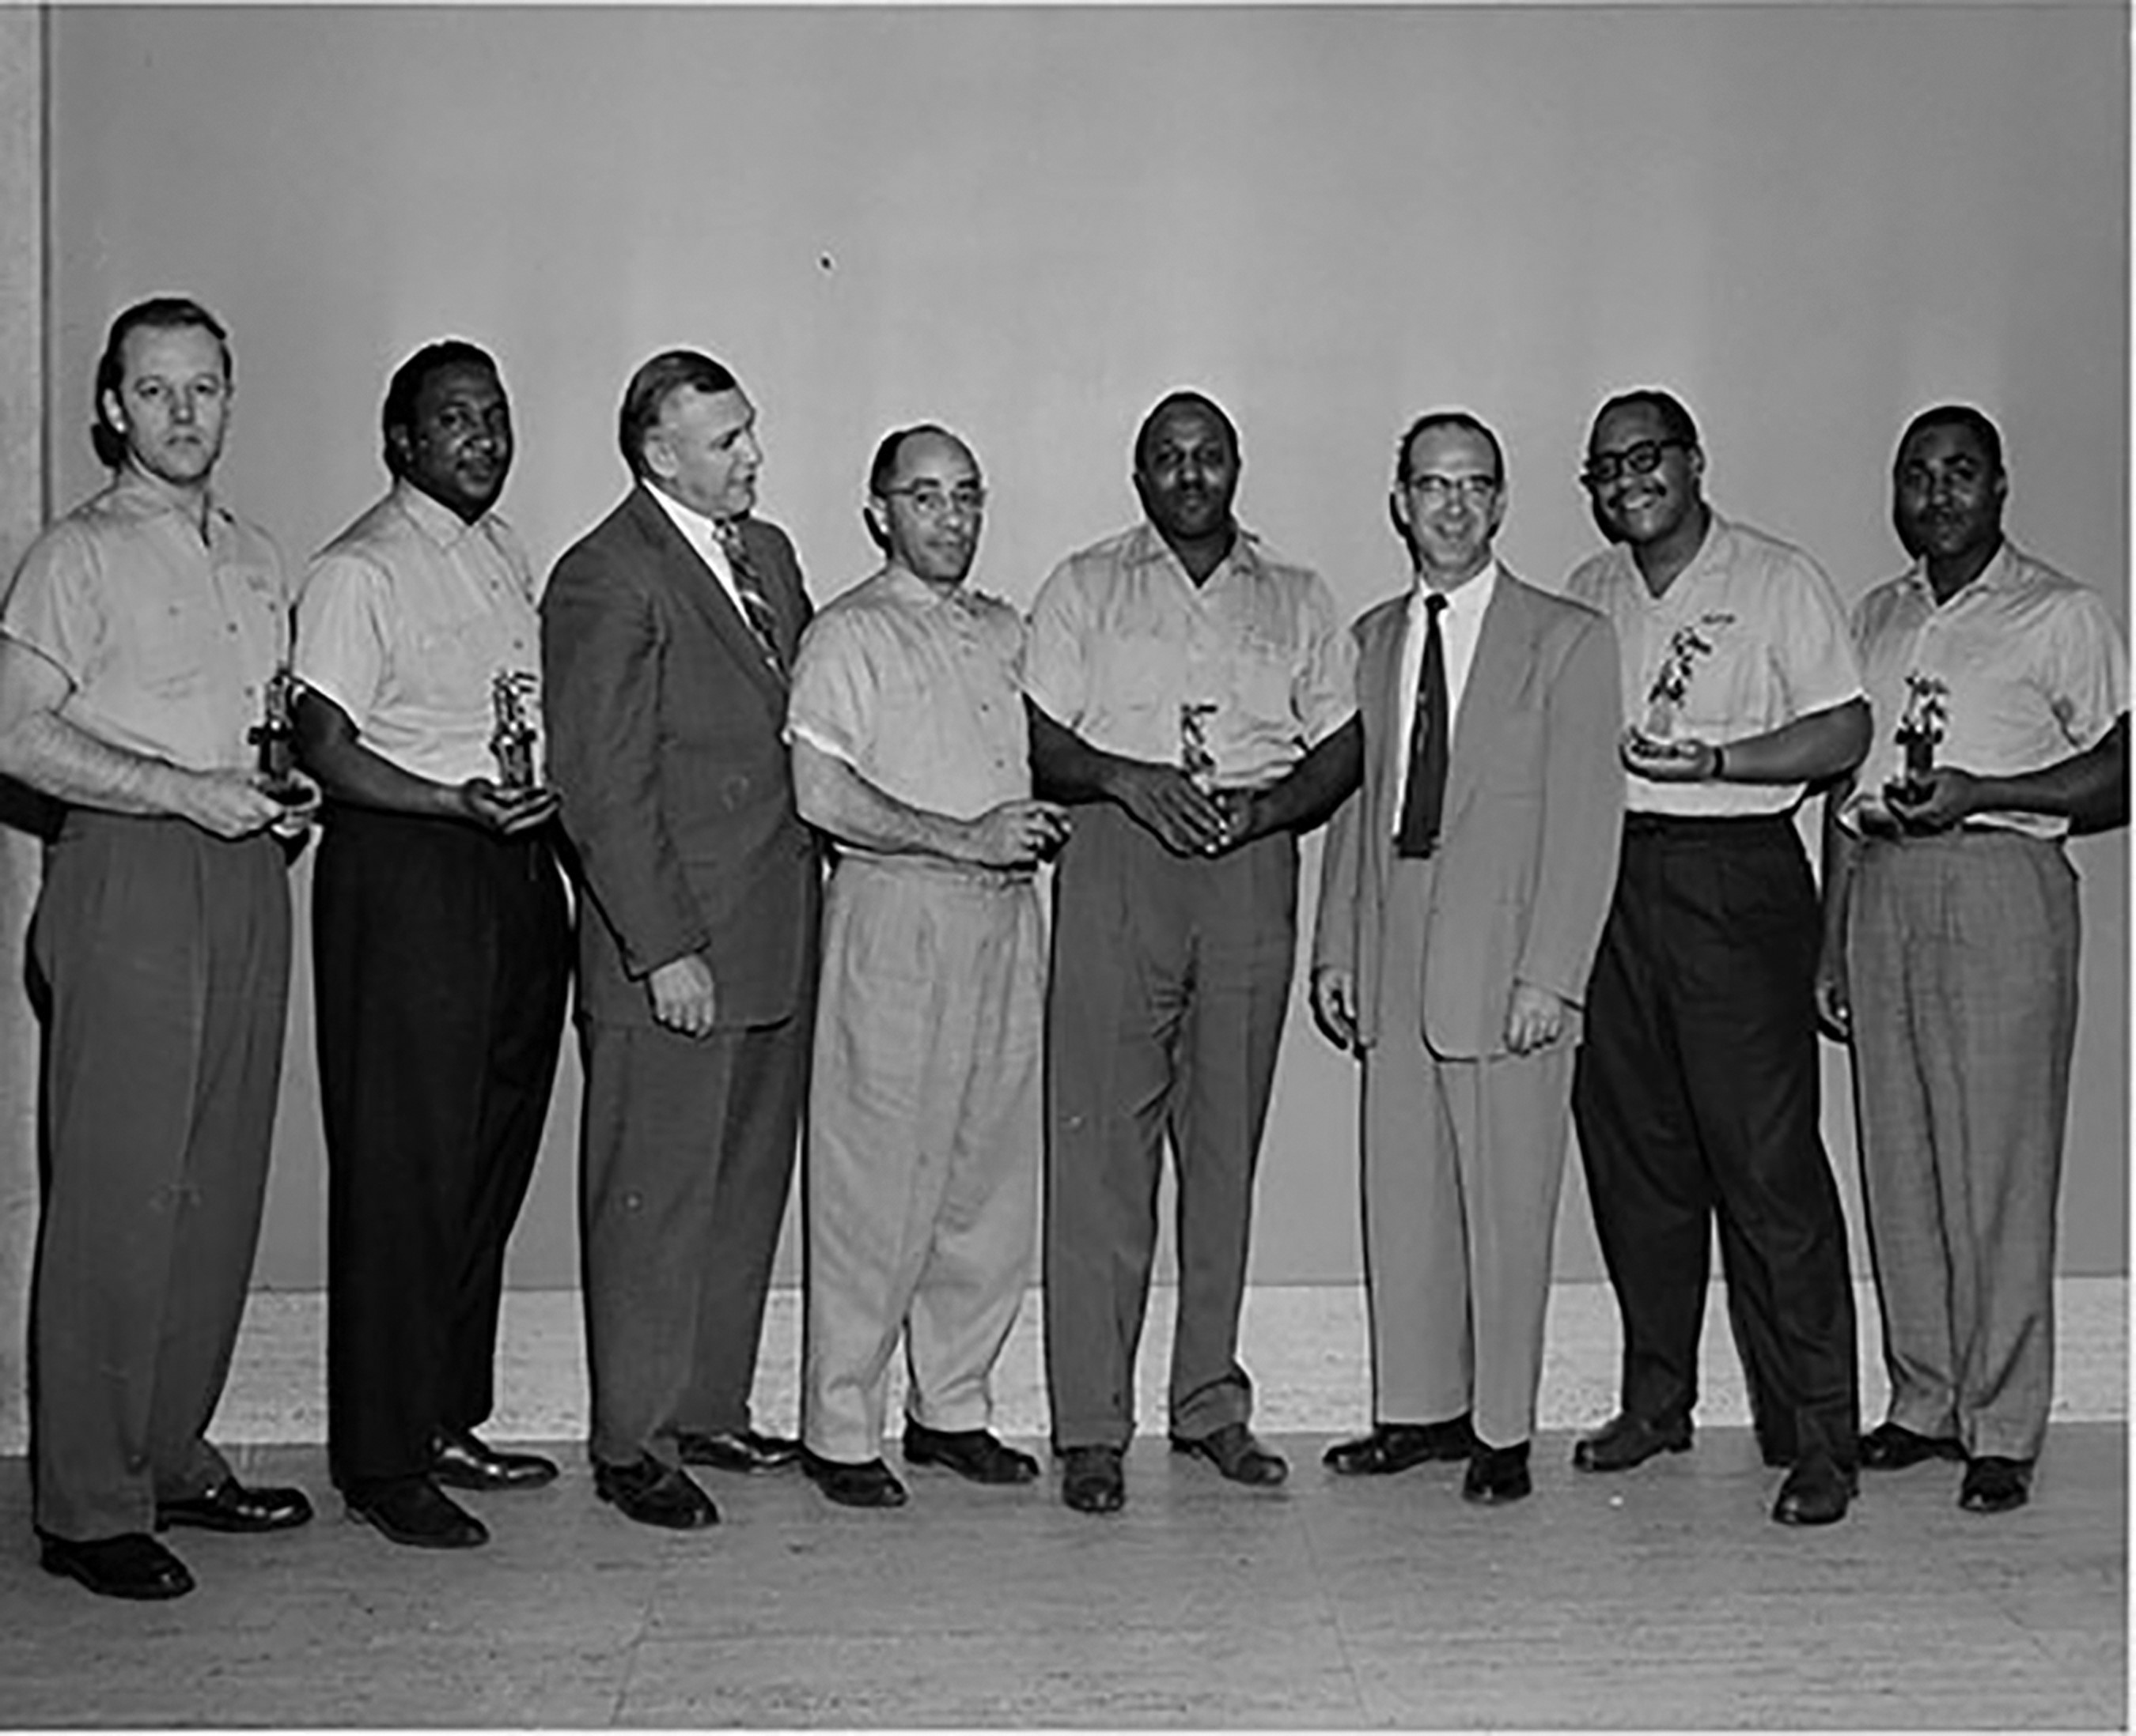
Image 2. UAW Local 49 Champions, Region 1 and 1A, undated (probably 1949). Source: Labor Album, Walter P. Reuther ...
Notes:
Image 2. UAW Local 49 Champions, Region 1 and 1A, undated (probably 1949). Source: Labor Album, Walter P. Reuther Library, Archive of Labor and Urban Affairs, Detroit, Michigan.
Unless provided in the caption above, the following copyright applies to the content of this slide: © The Author 2017. Published by Oxford University Press. All rights reserved. For permissions, please e-mail: journals.permissions@oup.comThis article is published and distributed under the terms of the Oxford University Press, Standard Journals Publication Model (https://academic.oup.com/journals/pages/about_us/legal/notices)

Slide 3
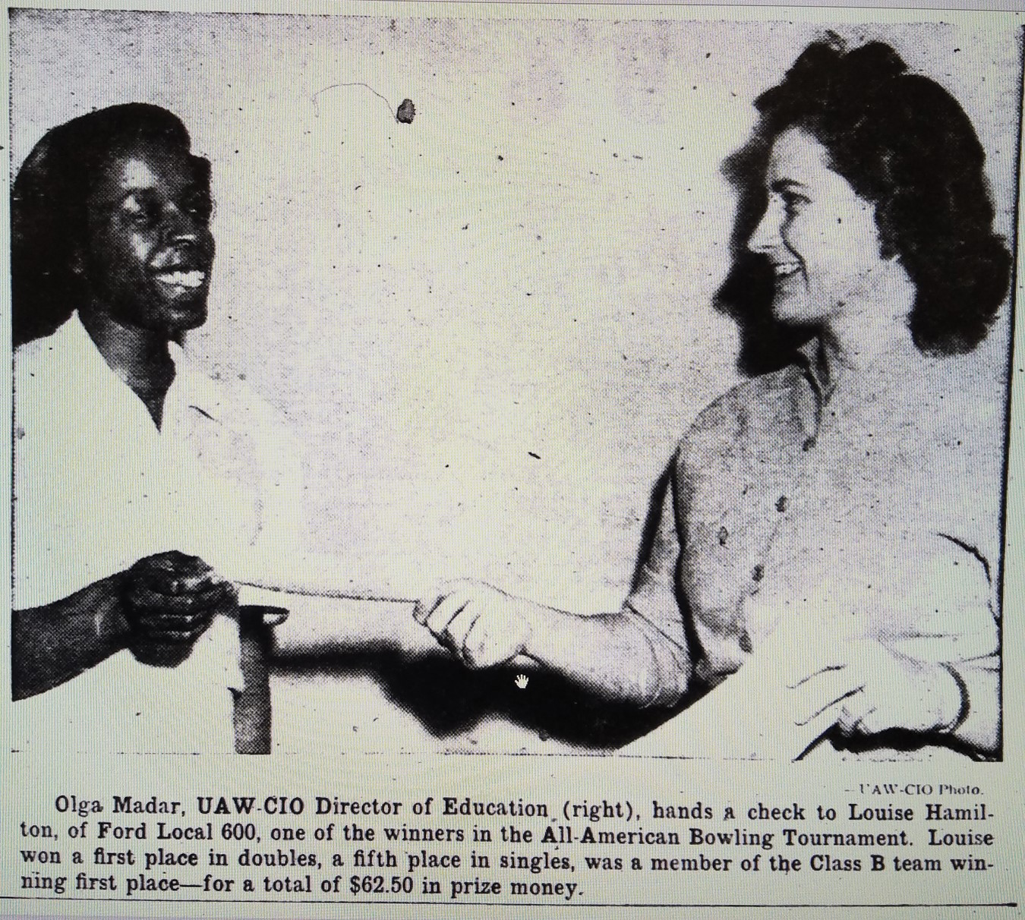
Image 3. Olga Madar congratulates Louise Hamilton on her first place doubles victory. Source: UAW, February 1948, 11.
Notes:
Image 3. Olga Madar congratulates Louise Hamilton on her first place doubles victory. Source: UAW, February 1948, 11.
Unless provided in the caption above, the following copyright applies to the content of this slide: © The Author 2017. Published by Oxford University Press. All rights reserved. For permissions, please e-mail: journals.permissions@oup.comThis article is published and distributed under the terms of the Oxford University Press, Standard Journals Publication Model (https://academic.oup.com/journals/pages/about_us/legal/notices)

