Slide 1
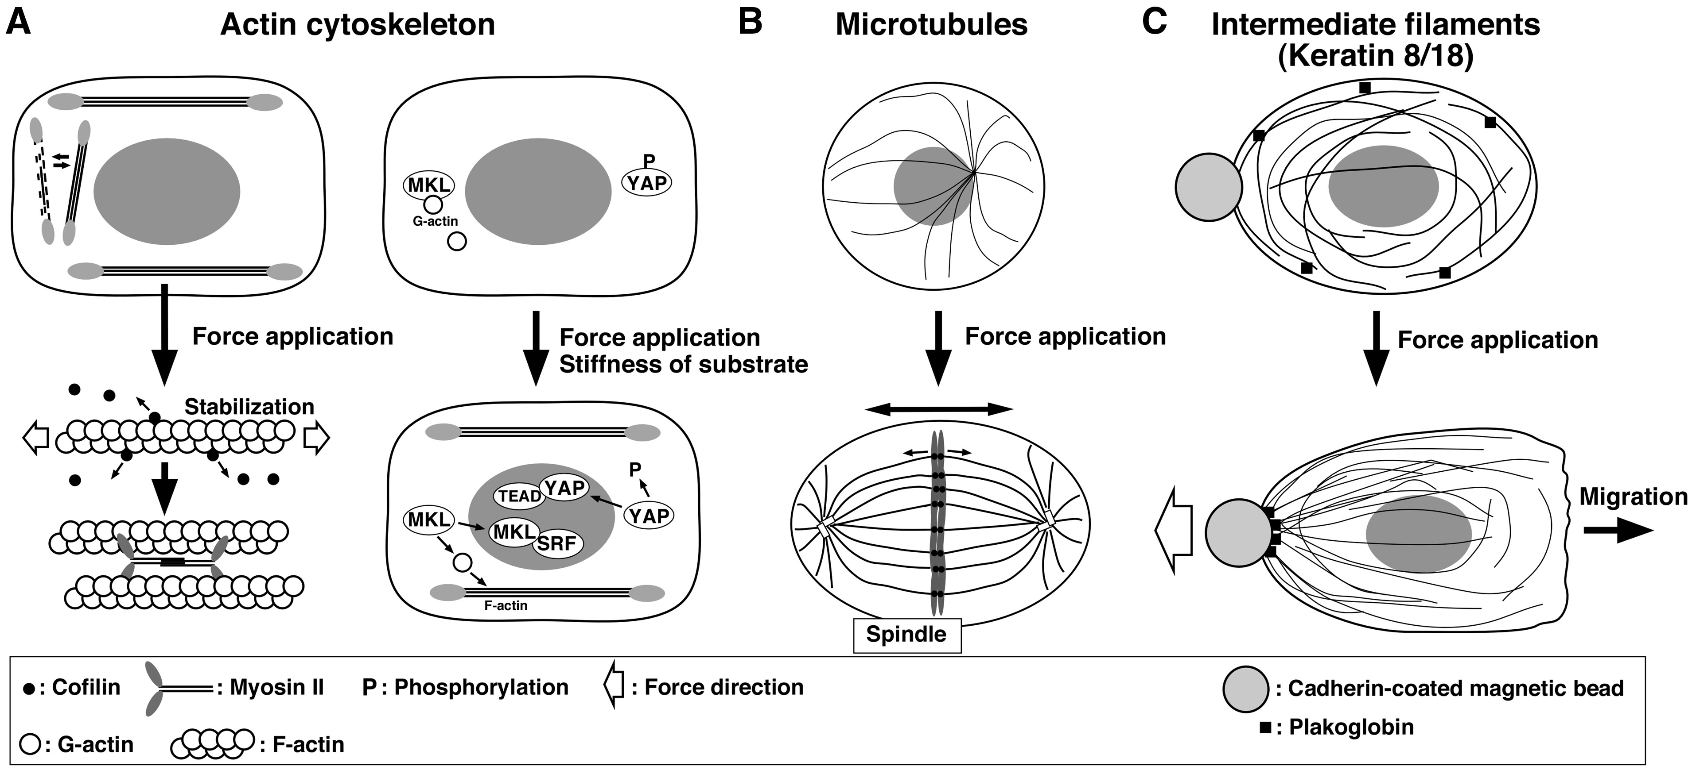
Fig. 1 Roles of the cytoskeleton in mechanosensing and mechanoresponses. (A) Actin cytoskeleton. (Left) When a cell ...
Notes:
Fig. 1 Roles of the cytoskeleton in mechanosensing and mechanoresponses. (A) Actin cytoskeleton. (Left) When a cell is stretched, actin filaments oriented parallel to the direction of stretch are extended, which facilitates cofilin dissociation and myosin II association, resulting in stabilization of the actin stress fibres. In contrast, relaxed actin filaments favour cofilin binding, which probably promotes disassembly of actin filaments. (Right) Mechanical stress-induced actin filament assembly stimulates the nuclear translocation and activity of the transcription co-activators, YAP and MKL. (B) Microtubules. Stretching of a cell orients the spindle parallel to the direction of stretch, which determines the orientation of cell division. (C) Intermediate filaments. When a cell is pulled by cadherin-coated magnetic beads, plakoglobin and K8/K18 filaments accumulate and are reorganized at the cell-bead adhesion site, which helps cells to migrate in the direction opposite to the pulling force.
Unless provided in the caption above, the following copyright applies to the content of this slide: © The Authors 2017. Published by Oxford University Press on behalf of the Japanese Biochemical Society. All rights reserved

Slide 2
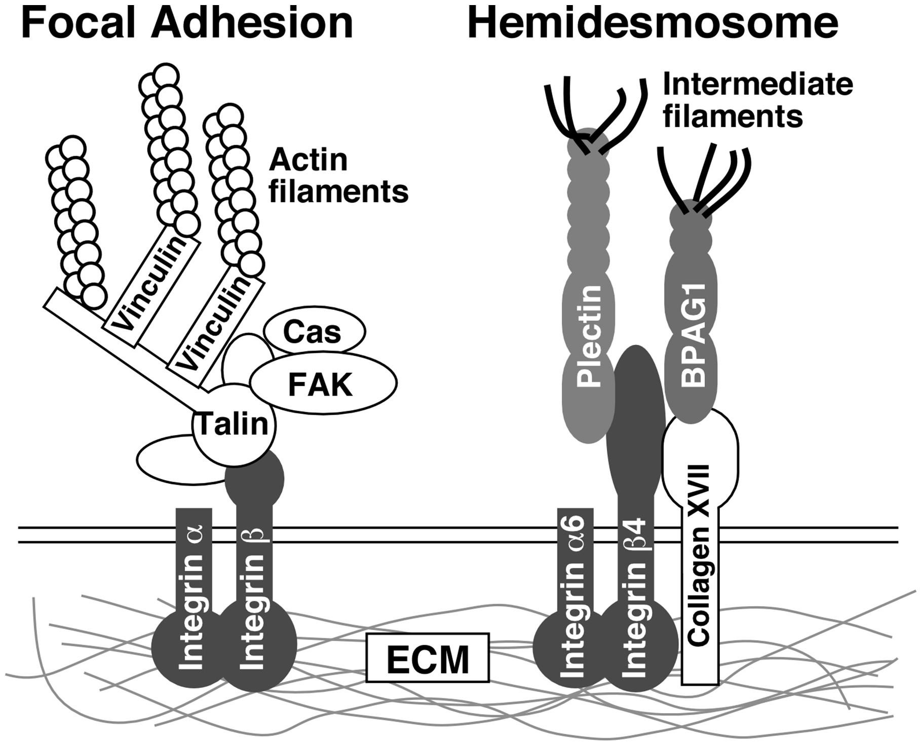
Fig. 2 Structures of focal adhesions and hemidesmosomes. (Left) Focal adhesion (FA). FAs connect the extracellular ...
Notes:
Fig. 2 Structures of focal adhesions and hemidesmosomes. (Left) Focal adhesion (FA). FAs connect the extracellular matrix (ECM) to actin filaments. Integrins bind to the ECM via the extracellular domain and accumulate many FA proteins, including talin, FAK, p130Cas and vinculin, to form FA. Talin is a key molecule for mechanosensing at FAs. Talin links β-integrin to actin filaments. Exertion of tensile force on FAs causes exposure of the vinculin-binding site of talin by force-induced conformational changes, resulting in enhancement of the vinculin–talin association and linkage of actin filaments to FAs. (Right) Hemidesmosome. Hemidesmosomes connect the ECM to IFs. In epithelial hemidesmosomes, integrin-α6β4 binds to the ECM via the extracellular domain and to plectin via the cytoplasmic domain. In epidermal hemidesmosomes, collagen type XVII also binds to the ECM via the extracellular domain and to BPAG1 via the cytoplasmic domain. Plectin and BPAG1 link integrin-α6β4 and collagen type XVII to IFs, respectively.
Unless provided in the caption above, the following copyright applies to the content of this slide: © The Authors 2017. Published by Oxford University Press on behalf of the Japanese Biochemical Society. All rights reserved

Slide 3
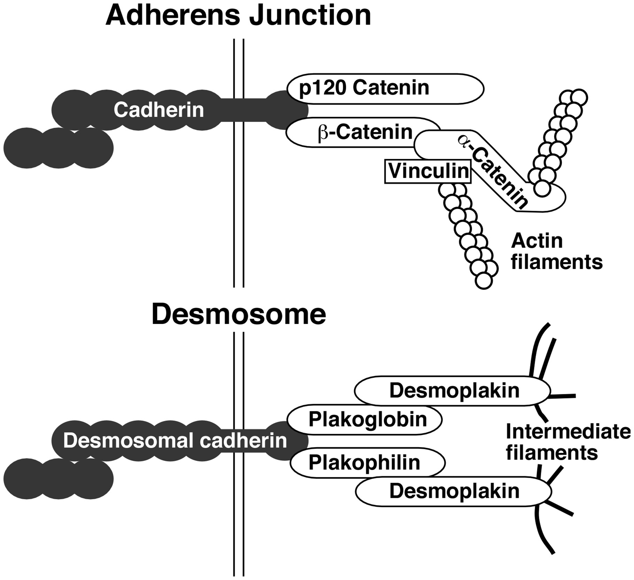
Fig. 3 Structures of adherence junctions and desmosomes. (Upper) Adherence junction (AJ). AJs connect actin ...
Notes:
Fig. 3 Structures of adherence junctions and desmosomes. (Upper) Adherence junction (AJ). AJs connect actin filaments between two cells. Cadherins bind homophilically via the extracellular region and bind to β-catenin and p120-catenin via the cytoplasmic domain. Cadherins link to actin filaments via β-catenin, α-catenin and vinculin. α-Catenin appears to be a key molecule for mechanosensing at AJs. When AJs are subjected to tensile force, α-catenin is extended and the vinculin-binding site of α-catenin is exposed via force-induced conformational changes, resulting in enhancement of vinculin binding to α-catenin and linkage of actin filaments to AJs. (Lower) Desmosome. Desmosomes connect IFs between two cells. Desmosomal cadherins (desmoglein and desmocolin) bind homophilically or heterophilically via the extracellular domain and bind to plakoglobin and plakophilin via the cytoplasmic domain. Desmosomal cadherins link to IFs via plakoglobin, plakophilin and desmoplakin.
Unless provided in the caption above, the following copyright applies to the content of this slide: © The Authors 2017. Published by Oxford University Press on behalf of the Japanese Biochemical Society. All rights reserved

Slide 4
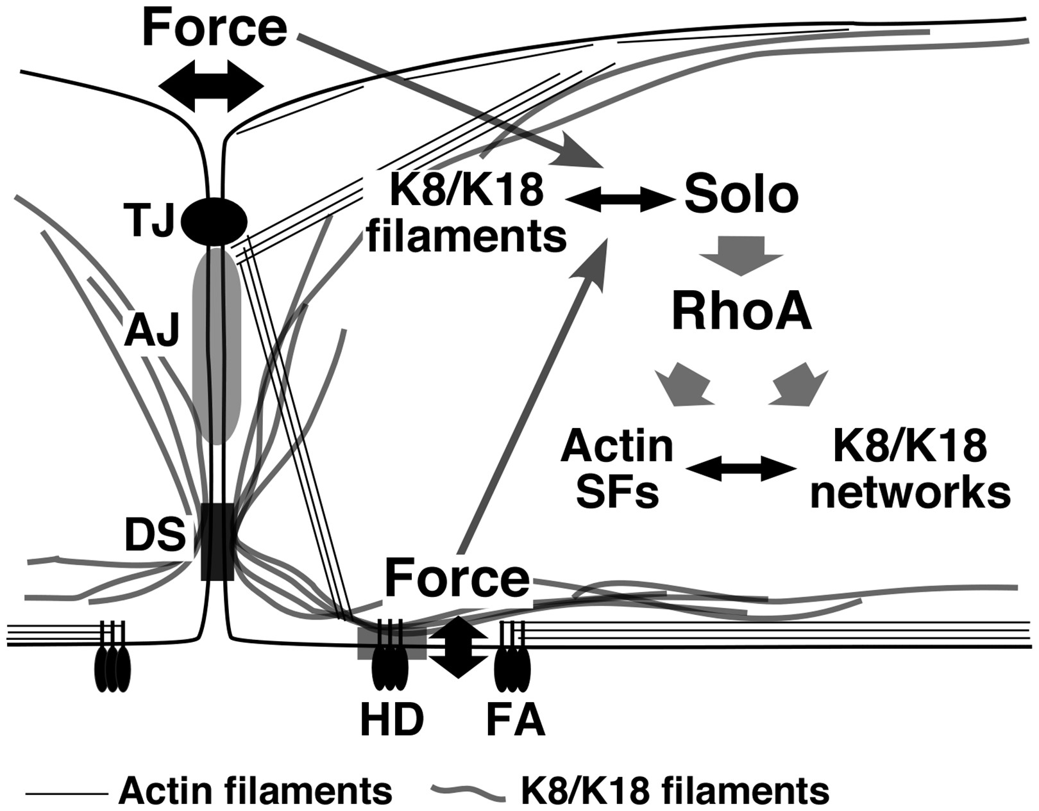
Fig. 4 The role of Solo and keratin filaments in mechanotransduction. Application of tensional forces to ...
Notes:
Fig. 4 The role of Solo and keratin filaments in mechanotransduction. Application of tensional forces to cell–substrate and cell–cell adhesion sites causes deformation of K8/K18 filaments. Since Solo binds to K8/K18 filaments via multiple binding sites, the force-induced deformation of K8/K18 filaments may induce conformational changes in Solo, leading to its activation. Solo activates RhoA, which in turn promotes the formation of actin stress fibres and K8/K18 networks. Force-induced reinforcement of stress fibres and keratin filaments probably contributes to protecting cells against external forces. DS, desmosome; HD, hemidesmosome; SF, stress fibre. Rho-GEFs and RhoGAPs involved in mechanotransduction Rho-GEFsOther namesTargetsRelevant mechanical stressReferencesAbrRhoA/Rac1/Cdc42Cyclic stretch(77)AlsinALS2/KIAA1563Rac1Cyclic stretch(77)ARHGEF10GEF10/KIAA1563RhoA/RhoB/RhoCCyclic stretch(77)BcrBcr1/KIAA0294RhoA/Rac1/Cdc42Cyclic stretch(77)DOCK180DOCK1Rac1/RhoATensile force(39)GEF-H1ARHGEF2/KIAA0651RhoACyclic stretch/Tensile force(75–77)LARGARHGEF12/KIAA0382RhoACyclic stretch/Tensile force(76, 77)p190RhoGEFARHGEF28/RGNEF/KIAA1998RhoACyclic stretch(77)PLEKHG1ARHGEF41/KIAA1209Rac1/Cdc42Cyclic stretch(77)P-REX2Rac1∼3/Cdc42/RhoG/TC10Cyclic stretch(77)SoloARHGEF40/Scambio/QuoRhoA/RhoCCyclic stretch/Tensile force(77, 78)α-PixARHGEF6/KIAA0006/COOL-2Rac1/Cdc42Cyclic stretch(77)PIX-1ARHGEF7/β-Pix/COOL-1Rac1/Cdc42Tensile force(50)Vav-2RhoACyclic stretch(74)Rho-GAPsp190RhoGAPARHGAP35/GRF-1RhoAShear stress/Stiffness of substrate(81–83)FilGAPARHGAP24Rac1/Cdc42Tensile force(84)
Unless provided in the caption above, the following copyright applies to the content of this slide: © The Authors 2017. Published by Oxford University Press on behalf of the Japanese Biochemical Society. All rights reserved

