Slide 1
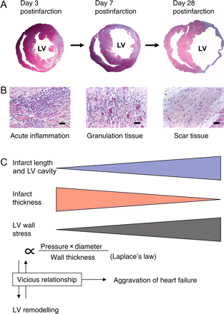
Figure 1 Effect of the postinfarction healing process on cardiac geometry and its relation to wall stress and heart ...
Notes:
Figure 1 Effect of the postinfarction healing process on cardiac geometry and its relation to wall stress and heart failure. (A) Transverse ventricular sections taken from mouse hearts on Day 3, 7, or 28 post-MI and stained with Masson's trichrome. (B) Photomicrographs of infarct tissue collected from mouse hearts on Day 3, 7, or 28 post-myocardial infarction (MI). (C) With the passage of time after the onset of MI, the infarct length and left ventricular cavity become larger, whereas the infarct wall thickness becomes thinner. Wall stress is proportional to the cavity diameter and intracavitary pressure, and inversely proportional to the wall thickness (Laplace's law). Thus, wall stress and ventricular remodelling (dilatation and wall thinning) have a vicious relationship, accelerating one another, and exacerbating heart failure.
Unless provided in the caption above, the following copyright applies to the content of this slide: Published on behalf of the European Society of Cardiology. All rights reserved. © The Author 2009. For permissions please email: journals.permissions@oxfordjournals.org.

Slide 2
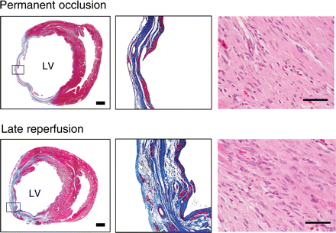
Figure 2 Effect of late perfusion on infarct tissue dynamics. Left panels: Masson's trichrome-stained transverse ...
Notes:
Figure 2 Effect of late perfusion on infarct tissue dynamics. Left panels: Masson's trichrome-stained transverse sections of left ventricle collected 4 weeks after myocardial infarction from hearts subjected to permanent occlusion or late reperfusion. Middle panels: infarcted wall at high magnification (boxed areas in the left panels). Right panels: hematoxylin–eosin stained sections of infarct tissue. Note the smaller left ventricular cavity, shorter infarct segment, and thicker infarct wall with higher cellularity in the heart with late reperfusion. Bars: 1 mm in the left panels, 20 µm in the right panels. (Reproduced from Nakagawa et al.42.)
Unless provided in the caption above, the following copyright applies to the content of this slide: Published on behalf of the European Society of Cardiology. All rights reserved. © The Author 2009. For permissions please email: journals.permissions@oxfordjournals.org.

Slide 3
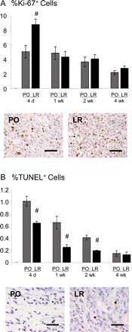
Figure 3 Proliferative and antiapoptotic effects of late reperfusion on postinfarct granulation tissue cells. (A) Time ...
Notes:
Figure 3 Proliferative and antiapoptotic effects of late reperfusion on postinfarct granulation tissue cells. (A) Time courses of the changes in Ki-67-positive proliferating cells in hearts with permanent occlusion and in those with late reperfusion. Photomicrographs obtained 4 days post-MI showing Ki-67-positive cells in the infarct area of a heart with permanent occlusion and one with late reperfusion (%Ki-67+ cells: 5.1 ± 0.85 vs. 8.8 ± 0.77%, P < 0.05). (B) Time-dependent changes in the incidences of in situ nick end-labelling (TUNEL)-positive apoptotic cells in hearts with permanent occlusion and in those with late reperfusion. Photomicrographs obtained 7 days post-MI showing TUNEL-positive cells in the infarct area of a heart with permanent occlusion and one with late reperfusion (%TUNEL+ cells: 0.66 ± 0.10 vs. 0.25 ± 0.04%, P < 0.05). #P < 0.05 vs. the permanent occlusion group (t-test). Bars: 20 µm. (Reproduced from Nakagawa et al.42.)
Unless provided in the caption above, the following copyright applies to the content of this slide: Published on behalf of the European Society of Cardiology. All rights reserved. © The Author 2009. For permissions please email: journals.permissions@oxfordjournals.org.

