Slide 1
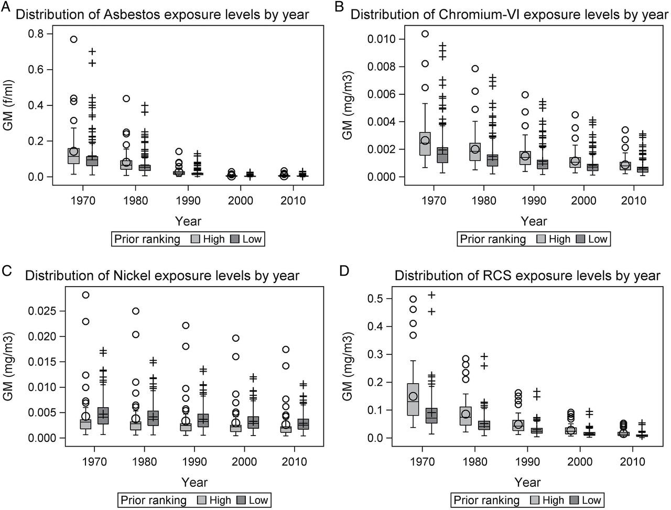
Figure 1 Distribution of the job-level estimated exposure levels for exposed jobs between 1970 and 2010.
Notes:
Figure 1 Distribution of the job-level estimated exposure levels for exposed jobs between 1970 and 2010.
Unless provided in the caption above, the following copyright applies to the content of this slide: © The Author 2016. Published by Oxford University Press on behalf of the British Occupational Hygiene Society.

