Slide 1
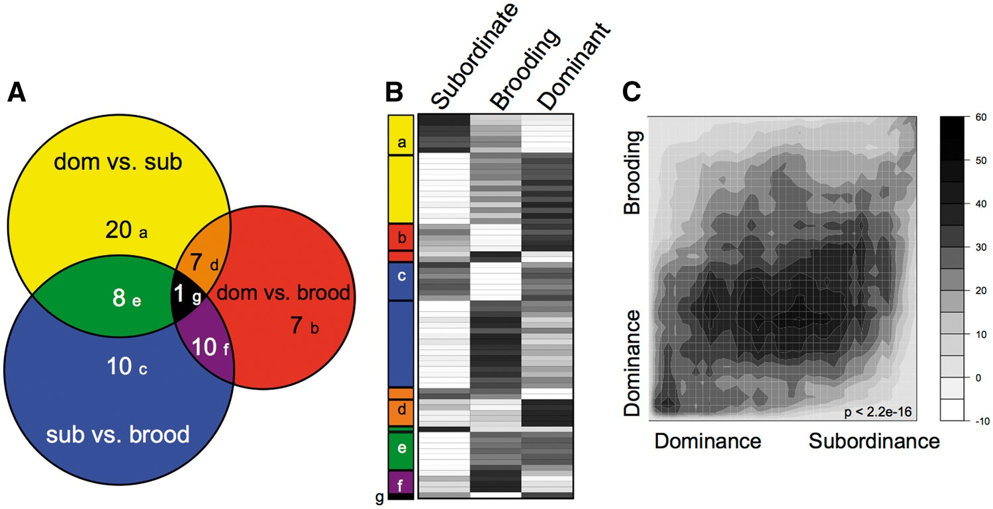
Fig. 1 Socially regulated and reproductively regulated neural gene expression in A. burtoni females. (A) Scaled Venn ...
Notes:
Fig. 1 Socially regulated and reproductively regulated neural gene expression in A. burtoni females. (A) Scaled Venn diagram depicts overlap of differentially expressed genes (P < 0.05 FDR) for each pair-wise comparison in this study (P < 0.05 FDR; Supplementary Table 1). (B) Heatmap indicates the relative expression level (black: high; white: low) in each phenotype for these 70 differentially expressed genes, grouped according to the Venn diagram modules and further subdivided by direction of regulation within the module. (C) Rank-rank hypergeometric map demonstrates an overall correlation between the gene expression profile for dominance compared with subordinance and to the brooding reproductive phenotype. Scale bar depicts the relative range of BY-corrected, −log10 transformed hypergeometric P-values for the RRHO analysis. P-value indicates Spearman rank correlation of the fold-change data.
Unless provided in the caption above, the following copyright applies to the content of this slide: © The Author 2016. Published by Oxford University Press on behalf of the Society for Integrative and Comparative Biology. All rights reserved. For permissions please email: journals.permissions@oup.com.

Slide 2
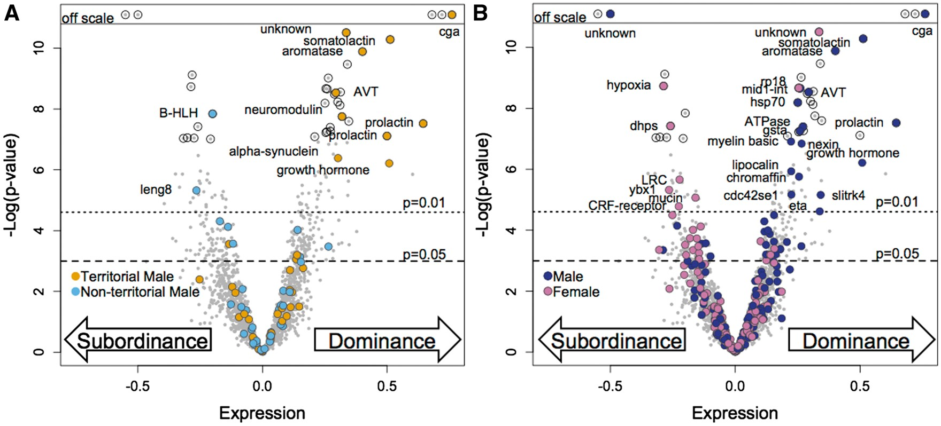
Table 2 In total, 39 genes show consistent expression biases between female dominance and sex (P < 0.05) In total, 31 ...
Notes:
Table 2 In total, 39 genes show consistent expression biases between female dominance and sex (P < 0.05) In total, 31 genes that show consistent expression biases between female subordinance and sex (P < 0.05) Female-biased genes associated with female subordinanceGenBank accession numberAbbreviated gene annotationXM_003442007.3LIM and SH3 protein 1 (lasp1)XR_268729.2uncharacterizedXM_005475529.1von Willebrand factor A domain-containing proteinXM_005461142.2hypoxia-inducible factor 1-alphaXR_001223047.1uncharacterizedXM_003445583.3ans-golgi network protein 2 (tgoln2)XM_013274594.1leukocyte receptor cluster (LRC) member 8 (leng8)XM_003452809.3deoxyhypusine synthase (dhps)XM_013275471.1cytokinesis protein 3XR_001224604.1acyl-coenzyme A thioesteraseXM_003448942.2cytochrome c oxidase subunit 7A2XM_013266972.1pleckstrin homology domain (plekha6)XM_005469874.2mucin-5ACXM_005473424.2proprotein convertase subtilisinXM_013277052.1human C3orf58 (clg9h3orf58)XM_013264267.1chromaffin granule amine transporterXM_003438067.3neuronal differentiation 6 (neurod6)XM_005458596.1uncharacterizedXM_013273869.1inositol polyphosphate phosphatase-like 1 (inppl1)XM_003445682.3transmembrane protein 127XM_013269342.1clathrin heavy chainXM_003456230.3nicolin 1 (nicn1)XM_005454863.2nuclear GTPase SLIP-GCXM_005461516.2SLIT and NTRK (slitrk4)XM_005462511.1olfactory receptor 2K2XM_005458825.2shisa family member 4 (shisa4)XM_003443990.3dehydrogenase E1 & transketolase (dhtkd1)XM_005450930.2coiled-coil domain - 136XM_013271758.1acyl-CoA synthetase long-chain (acsl4)XM_003455175.3early growth response 1 (egr1)XM_003458435.3MAM domain-containing glycosylphosphatidylinositol anchorTable 4In total, 26 genes that show contradictory expression biases between dominance and sex (P < 0.05) Female-biased genes associated with female dominanceGenBank accession numberAbbreviated gene annotationXM_003438153.3schwannomin-interacting proteinXM_003446848.2ADP/ATP translocaseXM_005453621.2protein-glutamine gamma-glutamyltransferaseXM_003456372.3niloticus coagulation factor XXM_003442872.3visininXM_005478262.2N-terminal EF-hand calcium-bindingXM_005475970.2glucagon family neuropeptidesXR_001224304.1uncharacterizedXM_003452424.2niloticus ribosomal protein S5 (rps5)XR_134814.3uncharacterizedXM_005452080.2transmembrane emp24XM_013269458.1ADP-ribosylation factor 1 (arf1)XM_013277498.1DnaJ (Hsp40) homolog (dnajc13)XM_003444320.3uncharacterizedXM_003450625.2EPH receptor B6 (ephb6)XM_003451557.2ribosomal protein L8 (rpl8)XM_013274785.1uncharacterizedMale-biased genes associated with female subordinanceXM_003437687.2synaptosomal-associated protein 25XM_003438309.3uncharacterizedXM_003448308.3glutamate receptorXM_003459428.3zinc finger and BTB (zbtb14)XM_005454355.1late endosomal/lysosomal adaptor (lamtor1)XM_005469157.2syntaxin 1B (stx1b)XM_005476752.2myelin protein zero (mpz)XM_013272974.1nuclear factor 1 XXM_005450398.2v-ral simian leukemia viral oncogene homolog B (ralb)Fig. 2Volcano plots representing gene expression bias associated with dominance phenotypes. Genes (gray circles) are plotted according to expression level in the comparison of dominant versus subordinate A. burtoni females (x-axis) and the −log10 P-value for differential expression (y-axis). P-value thresholds are indicated (dotted line = 0.01, dashed line = 0.05) and genes meeting the FDR correction at P < 0.05 are highlighted with black circles. In each plot, the genes are highlighted with color if they were also found to be differentially expressed in the comparison of (A) territorial and non-territorial males (P < 0.01) (B) male and female (P < 0.01) Abbreviated gene names are provided for the overlapping genes with significant gene expression bias in both comparisons.
Unless provided in the caption above, the following copyright applies to the content of this slide: © The Author 2016. Published by Oxford University Press on behalf of the Society for Integrative and Comparative Biology. All rights reserved. For permissions please email: journals.permissions@oup.com.

Slide 3
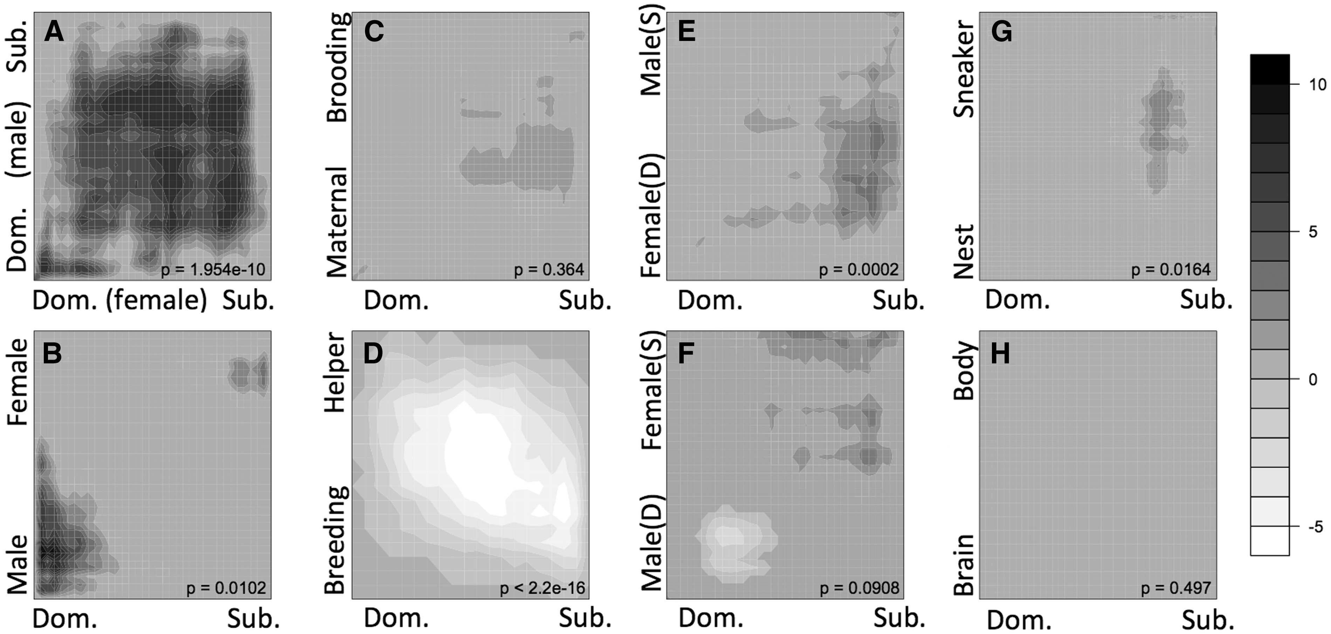
Fig. 3 RRHO plots demonstrate that expression patterns for different forms of dominance show patterns of overlap. ...
Notes:
Fig. 3 RRHO plots demonstrate that expression patterns for different forms of dominance show patterns of overlap. These representations are based on the full set of genes analyzed in each experiment pair and do not apply any statistical threshold cut-offs. For both lists, the genes were ranked according to the degree of expression bias (fold-difference). In all datasets, genes are ranked from 1 being the greatest bias toward dominant-like phenotype (shown in the lower left corner of each plot) to greater rank numbers for expression bias toward subordinate-like phenotypes. The rank list of female social dominance (x-axis) is compared to eight gene lists derived from (A) male social dominance in male A. burtoni (Renn et al. 2008), (B) sex bias in male versus female A. burtoni (Renn et al. 2008), (C) maternal aggression post release of fry versus mouth brooding stage in A. burtoni (Renn unpublished), (D) female social status of breeder versus helper females in the cooperatively breeding cichlid N. brichardi (Aubin-Horth et al. 2007), (E) sex-role dominance of aggressive females versus submissive males in the sex-role reversed cichlid J. marlieri (Schumer et al. 2011), (F) sex-role dominance of aggressive males versus submissive females in the sex-role conventional cichlid J. transcriptus (Schumer et al. 2011), (G) male breeding tactic of nest males versus sneaker males in the wrasse S. ocellatus (Stiver et al. 2015), (H) non-social regulation of gene expression between brain and body in A. burtoni (Renn et al. 2004) showed no overlap. Overlap was evaluated using a step size of 50 genes for all comparisons except G where step = 20. Heat map gray scale intensity indicates the significance of overlap between the set of genes from each list that are ranked above that sliding rank threshold position (i.e., between that point and the lower left corner). Scale bar indicates BY-corrected, negative natural log transformed hypergeometric P-values for each comparison except that D is plotted as −log10. By convention of the RRHO analysis, negative values indicate under enrichment and positive values indicate over-enrichment such that D represents an overall negative correlation. P-values provided are Spearman rank correlation of the fold change data.
Unless provided in the caption above, the following copyright applies to the content of this slide: © The Author 2016. Published by Oxford University Press on behalf of the Society for Integrative and Comparative Biology. All rights reserved. For permissions please email: journals.permissions@oup.com.

