Slide 1
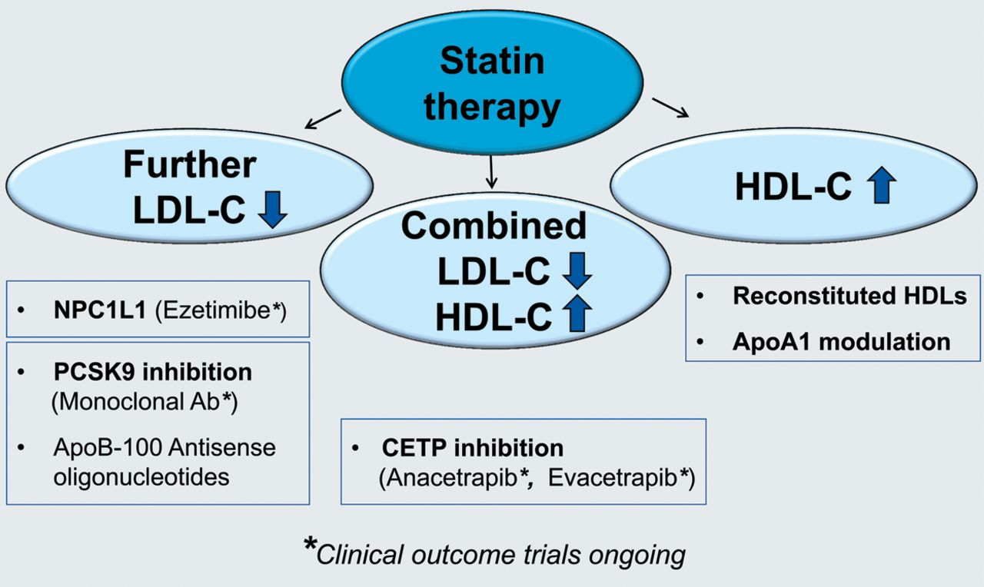
Figure 3 Strategies of ongoing clinical trials to examine which lipid-targeted therapy should be added to statin ...
Notes:
Figure 3 Strategies of ongoing clinical trials to examine which lipid-targeted therapy should be added to statin treatment in patients with high vascular risk. Ab, antibody; C, cholesterol; CETP, cholesteryl ester transfer protein.
Unless provided in the caption above, the following copyright applies to the content of this slide: Published on behalf of the European Society of Cardiology. All rights reserved. © The Author 2013. For permissions please email: journals.permissions@oup.com

Slide 2
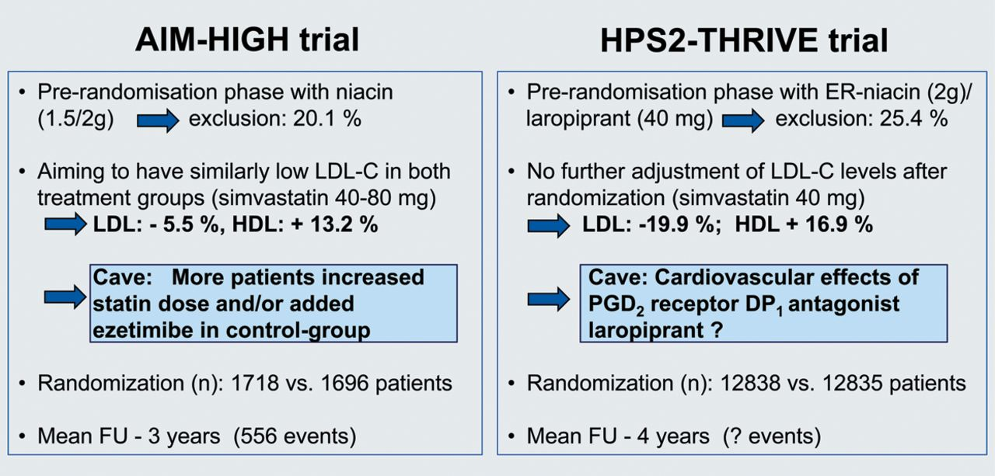
Figure 2 Comparison of the AIM-HIGH and the HPS2-THRIVE trial. C, cholesterol; ER, extended release; FU, follow-up.
Notes:
Figure 2 Comparison of the AIM-HIGH and the HPS2-THRIVE trial. C, cholesterol; ER, extended release; FU, follow-up.
Unless provided in the caption above, the following copyright applies to the content of this slide: Published on behalf of the European Society of Cardiology. All rights reserved. © The Author 2013. For permissions please email: journals.permissions@oup.com

Slide 3
Figure 1 Niacin (vitamin B3)—a lipid-modifying agent with a long history.
Notes:
Figure 1 Niacin (vitamin B3)—a lipid-modifying agent with a long history.
Unless provided in the caption above, the following copyright applies to the content of this slide: Published on behalf of the European Society of Cardiology. All rights reserved. © The Author 2013. For permissions please email: journals.permissions@oup.com

