Slide 1
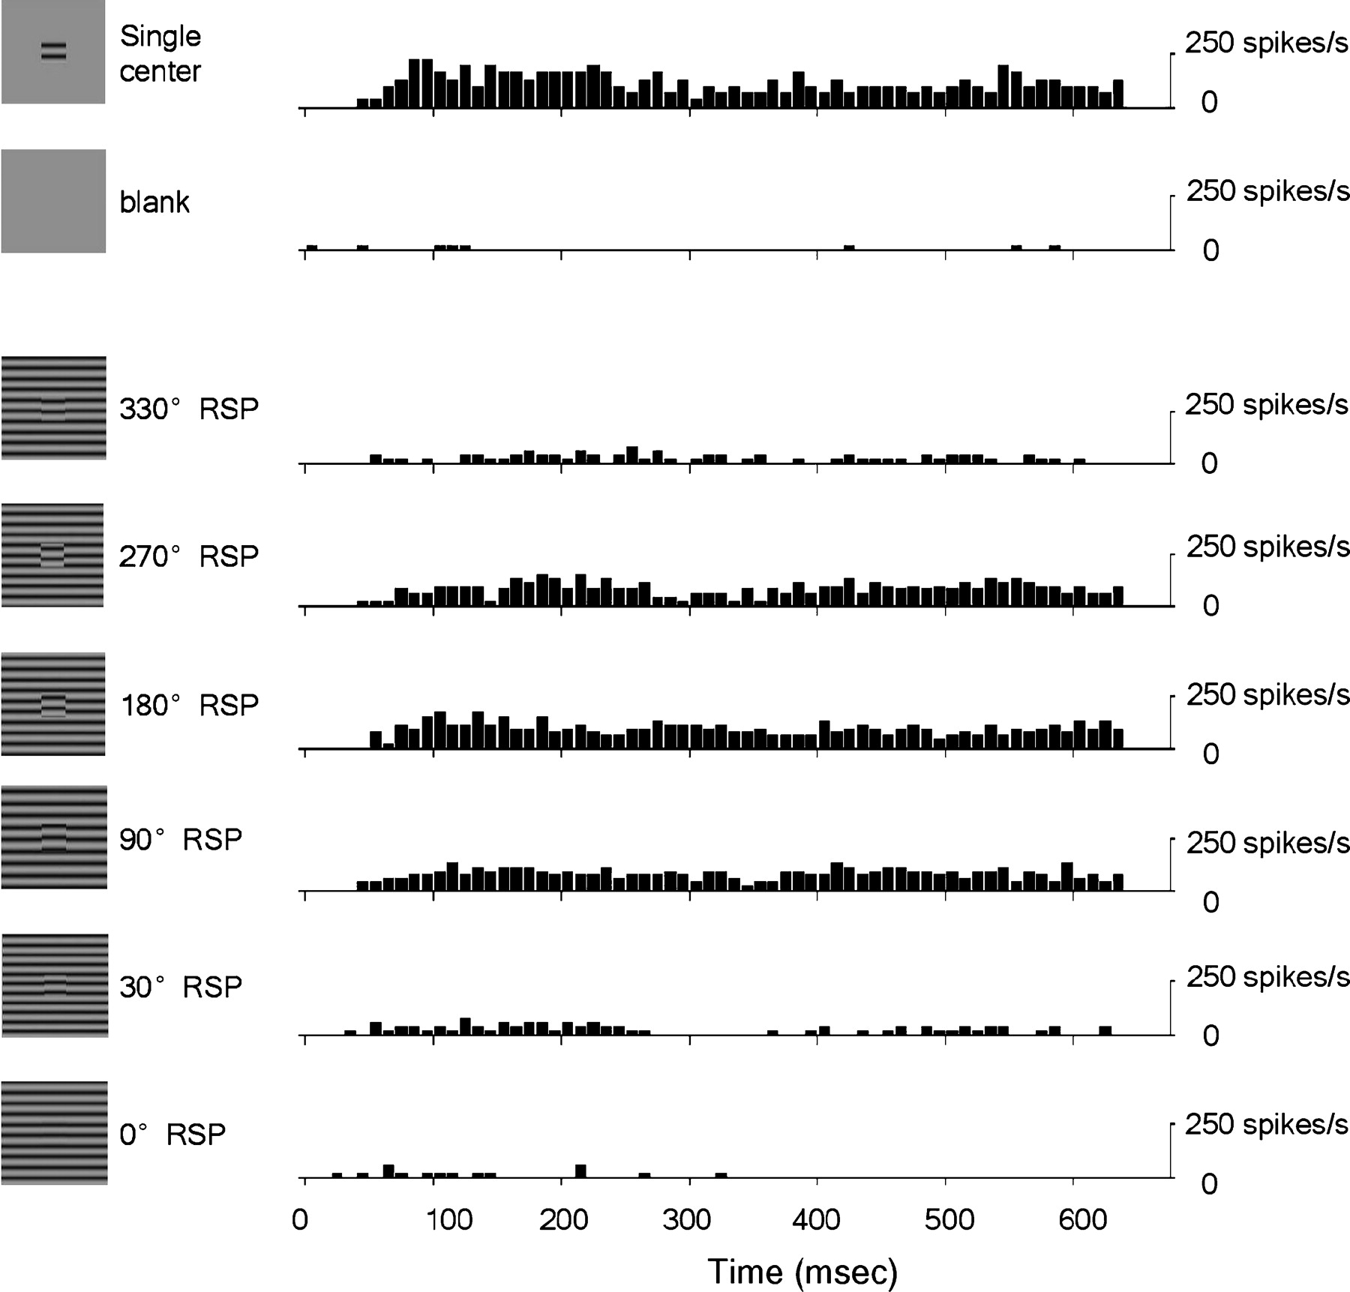
Figure 1. Responses of an example V1 cell to drifting grating stimuli of various configuration. For each cell, ...
Notes:
Figure 1. Responses of an example V1 cell to drifting grating stimuli of various configuration. For each cell, responses at 12 RSPs equally spaced between 0 and 330° were measured, six of which are shown here. Left panel: visual stimuli. The boundary between the center and surround gratings was set at the CRF border (the size of the CRF was 1.2°). Right panel: post-stimulus time histogram of the cell for each stimulus configuration (time of stimulus onset is defined as 0). In each trial, the drifting gratings (3 Hz) were presented for two cycles, and the responses from six trials were averaged.
Unless provided in the caption above, the following copyright applies to the content of this slide: © The Author 2005. Published by Oxford University Press. All rights reserved. For permissions, please e-mail: journals.permissions@oupjournals.org

Slide 2
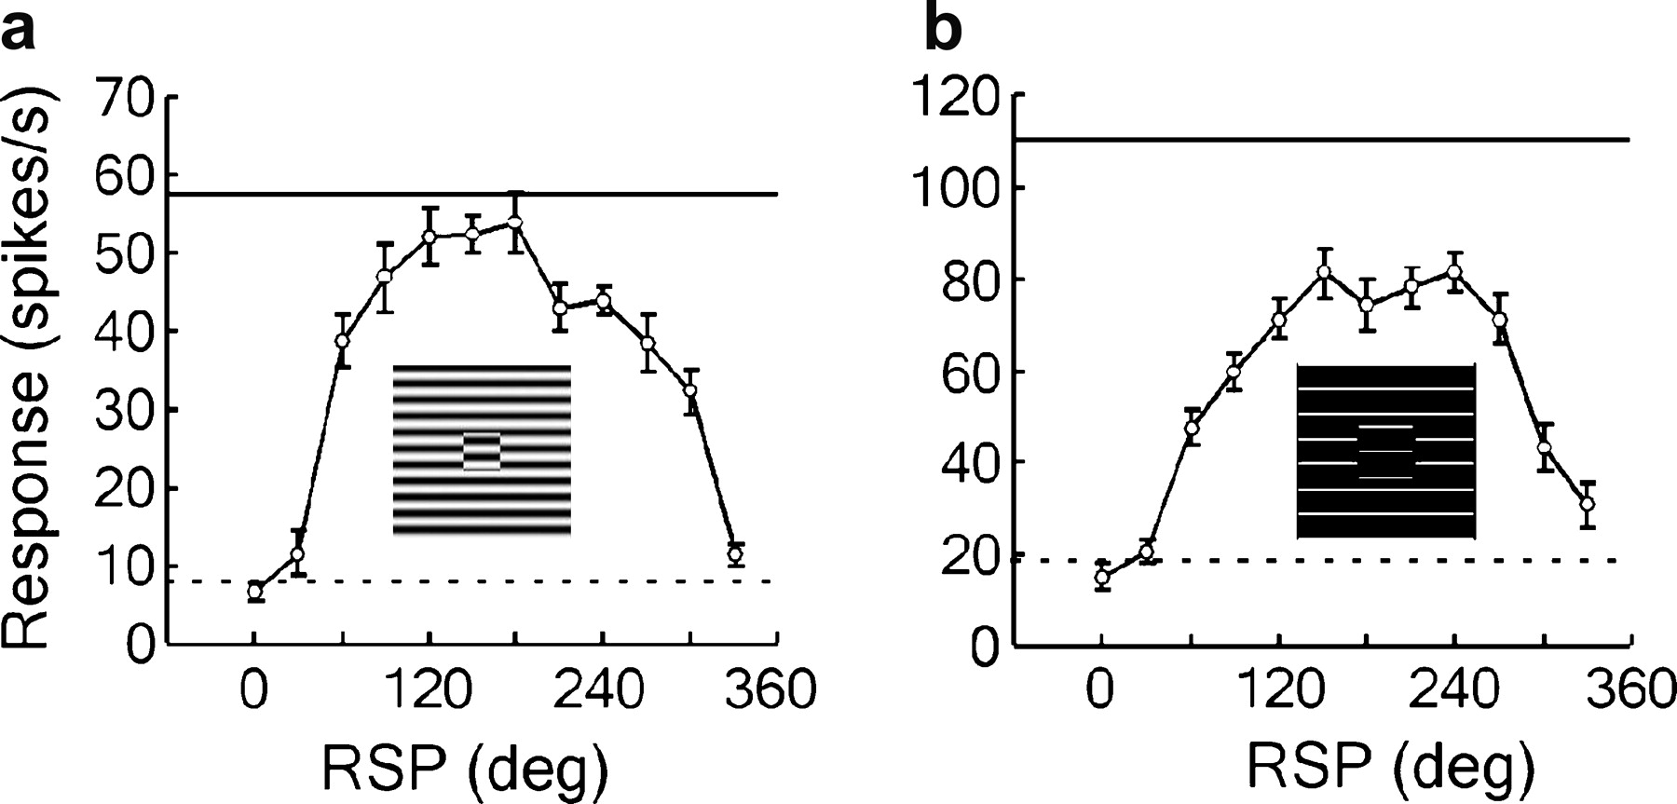
Figure 2. Responses of V1 cells as functions of RSP. (a) RSP–response curve of a cell tested with sinusoidal gratings. ...
Notes:
Figure 2. Responses of V1 cells as functions of RSP. (a) RSP–response curve of a cell tested with sinusoidal gratings. (b) RSP–response curve of another cell tested with abutting lines. Both cells exhibited strong suppression at both the side and end regions. Insets show stimulus gratings with 180° RSP. The solid line represents the response level when the cell was stimulated by the center grating alone; the dashed line indicates spontaneous activity level. Error bars represent the SEMs.
Unless provided in the caption above, the following copyright applies to the content of this slide: © The Author 2005. Published by Oxford University Press. All rights reserved. For permissions, please e-mail: journals.permissions@oupjournals.org

Slide 3
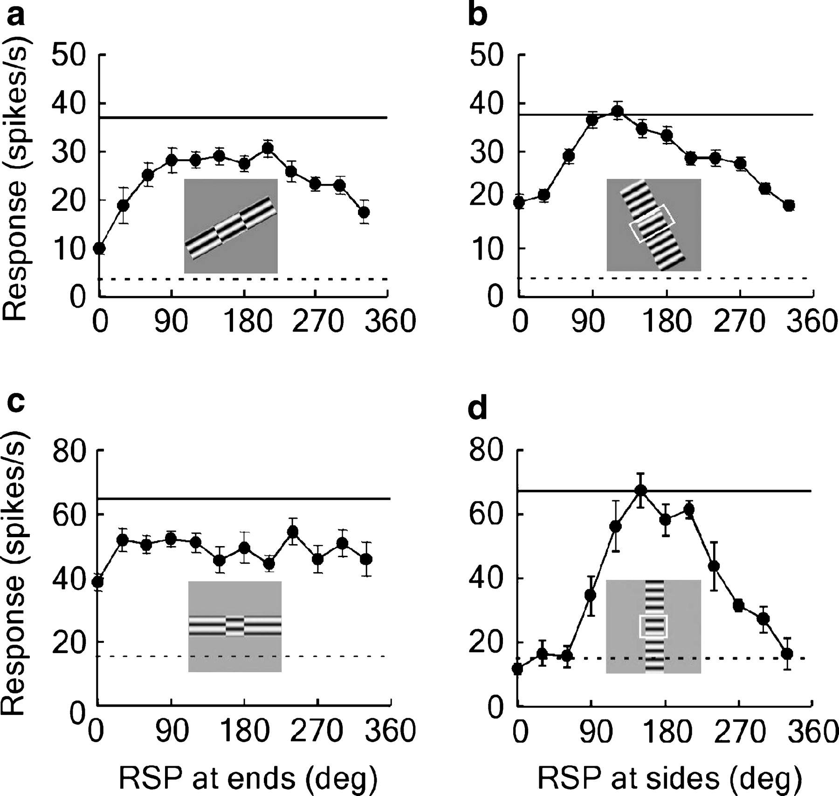
Figure 3. Contribution of end- and side-suppression to RSP sensitivity. (a, b) RSP-response curves for the end and side ...
Notes:
Figure 3. Contribution of end- and side-suppression to RSP sensitivity. (a, b) RSP-response curves for the end and side regions of a cell exhibiting suppression at both regions. (c, d) RSP response curves of another cell showing suppression exclusively at the side regions. Square represents CRF. The solid line represents the response level when the cell was stimulated by the center grating alone; the dashed line indicates spontaneous activity level.
Unless provided in the caption above, the following copyright applies to the content of this slide: © The Author 2005. Published by Oxford University Press. All rights reserved. For permissions, please e-mail: journals.permissions@oupjournals.org

Slide 4
Figure 4. Relationship between RSP sensitivity (SPS) and the strength of ERF suppression. (a) SPS plotted against ...
Notes:
Figure 4. Relationship between RSP sensitivity (SPS) and the strength of ERF suppression. (a) SPS plotted against suppression index when both end and side regions were stimulated. (b, c) SPS versus suppression index when only the end region or the side region was stimulated. Each point represents data from one cell. Filled and open points represent data from monkey A and monkey B, respectively. Line represents linear regression.
Unless provided in the caption above, the following copyright applies to the content of this slide: © The Author 2005. Published by Oxford University Press. All rights reserved. For permissions, please e-mail: journals.permissions@oupjournals.org

Slide 5
Figure 5. Spatial extent of SPS. (a) RSP–response curves of a cell tested at various center grating sizes (filled ...
Notes:
Figure 5. Spatial extent of SPS. (a) RSP–response curves of a cell tested at various center grating sizes (filled circles, 0.5 × 0.5°; open squares, 1.0 × 1.0°; filled triangles, 1.5 × 1.5°; open circles, 2.0 × 2.0°; ×, 2.5 × 2.5°). (b) SPS as a function of center grating size, deduced from the above curves. (c) SPS as a function of center grating length for another cell.
Unless provided in the caption above, the following copyright applies to the content of this slide: © The Author 2005. Published by Oxford University Press. All rights reserved. For permissions, please e-mail: journals.permissions@oupjournals.org

Slide 6
Figure 6. Elimination of RSP sensitivity by gaps at the center/surround boundary, for a cell with a 1.5° CRF and 4° ...
Notes:
Figure 6. Elimination of RSP sensitivity by gaps at the center/surround boundary, for a cell with a 1.5° CRF and 4° inhibitory end regions. (a) Normal RSP–response curve of the cell. (b) RSP–response curve obtained with 0.2° gray gaps inserted at the boundary between the CRF and the end regions. (c) RSP–response curve obtained when the gap width is increased to 0.5°.
Unless provided in the caption above, the following copyright applies to the content of this slide: © The Author 2005. Published by Oxford University Press. All rights reserved. For permissions, please e-mail: journals.permissions@oupjournals.org

Slide 7
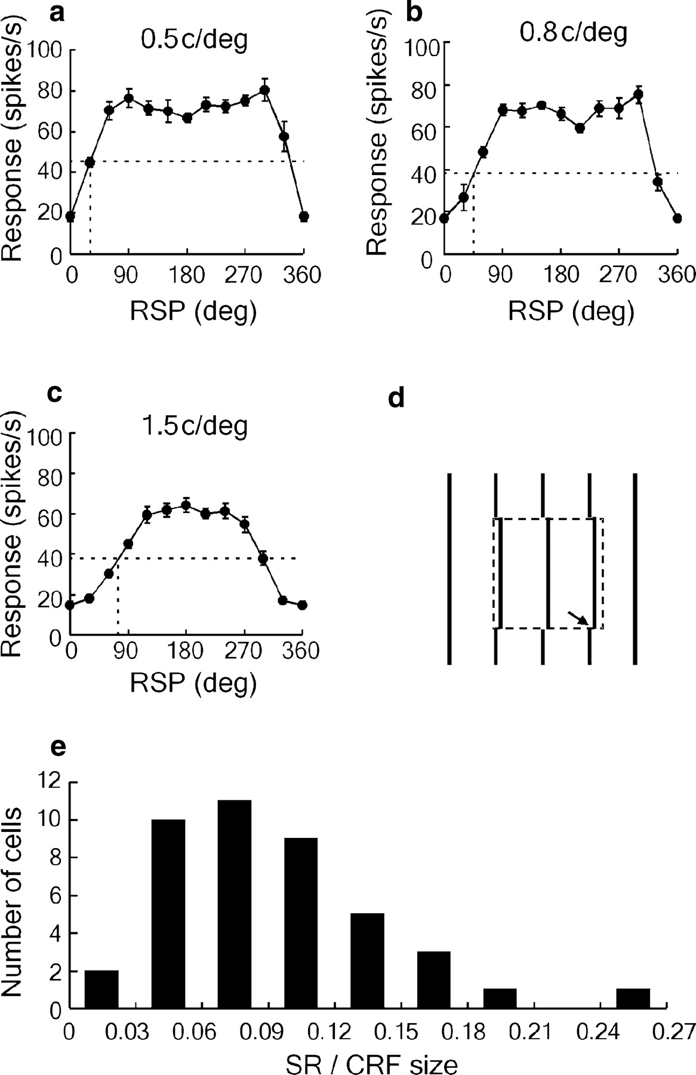
Figure 7. Spatial resolution for detecting RSP at the boundary. (a–c) RSP–response curves tested with gratings at ...
Notes:
Figure 7. Spatial resolution for detecting RSP at the boundary. (a–c) RSP–response curves tested with gratings at different spatial frequencies, for a cell with a 2.5° CRF. Horizontal line indicates the half-height of the RSP–response curve. RSP at the intersections between the curve and the horizontal line indicates the half-height release of ERF suppression, which occurred at 30, 45 and 75° (indicated by the vertical lines) in (a), (b) and (c), respectively. (d) Spatial resolution (arrow) for RSP of the cell, computed from the mean of the measurements in (a–c). Dashed square indicates CRF. (e) Distribution of spatial resolution for a population of cells (n = 42).
Unless provided in the caption above, the following copyright applies to the content of this slide: © The Author 2005. Published by Oxford University Press. All rights reserved. For permissions, please e-mail: journals.permissions@oupjournals.org

