Slide 1
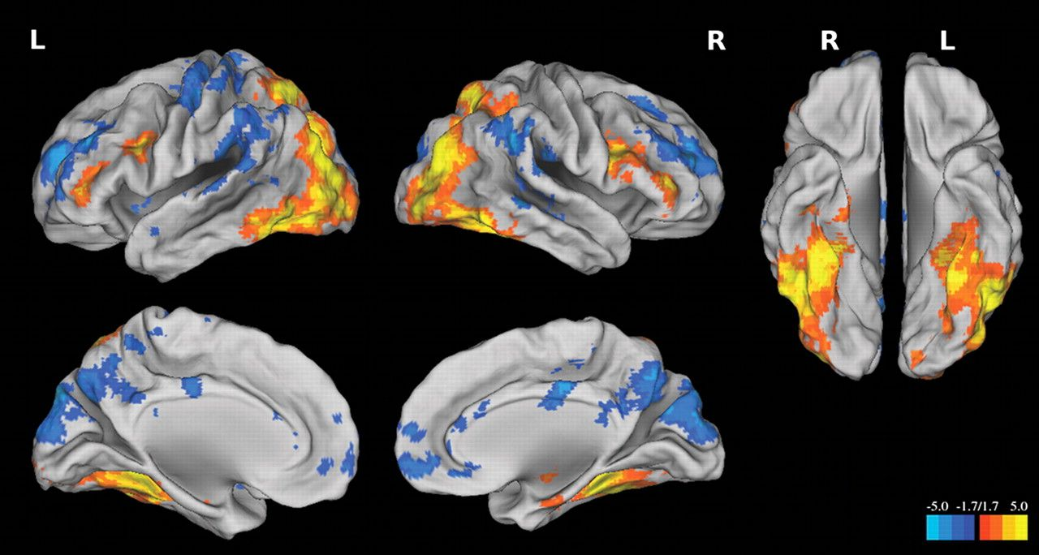
Figure 1. Activation and deactivation statistical maps. Statistical maps are defined by one-sample t-tests across young ...
Notes:
Figure 1. Activation and deactivation statistical maps. Statistical maps are defined by one-sample t-tests across young and old subjects, covarying for task memory performance. Warm colors are activations (hits > misses), while cool colors are deactivations (hits < misses).
Unless provided in the caption above, the following copyright applies to the content of this slide: © The Author 2011. Published by Oxford University Press. All rights reserved. For permissions, please e-mail: journals.permissions@oup.com

Slide 2
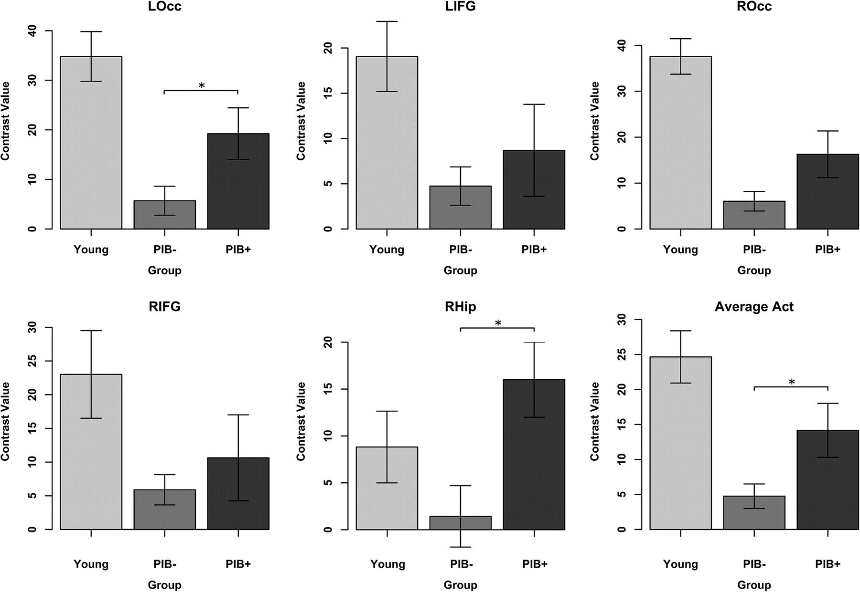
Figure 2. Task activation across groups. Mean contrast values (hits vs. misses) for each task-positive ROI as well as ...
Notes:
Figure 2. Task activation across groups. Mean contrast values (hits vs. misses) for each task-positive ROI as well as an average across the 5 ROIs. Error bars reflect the standard error estimates of each mean. *Indicates significant difference between PIB+ and PIB− groups (P < 0.05, controlling for age). LOcc, left occipital; LIFG, left inferior frontal gyrus; ROcc, right occipital; RIFG, right inferior frontal gyrus; RHip, right hippocampus; and Average Act, average activation across 5 ROIs.
Unless provided in the caption above, the following copyright applies to the content of this slide: © The Author 2011. Published by Oxford University Press. All rights reserved. For permissions, please e-mail: journals.permissions@oup.com

Slide 3
Figure 3. Relationships between activation and cognitive measures. Positive relationships between fMRI contrast values ...
Notes:
Figure 3. Relationships between activation and cognitive measures. Positive relationships between fMRI contrast values and measures of memory were identified within PIB+ subjects. Specifically, activation in LOcc was correlated with memory performance during the fMRI experiment (measured with the d-prime of high-confidence recognition responses, left; P = 0.007), whereas RHip and the average activation across the 5 task-positive ROIs were correlated with the visual memory factor score (middle, right; P = 0.031 and 0.035, respectively). Values are ranked due to the small number of subjects. There were no relationships with the other factor scores or within young or PIB− old subjects.
Unless provided in the caption above, the following copyright applies to the content of this slide: © The Author 2011. Published by Oxford University Press. All rights reserved. For permissions, please e-mail: journals.permissions@oup.com

Slide 4
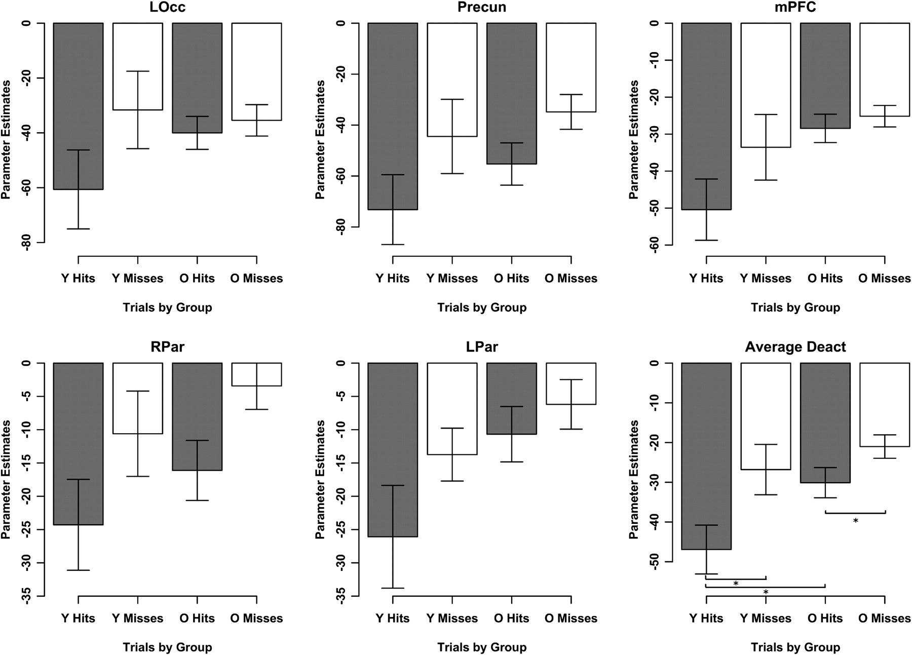
Figure 4. Trial parameter estimates for task-negative regions. Average trial parameter estimates for each task-negative ...
Notes:
Figure 4. Trial parameter estimates for task-negative regions. Average trial parameter estimates for each task-negative ROI is plotted and reveals greater deactivation during hits than during misses relative to fixation across all subjects. Error bars reflect the standard error estimates of each mean. Although old subjects show significantly greater deactivation during hits than misses, the magnitude of deactivation during hits is reduced compared with young subjects. t-tests were performed within and between young and old subjects for the average deactivation measure, and significant differences are denoted with an asterisk. O = old, Y = young.
Unless provided in the caption above, the following copyright applies to the content of this slide: © The Author 2011. Published by Oxford University Press. All rights reserved. For permissions, please e-mail: journals.permissions@oup.com

Slide 5
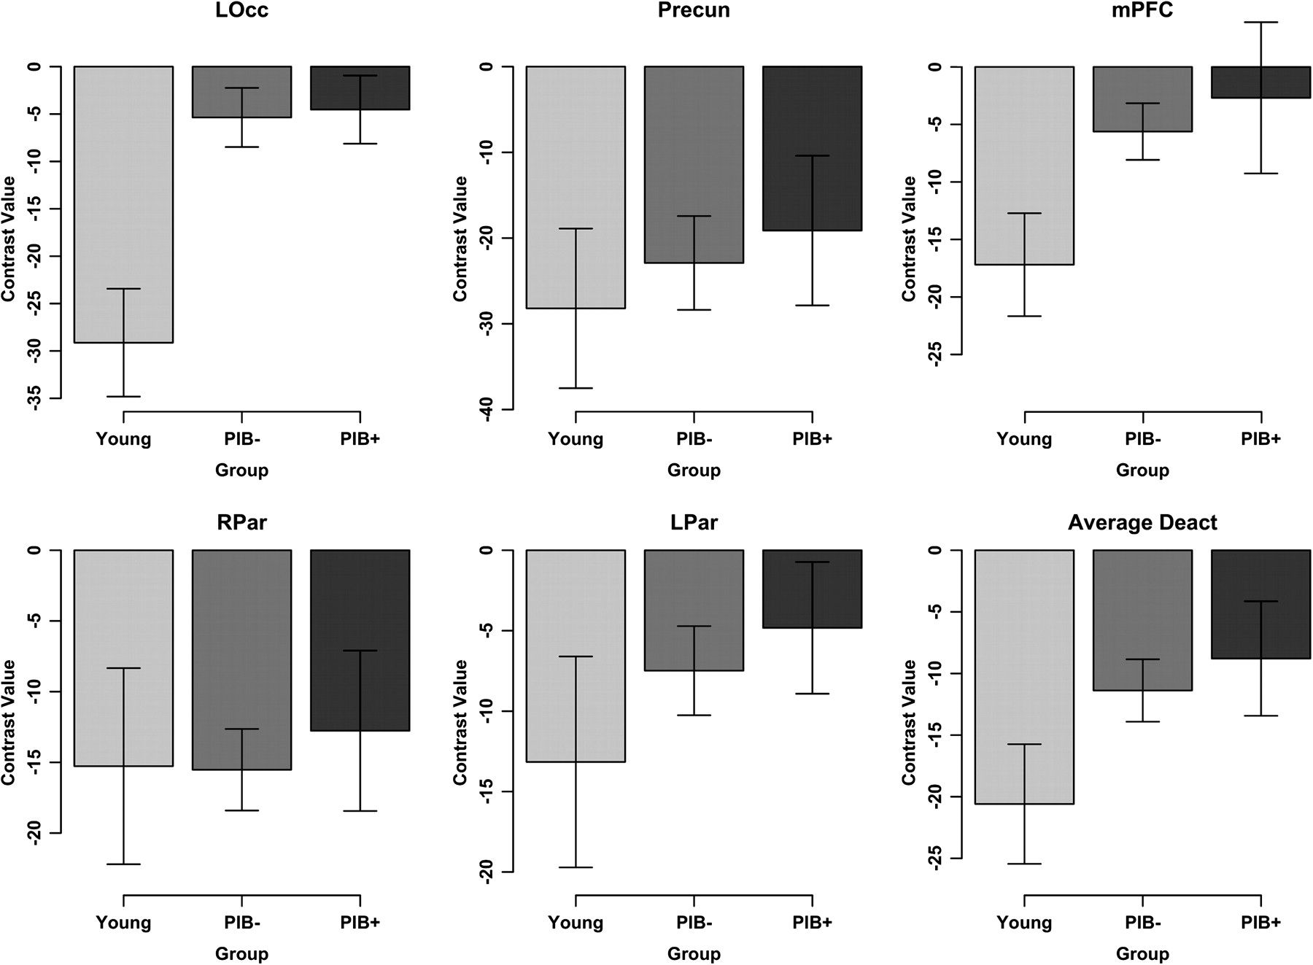
Figure 5. Task deactivation across groups. Average contrast values for hits versus misses are plotted for each ...
Notes:
Figure 5. Task deactivation across groups. Average contrast values for hits versus misses are plotted for each task-negative ROI. Error bars reflect the standard error estimates of each mean. Between group t-tests revealed reduced deactivation in old compared with young across multiple ROIs (LOcc and mPFC), but an effect of PIB status was not identified.
Unless provided in the caption above, the following copyright applies to the content of this slide: © The Author 2011. Published by Oxford University Press. All rights reserved. For permissions, please e-mail: journals.permissions@oup.com

