Slide 1
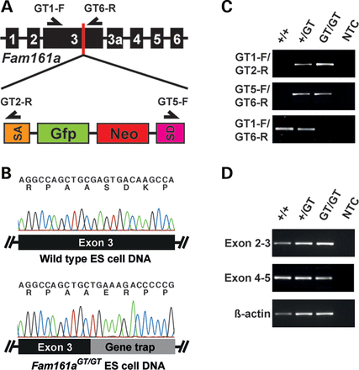
Figure 1. Disruption of the murine Fam161a locus and molecular characterization. (A) Schematic presentation of the ...
Notes:
Figure 1. Disruption of the murine Fam161a locus and molecular characterization. (A) Schematic presentation of the Fam161a locus. The UPA vector disrupts the UPF0564 domain encoded by exon 3. Features of the UPA vector were described earlier (12,13). SA, splicing acceptor, GFP, green fluroescent protein gene; Neo, neomycin resistance gene, SD, splicing donor. (B) Electropherograms showing sequencing results of genomic DNA isolated from wild-type and Fam161a gene trapped (Fam161aGT/GT) murine embryonic stem cells. Letters above the electropherograms indicate the nucleotides and amino acid sequences. (C) PCR genotyping for detection of the mutant Fam161aGT/GT (GT) allele in genomic DNA from wild type (+/+), heterozygous (GT/+) and homozygous (GT/GT) mice. The location of genotyping primers is given as black arrows in (A). (D) RT-PCR analysis with retinal cDNA from wild-type (+/+), heterozygous (+/GT) and 1-month-old homozygous (GT/GT) Fam161a gene trapped mice. Truncation of the Fam161a locus by gene trapping did not affect transcript expression or induce mRNA decay. β-Actin gene expression was used as positive control.
Unless provided in the caption above, the following copyright applies to the content of this slide: © The Author 2014. Published by Oxford University Press. All rights reserved. For Permissions, please email: journals.permissions@oup.com

Slide 2
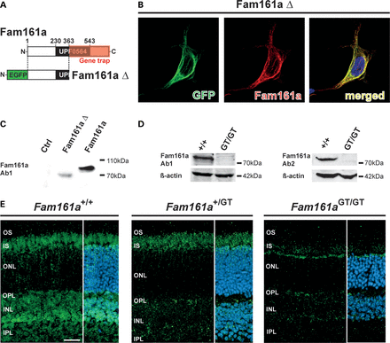
Figure 2. Fam161a protein expression in vitro and in the Fam161a^{GT/GT} retina. (A) Schematic diagram of the ...
Notes:
Figure 2. Fam161a protein expression in vitro and in the Fam161aGT/GT retina. (A) Schematic diagram of the gene trap within the Fam161a protein and the EGFP-Fam161a truncation construct (Fam161aΔ) used for expression in Hek293 cells. (B) Fluorescence images show Hek293 cells overexpressing the Fam161aΔ construct. EGFP fluorescence (green) and the anti-Fam161a antibody (red) both detect the truncated Fam161a protein in a cytoskeletal localization. (C) Immunoblot analysis of lysates isolated from Hek293 cells overexpressing Fam161aΔ or GST-tagged wild-type Fam161a (Fam161a) using antibody Ab1. (D) Western blot analysis with two different anti-Fam161a antibodies (Ab1 and Ab2) shows the absence of full-length Fam161a protein expression in Fam161aGT/GT animals. (E) Representative fluorescent images of retinal sections from 1-month-old Fam161a+/+, Fam161a+/GT and Fam161aGT/GT mice, stained with anti-Fam161a antibody Ab1 recognizing the N-terminus. The retina was counterstained with 4′,6-diamidino-2-phenylindole (DAPI) to define nuclear layers. Fam161a immunostaining was detected in inner segments and the OPL of both Fam161a+/+ and Fam161a+/GT mice. Strongly reduced Fam161a immunoreactivity was seen in Fam161aGT/GT retinas. OS, outer segments; IS, inner segments; ONL, outer nuclear layer; OPL, outer plexiform layer; INL, inner nuclear layer; IPL, inner plexiform layer. Scale bar, 20 µm.
Unless provided in the caption above, the following copyright applies to the content of this slide: © The Author 2014. Published by Oxford University Press. All rights reserved. For Permissions, please email: journals.permissions@oup.com

Slide 3
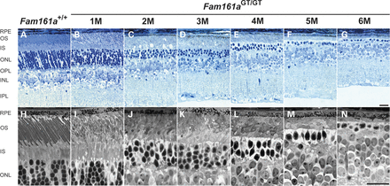
Figure 3. Disruption of the Fam161a locus leads to progressive retinal degeneration. Light microscopy of horizontal ...
Notes:
Figure 3. Disruption of the Fam161a locus leads to progressive retinal degeneration. Light microscopy of horizontal retinal cross-sections from 1- to 6-month-old animals (A–G) reveal massive photoreceptor loss in Fam161aGT/GT retinas (C–G), which is preceded by the appearance of abnormal outer and inner segment morphology (B). High-magnification histological images of the outer retina illustrate disorganization of photoreceptor segments (I), distorted disk stacks (J–N) and pyknotic photoreceptor nuclei (J–N) in Fam161aGT/GT retinas. After 6 months, Fam161aGT/GT retinas were almost devoid of photoreceptors. RPE, retinal pigment epithelium; OS, outer segments; IS, inner segments; ONL, outer nuclear layer; OPL, outer plexiform layer; INL, inner nuclear layer; IPL, inner plexiform layer; GCL, ganglion cell layer. Scale bar, 20 µm.
Unless provided in the caption above, the following copyright applies to the content of this slide: © The Author 2014. Published by Oxford University Press. All rights reserved. For Permissions, please email: journals.permissions@oup.com

Slide 4
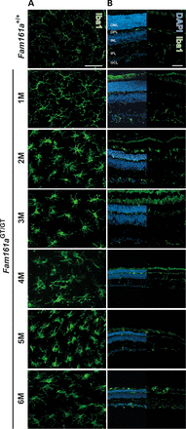
Figure 4. Microglial reactivity in the Fam161a^{GT/GT} retina. (A) Retinal whole-mount images of Iba1-positive ...
Notes:
Figure 4. Microglial reactivity in the Fam161aGT/GT retina. (A) Retinal whole-mount images of Iba1-positive microglial cells in retinas from 1- to 6-month-old wild-type and Fam161aGT/GT mice reveal progressive changes of microglial morphology, including bloated cell somata and loss of ramification. (B) Fluorescence images of Iba1-immunolabeling and DAPI counterstaining in retinal sections show microglial migration to the damaged outer retina in Fam161aGT/GT mice compared with wild-type controls. ONL, outer nuclear layer; OPL, outer plexiform layer; INL, inner nuclear layer; IPL, inner plexiform layer; GCL, ganglion cell layer. Scale bars, 50 µm.
Unless provided in the caption above, the following copyright applies to the content of this slide: © The Author 2014. Published by Oxford University Press. All rights reserved. For Permissions, please email: journals.permissions@oup.com

Slide 5
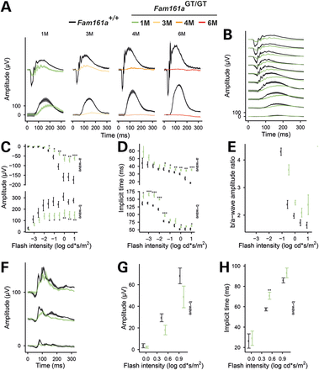
Figure 5. Disruption of the Fam161a gene causes early ERG defects. (A) Representative scotopic ERG recordings are shown ...
Notes:
Figure 5. Disruption of the Fam161a gene causes early ERG defects. (A) Representative scotopic ERG recordings are shown for two different stimulus intensities in 1-, 3-, 4- and 6-month-old Fam161aGT/GT mice (colored lines) and age-matched wild-type mice (Fam161a+/+, black lines). (B) Average of dark-adapted ERG waveforms for all stimulus intensities (green lines, 1-month-old Fam161aGT/GT; black lines, age-matched wild-type). (C–E) Comparison of corresponding a- and b-wave amplitudes, implicit times and b/a-wave ratios of Fam161aGT/GT (green) mice versus age-matched controls (black). (F) Average light-adapted (photopic) ERG recordings at three different stimulus intensities of 1-month-old Fam161aGT/GT animals (green lines) versus age-matched wild-type (black lines). Fam161aGT/GT animals (green) showed reduced waveform amplitudes (G) and prolonged implicit times (H) in comparison with wild-type (black) at the age of 1 month. *P < 0.05; **P < 0.01; ***P < 0.001. One-way ANOVA, followed by multiple t-test using the Holm–Sidak method.
Unless provided in the caption above, the following copyright applies to the content of this slide: © The Author 2014. Published by Oxford University Press. All rights reserved. For Permissions, please email: journals.permissions@oup.com

Slide 6
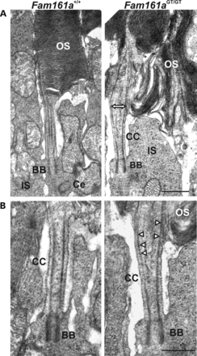
Figure 6. Ultrastructural analysis of Fam161a^{GT/GT} photoreceptor cilia. (A) Electron micrographs of ...
Notes:
Figure 6. Ultrastructural analysis of Fam161aGT/GT photoreceptor cilia. (A) Electron micrographs of longitudinal sections through the ciliary region of photoreceptor cells of 1-month-old Fam161aGT/GT and wild-type mice. Photoreceptor outer segment (OS) disks of Fam161aGT/GT mice were disorganized in a perpendicular orientation and the outer segment base was widened (double headed arrow). (B) High magnification view of the connecting cilium (CC). Fam161aGT/GT photoreceptors had shortened connecting cilia with their microtubules spread (arrowheads) in their upper part (above arrow). The structure of the ciliary base, namely the basal body (BB) and the adjacent daughter centriole (Ce), or other organelles of inner segment (IS) were not altered in Fam161aGT/GT mice. Scale bars, 500 nm.
Unless provided in the caption above, the following copyright applies to the content of this slide: © The Author 2014. Published by Oxford University Press. All rights reserved. For Permissions, please email: journals.permissions@oup.com

Slide 7
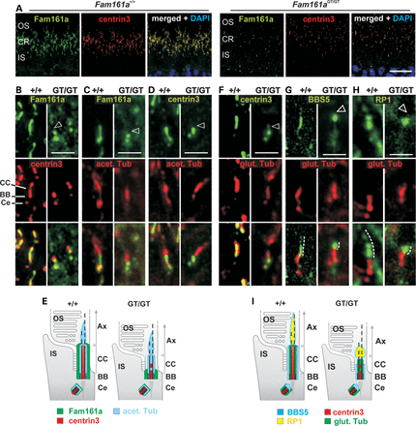
Figure 7. Ciliary marker analysis in Fam161a^{GT/GT} photoreceptor cells. (A) Indirect immunofluorescence ...
Notes:
Figure 7. Ciliary marker analysis in Fam161aGT/GT photoreceptor cells. (A) Indirect immunofluorescence co-labeling of Fam161 and centrin3 of inner- (IS) and outer segments (OS) of photoreceptors revealed strongly reduced Fam161a levels in a disrupted ciliary region (CR) of Fam161aGT/GT mice compared with wild-type animals. (B–D) High magnifications of the connecting cilium (CC) in wild-type retinas show the co-localization of Fam161a with the ciliary proteins centrin3 (B), acetylated α-tubulin (C) and co-localization of centrin3 with acetylated α-tubulin (D). (E) The cartoon describes the organization of the photoreceptor connecting cilium and the (mis)localization of the respective proteins examined in wild-type and Fam161aGT/GT mice. (F–H) High magnifications of the connecting cilium in wild-type and Fam161aGT/GT retinas show the co-localization of glutamylated α-tubulin with the ciliary protein centrin3 (F) and the outer segment marker proteins BBS5 (G) and RP1(H). (I) The cartoon describes the organization of the photoreceptor connecting cilium and the localization of the respective proteins examined in wild-type and Fam161aGT/GT mice. Yellow color in merged pictures denotes co-localization, and arrowheads point to missing protein labels. The truncated Fam161a protein is restricted to the basal body (BB) and the adjacent centriole (Ce) in Fam161aGT/GT mice (B and C). Centrin3 resembles Fam161a mislocalization but remains slightly at the base of the connecting cilium (B and D). Tubulin acetylation was mainly detected adjacent to the proximity of Fam161a/centrin3 staining in both, wild-type and Fam161aGT/GT mice (C and D), while labeling of glutamylated tubulin was shortened in Fam161aGT/GT mice (F–H). Both axoneme (Ax) markers, BBS5 and RP1, are linearly located in wild-type OS, but aggregate at the OS base in Fam161aGT/GT mice (G and H). OS, outer segment; IS, inner segment; Ax, axoneme; CC, connecting cilium; BB, basal body; Ce, centriole. Scale bar, 2 µm.
Unless provided in the caption above, the following copyright applies to the content of this slide: © The Author 2014. Published by Oxford University Press. All rights reserved. For Permissions, please email: journals.permissions@oup.com

Slide 8
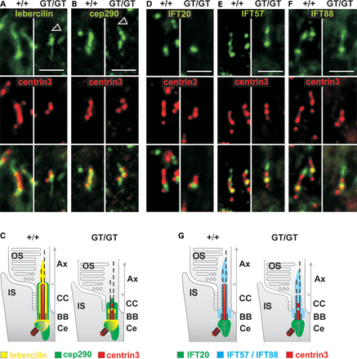
Figure 8. Analysis of Fam161a interaction partners and IFT components in Fam161a^{GT/GT} photoreceptor cells. ...
Notes:
Figure 8. Analysis of Fam161a interaction partners and IFT components in Fam161aGT/GT photoreceptor cells. (A–F) High magnifications of the connecting cilium co-labeled with the ciliary marker centrin3 and lebercilin (Lca5) (A), Cep290 (B), or the IFT components IFT20 (D), IFT57 (E) and IFT88 (F). (C and G) Cartoons describe the organization of the photoreceptor connecting cilia and the localization of the respective proteins examined in wild-type and Fam161aGT/GT mice. Yellow color in merged pictures denotes co-localization, and arrowheads point to missing protein labels. In wild-type photoreceptors, lebercilin (A) was located in all ciliary compartments and Cep290 perfectly co-localized with centrin3 (B). In Fam161aGT/GT mice only the lebercilin localization at the ciliary base remained (A), whereas Cep290 partially co-localized with centrin3 (B). IFT20 (D) was localized at the ciliary base, whereas IFT57 (E) and IFT88 (F) exhibited additional localization and at the tip of the connecting cilium (D–F). This localization pattern was not changed in Fam161aGT/GT mice. OS, outer segment; IS, inner segment; Ax, axoneme; CC, connecting cilium; BB, basal body; Ce, centriole. Scale bar, 2 µm.
Unless provided in the caption above, the following copyright applies to the content of this slide: © The Author 2014. Published by Oxford University Press. All rights reserved. For Permissions, please email: journals.permissions@oup.com

Slide 9
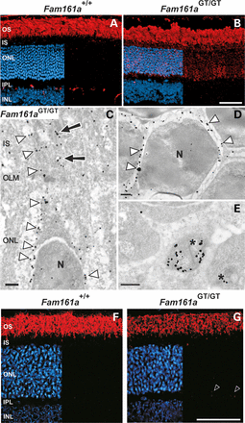
Figure 9. Mislocalization of opsin and peripherin2 in Fam161a^{GT/GT} retinas. (A and B) Merged ...
Notes:
Figure 9. Mislocalization of opsin and peripherin2 in Fam161aGT/GT retinas. (A and B) Merged immunofluorescence images of opsin-immunoreactivity (red) with DAPI-counterstain (blue) in retinal sections from (A) wild-type mice and (B) 1-month-old Fam161aGT/GT mice. (B) Images of retinas from 1-month-old Fam161aGT/GT mice reveal opsin immunoreactivity lining photoreceptor nuclei in the outer nuclear layer (ONL), as well as scattered opsin immunoreactivity along the inner segments of photoreceptors. (C–E) Silver enhanced immunogold labeling of opsin in rod cells of 1-month-old Fam161aGT/GT mice. Opsin was mislocalized to the cytoplasmic membrane (arrowheads) and internal membranes (arrows) of the IS (C), in the perinuclear cytoplasmic membrane (arrowheads) in the ONL (D) and in the synaptic terminals of rod ribbion synapses (E, asterisks) of Fam161aGT/GT mice. (F and G) Merged immunofluorescence images of peripherin2 immunoreactivity (red) with DAPI-counterstain (blue) in retinal sections from (F) wild-type mice and (G) 1-month-old Fam161aGT/GT mice. (G) Images of retinas from 1-month-old Fam161aGT/GT mice reveal decreased peripherin2 immunoreactivity in photoreceptor outer segments (∼50% compared with wild-type) and mislocalized peripherin2 in photoreceptor synaptic endings (white arrows OPL). OS, outer segments; IS, inner segments; ONL, outer nuclear layer; OPL, outer plexiform layer; INL, inner nuclear layer; OLM, outer limiting membrane. Scale bars: A, B, F, G, 50 µm; C–E, 0.5 µm.
Unless provided in the caption above, the following copyright applies to the content of this slide: © The Author 2014. Published by Oxford University Press. All rights reserved. For Permissions, please email: journals.permissions@oup.com

