Slide 1
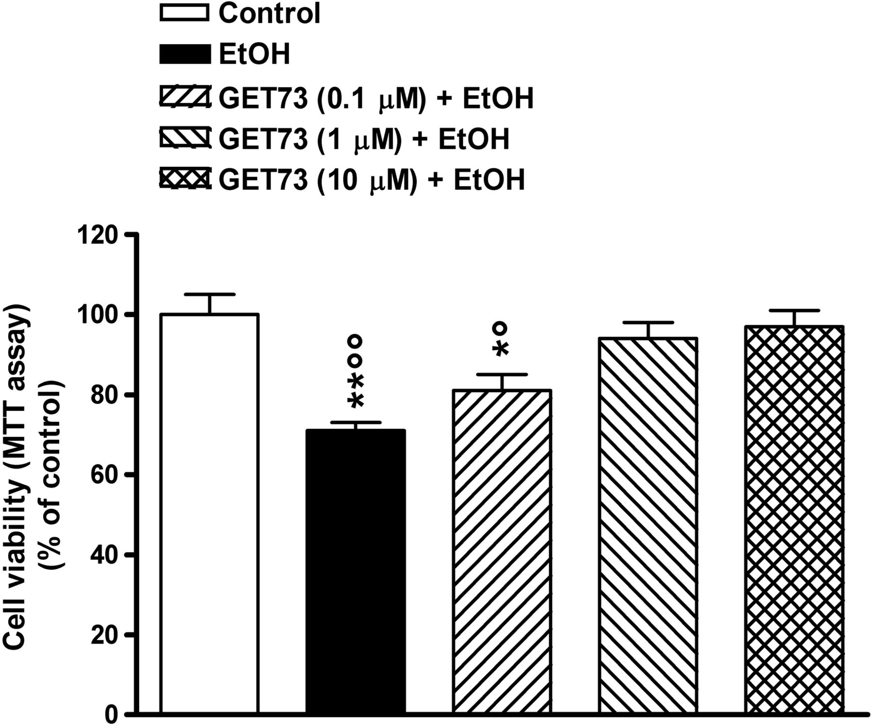
Fig. 1. Cell viability in hippocampal cell cultures exposed to ethanol (EtOH; 75 mM, 4 days) alone or in combination ...
Notes:
Fig. 1. Cell viability in hippocampal cell cultures exposed to ethanol (EtOH; 75 mM, 4 days) alone or in combination with GET73. The compound was added 1 h prior to EtOH exposure and maintained in contact with neurons during ethanol exposure. Control cultures were not exposed to EtOH. Each value represents the mean ± SEM (n = 40). *P < 0.05; **P < 0.01 significantly different from control group; °P < 0.05; °°P < 0.01 significantly different from GET73 (1 µM) + EtOH and GET73 (10 µM) + EtOH groups, according to ANOVA followed by the Newman–Keuls test for multiple comparisons.
Unless provided in the caption above, the following copyright applies to the content of this slide: © The Author 2015. Medical Council on Alcohol and Oxford University Press. All rights reserved

Slide 2
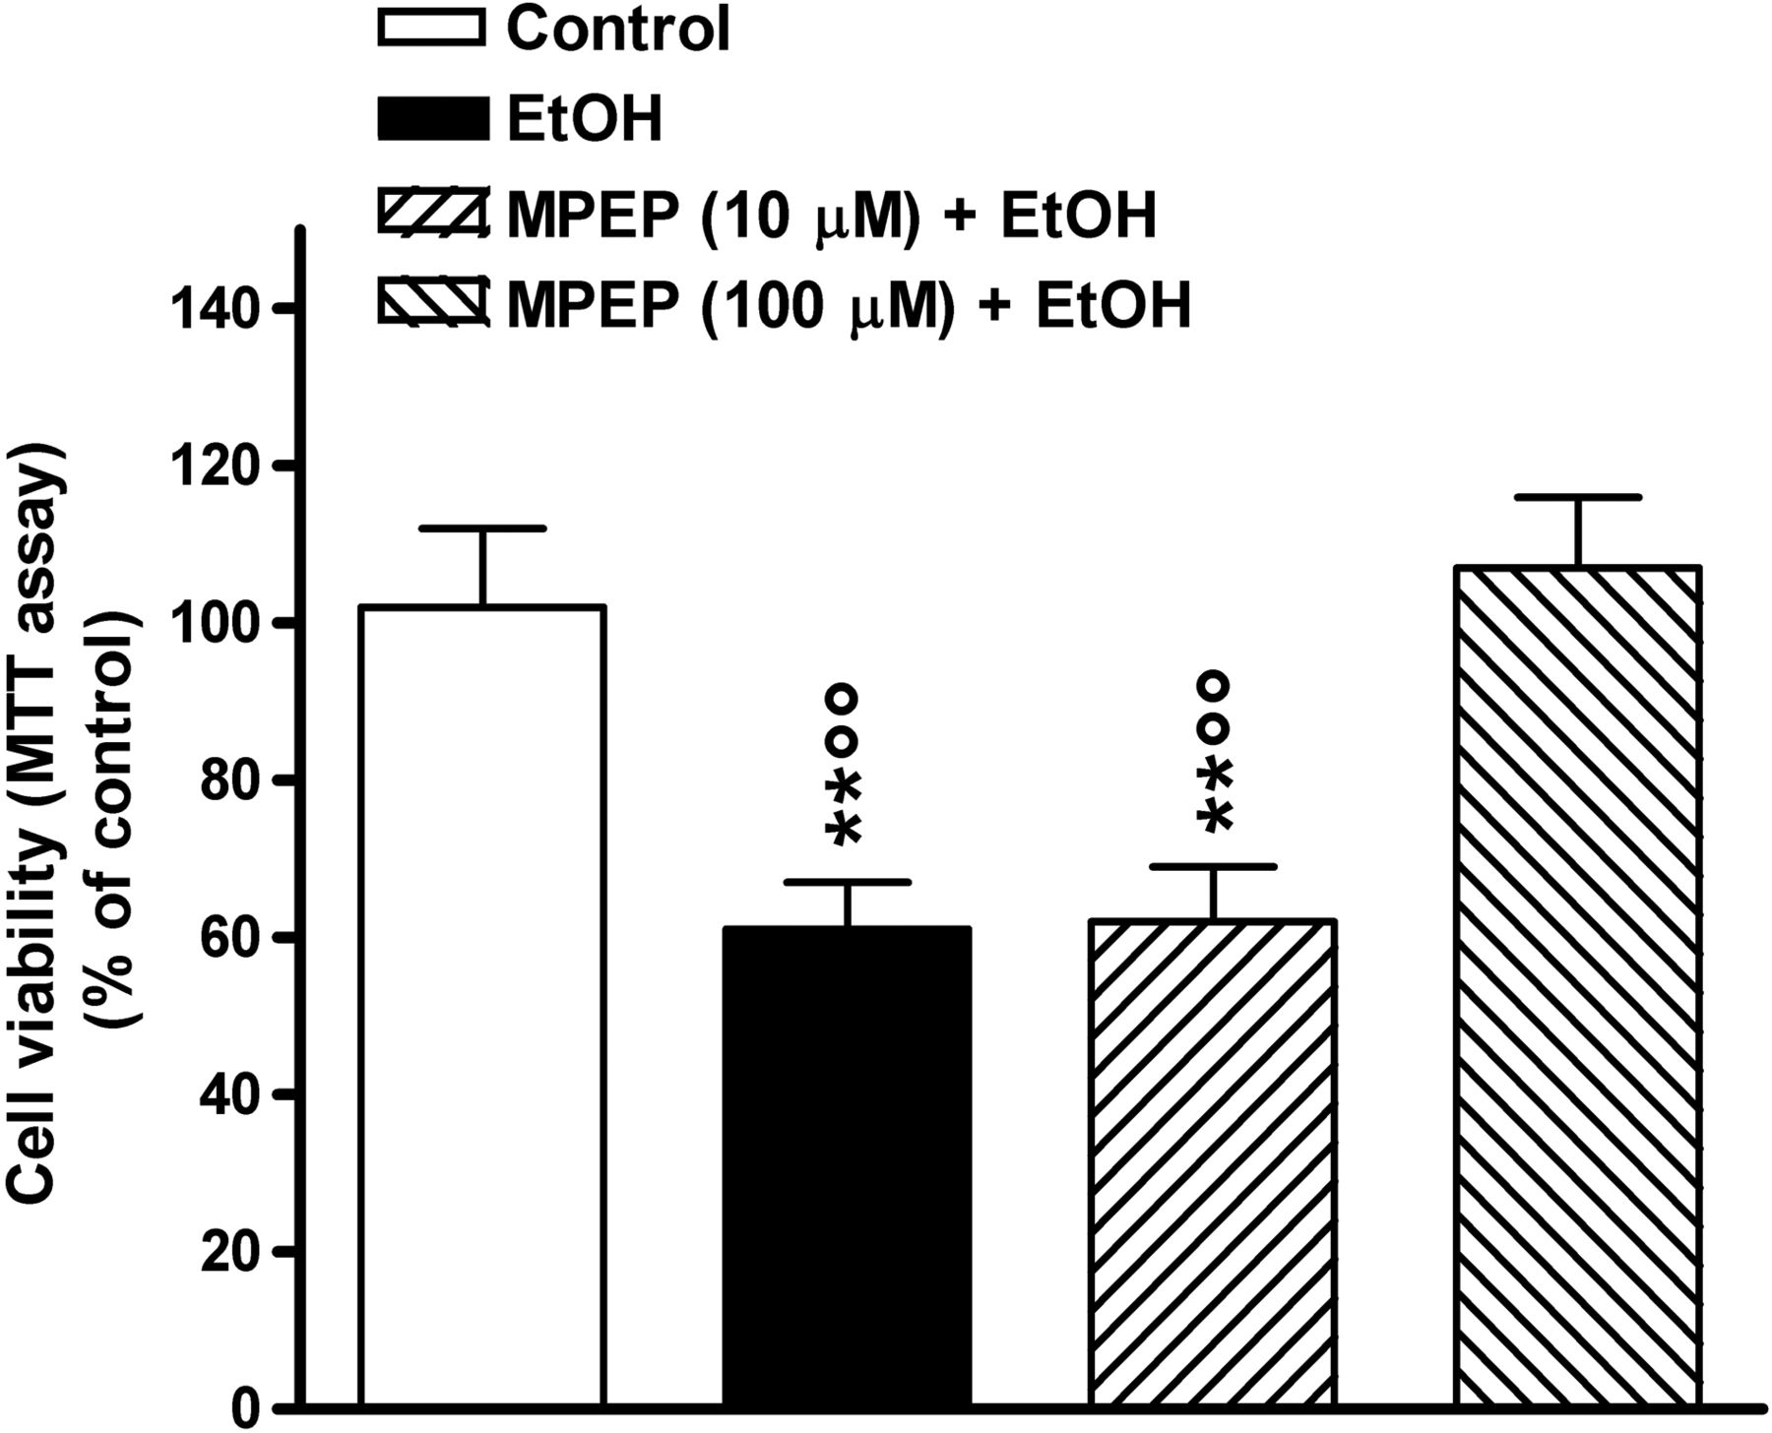
Fig. 2. Cell viability in hippocampal cell cultures exposed to ethanol (EtOH; 75 mM, 4 days) alone or in combination ...
Notes:
Fig. 2. Cell viability in hippocampal cell cultures exposed to ethanol (EtOH; 75 mM, 4 days) alone or in combination with MPEP. The negative allosteric modulator at the mGlu5 receptors was added 1 h prior to EtOH exposure and maintained in contact with neurons during ethanol exposure. Control cultures were not exposed to EtOH. Each value represents the mean ± SEM (n = 40). **P < 0.01 significantly different from control group; °°P < 0.01 significantly different from MPEP (100 µM) + EtOH group, according to ANOVA followed by the Newman–Keuls test for multiple comparisons.
Unless provided in the caption above, the following copyright applies to the content of this slide: © The Author 2015. Medical Council on Alcohol and Oxford University Press. All rights reserved

Slide 3
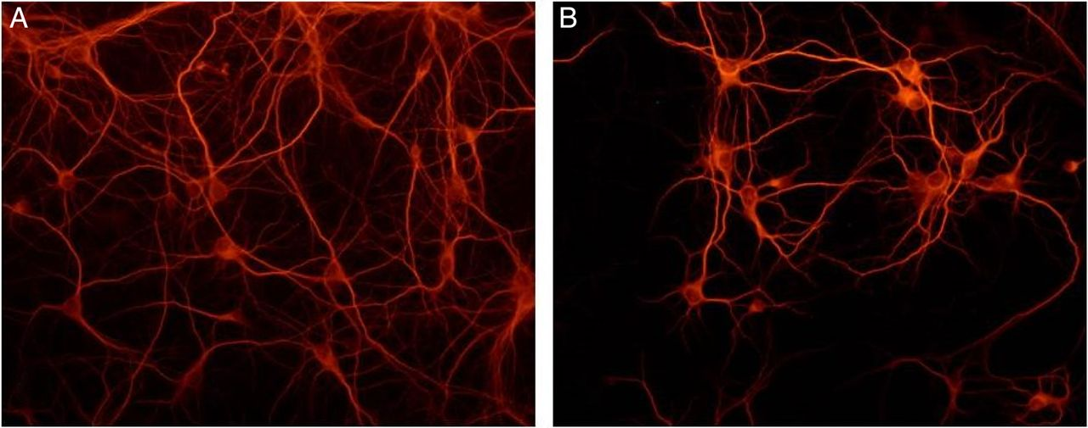
Fig. 3. Representative photomicrographs of MAP2 immunocytochemistry in hippocampal cell cultures not exposed (A) and ...
Notes:
Fig. 3. Representative photomicrographs of MAP2 immunocytochemistry in hippocampal cell cultures not exposed (A) and exposed to ethanol (75 mM, 4 days; B). Surviving neurons were stained with anti-MAP2 antibody and observed under fluorescence microscope (magnification ×20).
Unless provided in the caption above, the following copyright applies to the content of this slide: © The Author 2015. Medical Council on Alcohol and Oxford University Press. All rights reserved

Slide 4
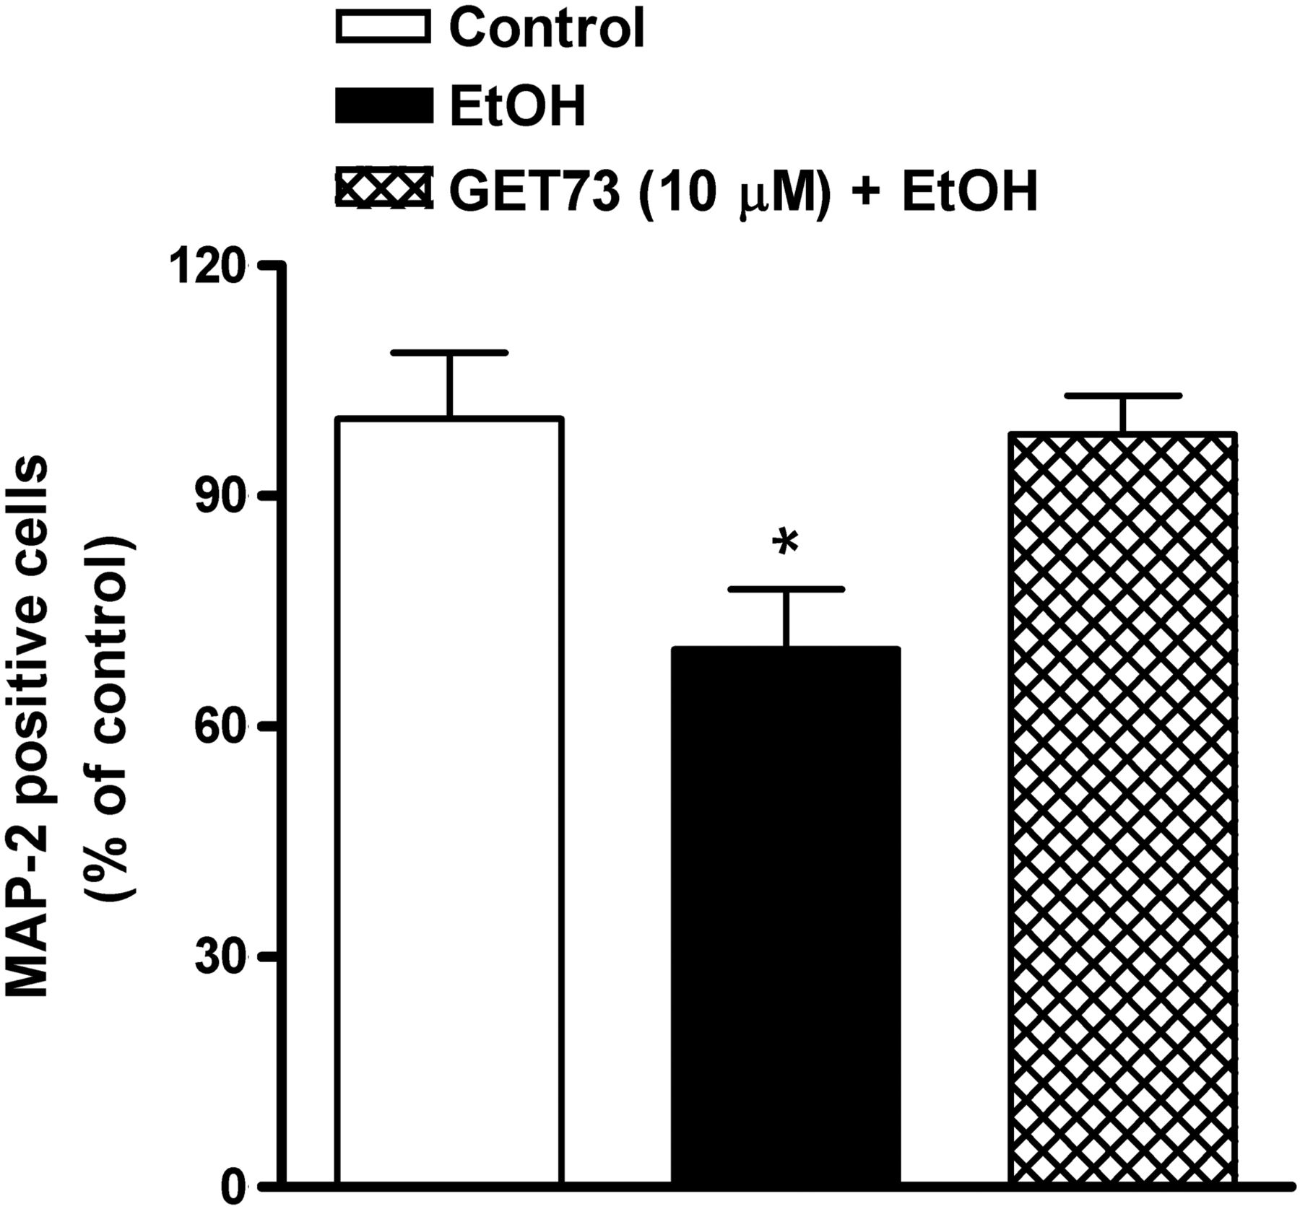
Fig. 4. MAP2 positive cell number in primary hippocampal cell cultures exposed to ethanol (EtOH; 75 mM, 4 days) alone ...
Notes:
Fig. 4. MAP2 positive cell number in primary hippocampal cell cultures exposed to ethanol (EtOH; 75 mM, 4 days) alone or in combination with GET73. Neurons were stained with anti-MAP2 antibody and observed under fluorescent microscope. GET73 was added 1 h prior to EtOH exposure and maintained in contact with neurons during ethanol exposure. Control cultures were not exposed to EtOH. Data are expressed as percentage of control values. Each value represents the mean ± SEM, n = 8. *P < 0.05 significantly different from the other groups, according to ANOVA followed by the Newman–Keuls test for multiple comparisons.
Unless provided in the caption above, the following copyright applies to the content of this slide: © The Author 2015. Medical Council on Alcohol and Oxford University Press. All rights reserved

Slide 5
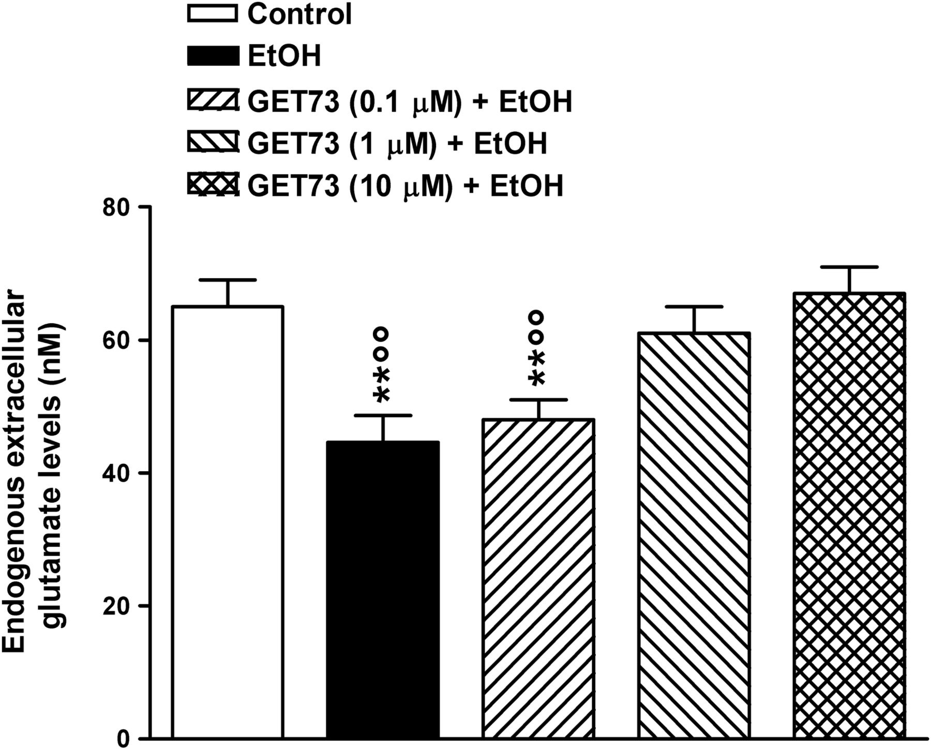
Fig. 5. Extracellular glutamate levels in hippocampal cell cultures exposed to ethanol (EtOH; 75 mM, 4 days) alone or ...
Notes:
Fig. 5. Extracellular glutamate levels in hippocampal cell cultures exposed to ethanol (EtOH; 75 mM, 4 days) alone or in combination with GET73. The compound was added 1 h prior to EtOH exposure and maintained in contact with neurons during ethanol exposure. Control cultures were not exposed to EtOH. Data are expressed as absolute values (nM). Each value represents the mean ± SEM, n = 16. **P < 0.01 significantly different from control group; °°P < 0.01 significantly different from GET73 (1 µM) + EtOH and GET73 (10 µM) + EtOH groups, according to ANOVA followed by the Newman–Keuls test for multiple comparisons.
Unless provided in the caption above, the following copyright applies to the content of this slide: © The Author 2015. Medical Council on Alcohol and Oxford University Press. All rights reserved

Slide 6
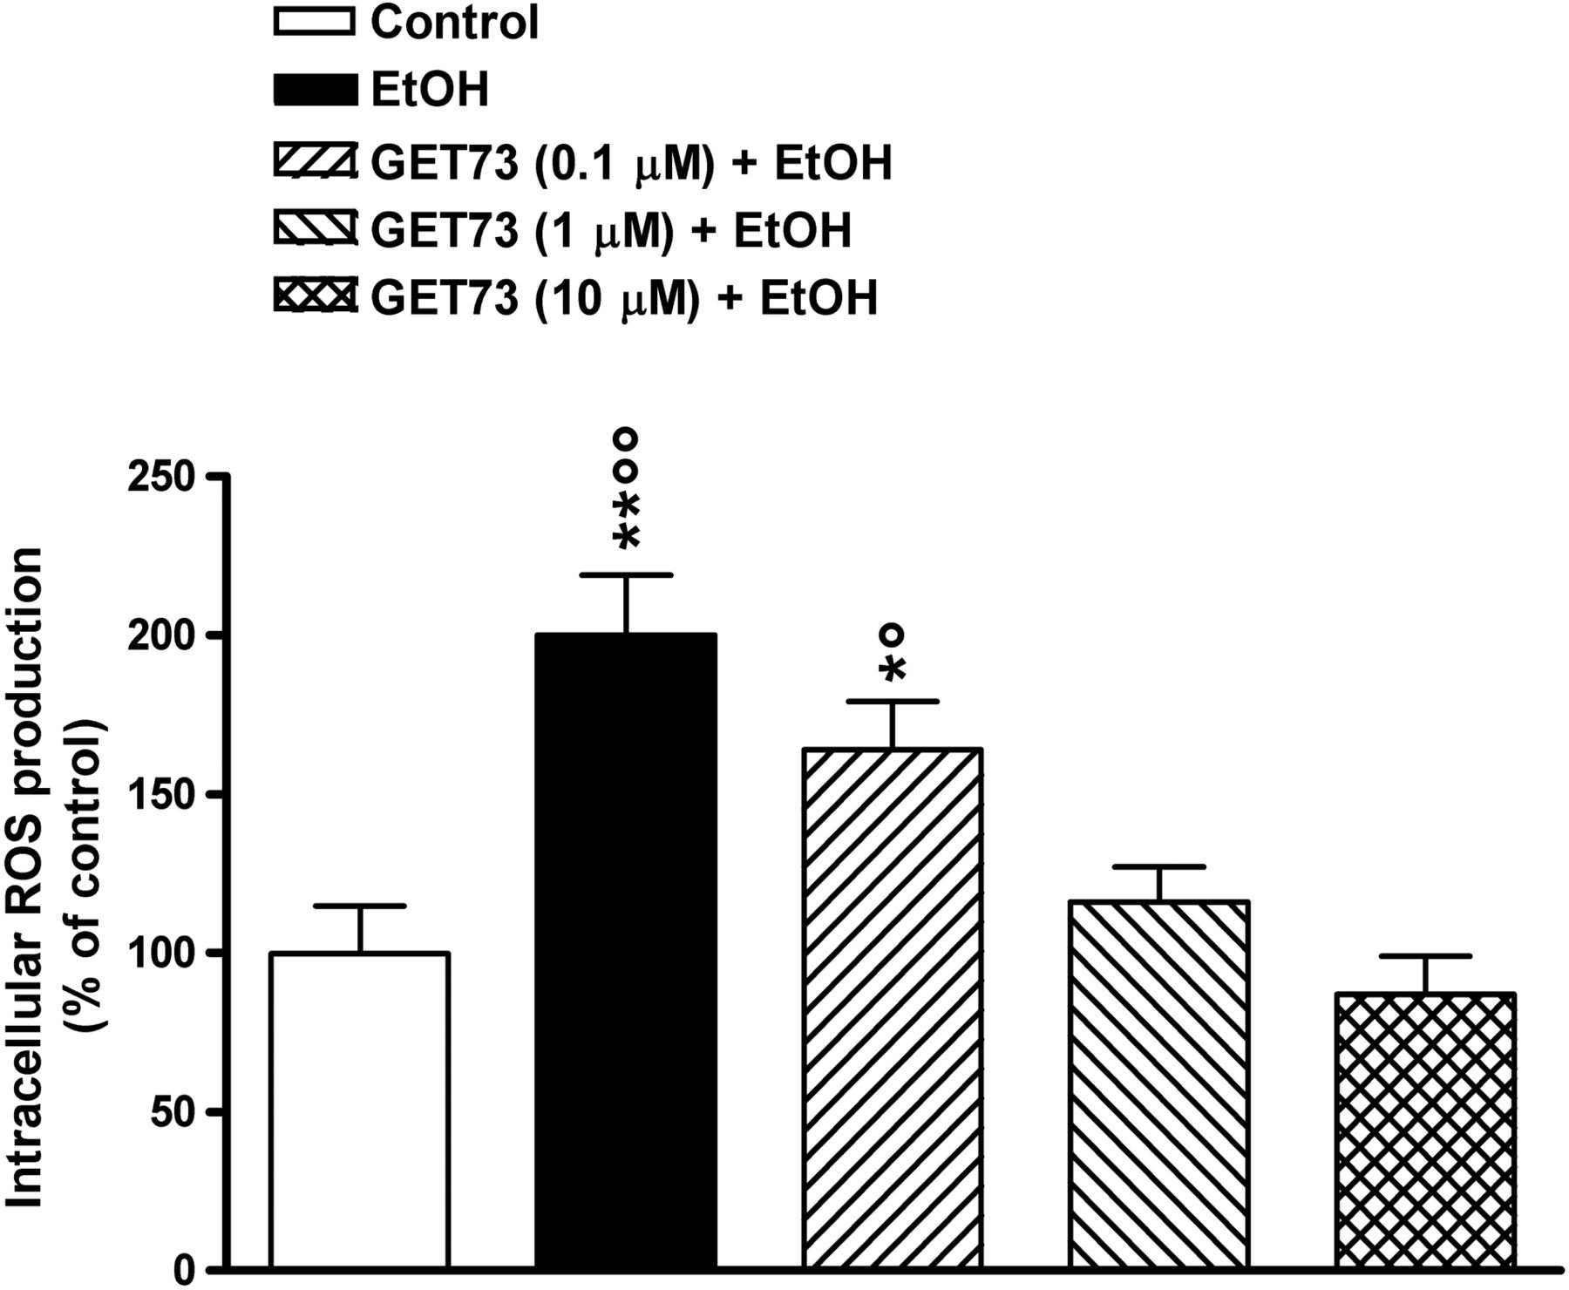
Fig. 6. Intracellular ROS production in hippocampal cell cultures exposed to ethanol (EtOH; 75 mM, 4 days) alone or ...
Notes:
Fig. 6. Intracellular ROS production in hippocampal cell cultures exposed to ethanol (EtOH; 75 mM, 4 days) alone or in combination with GET73. The compound was added 1 h prior to EtOH exposure and maintained in contact with neurons during ethanol exposure. Control cultures were not exposed to EtOH. Data are expressed as percentage of control values. Each value represents the mean ± SEM, n = 16. *P < 0.05, **P < 0.01 significantly different from control group; °P < 0.05; °°P < 0.01 significantly different from GET73 (1 µM) + EtOH and GET73 (10 µM) + EtOH groups, according to ANOVA followed by the Newman–Keuls test for multiple comparisons.
Unless provided in the caption above, the following copyright applies to the content of this slide: © The Author 2015. Medical Council on Alcohol and Oxford University Press. All rights reserved

