Slide 1
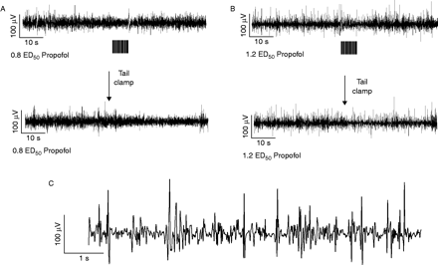
Fig 1 Examples of the raw electroencephalogram in an animal anaesthetized with propofol. The top tracing in a shows ...
Notes:
Fig 1 Examples of the raw electroencephalogram in an animal anaesthetized with propofol. The top tracing in a shows the response to 20 electrical stimuli delivered to the tail at 3 Hz at 0.8 effective dose required to prevent movement (ED50); the stimulus artefacts are below the tracing. Note that there is minimal electroencephalographic (EEG) activation. The bottom tracing in (a) shows the response to a tail clamp applied for 30 s beginning at the arrow. There is EEG activation. The tracings in (b) show the corresponding responses at 1.2 ED50; there is minimal or no EEG activation. The tracing in (c) shows the EEG spikes typically observed during propofol anaesthesia.
Unless provided in the caption above, the following copyright applies to the content of this slide: © The Board of Management and Trustees of the British Journal of Anaesthesia 2005. All rights reserved. For Permissions, please e-mail: journal.permissions@oupjournals.org

Slide 2
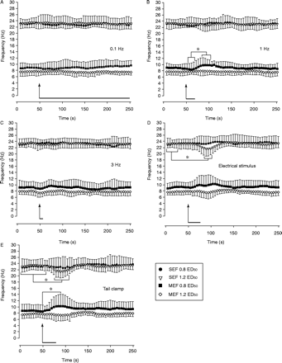
Fig 2 Summary data (mean, sd) for propofol at 0.8 and 1.2 effective dose (ED₅₀) showing the median edge ...
Notes:
Fig 2 Summary data (mean, sd) for propofol at 0.8 and 1.2 effective dose (ED50) showing the median edge frequency (MEF) and spectral edge frequency (SEF) for 20 electrical stimuli applied at (a) 0.1 Hz, (b) 1 Hz and (c) 3 Hz, as well as responses to tetanic electrical stimulus (d) and (e) tail clamp (each 30 s). Data points are plotted every 5 s. The stimuli were applied at the 50 s time point (arrow). The duration of each stimulus is noted by the black bar to the right of each arrow. Significance markers (*) show the SEF and MEF values after initiation of each stimulus that are significantly different from prestimulus (control) values. In contrast to the results with halothane, few significant changes occurred: the MEF increased with the 1 Hz stimulus and tail clamp stimulus at 0.8 ED50; there was a paradoxical decrease in the SEF at 1.2 ED50 when the tetanic electrical stimulus and the tail clamp were applied (d and e). For clarity, not all significant changes are shown, e.g. differences between the peak electroencephalographic change and the recovery values after stimulus. n=8.
Unless provided in the caption above, the following copyright applies to the content of this slide: © The Board of Management and Trustees of the British Journal of Anaesthesia 2005. All rights reserved. For Permissions, please e-mail: journal.permissions@oupjournals.org

Slide 3
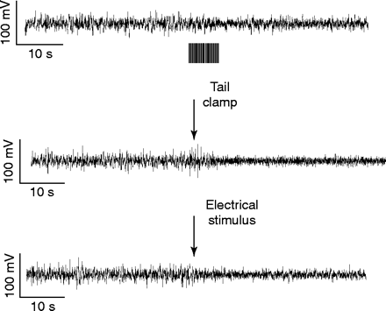
Fig 3 Examples of the raw electroencephalogram in an animal anaesthetized with halothane at 1.2 minimum alveolar ...
Notes:
Fig 3 Examples of the raw electroencephalogram in an animal anaesthetized with halothane at 1.2 minimum alveolar concentration (MAC). The top tracing shows the response to 20 electrical stimuli delivered to the tail at 3 Hz; the stimulus artefacts are below the tracing. The middle tracing shows the response to a tail clamp applied for 30 s beginning at the arrow. The bottom tracing shows the electroencephalographic (EEG) response to the 50 Hz tetanic stimulus applied to the tail for 30 s. Note that there is EEG activation with all three stimuli, especially for the latter two, despite a high halothane concentration.
Unless provided in the caption above, the following copyright applies to the content of this slide: © The Board of Management and Trustees of the British Journal of Anaesthesia 2005. All rights reserved. For Permissions, please e-mail: journal.permissions@oupjournals.org

Slide 4
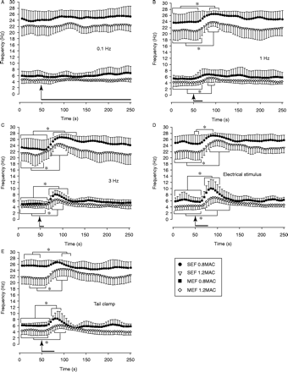
Fig 4 Summary data (mean, SD) for halothane at 0.8 and 1.2 minimum alveolar concentration (MAC). Median edge ...
Notes:
Fig 4 Summary data (mean, SD) for halothane at 0.8 and 1.2 minimum alveolar concentration (MAC). Median edge frequency (MEF) and spectral edge frequency (SEF) for twenty electrical stimuli applied at (a) 0.1 Hz, (b) 1 Hz and (c) 3 Hz, and responses to the (d) tetanic electrical stimulus and (e) tail clamp (each 30 s) are shown. Data points are plotted every 5 s. The stimuli were applied at the 50 s time point (arrow). The duration of each stimulus is noted by the black bar to the right of each arrow. Significance markers (*) show SEF and MEF values after initiation of each stimulus that are significantly different from prestimulus (control) values. The SEF and MEF increased for almost all of the stimuli, except for the 0.1 Hz stimulus and the MEF for the 1 Hz stimulus at 0.8 MAC, although in the latter example the MEF trended to increase. For clarity, not all significant changes are shown; e.g. differences between the peak electroencephalographic change and the recovery values after stimulus. n=8.
Unless provided in the caption above, the following copyright applies to the content of this slide: © The Board of Management and Trustees of the British Journal of Anaesthesia 2005. All rights reserved. For Permissions, please e-mail: journal.permissions@oupjournals.org

