Slide 1
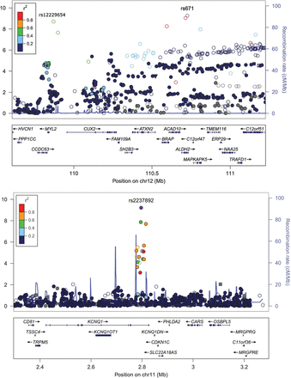
Figure 1. Regional plots for the four novel loci identified in this study. SNPs are plotted by their position on the ...
Notes:
Figure 1. Regional plots for the four novel loci identified in this study. SNPs are plotted by their position on the chromosome against their association (−log10 P-value) with BMI using Stage I (GWAS meta-analysis) data. The name and P-value for the top SNP shown on the plots is based on all combined data with full genomic control adjustment (Table 1). Estimated recombination rates (from HapMap) are plotted in cyan to reflect the local LD structure. The SNPs surrounding the top SNP (rs671 was used for the ALDH2/MYL2 locus) are color-coded (see inset) to reflect their LD with the top SNP (using pair-wise r2 values from HapMap CHB + JPT data). Genes and positions of exons, as well as directions of transcription, are shown below the plots (using data from the UCSC Genome Browser, genome.ucsc.edu). Plots were generated using LocusZoom.
Unless provided in the caption above, the following copyright applies to the content of this slide: © The Author 2014. Published by Oxford University Press. All rights reserved. For Permissions, please email: journals.permissions@oup.com

