Slide 1
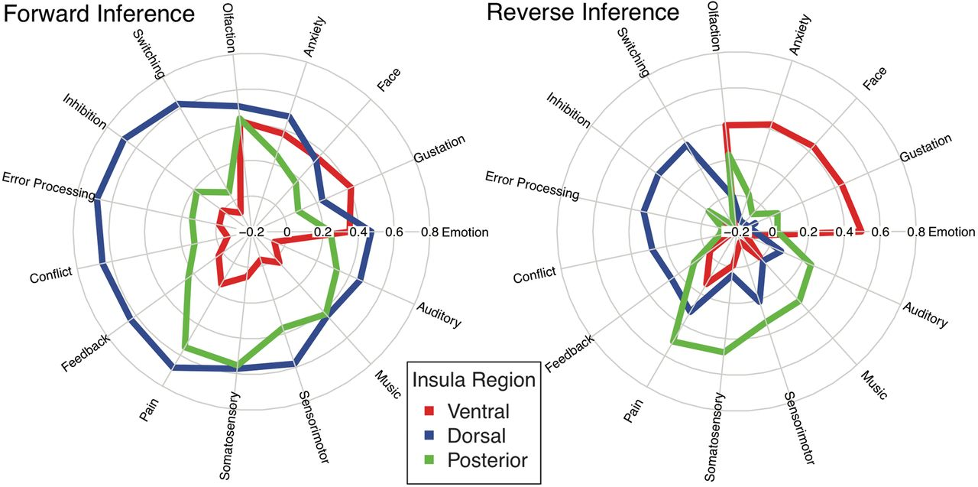
Figure 5. Consistency and specificity of functions associated with meta-analytic coactivation of parcellated insular ...
Notes:
Figure 5. Consistency and specificity of functions associated with meta-analytic coactivation of parcellated insular networks. The correlation values for the top 5 topics for each cluster using forward and reverse inference. Topics were selected if they were present in both forward and reverse inference analyses and represented nonmethod terms.
Unless provided in the caption above, the following copyright applies to the content of this slide: © The Author 2012. Published by Oxford University Press. All rights reserved. For permissions, please e-mail: journals.permissions@oup.com

Slide 2
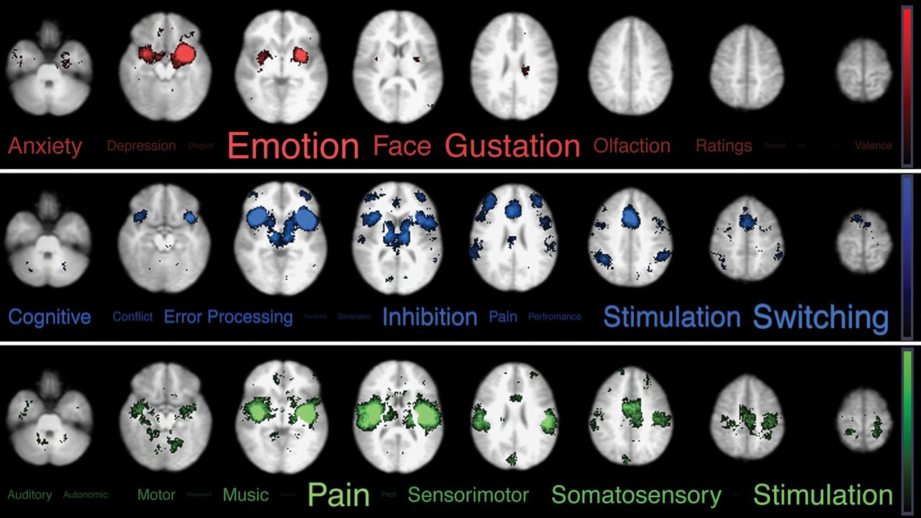
Figure 4. Functional rankings of coactivation maps. Figure 4 depicts the results of the decoding analysis. The top 15 ...
Notes:
Figure 4. Functional rankings of coactivation maps. Figure 4 depicts the results of the decoding analysis. The top 15 topics from the reverse inference analysis that were associated with each Meta-Analytic Functional Coactivation Analysis network map. Red = network associated with ventroanterior insula. Blue = network coupled with dorsoanterior insula. Green = network connected to posterior insula. Images are presented in neurological orientation and thresholded using whole brain cluster correction with an initial cluster threshold of Z > 4.5 and a Family Wise Error corrected threshold of P < 0.05 size and transparency of word clouds reflect rank-ordered correlation coefficients exponentiated to the 2nd power, which emphasizes terms that are most associated with each network (Poldrack et al. 2009).
Unless provided in the caption above, the following copyright applies to the content of this slide: © The Author 2012. Published by Oxford University Press. All rights reserved. For permissions, please e-mail: journals.permissions@oup.com

Slide 3
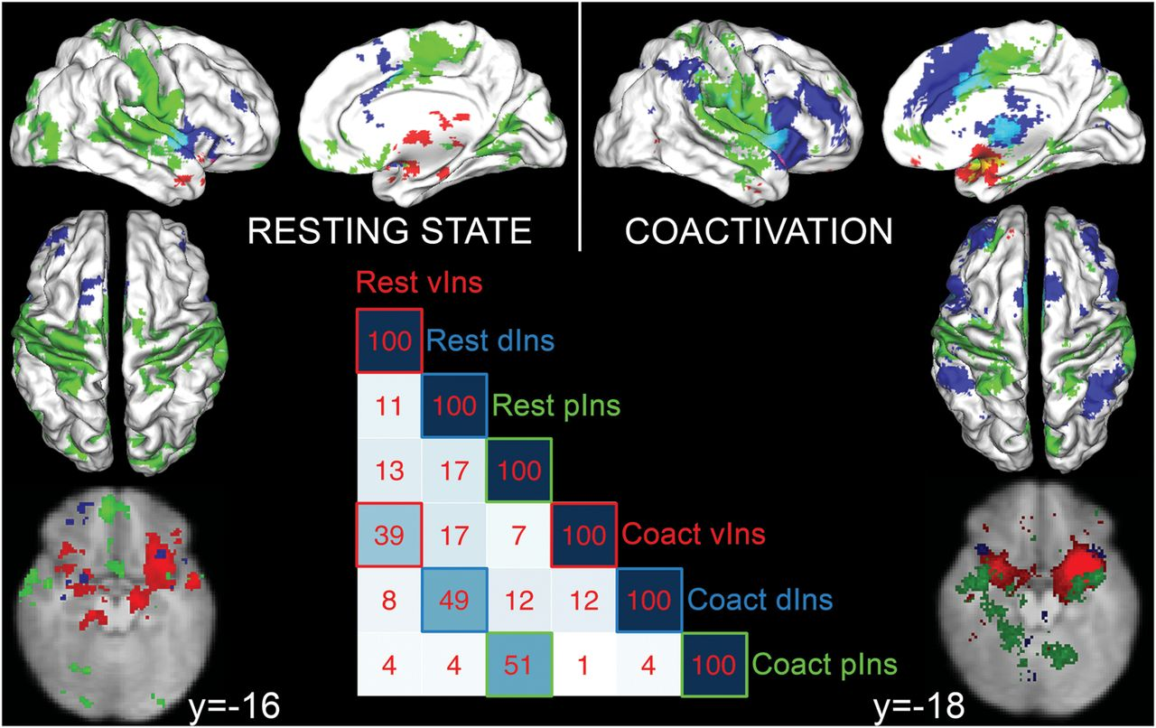
Figure 3. Positively connected functionally parcellated networks. Figure 3 depicts the brain networks that are ...
Notes:
Figure 3. Positively connected functionally parcellated networks. Figure 3 depicts the brain networks that are functionally coupled to each insular subregion controlling for activity in other subregions. The resting-state analysis assesses functional connectivity using multilevel multiple regression. The coactivation analysis highlights networks that are coactive across studies in the Neurosynth database using multiple logistic regression. vIns (red) = networks connected to the ventroanterior region of the insula. dIns (blue) = networks connected to the dorsoanterior region of the insula. pIns (green) = networks connected to the posterior insular region. Images are presented using neurological conventions (i.e., right = right). Both analyses are thresholded using whole brain cluster correction with an initial cluster threshold of Z > 2.3 for the resting state and Z > 4.5 for the coactivation and a Family Wise Error corrected threshold of P < 0.05. The correlation matrix reflects the spatial coherence of the networks using Pearson correlations multiplied by 100.
Unless provided in the caption above, the following copyright applies to the content of this slide: © The Author 2012. Published by Oxford University Press. All rights reserved. For permissions, please e-mail: journals.permissions@oup.com

Slide 4
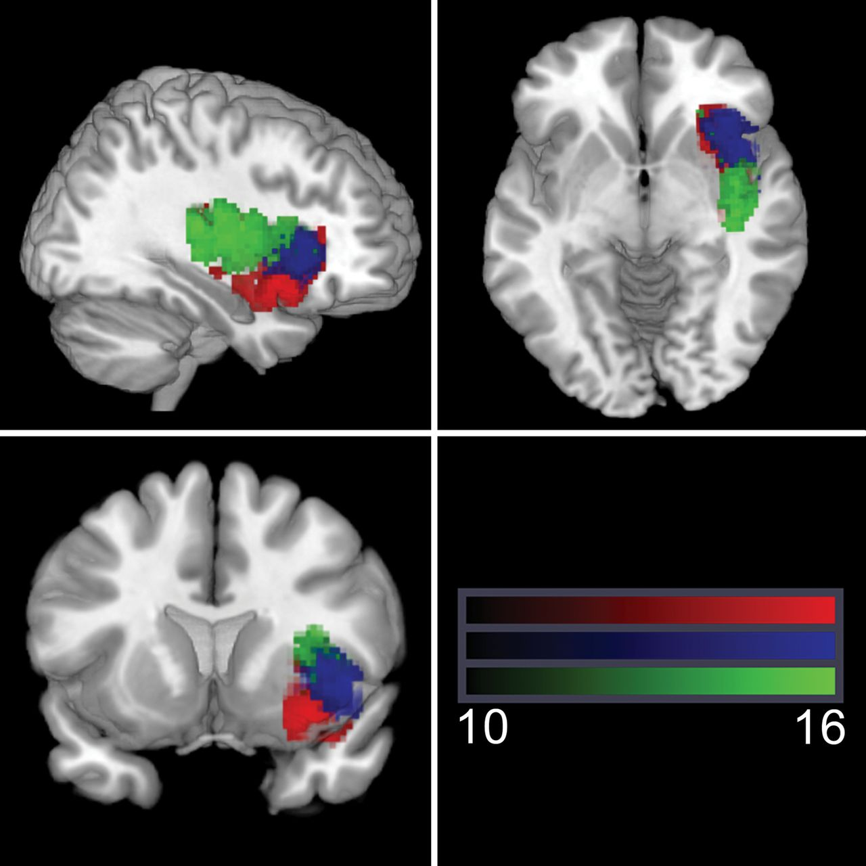
Figure 2. Results of the functional parcellation analysis. Figure 2 depicts the number of subjects loading on each ...
Notes:
Figure 2. Results of the functional parcellation analysis. Figure 2 depicts the number of subjects loading on each cluster for each voxel in the insula.
Unless provided in the caption above, the following copyright applies to the content of this slide: © The Author 2012. Published by Oxford University Press. All rights reserved. For permissions, please e-mail: journals.permissions@oup.com

Slide 5
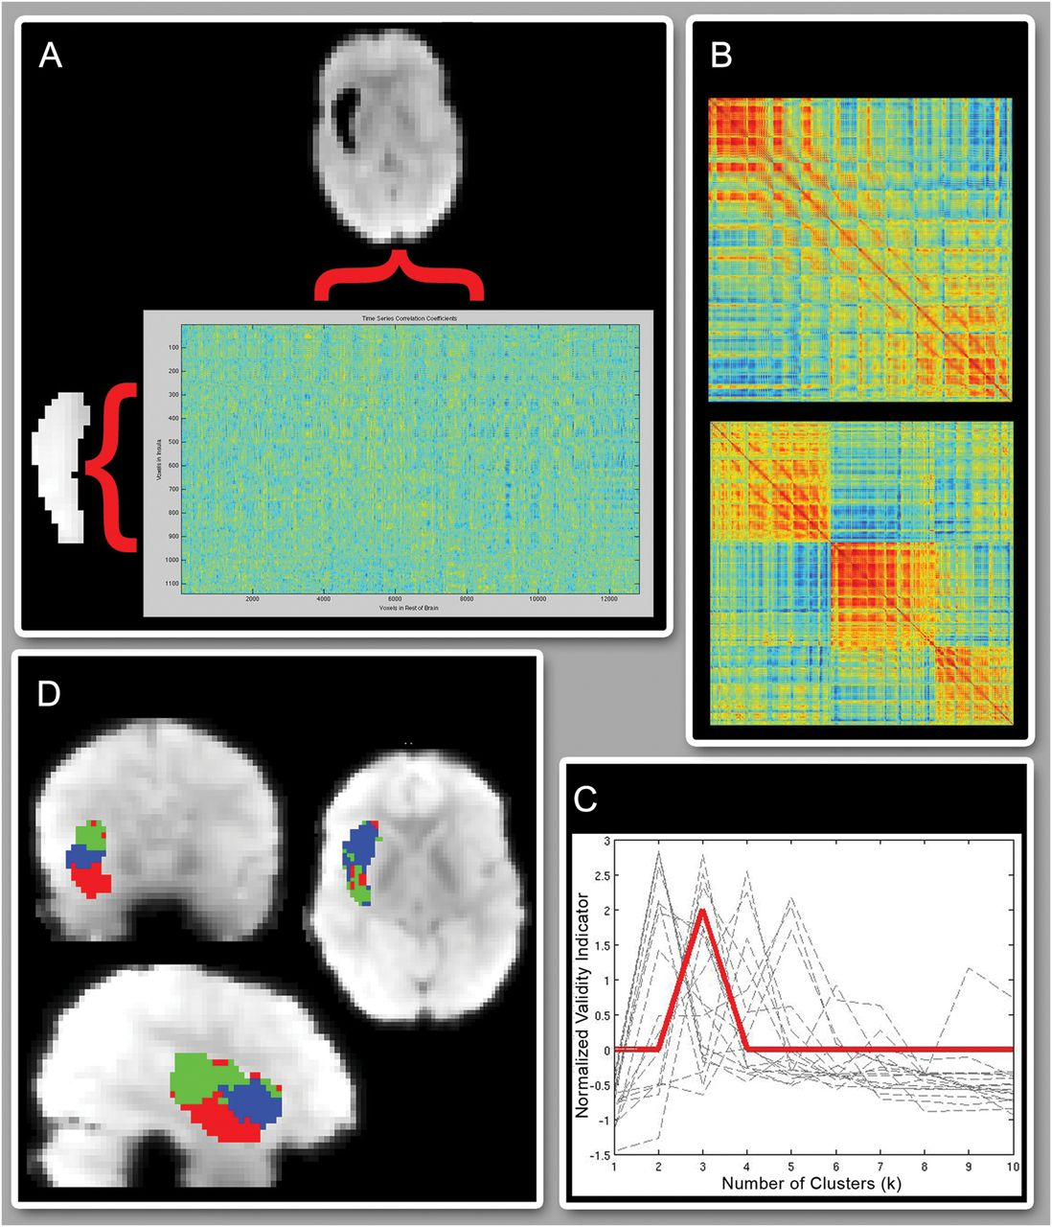
Figure 1. Functional parcellation method. Panel A depicts a high-resolution right insula (2.5 × 2.5 × 3 mm³) ...
Notes:
Figure 1. Functional parcellation method. Panel A depicts a high-resolution right insula (2.5 × 2.5 × 3 mm3) by low-resolution rest of brain matrix (5 × 5 × 6 mm3) of voxel-wise time series correlations. Panel B depicts 2 correlation matrices of voxels in the insula based on their pattern of connectivity with the rest of the brain. The upper matrix is the unordered matrix for one subject. The lower matrix is the same matrix ordered by the clustering algorithm. Panel C depicts the VI metric, which selects 3 as the optimal number of clusters (k). Panel D depicts the 3D spatial maps sorted by the results of the cluster analysis.
Unless provided in the caption above, the following copyright applies to the content of this slide: © The Author 2012. Published by Oxford University Press. All rights reserved. For permissions, please e-mail: journals.permissions@oup.com

