Slide 1
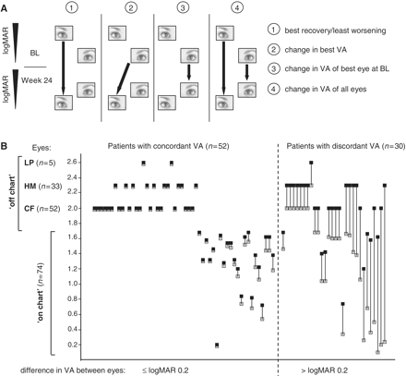
Figure 1 (A) Visual acuity efficacy end-points (filled arrows) between baseline and Week 24. (1) Primary ...
Notes:
Figure 1 (A) Visual acuity efficacy end-points (filled arrows) between baseline and Week 24. (1) Primary end-point—best recovery/least worsening in visual acuity, one value per patient. (2) Main secondary end-point—change in best visual acuity, one value per patient. (3) Pre-specified secondary end-point—change in visual acuity of best eye at baseline, one value per patient. (4) Pre-specified secondary end-point—change in visual acuity of all eyes (both eyes of a patient considered independent), two values per patient. (B) Visual acuity at baseline for all patients. Both eyes are shown for each subject, connected by a solid line (grey squares = eye with better visual acuity; black squares = eye with worse visual acuity). BL = baseline; CF = finger counting; HM = hand motion; LP = light perception; VA = visual acuity.
Unless provided in the caption above, the following copyright applies to the content of this slide: © The Author (2011). Published by Oxford University Press on behalf of the Guarantors of Brain.This is an Open Access article distributed under the terms of the Creative Commons Attribution Non-Commercial License (http://creativecommons.org/licenses/by-nc/2.5), which permits unrestricted non-commercial use, distribution, and reproduction in any medium, provided the original work is properly cited.

Slide 2
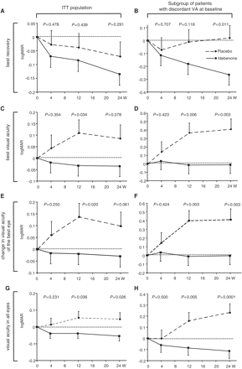
Figure 2 Change in visual acuity (logMAR) end-points over time for the change in best recovery of visual acuity (A and ...
Notes:
Figure 2 Change in visual acuity (logMAR) end-points over time for the change in best recovery of visual acuity (A and B), change in best visual acuity (C and D), change in visual acuity of the patients’ best eye at baseline (E and F) and change in visual acuity for all eyes (G and H). For each analysis two populations are presented: the whole study population (n = 82, intent-to-treat population for visual acuity end-points) (A, C, E and G) and subpopulation of patients with discordant visual acuities at baseline (n = 30, B, D, F and H). Filled squares/solid line = idebenone group; filled circles/dashed lines = placebo group, P-values for comparison between idebenone and placebo groups. Data are estimated means (±SEM) from mixed model for repeat measures based on the change from baseline. ITT = intent-to-treat; VA = visual acuity; W = weeks.
Unless provided in the caption above, the following copyright applies to the content of this slide: © The Author (2011). Published by Oxford University Press on behalf of the Guarantors of Brain.This is an Open Access article distributed under the terms of the Creative Commons Attribution Non-Commercial License (http://creativecommons.org/licenses/by-nc/2.5), which permits unrestricted non-commercial use, distribution, and reproduction in any medium, provided the original work is properly cited.

Slide 3
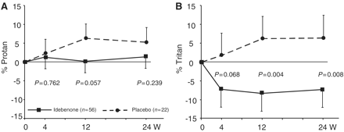
Figure 3 Change in colour contrast sensitivity for red–green (Protan; A) and blue–yellow (Tritan; B). Data are ...
Notes:
Figure 3 Change in colour contrast sensitivity for red–green (Protan; A) and blue–yellow (Tritan; B). Data are estimated mean changes from baseline (± SEM) from mixed model for repeat measures. Filled squares/solid lines = idebenone group; filled circles/dashed lines = placebo group.
Unless provided in the caption above, the following copyright applies to the content of this slide: © The Author (2011). Published by Oxford University Press on behalf of the Guarantors of Brain.This is an Open Access article distributed under the terms of the Creative Commons Attribution Non-Commercial License (http://creativecommons.org/licenses/by-nc/2.5), which permits unrestricted non-commercial use, distribution, and reproduction in any medium, provided the original work is properly cited.

Slide 4
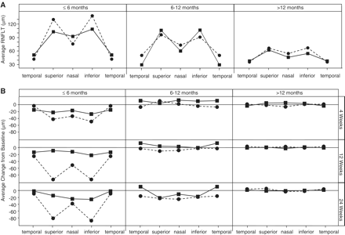
Figure 4 Retinal nerve fibre layer thickness at baseline for patients with disease onset of ≤6, 6–12 and >12 months ...
Notes:
Figure 4 Retinal nerve fibre layer thickness at baseline for patients with disease onset of ≤6, 6–12 and >12 months (A). The mean retinal nerve fibre layer thickness for the temporal, superior, nasal and inferior retinal quadrants are shown. Relative change from baseline to Weeks 4, 12 and 24 in retinal nerve fibre layer thickness (B). n = 6/4 (idebenone/placebo) for eyes with disease onset of ≤6 months; n = 8/6 for eyes with disease onset of 6–12 months; n = 32/26 for eyes with disease onset of >12 months. Filled squares/solid line = idebenone group; filled circles/dashed line = placebo group. RNFLT = retinal nerve fibre layer thickness.
Unless provided in the caption above, the following copyright applies to the content of this slide: © The Author (2011). Published by Oxford University Press on behalf of the Guarantors of Brain.This is an Open Access article distributed under the terms of the Creative Commons Attribution Non-Commercial License (http://creativecommons.org/licenses/by-nc/2.5), which permits unrestricted non-commercial use, distribution, and reproduction in any medium, provided the original work is properly cited.

