Slide 1
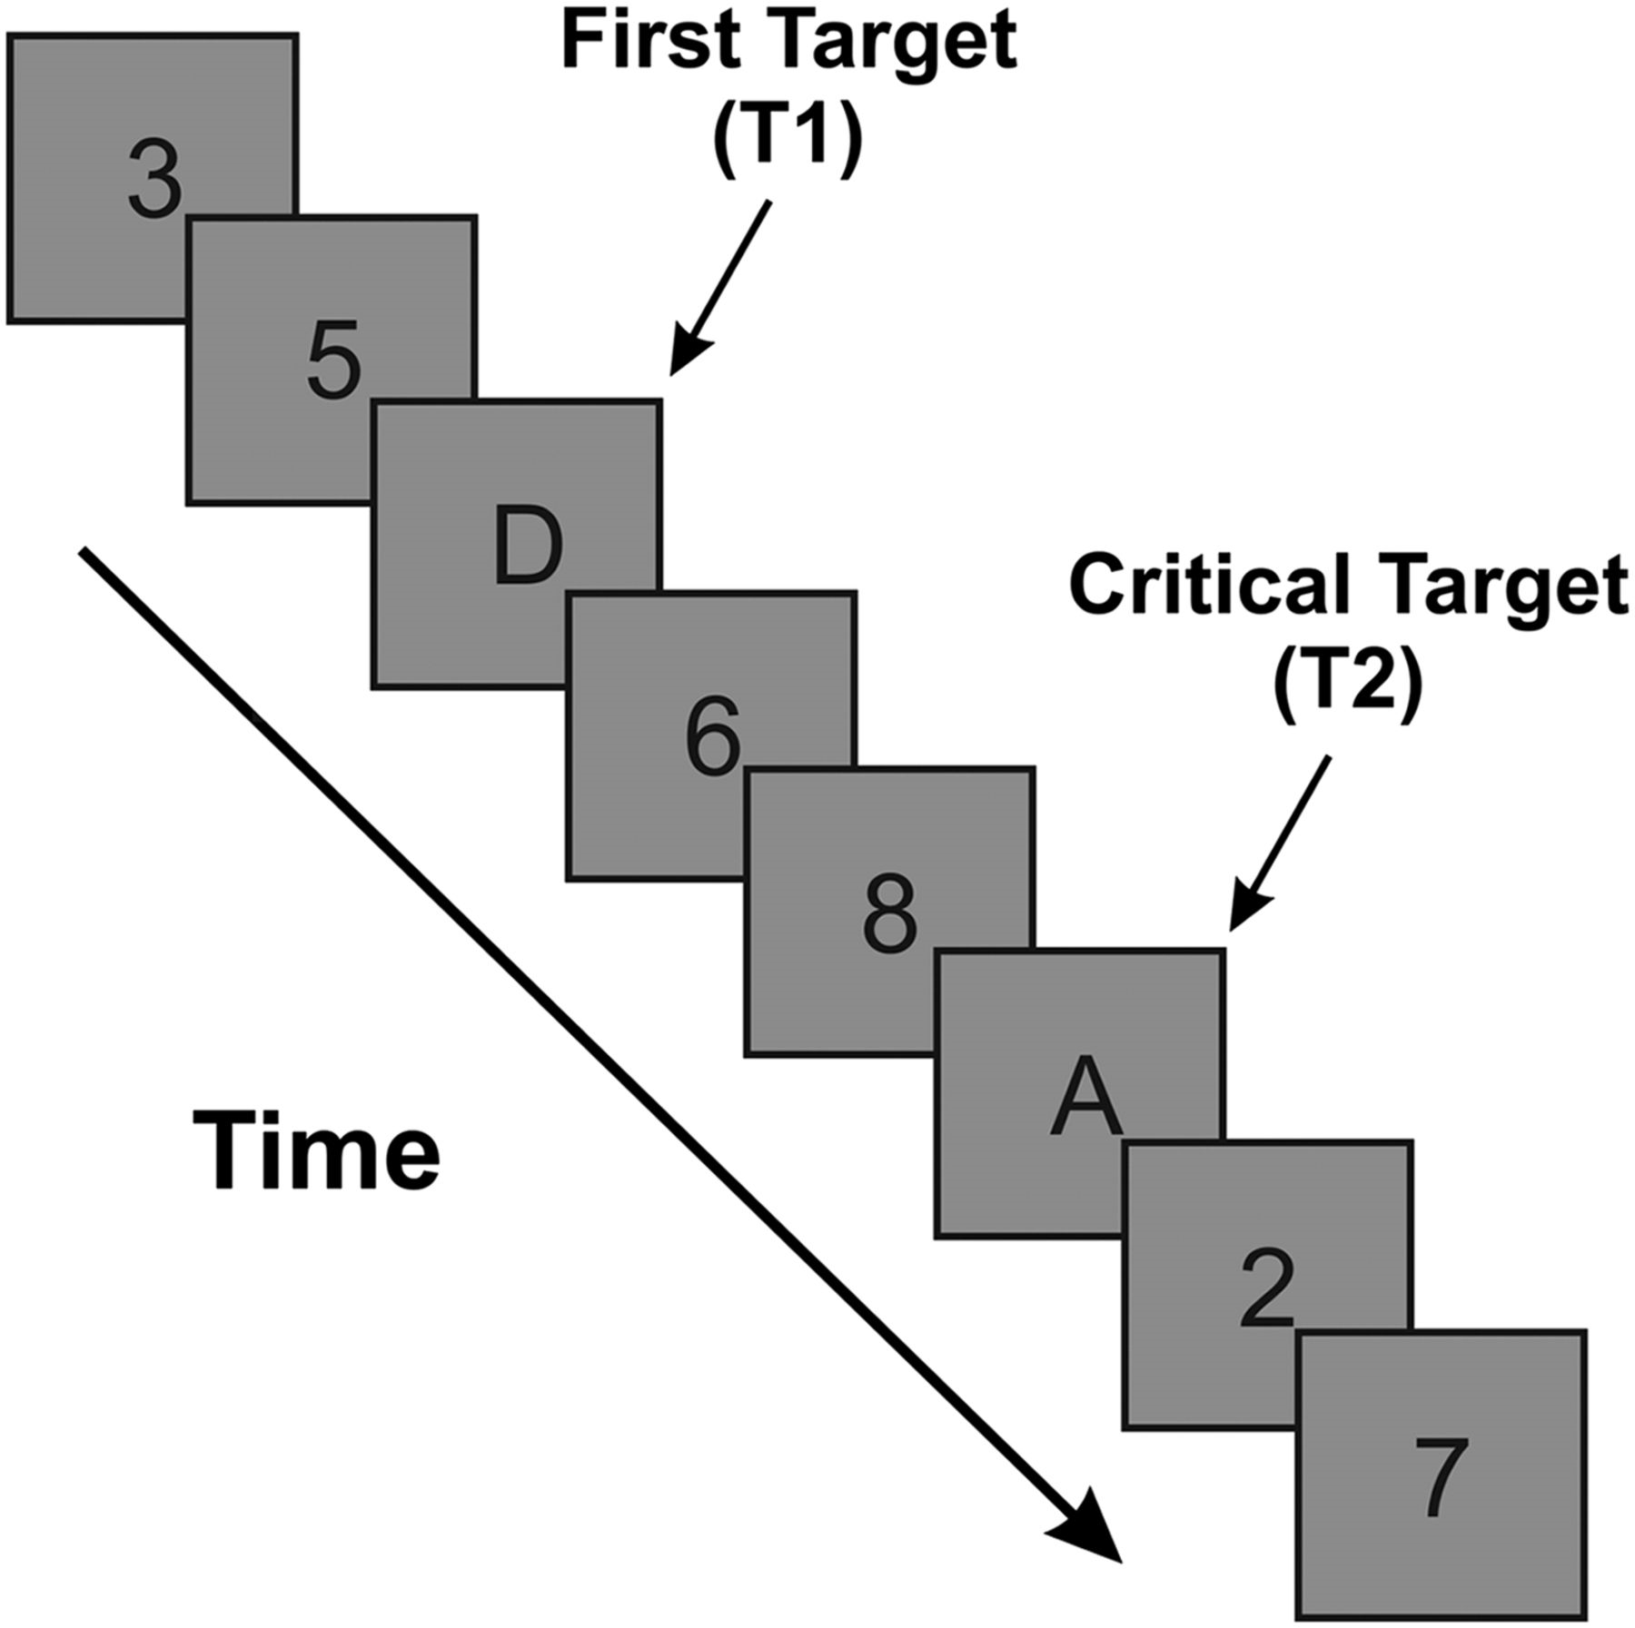
Figure 1. The AB paradigm with target letters and digit distractors. Stimuli replace one another in the center of the ...
Notes:
Figure 1. The AB paradigm with target letters and digit distractors. Stimuli replace one another in the center of the monitor at a rate of 90 ms/item. In the current EEG study, participants were required to identify the 2 letters after viewing a 19-item stream. T2 appeared at lag 3 on 90% of trials. Electroencephalographic activity was recorded before and during each stream.
Unless provided in the caption above, the following copyright applies to the content of this slide: © The Author 2011. Published by Oxford University Press. All rights reserved. For permissions, please e-mail: journals.permissions@oup.com

Slide 2
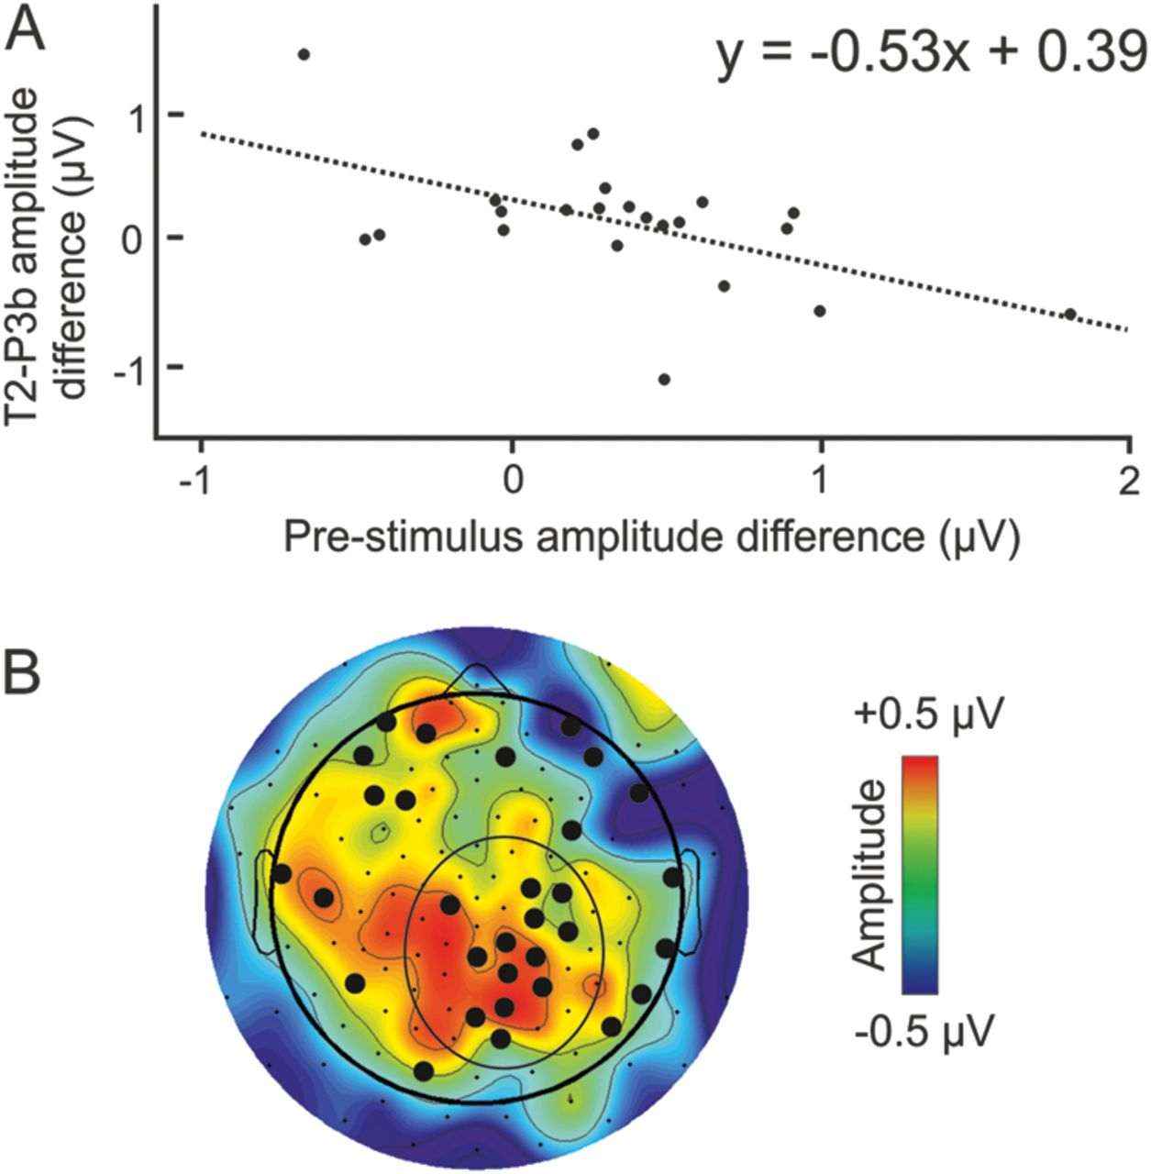
Figure 5. Relationship between correct report, prestimulus brain activity, and poststimulus brain activity. (A) ...
Notes:
Figure 5. Relationship between correct report, prestimulus brain activity, and poststimulus brain activity. (A) Correlation between the T2-P3b poststimulus effect (mean amplitude difference for T2-undetected trials minus T2-detected trials) in the parietal group of electrodes in the period 750–850 ms after T1 (which corresponded to 480–580 ms after T2) and the prestimulus effect (mean amplitude difference for T2-undetected trials minus T2-detected trials) in the frontal group of electrodes in the period 230–100 ms before the onset of the RSVP stream (which corresponded to 770–900 ms after the fixation cross). The linear regression equation is displayed. (B) Difference topography (T2-undetected trials minus T2-detected trials) for the poststimulus effect in the middle of the T2-P3b period (750–850 ms after T1 or 480–580 ms after T2). The coloring of the map shows amplitude. The bold electrodes indicate the location of electrodes with statistically significant prestimulus/poststimulus effect correlations. The circled electrodes indicate the parietal group used to calculate the T2-P3b effect.
Unless provided in the caption above, the following copyright applies to the content of this slide: © The Author 2011. Published by Oxford University Press. All rights reserved. For permissions, please e-mail: journals.permissions@oup.com

Slide 3
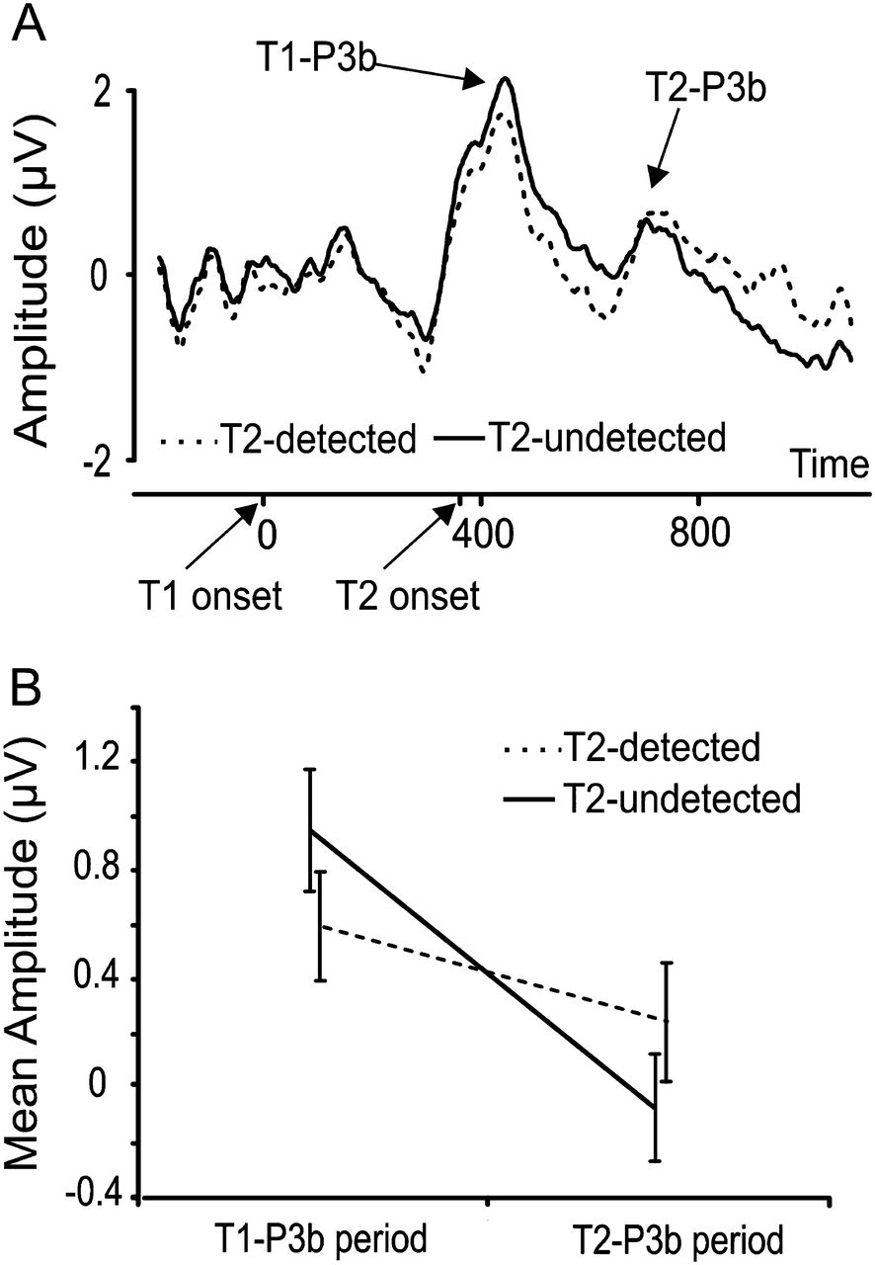
Figure 4. Poststimulus neural activity locked to T1 onset. (A) Group mean ERPs in T2-detected and T2-undetected trials ...
Notes:
Figure 4. Poststimulus neural activity locked to T1 onset. (A) Group mean ERPs in T2-detected and T2-undetected trials in the centro-parietal electrode pool. The T1-P3b and the T2-P3b ERP components are as indicated. Tukey post hoc contrasts confirmed that T1-P3b mean amplitude was significantly higher on T2-undetected trials versus T2-detected trials and that T2-P3b mean amplitude was significantly higher on T2-detected trials versus T2-undetected trials. (B) Mean amplitude of the T1-P3b and T2-P3b ERP components in the periods 300–600 ms after T1 (T1-P3b) and 650–950 ms after T1 (T2-P3b).
Unless provided in the caption above, the following copyright applies to the content of this slide: © The Author 2011. Published by Oxford University Press. All rights reserved. For permissions, please e-mail: journals.permissions@oup.com

Slide 4
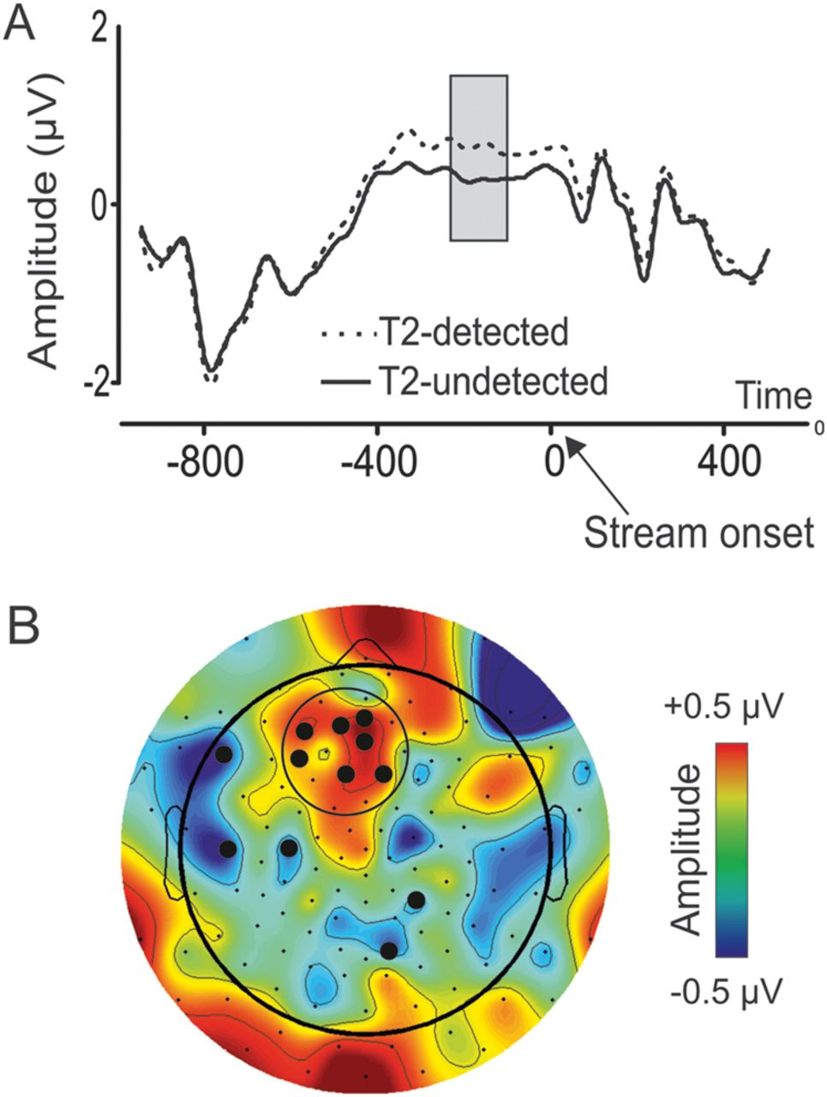
Figure 3. The prestimulus ERP effect locked to the onset of the fixation cross. (A) Group mean ERPs across T2-detected ...
Notes:
Figure 3. The prestimulus ERP effect locked to the onset of the fixation cross. (A) Group mean ERPs across T2-detected and T2-undetected trials in the frontal electrode pool. Mean amplitude was contrasted between T2-detected and T2-undetected trials in the period 230–100 ms before the onset of the RSVP stream (i.e., 770–900 ms after the onset of the fixation cross). The significant prestimulus difference between T2-detected and T2-undetected trials is marked by the gray box. (B) Difference topography for the mean amplitude of T2-detected minus T2-undetected trials in the period 230–100 ms before the RSVP stream. Highlighted electrodes indicate statistically significant differences between T2-detected and T2-undetected trials in the period 230–100 ms before the RSVP stream. The 7 circled electrodes indicate the location of the frontal electrode pool used for statistical analyses.
Unless provided in the caption above, the following copyright applies to the content of this slide: © The Author 2011. Published by Oxford University Press. All rights reserved. For permissions, please e-mail: journals.permissions@oup.com

Slide 5
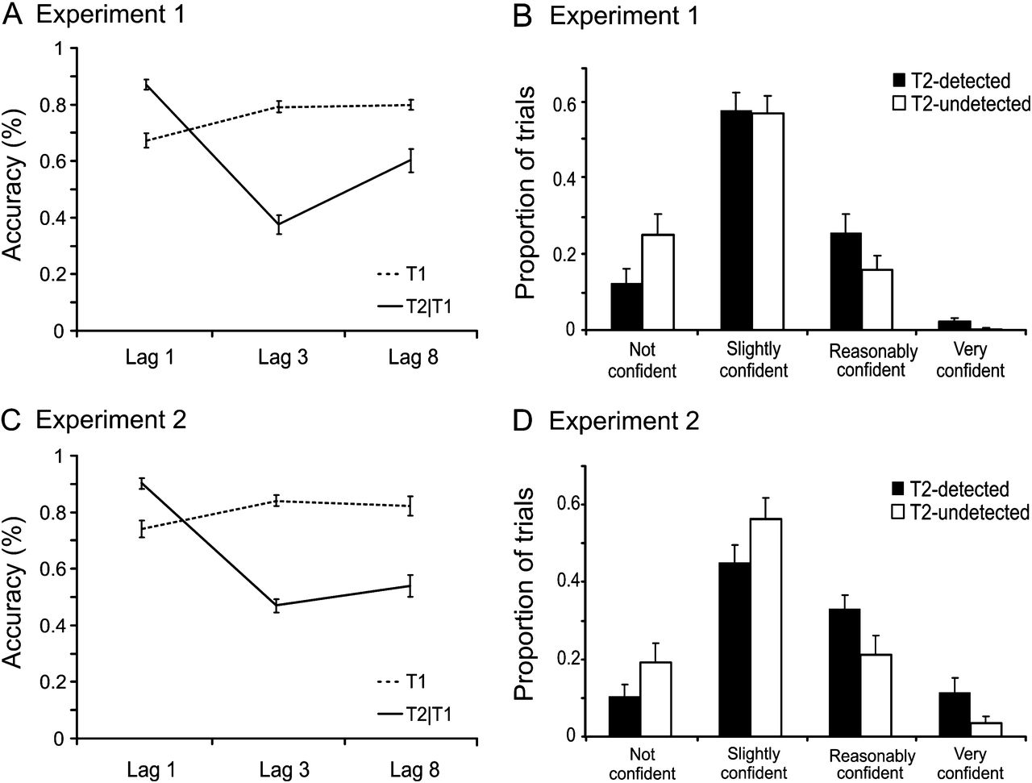
Figure 2. Behavioral data from Experiments 1 and 2. All error bars shown standard errors of the mean. (A) Accuracy for ...
Notes:
Figure 2. Behavioral data from Experiments 1 and 2. All error bars shown standard errors of the mean. (A) Accuracy for T1 and T2|T1 across lags 1, 3, and 8 in Experiment 1. Tukey post hoc contrasts confirmed that T1 accuracy was reduced at lag 1 versus lag 3 but did not differ between lags 3 and 8. Additionally, Tukey comparisons confirmed that T2|T1 accuracy was significantly higher at lag 1 than lag 3 and was higher at lag 8 versus lag 3. (B) Confidence ratings on T2-detected and T2-undetected trials in Experiment 1. (C) Accuracy for T1 and T2|T1 across lags 1, 3, and 8 in Experiment 1. Tukey post hoc contrasts revealed that T1 accuracy was reduced at lag 1 versus lag 3 but did not differ between lags 3 and 8. T2|T1 accuracy was significantly higher at lag 1 than lag 3 and did not differ between lags 3 and 8. (D) Confidence ratings on T2-detected and T2-undetected trials in Experiment 2. Across both Experiments 1 and 2, post hoc contrasts revealed that participants were more likely to use the middle 2 confidence ratings than the 2 extreme confidence ratings. Furthermore, the 2 low confidence ratings were more likely to be employed on T2-undetected trials versus T2-detected trials. Conversely, the 2 high confidence ratings were more likely to be employed on T2-detected trials versus T2-undetected trials.
Unless provided in the caption above, the following copyright applies to the content of this slide: © The Author 2011. Published by Oxford University Press. All rights reserved. For permissions, please e-mail: journals.permissions@oup.com

