Slide 1
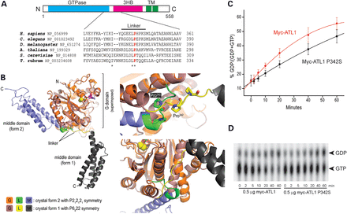
Figure 1. Atlastin-1 P342S SPG3A mutation affects a critical residue for conformational shifts. (A) Schematic diagram ...
Notes:
Figure 1. Atlastin-1 P342S SPG3A mutation affects a critical residue for conformational shifts. (A) Schematic diagram of atlastin-1 domain organization (top) and sequence comparisons among different species in the atlastin-1 linker region (bottom). Asterisks denote conserved residues, and the conserved Pro342 residue is shown in red. 3HB, three-helical bundle; TM, transmembrane domains. (B) Left, superposition of the cytosolic domain of atlastin-1 in two different crystal forms, denoted 1 and 2, with the respective GTPase domains as the reference. Right, major differences in conformation between these forms affect a GTPase domain-internal helix and the position of the 3HB domain, accompanied by restructuring of the linker region; the different positions of Pro342 are shown. This image with labels modified slightly is reproduced with permission from Byrnes and Sondermann (20). (C and D) Myc-tagged wild-type atlastin-1 or the P342 missense mutant were immunopurified from COS7 cells, and GTP hydrolysis was performed in vitro and plotted as a function of time (C). Representative thin-layer chromatography plates show conversion of GTP to GDP (D). Means ± SD are graphed.
Unless provided in the caption above, the following copyright applies to the content of this slide: Published by Oxford University Press 2014. This work is written by (a) US Government employee(s) and is in the public domain in the US.

Slide 2
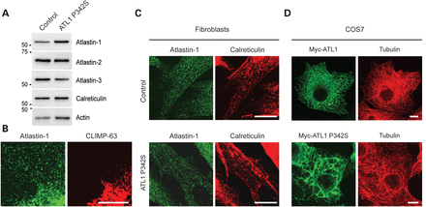
Figure 2. Atlastin P342S localizes to the tubular ER and disrupts ER morphology. (A) Aliquots of total membranes (10 μg ...
Notes:
Figure 2. Atlastin P342S localizes to the tubular ER and disrupts ER morphology. (A) Aliquots of total membranes (10 μg of protein per lane) from control or SPG3A P342S human fibroblasts were immunblotted for the indicated ER proteins. Sizes of molecular weight standards (in kDa) are at the left. (B) Fibroblasts were co-immunostained for endogenous atlastin-1 (green) and CLIMP-63 (red). (C) Control or SPG3A P342S human fibroblasts were co-immunostained for atlastin-1 (green) and calreticulin (red). (D) COS7 cells were transfected with Myc-tagged wild-type or P342S mutant atlastin-1 and co-immunostained for Myc-epitope (green) and β-tubulin (red). Scale bars: 10 μm in (B) and 20 μm in (C and D).
Unless provided in the caption above, the following copyright applies to the content of this slide: Published by Oxford University Press 2014. This work is written by (a) US Government employee(s) and is in the public domain in the US.

Slide 3
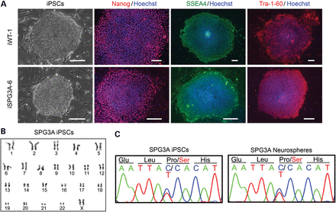
Figure 3. Generation of SPG3A iPSC lines. (A) Control and SPG3A iPSC lines expressed the human ESC markers Tra-1-60 ...
Notes:
Figure 3. Generation of SPG3A iPSC lines. (A) Control and SPG3A iPSC lines expressed the human ESC markers Tra-1-60 (red), Nanog (red) and SSEA-4 (green), as visualized by immunofluorescence microscopy. Hoechst nuclear staining is blue. Scale bars: 100 µm. (B) SPG3A iPSC lines maintained a normal 46,XX female karyotype after 10 passages as shown by G-banded analysis. (C) DNA sequencing electropherograms confirm the presence of a heterozygous c.1024C>T, p.Pro342Ser mutation before and after neural differentiation.
Unless provided in the caption above, the following copyright applies to the content of this slide: Published by Oxford University Press 2014. This work is written by (a) US Government employee(s) and is in the public domain in the US.

Slide 4
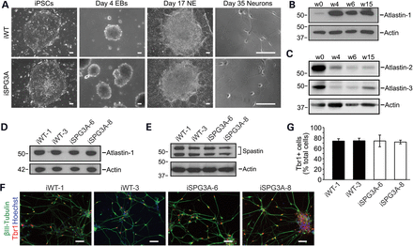
Figure 4. Neural differentiation of SPG3A iPSCs. (A) Representative differential interference contrast images of ...
Notes:
Figure 4. Neural differentiation of SPG3A iPSCs. (A) Representative differential interference contrast images of control and SPG3A cells during neural differentiation at various stages. EB, embryoid body; NE, neuroepithelial. Scale bars: 100 µm. (B) Cell aliquots were immunoblotted for atlastin-1 during different stages (Weeks 0, 4, 6 and 15) of neural differentiation. Actin levels were monitored as a control for protein loading. (C) Atlastin-2 and -3 levels decrease following neural differentiation. Cell aliquots were immunoblotted during different stages (Weeks 0, 4, 6 and 15) of neural differentiation as shown. Actin levels were monitored as a control for protein loading. (D) Immunoblot analysis of atlastin-1 protein levels in extracts from week 15 neurons derived from wild-type (iWT-1 & iWT-3) and SPG3A iPSCs (iSPG3A-6 & iSPG3A-8). Actin levels were monitored as a control for protein loading. (E) Spastin levels are not dramatically altered in SPG3A neurons. Protein samples from week 15 neurons were immunoblotted for spastin. Actin levels were monitored as a control for protein loading. (F) Both control and SPG3A neurons efficiently generated Tbr1+ (red) glutamatergic neurons. Nuclei are identified with Hoechst staining (blue), and βIII-tubulin and Tbr1 were visualized by immunofluorescence microscopy. Scale bars: 50 µm. (G) Quantification of Tbr1+ neurons did not reveal any significant differences between the indicated iPSC lines. Data are presented as means ± SD, N = 3. In (B–E), migrations of molecular mass standards in kDa are indicated to the left.
Unless provided in the caption above, the following copyright applies to the content of this slide: Published by Oxford University Press 2014. This work is written by (a) US Government employee(s) and is in the public domain in the US.

Slide 5
Figure 5. SPG3A neurons display reduced axon outgrowth. (A) Fluorescence images of tau⁺ axons from ...
Notes:
Figure 5. SPG3A neurons display reduced axon outgrowth. (A) Fluorescence images of tau+ axons from iPSC-derived neurons 2 days after plating. Scale bars: 200 µm. (B) Quantification of tau+ axon length shows a significant reduction in SPG3A neurons. Data are presented as means ± SD, N = 3–6 coverslips, with at least 1100 cells analyzed per group. **P < 0.01 versus control (iWT-1).
Unless provided in the caption above, the following copyright applies to the content of this slide: Published by Oxford University Press 2014. This work is written by (a) US Government employee(s) and is in the public domain in the US.

Slide 6
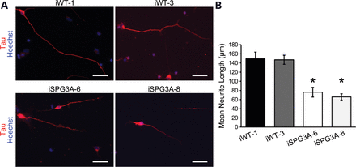
Figure 6. Reduced axon outgrowth in dissociated SPG3A neurons. (A) Control and SPG3A iPSC-derived neurons were plated ...
Notes:
Figure 6. Reduced axon outgrowth in dissociated SPG3A neurons. (A) Control and SPG3A iPSC-derived neurons were plated and cultured for 48 h prior to staining for tau. Nuclei are identified with Hoechst staining (blue). (B) Quantification of mean tau+ process length for each group. N = 3 coverslips, with at least 50 cells analyzed per group. Data are presented as means ± SD. *P < 0.05 versus controls.
Unless provided in the caption above, the following copyright applies to the content of this slide: Published by Oxford University Press 2014. This work is written by (a) US Government employee(s) and is in the public domain in the US.

Slide 7
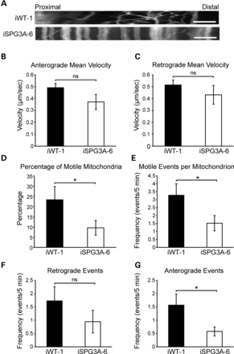
Figure 7. Decreased mitochondrial transport in SPG3A neurons. (A) Representative distance versus time kymographs show ...
Notes:
Figure 7. Decreased mitochondrial transport in SPG3A neurons. (A) Representative distance versus time kymographs show decreased motile mitochondria. Scale bar: 5 µm. (B and C) Velocities of movement events in anterograde (B) and retrograde (C) directions were not significantly affected in SPG3A neurons. (D) The percentage of motile mitochondria was significantly decreased in SPG3A neurons. (E) The number of motile movement events (velocity >300 nm/s) was also decreased in SPG3A neurons. (F and G) There was a non-significant trend toward a decreased frequency of motile movement events (per mitochondrion over 5 min) in the retrograde direction (F), whereas the frequency of events in the anterograde direction (G) was significantly reduced in SPG3A neurons. Data are presented as means ± SEM, N = 10–20 cells. *P < 0.05 versus control group (iWT-1); ns, not significant.
Unless provided in the caption above, the following copyright applies to the content of this slide: Published by Oxford University Press 2014. This work is written by (a) US Government employee(s) and is in the public domain in the US.

Slide 8
Figure 8. Vinblastine or taxol treatment partially rescues the axon outgrowth phenotype in SPG3A-derived neurons. (A) ...
Notes:
Figure 8. Vinblastine or taxol treatment partially rescues the axon outgrowth phenotype in SPG3A-derived neurons. (A) Immunofluorescence images of control (iWT-1) and SPG3A (iSPG3A-6)-plated neural clusters treated with vehicle, 10 nm vinblastine or 10 nm taxol for 48 h. Scale bars: 100 µm. (B) Quantification of axon length showed that vinblastine and taxol treatment significantly increased the length of axons in SPG3A-derived neurons. Data are presented as means ± SD, with a minimum of 1100 cells analyzed per group. *P < 0.05 versus controls (iWT-1); #P < 0.05 versus vehicle-treated SPG3A group.
Unless provided in the caption above, the following copyright applies to the content of this slide: Published by Oxford University Press 2014. This work is written by (a) US Government employee(s) and is in the public domain in the US.

