Slide 1
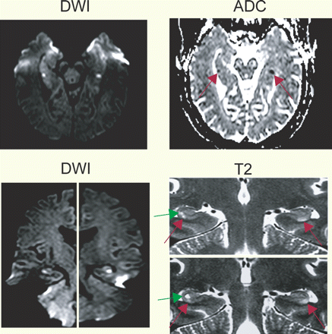
Fig. 1 Representative 3 T MRI showing typical DWI lesions with subsequent ADC changes corresponding to lesions in ...
Notes:
Fig. 1 Representative 3 T MRI showing typical DWI lesions with subsequent ADC changes corresponding to lesions in T2-weighted images. Note in this case the bilateral T2 lesions in the CA-1 sector of the cornu ammonis (red arrow) extending over 4–5 mm (slice thickness 2 mm) which are clearly separated from the cavity of the pre-existing vestigial hippocampal sulcus (green arrow) located in deeper subcortical layers in the vicinity of the gyrus dentatus.
Unless provided in the caption above, the following copyright applies to the content of this slide: © The Author (2006). Published by Oxford University Press on behalf of the Guarantors of Brain. All rights reserved. For Permissions, please email: journals.permissions@oxfordjournals.org

Slide 2
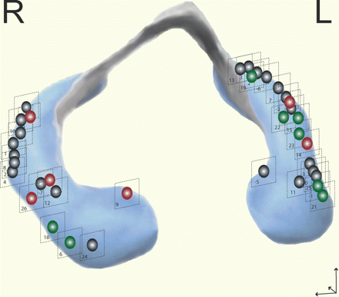
Fig. 2 (A) Anatomical template showing a representative coronary slice of the hippocampal cornu ammonis indicating ...
Notes:
Fig. 2 (A) Anatomical template showing a representative coronary slice of the hippocampal cornu ammonis indicating the vascular distribution and the topography of the CA neuronal sectors after Lorento de No (1934). Graphical template modified after Duvernoy (2005); used with permission. (B) Synopsis of all 34 DWI/T2 lacunar lesions depicted from T2-weighted images of each patient and transferred to an anatomical template of the cornu ammonis. The topography of the lesions within the cornu ammonis was referred to the distribution of the CA sectors according to the anatomical reference Atlas of Duvernoy and transferred from the MR-images to a 2D graphical model (Duvernoy, 2005). (C) Representative MRI sequences showing that lesions were confined to the CA-1 cortical areas of the cornu ammonis and were clearly distinguishable from the residual cavities of the vestigial hippocampal sulcus that were found in the subcortical layers in the vicinity of the gyrus dentatus. Note the anatomical resolution of the different neuronal layers in the 3 T MR-images.
Unless provided in the caption above, the following copyright applies to the content of this slide: © The Author (2006). Published by Oxford University Press on behalf of the Guarantors of Brain. All rights reserved. For Permissions, please email: journals.permissions@oxfordjournals.org

Slide 3
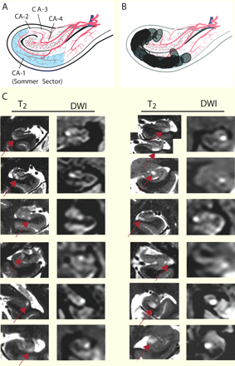
Fig. 3 Synopsis of representative DWI/T₂ lesions showing the time course of lesion evolution from the ...
Notes:
Fig. 3 Synopsis of representative DWI/T2 lesions showing the time course of lesion evolution from the acute phase of the TGA to the 6 months follow-up in identical slice positions. In almost all cases DWI changes were already detectable in the acute phase of the TGA preceding the T2 changes. No residual structural changes in the location of the acute T2 changes were detectable after 6 months after the TGA.
Unless provided in the caption above, the following copyright applies to the content of this slide: © The Author (2006). Published by Oxford University Press on behalf of the Guarantors of Brain. All rights reserved. For Permissions, please email: journals.permissions@oxfordjournals.org

Slide 4
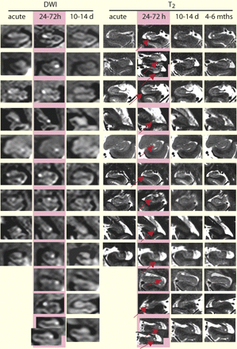
Fig. 4 Synopsis of the time course and degree of verbal memory deficits in the RAVLT subtests (sum scores values ...
Notes:
Fig. 4 Synopsis of the time course and degree of verbal memory deficits in the RAVLT subtests (sum scores values trials 1–5, retention, delayed recall and recognition) in those patients that were tested within 24 h after TGA onset and which showed memory impairments in at least one subtask of the RAVLT. *P < 0.05, paired t-test. The age-matched reference values for the RAVLT were as follows (mean ± SD) (Geffen et al., 1990): sum score list I-V: 49.0 ± 7.1 (f), 37.7± 8.4 (m); retention: 9.8 ± 1.6 (f), 7.2 ± 2.8 (m); delayed recall: 10.3 ± 2.3 (f), 7.1 ± 3.8 (m); recognition: 13.8 ± 1.1 (f), 12.4 ± 2.8 (m) (f = female; m = male).
Unless provided in the caption above, the following copyright applies to the content of this slide: © The Author (2006). Published by Oxford University Press on behalf of the Guarantors of Brain. All rights reserved. For Permissions, please email: journals.permissions@oxfordjournals.org

Slide 5
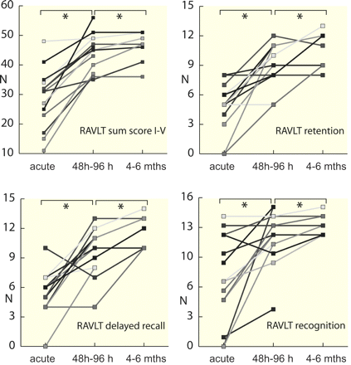
Fig. 5 3D model of the hippocampus showing the anterior–posterior distribution of the DWI/T₂ lesions with ...
Notes:
Fig. 5 3D model of the hippocampus showing the anterior–posterior distribution of the DWI/T2 lesions with a preponderance of the left side. Lesions were located in the lateral hippocampus and were equally distributed along the anterior–posterior axis of the hippocampus thus showing no preference for the vascular territories of the supplying posterior cerebral artery or the anterior choroidal artery, the latter supplying the head of the hippocampus. Green spots indicate lesions with impaired verbal memory during the acute phase while red spots indicate lesions of additional non-verbal memory deficits. Please note that one patient with impaired non-verbal memory (red) was left-handed. Black spots indicate normal memory testing (24 h). Template modified after , used with permission.
Unless provided in the caption above, the following copyright applies to the content of this slide: © The Author (2006). Published by Oxford University Press on behalf of the Guarantors of Brain. All rights reserved. For Permissions, please email: journals.permissions@oxfordjournals.org

