Slide 1
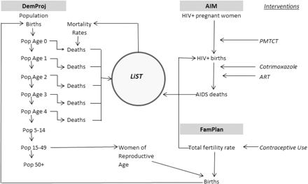
Figure 1 Interactions between LiST and other modules in Spectrum
Notes:
Figure 1 Interactions between LiST and other modules in Spectrum
Unless provided in the caption above, the following copyright applies to the content of this slide: Published by Oxford University Press on behalf of the International Epidemiological Association © The Author 2010; all rights reserved.This is an Open Access article distributed under the terms of the Creative Commons Attribution Non-Commercial License (http://creativecommons.org/licenses/by-nc/2.5/) which permits unrestricted non-commercial use, distribution, and reproduction in any medium, provided the original work is properly cited.

