Slide 1
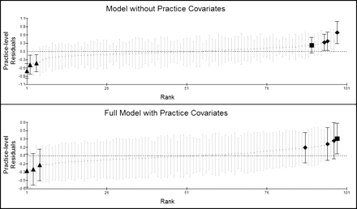
Figure 1. Practice-level effects by practice.
Notes:
Figure 1. Practice-level effects by practice.
Unless provided in the caption above, the following copyright applies to the content of this slide: © The Author 2011. Published by Oxford University Press on behalf of the Society for Research on Nicotine and Tobacco. All rights reserved. For permissions, please e-mail: journals.permissions@oup.com

