Slide 1
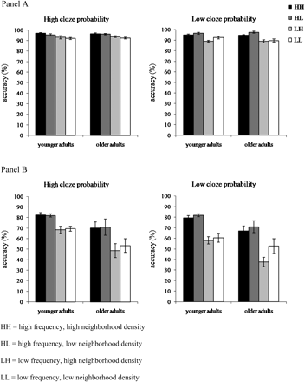
Figure 1. Average accuracy by signal-to-noise ratio (SNR), group, cloze probability, and condition. Error bars ...
Notes:
Figure 1. Average accuracy by signal-to-noise ratio (SNR), group, cloze probability, and condition. Error bars represent standard error. Panel A: SNR = +10 dB. Panel B: SNR = −3 dB.
Unless provided in the caption above, the following copyright applies to the content of this slide: © The Author 2010. Published by Oxford University Press on behalf of The Gerontological Society of America. All rights reserved. For permissions, please e-mail: journals.permissions@oxfordjournals.org.

Slide 2
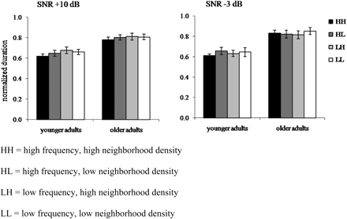
Figure 2. Average normalized duration by signal-to-noise ratio (SNR), group, and condition. Error bars represent ...
Notes:
Figure 2. Average normalized duration by signal-to-noise ratio (SNR), group, and condition. Error bars represent standard error. Normalized duration was measured as the time from response onset to response offset divided by the length of the stimulus sentence.
Unless provided in the caption above, the following copyright applies to the content of this slide: © The Author 2010. Published by Oxford University Press on behalf of The Gerontological Society of America. All rights reserved. For permissions, please e-mail: journals.permissions@oxfordjournals.org.

Slide 3
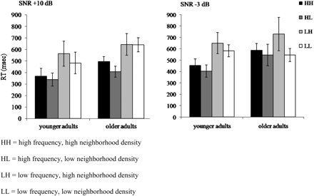
Figure 3. Average response time by signal-to-noise ratio (SNR), group, and condition. Error bars represent standard ...
Notes:
Figure 3. Average response time by signal-to-noise ratio (SNR), group, and condition. Error bars represent standard error. Response time was measured as the time from stimulus offset to response onset.
Unless provided in the caption above, the following copyright applies to the content of this slide: © The Author 2010. Published by Oxford University Press on behalf of The Gerontological Society of America. All rights reserved. For permissions, please e-mail: journals.permissions@oxfordjournals.org.

