Slide 1
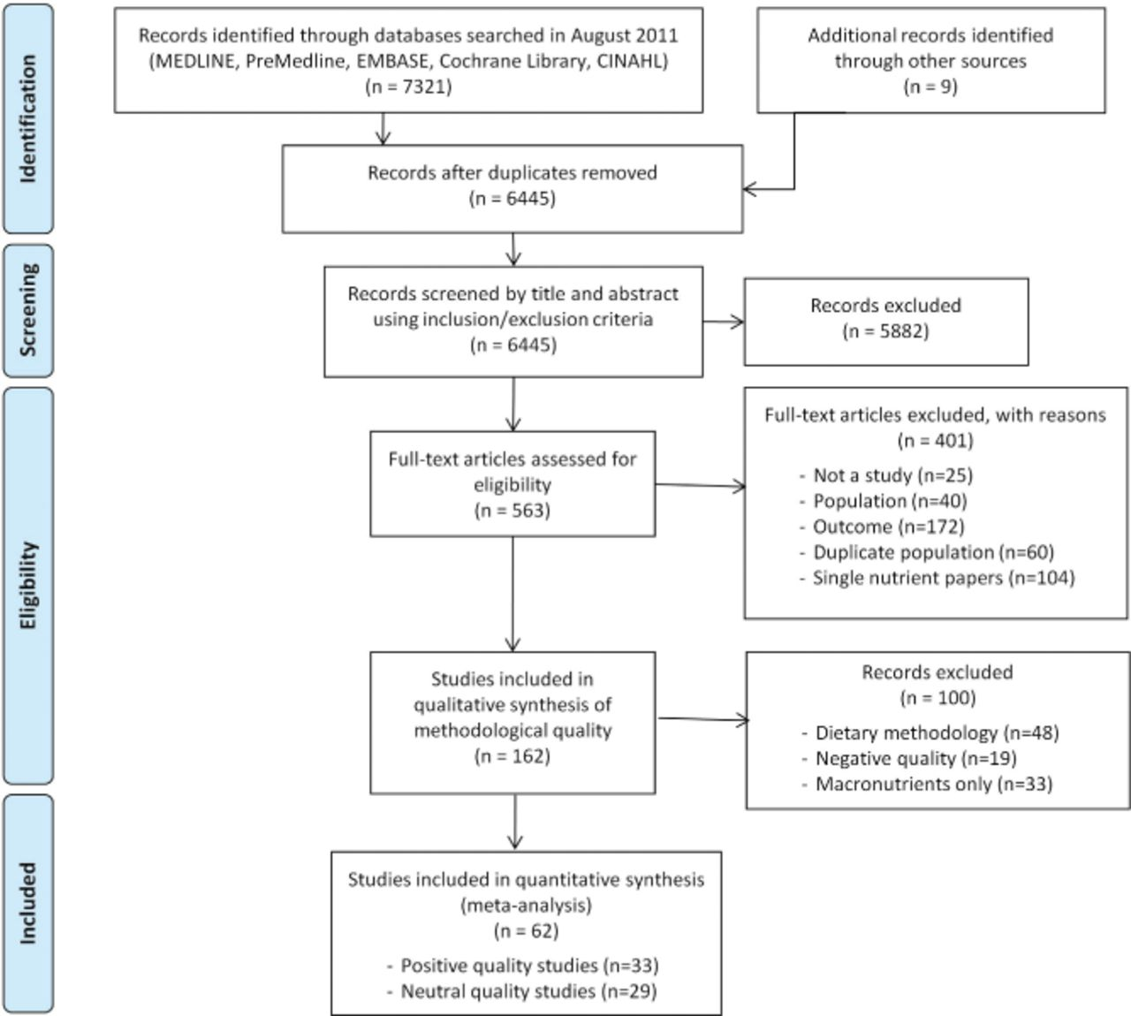
Figure 1 Flow diagram for the selection of included studies. Each stage of the selection process was conducted by two ...
Notes:
Figure 1 Flow diagram for the selection of included studies. Each stage of the selection process was conducted by two independent reviewers.
Unless provided in the caption above, the following copyright applies to the content of this slide: © 2013 International Life Sciences Institute

Slide 2
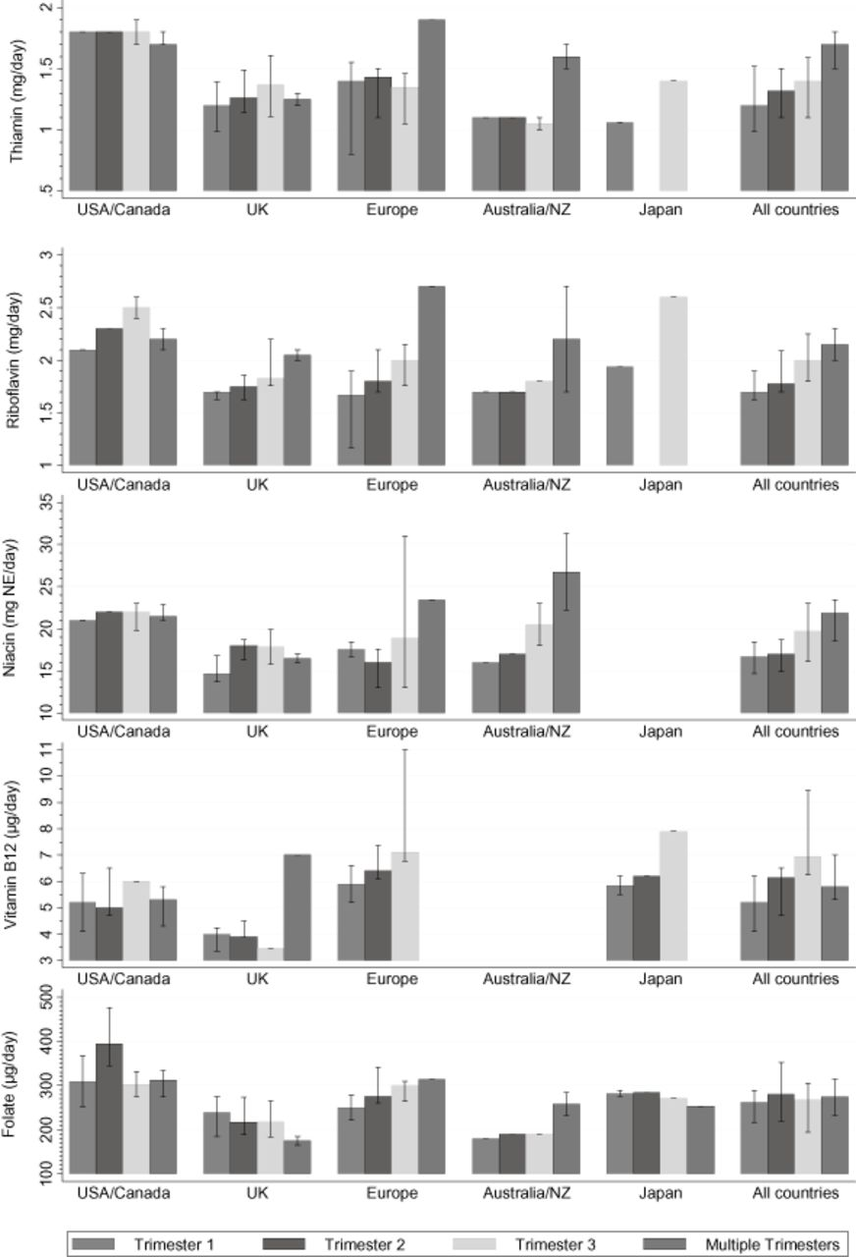
Figure 2 Median daily intakes of B vitamins during pregnancy in each geographical region, reported by trimester. ...
Notes:
Figure 2 Median daily intakes of B vitamins during pregnancy in each geographical region, reported by trimester. “Multiple trimester” values refer to data reported by included studies that represent multiple trimesters within the one dietary value.
Unless provided in the caption above, the following copyright applies to the content of this slide: © 2013 International Life Sciences Institute

Slide 3
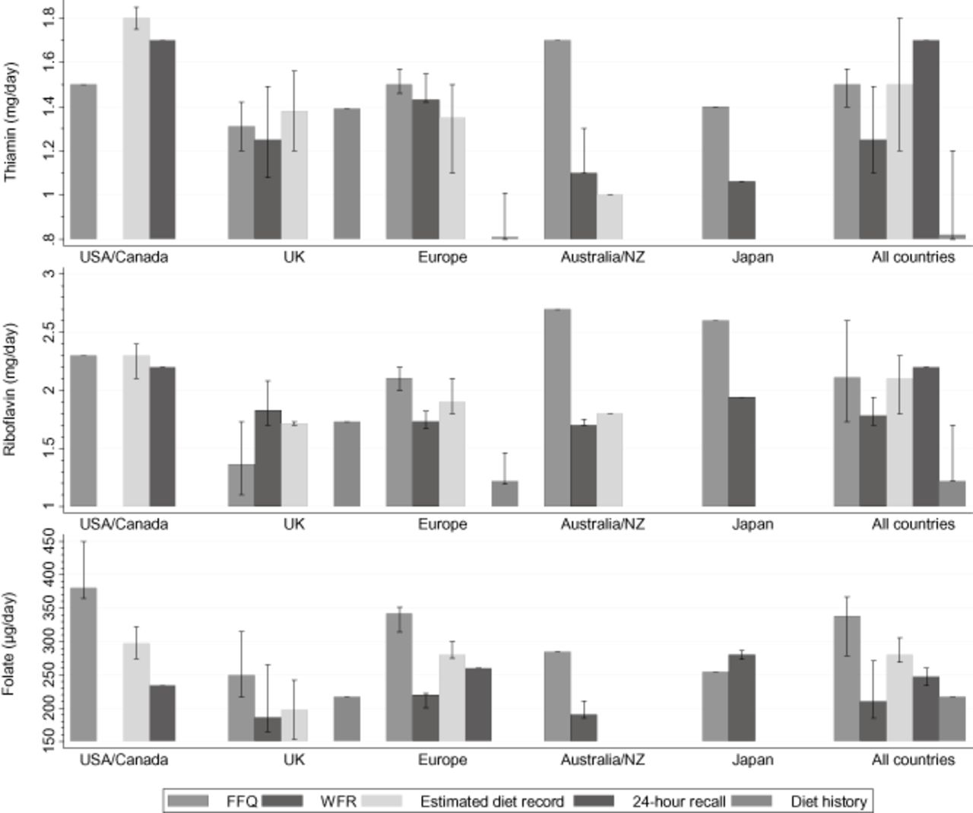
Figure 3 Median daily intakes of vitamins (thiamin, riboflavin, and folate) during pregnancy for which differences by ...
Notes:
Figure 3 Median daily intakes of vitamins (thiamin, riboflavin, and folate) during pregnancy for which differences by dietary methodology were reported. Abbreviations: FFQ, food frequency questionnaire; WFR, weighed food record.
Unless provided in the caption above, the following copyright applies to the content of this slide: © 2013 International Life Sciences Institute

Slide 4
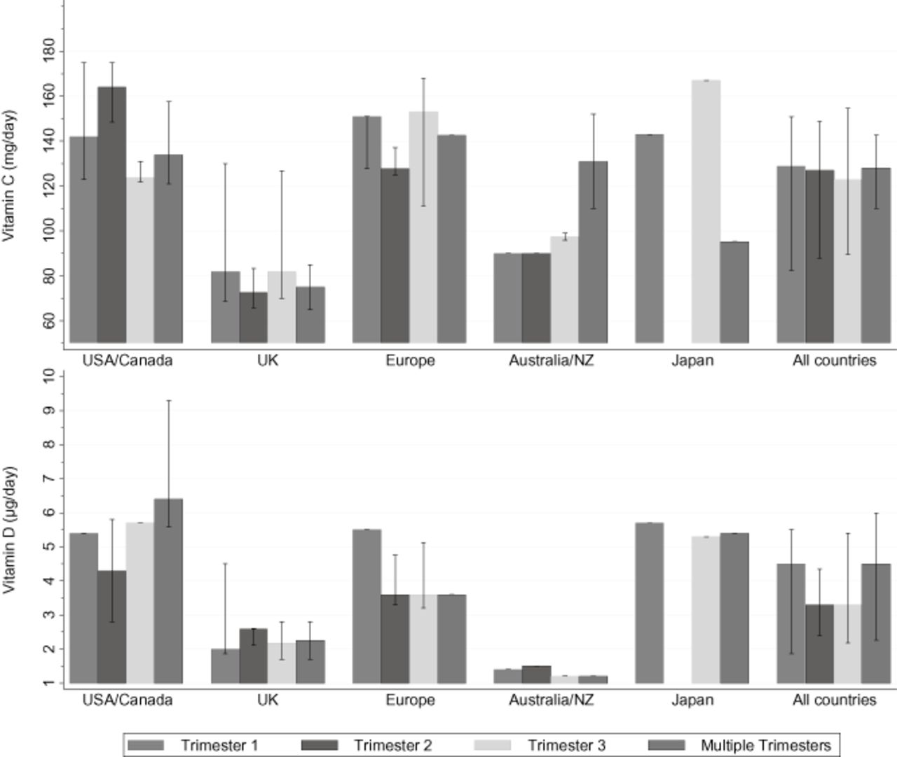
Figure 4 Median daily intakes of vitamins C and D during pregnancy in each geographical region, reported by trimester. ...
Notes:
Figure 4 Median daily intakes of vitamins C and D during pregnancy in each geographical region, reported by trimester. “Multiple trimester” values refer to data reported by included studies that represent multiple trimesters within the one dietary value.
Unless provided in the caption above, the following copyright applies to the content of this slide: © 2013 International Life Sciences Institute

Slide 5
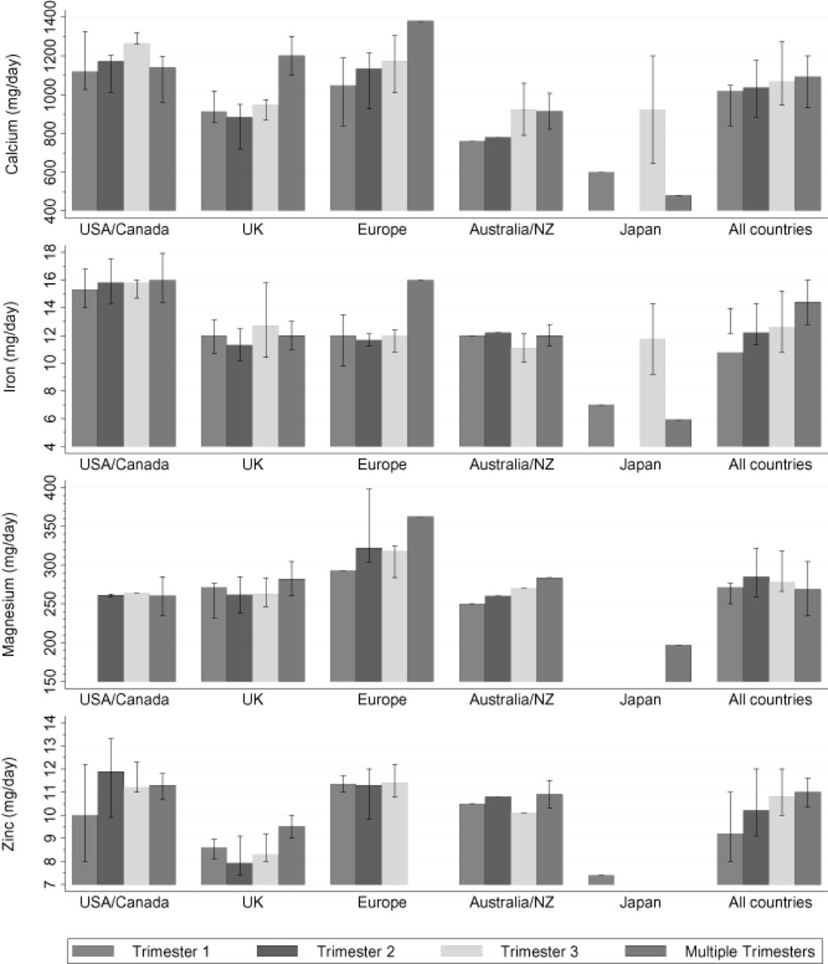
Figure 5 Median mineral intakes during pregnancy in each geographical region, reported by trimester. “Multiple ...
Notes:
Figure 5 Median mineral intakes during pregnancy in each geographical region, reported by trimester. “Multiple trimester” values refer to data reported by included studies that represent multiple trimesters within the one dietary value.
Unless provided in the caption above, the following copyright applies to the content of this slide: © 2013 International Life Sciences Institute

