Slide 1
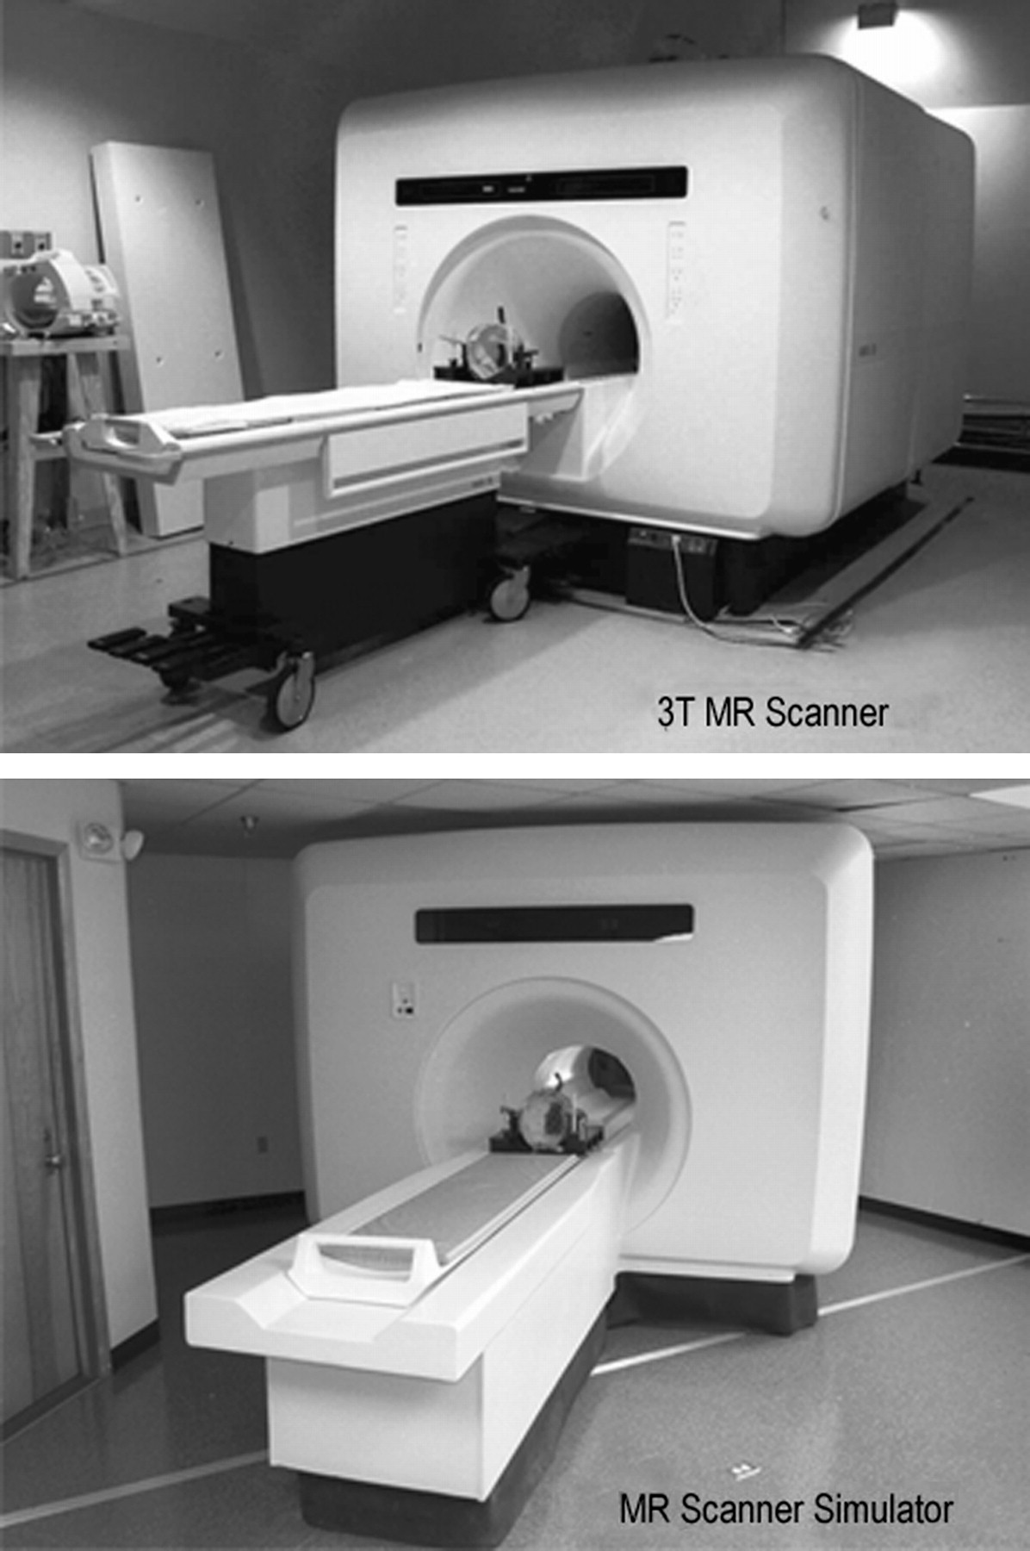
Figure 1. Comparison of the 3-T GE Signa scanner used in the collection of the hemodynamic data and the MR simulator ...
Notes:
Figure 1. Comparison of the 3-T GE Signa scanner used in the collection of the hemodynamic data and the MR simulator used for the collection of the dense-array EEG data. Virtually all physical and perceptual characteristics are matched for the 2 environments.
Unless provided in the caption above, the following copyright applies to the content of this slide: © The Author 2006. Published by Oxford University Press. All rights reserved. For permissions, please e-mail: journals.permissions@oxfordjournals.org

Slide 2
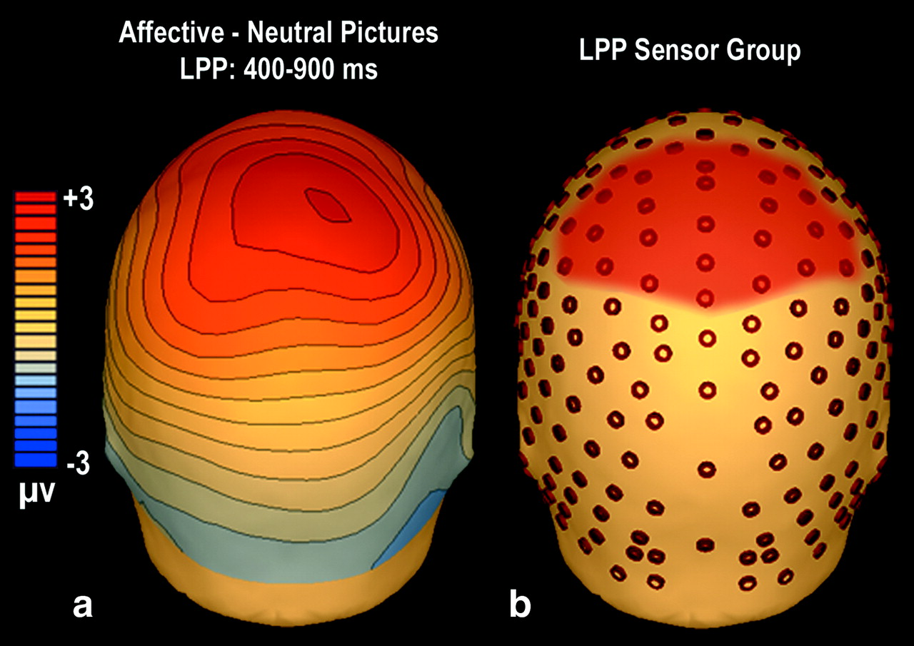
Figure 2. (a) Difference map of scalp voltage topography between affective (pleasant and unpleasant, see Fig. 5a for ...
Notes:
Figure 2. (a) Difference map of scalp voltage topography between affective (pleasant and unpleasant, see Fig. 5a for independent maps) and neutral picture perception, from 400 to 900 ms after picture onset, seen from the back of the head. Red values indicate relative positivity. (b) Location of 27 sensors selected for estimate of LPP amplitude shaded in red.
Unless provided in the caption above, the following copyright applies to the content of this slide: © The Author 2006. Published by Oxford University Press. All rights reserved. For permissions, please e-mail: journals.permissions@oxfordjournals.org

Slide 3
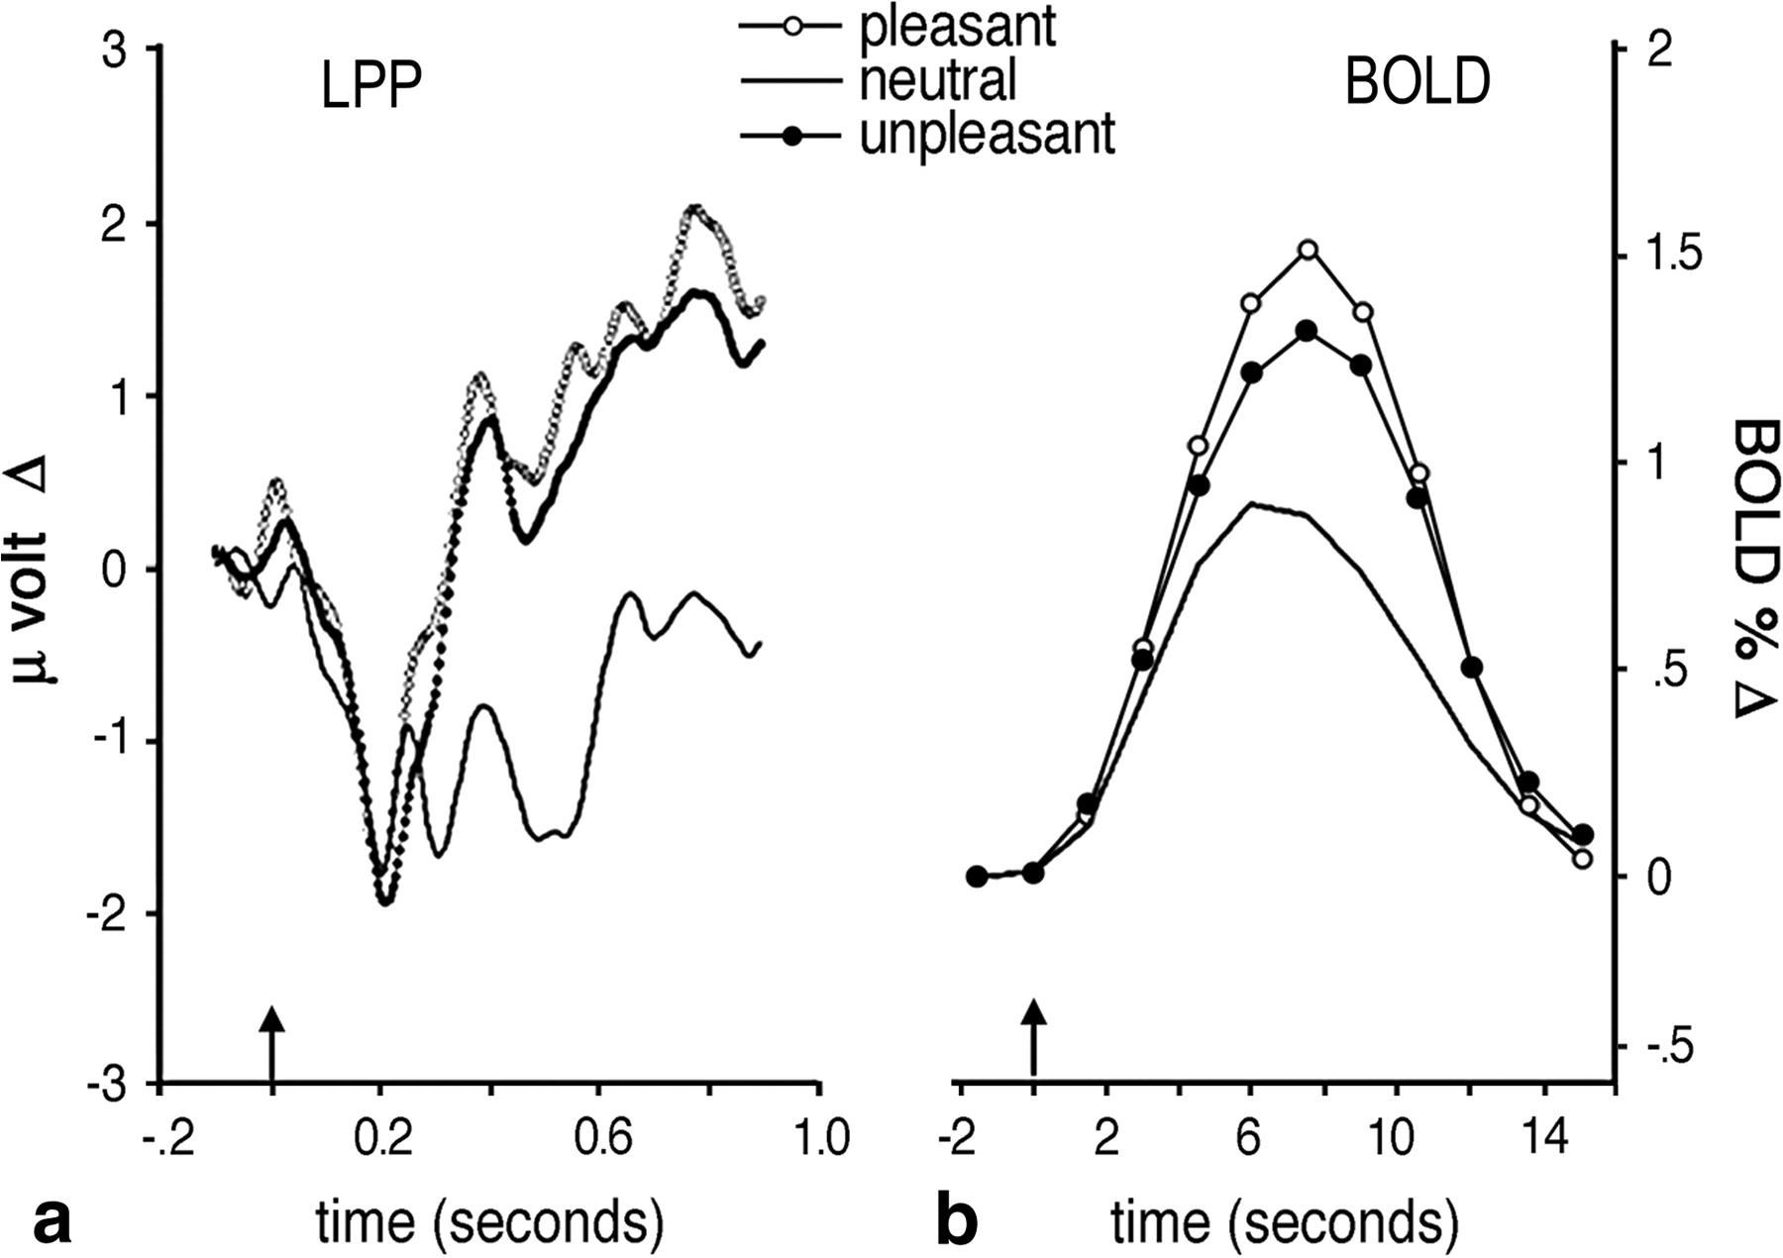
Figure 3. Time course development of the LPP (a) and visual cortical BOLD (b) for pleasant, neutral, and unpleasant ...
Notes:
Figure 3. Time course development of the LPP (a) and visual cortical BOLD (b) for pleasant, neutral, and unpleasant picture contents. The LPP waveform represents 27 centroparietal sensors (Fig. 2b), whereas the BOLD waveform represents average activity in inferotemporal, lateral occipital, and parietal ROIs. Picture onset is indicated by the arrow at time zero.
Unless provided in the caption above, the following copyright applies to the content of this slide: © The Author 2006. Published by Oxford University Press. All rights reserved. For permissions, please e-mail: journals.permissions@oxfordjournals.org

Slide 4
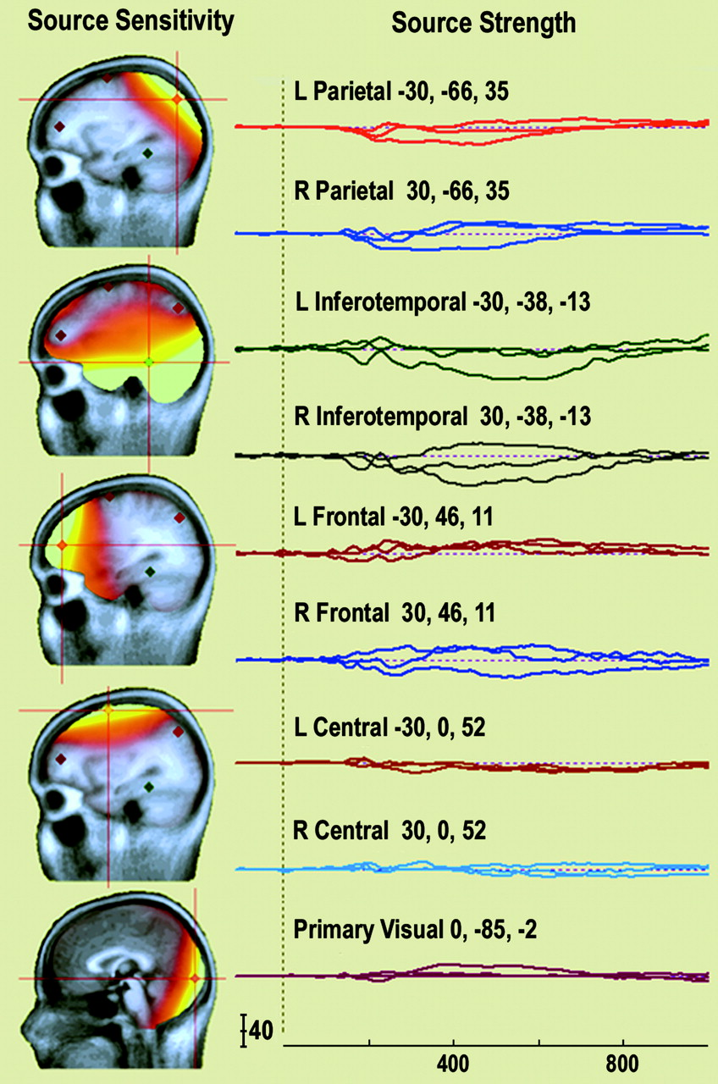
Figure 4. Source sensitivity maps and source strength waveforms (in nanoamperes) for the 9 discrete regional sources ...
Notes:
Figure 4. Source sensitivity maps and source strength waveforms (in nanoamperes) for the 9 discrete regional sources used to model the LPP slow wave, over the first second of picture presentation. The sensitivity maps show the independence of cortical representation for each source (depicted in one hemisphere), with bright yellow indicating the greatest sensitivity and red the least sensitivity. The source waveforms show the activation time course of each modeled source through the first second of picture presentation, for x, y, and z dimensions. Talairach coordinates for each source are shown above the waveform.
Unless provided in the caption above, the following copyright applies to the content of this slide: © The Author 2006. Published by Oxford University Press. All rights reserved. For permissions, please e-mail: journals.permissions@oxfordjournals.org

Slide 5
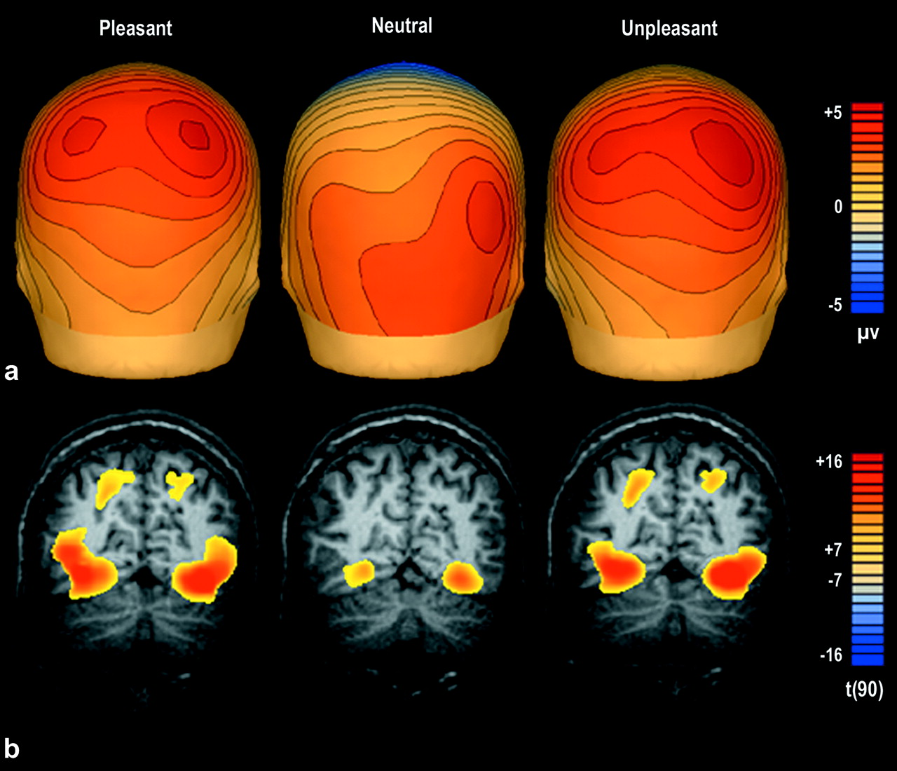
Figure 5. Comparison of ERP scalp topography (a) and fMRI BOLD contrast overlay (b) for pleasant, neutral, and ...
Notes:
Figure 5. Comparison of ERP scalp topography (a) and fMRI BOLD contrast overlay (b) for pleasant, neutral, and unpleasant picture presentations. The ERP map represents average microvolt change from 400 to 900 ms after picture onset, with red indicating positivity and blue indicating negativity. The BOLD contrast overlay, coronal slice y = −68, represents a random-effects analysis of picture elicited activity, peaking roughly 8 s after picture onset, with red indicating more reliable increases in oxygenated blood flow and yellow indicating a threshold of P < 0.000000001.
Unless provided in the caption above, the following copyright applies to the content of this slide: © The Author 2006. Published by Oxford University Press. All rights reserved. For permissions, please e-mail: journals.permissions@oxfordjournals.org

