Slide 1
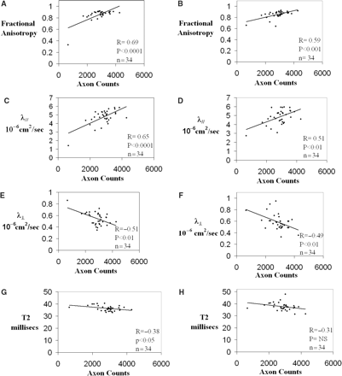
Fig. 1 Graphs showing axon counts from medial dorsal columns at spinal cord level T3 relative to (A, B) FA, (C, D) ...
Notes:
Fig. 1 Graphs showing axon counts from medial dorsal columns at spinal cord level T3 relative to (A, B) FA, (C, D) axial diffusivity = λ∥, (E, F) radial diffusivity = λ⊥, and (G, H). T2 imaging derived from (A, C, E, G) fibre tracking or (B, D, F, H) ROI corresponding to area used to count axons. (Focal myelitis model; n = 11, lysolecithin model; n = 14, controls; n = 9.).
Unless provided in the caption above, the following copyright applies to the content of this slide: © The Author (2007). Published by Oxford University Press on behalf of the Guarantors of Brain. All rights reserved. For Permissions, please email: journals.permissions@oxfordjournals.org

Slide 2
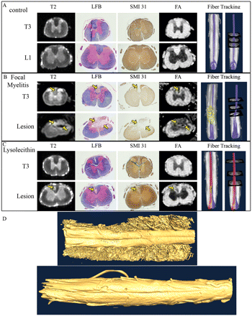
Fig. 2 Images of diffusion tensor imaging and immunohistochemistry from rat spinal cords with and without focal ...
Notes:
Fig. 2 Images of diffusion tensor imaging and immunohistochemistry from rat spinal cords with and without focal inflammatory and demyelinating lesions at the site of and distal to the lesion in rat. Representative images of T2-weighted imaging (column 1), LFB; Mag., 4× (column 2), SMI-31 immunohistochemistry; Mag., 4× (column 3) and fractional anisotropy (column 4) from spinal cord sections taken at the site of injection (bottom row) and distal to the lesion (top row) from (A) control rat with no manipulations, (B) MOG immunized rat injected with LPS, 21 dpi and (C) rat injected with lysolecithin, 14 dpi. Arrows identify tissue pathology. Fibre tracking (columns 5 and 6) results show tracked dorsal column fibres (blue) and lesions defined by T2 hyperintensity (yellow). For the lysolecithin model, dorsal column fibres running on the side with the lesion (red), and the contralateral side (blue) are separated. (D) Three dimensional surface rendering of rat spinal cords reconstructed from high resolution images.
Unless provided in the caption above, the following copyright applies to the content of this slide: © The Author (2007). Published by Oxford University Press on behalf of the Guarantors of Brain. All rights reserved. For Permissions, please email: journals.permissions@oxfordjournals.org

Slide 3
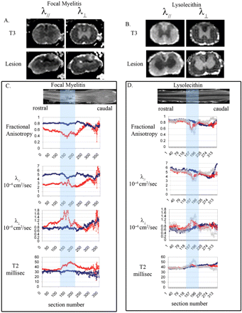
Fig. 3 Images and graphs of DTI from rat spinal cord sections at the focal lesion and distally (level T3) in (A, C) ...
Notes:
Fig. 3 Images and graphs of DTI from rat spinal cord sections at the focal lesion and distally (level T3) in (A, C) MOG-immunized rat injected with LPS, 21 dpi and (B, D) rat injected with lysolecithin, 14 dpi. (A, B) Representative images of spinal cord sections illustrating axial diffusivity (λ∥) and radial diffusivity (λ⊥) at the site of injection (bottom row) and distal to the lesion (top row). (C, D) Sagittal images from T2 imaging depicting a lesion in spinal cord with corresponding graphs of fractional anisotropy, λ∥, λ⊥, and T2-weighted measures derived with fibre tracking for which the lesion is identified by a box. (C) Dorsal column fibre-tracking-derived DTI measures for MOG + LPS rat spinal cord are denoted by red triangles and blue circles indicate DTI measures from control rat spinal cord. (D) Dorsal column fibre-tracking-derived DTI measures from injection side of lysolecithin-injected rat spinal cord are denoted by red triangles, DTI measures derived from fibre tracking including only damaged axons are denoted by grey crosses and dorsal column fibre-tracking-derived DTI measures from the contralateral control side of the spinal cord are denoted by blue circles. These images are from the same rats depicted in Fig. 1. Simple thresholding using was used to distinguish spinal cord from non-cord tissue.
Unless provided in the caption above, the following copyright applies to the content of this slide: © The Author (2007). Published by Oxford University Press on behalf of the Guarantors of Brain. All rights reserved. For Permissions, please email: journals.permissions@oxfordjournals.org

Slide 4
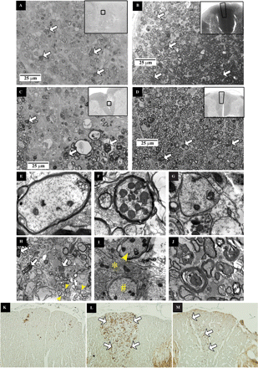
Fig. 4 Photographs of Toluidine blue stained spinal cord sections (A–D), electron microscopy (E–J) and ...
Notes:
Fig. 4 Photographs of Toluidine blue stained spinal cord sections (A–D), electron microscopy (E–J) and immunohistochemistry with SMI-32 (K, L) from rat spinal cord. Toluidine blue stained dorsal column from spinal cord sections (Mag; 100×, inset Mag;10×) from MOG immunized rat injected with LPS, 21 dpi (A) at the lesion site and (B) distal to the lesion at T3 and from rat injected with lysolecithin, 21 dpi (C) at the lesion site and (D) distal to the lesion at T3. Arrows point to degenerating axons, (A,C) boxed areas in the lesion insets identify the location of the 100× regions, and (B,D) the polygons in the T3 insets identifies the region used for axon counting. Electron micrographs depict (E) a normal axon with intact myelin, Mag; 35 K, (F) an axon with an abnormally large number of mitochondria Mag; 17 K, (G) an unmyelinated axon, Mag; 15 K and (H) regions of remyelinating axons (yellow arrow heads) and degenerating axons (white arrows) from a dorsal column lesion in a MOG + LPS rat spinal cord and (I) a thinly myelinated axon (yellow arrow head) and unmyelinated axon (#) separated by gliosis (*) Mag; 25 K from a dorsal column lesion in lysolecithin-injected rat spinal cord and (J) degenerating axons Mag; 6 K, from a dorsal column rostral to a lesion in a lysolecithin-injected rat spinal cord. SMI-32 immunohistochemistry from spinal cord sections rostral to the injection site (Mag; 20×) from (K) a control rat injected with cytokine, without MOG immunization, (L) MOG immunized rat injected with LPS 21 dpi and (M) rat injected with lysolecithin 7 dpi. Arrows indicate areas with immunostaining.
Unless provided in the caption above, the following copyright applies to the content of this slide: © The Author (2007). Published by Oxford University Press on behalf of the Guarantors of Brain. All rights reserved. For Permissions, please email: journals.permissions@oxfordjournals.org

