Slide 1
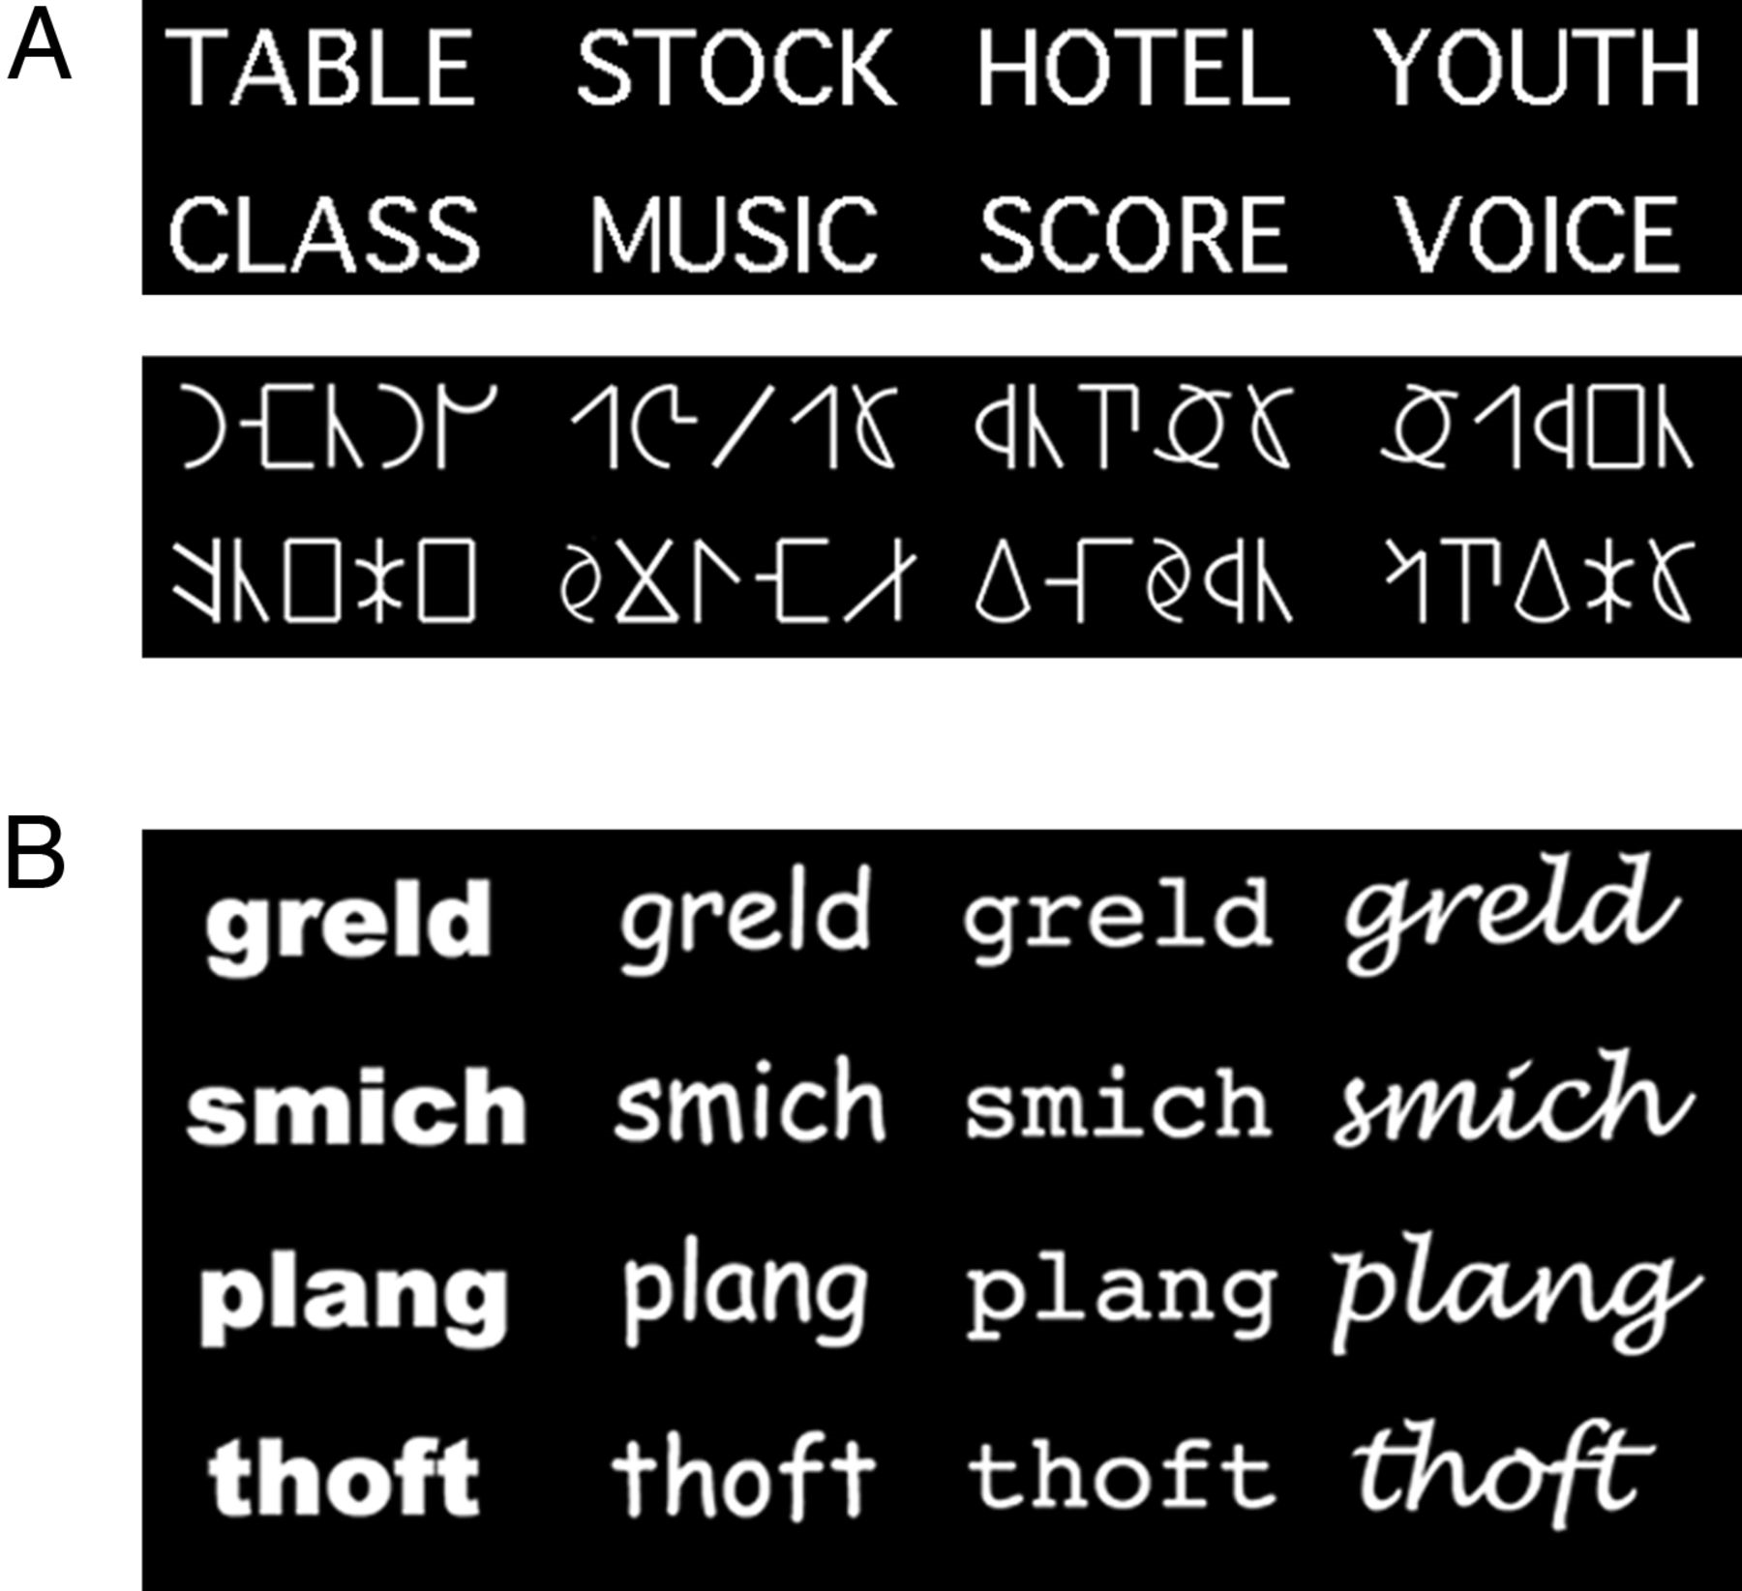
Figure 1. Experimental orthographic stimuli. (A) Examples of words and false-font strings. (B) Pseudoword stimuli (4 ...
Notes:
Figure 1. Experimental orthographic stimuli. (A) Examples of words and false-font strings. (B) Pseudoword stimuli (4 pseudowords × 4 types of font).
Unless provided in the caption above, the following copyright applies to the content of this slide: © The Author 2012. Published by Oxford University Press. All rights reserved. For Permissions, please e-mail: journals.permissions@oup.com

Slide 2
Figure 2. Univariate mapping of word processing (group results). (A) Words elicit extensive activation in the bilateral ...
Notes:
Figure 2. Univariate mapping of word processing (group results). (A) Words elicit extensive activation in the bilateral ventral cortex (q < 0.05). Activation peaks (q< 0.001) are located in the bilateral inferior occipital gyrus (IOG) and the left inferior frontal gyrus (IFG). Crosshairs mark the location of the peaks (left IOG: −41, −69, −16; right IOG: 26, −84, −9; left IFG: −34, 26, 4). (B) Words elicit higher activation than false-font strings in the bilateral middle temporal gyrus (MTG) but not in more ventral occipital/fusiform regions (q < 0.05). Crosshairs mark the location of the peaks in the right (51, −31, −1) and left (−49, −36, −1) hemispheres.
Unless provided in the caption above, the following copyright applies to the content of this slide: © The Author 2012. Published by Oxford University Press. All rights reserved. For Permissions, please e-mail: journals.permissions@oup.com

Slide 3
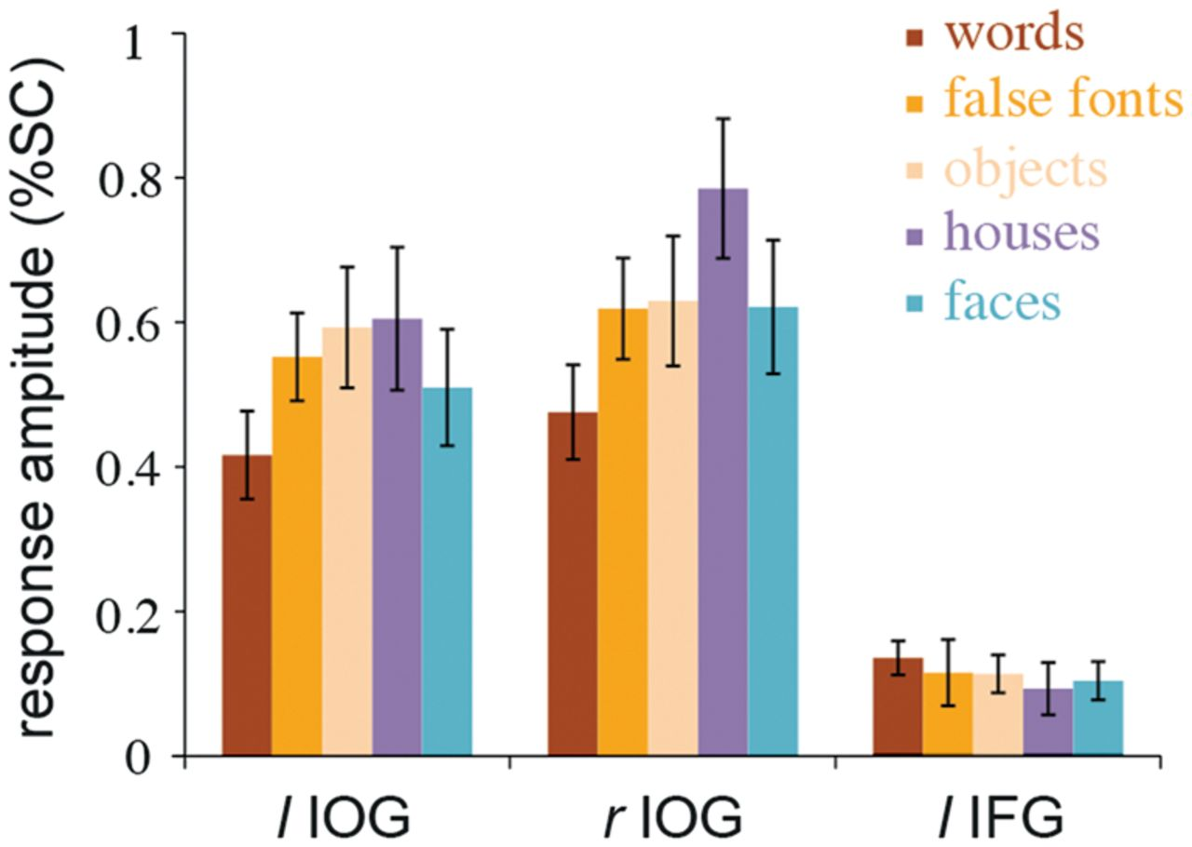
Figure 3. Response amplitudes of 3 ROIs involved in orthographic processing. Average BOLD responses are shown for each ...
Notes:
Figure 3. Response amplitudes of 3 ROIs involved in orthographic processing. Average BOLD responses are shown for each of 5 different visual categories (±1SE).
Unless provided in the caption above, the following copyright applies to the content of this slide: © The Author 2012. Published by Oxford University Press. All rights reserved. For Permissions, please e-mail: journals.permissions@oup.com

Slide 4
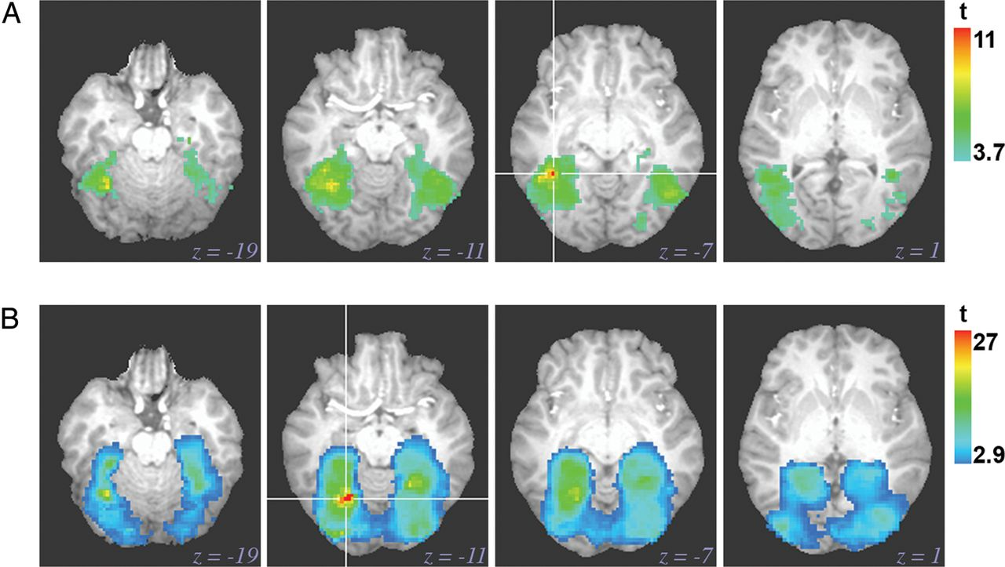
Figure 4. Category-level information-based maps (group results). Extensive and largely overlapping areas of the ...
Notes:
Figure 4. Category-level information-based maps (group results). Extensive and largely overlapping areas of the bilateral ventral cortex support category-level discrimination of (A) words (relative to false-font strings) and (B) faces (relative to houses). Crosshairs mark the discriminability peak of each map (words: −39, −46, −7; faces: −24, −61, −11).
Unless provided in the caption above, the following copyright applies to the content of this slide: © The Author 2012. Published by Oxford University Press. All rights reserved. For Permissions, please e-mail: journals.permissions@oup.com

Slide 5
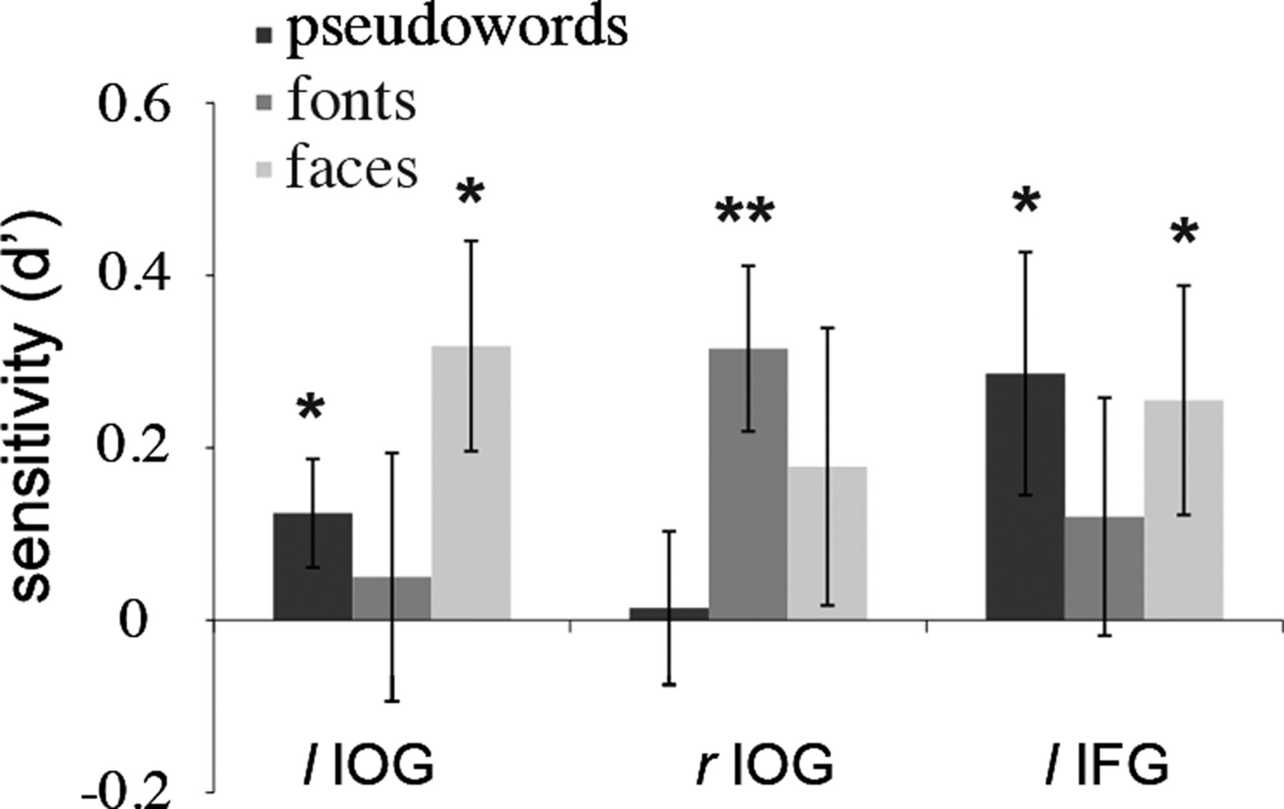
Figure 5. Individual-level discrimination for different pseudowords (across font), for different fonts (across ...
Notes:
Figure 5. Individual-level discrimination for different pseudowords (across font), for different fonts (across pseudoword), and for different facial identities (across expression). Different ROIs show sensitivity to font and pseudoword discrimination but the same left ROIs exhibit sensitivity for both pseudowords and faces (*P < 0.05, **P< 0.01).
Unless provided in the caption above, the following copyright applies to the content of this slide: © The Author 2012. Published by Oxford University Press. All rights reserved. For Permissions, please e-mail: journals.permissions@oup.com

Slide 6
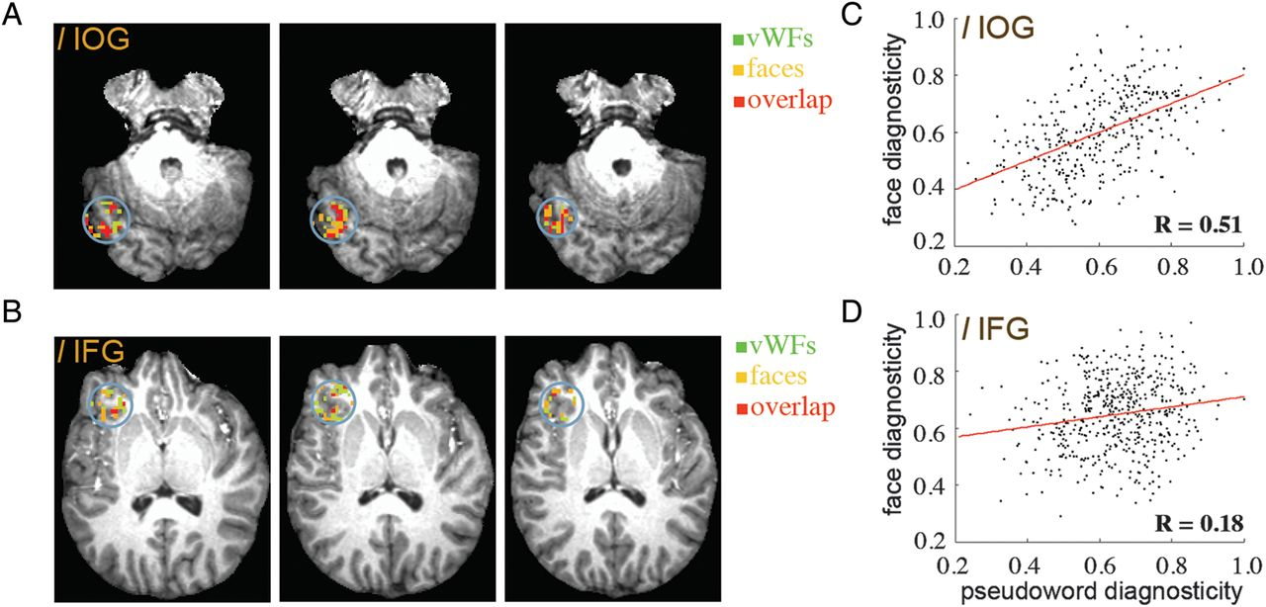
Figure 6. (A, B) Distribution of individual-level orthographic/face information in a representative subject. The maps ...
Notes:
Figure 6. (A, B) Distribution of individual-level orthographic/face information in a representative subject. The maps show voxels diagnostic for psudoword discrimination, face discrimination and their overlap (in native space). For either discrimination the top 100 voxels (ranked by recursive feature elimination) are selected and color-labeled separately in 2 ROIs: the left IOG and the left IFG. The maps show extensive overlap in the IOG but not in the IFG. (C, D) Correlation of voxel diagnosticity (across all ROI voxels) for orthographic and face discrimination in the same subject.
Unless provided in the caption above, the following copyright applies to the content of this slide: © The Author 2012. Published by Oxford University Press. All rights reserved. For Permissions, please e-mail: journals.permissions@oup.com

