Slide 1
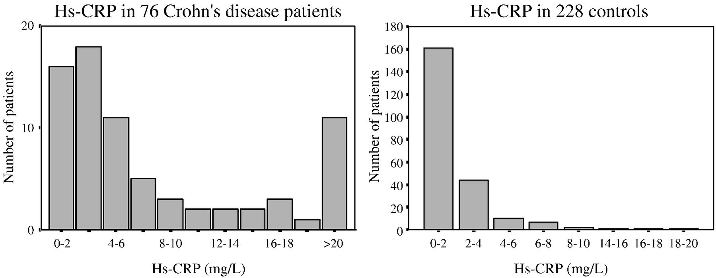
Figure 1 Distribution of hs-CRP in 76 Crohn's disease patients in remission and in 228 matched controls.
Notes:
Figure 1 Distribution of hs-CRP in 76 Crohn's disease patients in remission and in 228 matched controls.
Unless provided in the caption above, the following copyright applies to the content of this slide: © 2008 European Crohn's and Colitis Organisation

