Slide 1
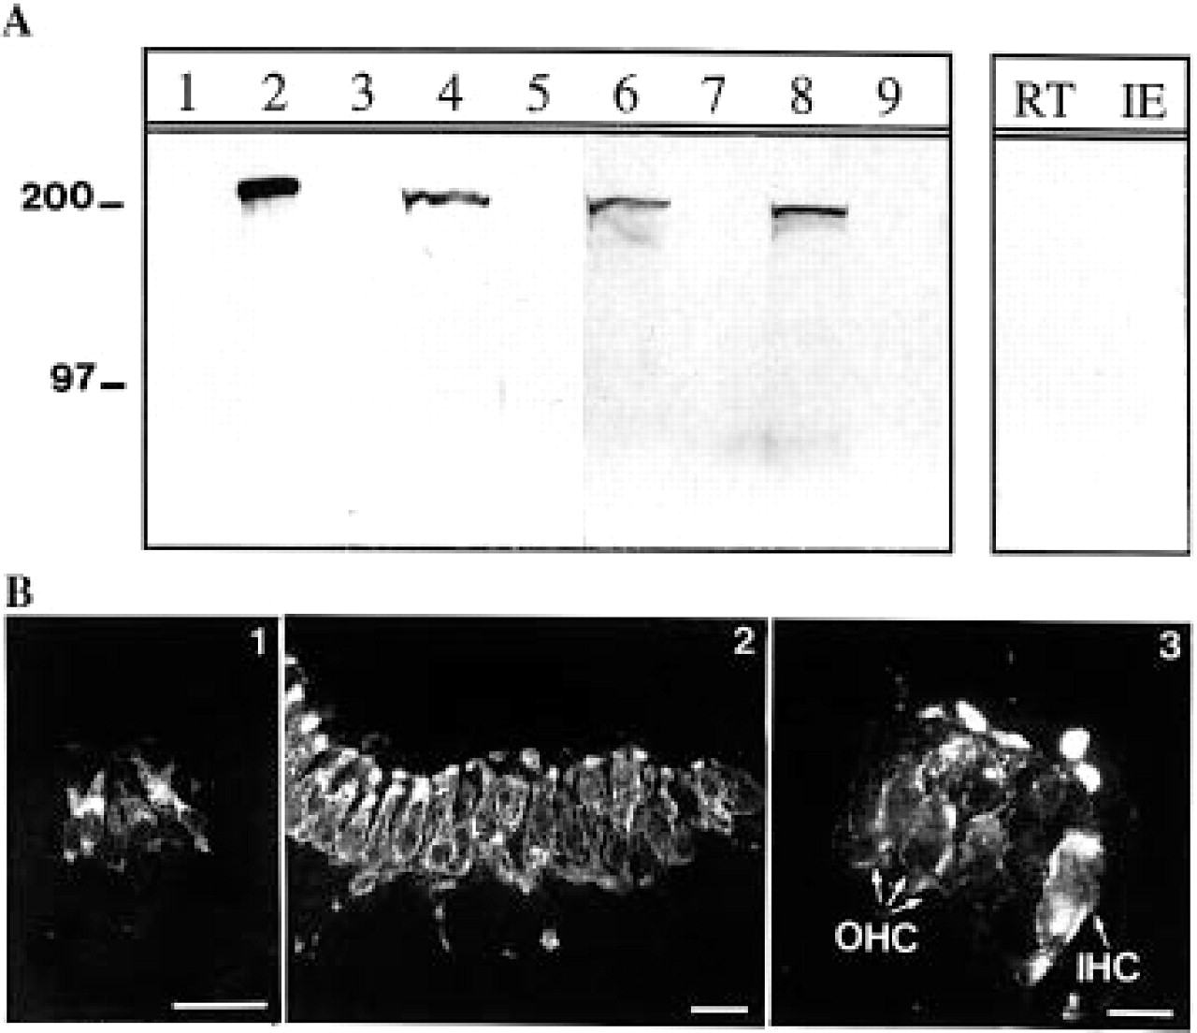
Figure 1 Tissue distribution of myosin VIIA in mouse. ( A ) Western blot analysis: the polyclonal antibody to a human ...
Notes:
Figure 1 Tissue distribution of myosin VIIA in mouse. ( A ) Western blot analysis: the polyclonal antibody to a human myosin VIIA tail fragment detects a unique band in the adult mouse testis (2), retina (4), inner ear (6) and kidney (8). No immunoreactive band is detected in the skin (1), spleen (3), muscle (5), brain (7) or heart (9) extracts. Preadsorption of the antibody with the myosin VIIA tail fragment results in the absence of immunoreactive band in the retina (RT) and inner ear (IE) extracts. Molecular mass standards (in kDa) are indicated on the left. ( B ) Immunohistofluorescence on the inner ear: at E14 (1), immunolabeling is restricted to the immature hair cells in the mouse otocyst. At E18, myosin VIIA is present in vestibular (2) as well as cochlear (3) sensory hair cells. In the cochlea, both inner (IHC) and outer (OHC) hair cells express the protein. The immunolabeling is observed in the cytoplasm, the cuticular plate and the stereocilia. Scale bar=25µm for (1,2) and 10 µm for (3).
Unless provided in the caption above, the following copyright applies to the content of this slide: © 1996 Oxford University Press

Slide 2
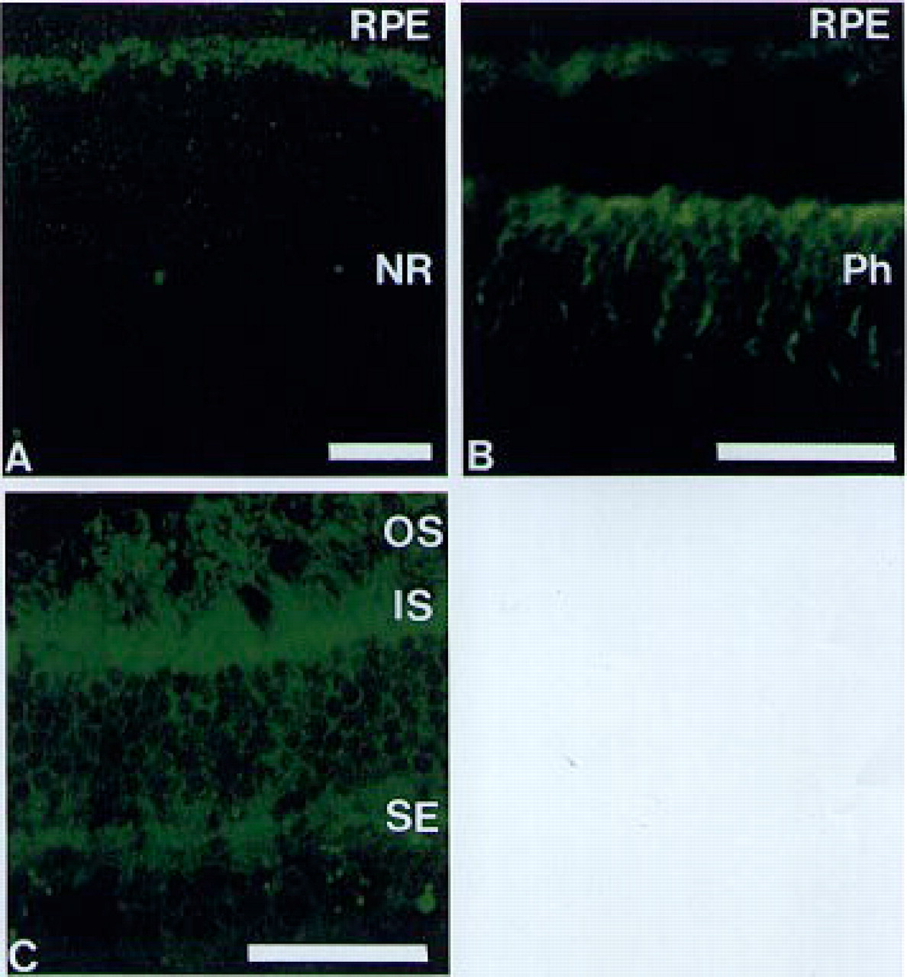
Figure 2 Cell distribution of myosin VIIA in the human retina. In a 10 week old fetus ( A ), myosin VIIA is detected ...
Notes:
Figure 2 Cell distribution of myosin VIIA in the human retina. In a 10 week old fetus ( A ), myosin VIIA is detected exclusively in the retinal pigment epithelium (RPE) cells; no immunolabeling is present in the neural retina (NR). At 24 weeks ( B ), myosin VIIA is present in the pigment epithelium cells and in the photoreceptor cells (Ph). In the adult photoreceptor cells ( C ), myosin VIIA is concentrated in the inner segments (IS), base of outer segments (OS) and synaptic endings (SE). The space between RPE and photoreceptor cells in (B) is due to the detachment of the neural retina during tissue preparation. Confocal microscopy. Scale bars = 50 µm.
Unless provided in the caption above, the following copyright applies to the content of this slide: © 1996 Oxford University Press

Slide 3
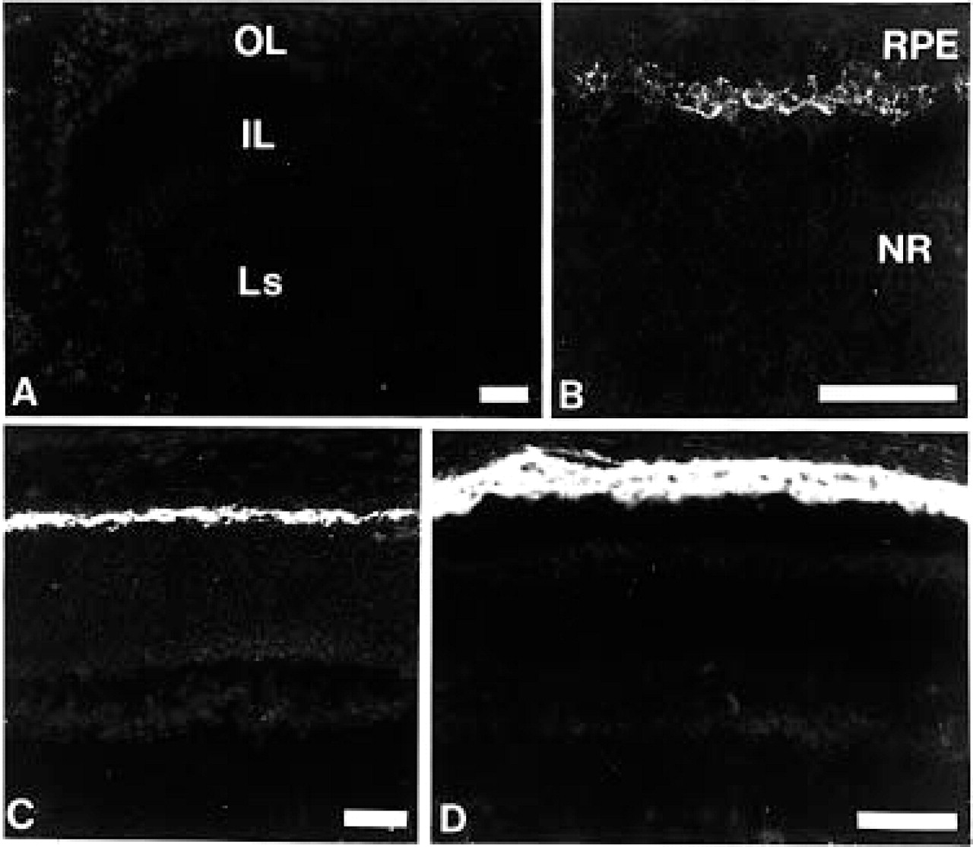
Figure 3 Cell distribution of myosin VIIA in the mouse retina. At E11 ( A ), no immunolabeling is detected in the ...
Notes:
Figure 3 Cell distribution of myosin VIIA in the mouse retina. At E11 ( A ), no immunolabeling is detected in the optic cup. At E14 ( B ), myosin VIIA is already present in the retinal pigment epithelium (RPE); the labeling increases at E18 ( C ) and is maximal at the age of 6 months ( D ). No immunolabeling is observed in the neural retina (NR) at any stage of embryonic development and during post-natal life. IL, inner layer of the optic cup (future neural retina); OL, outer layer of the optic cup (future RPE); Ls, lens. Scale bars = 50 µm.
Unless provided in the caption above, the following copyright applies to the content of this slide: © 1996 Oxford University Press

Slide 4
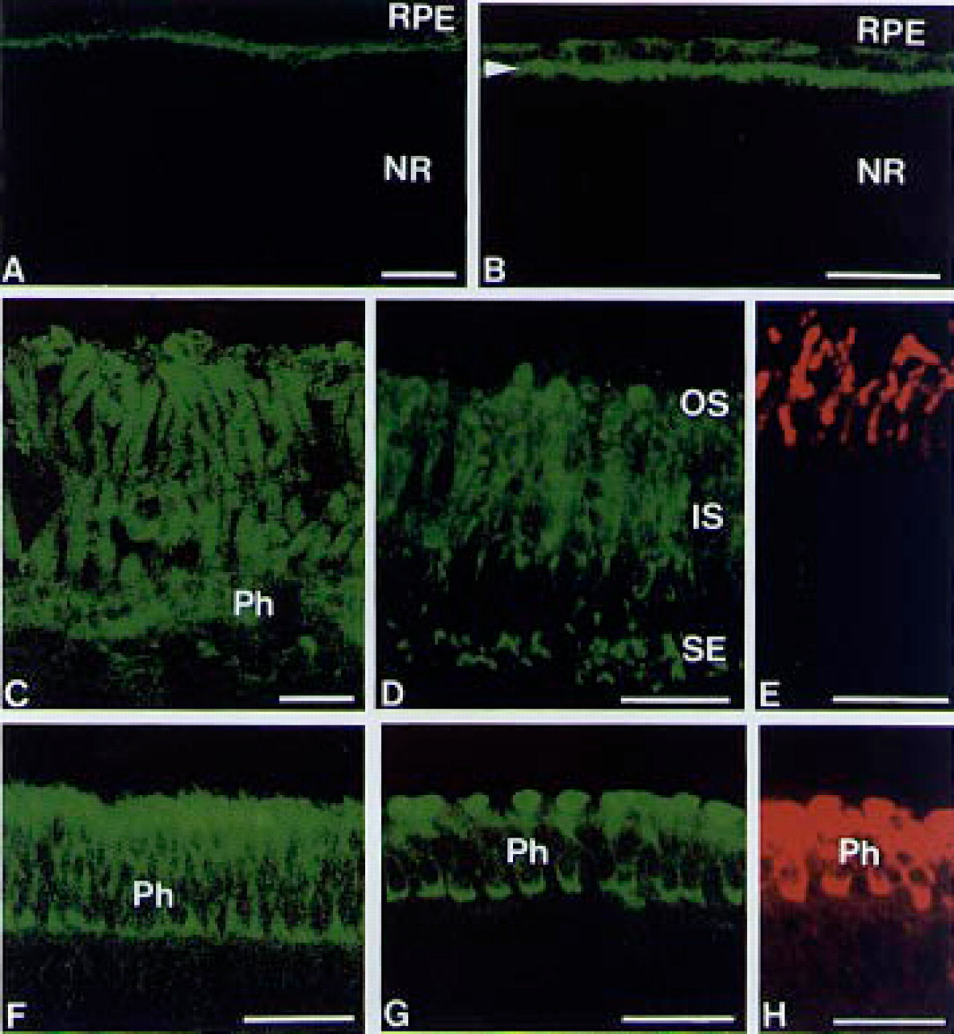
Figure 4 Retinal cell distribution of myosin VIIA in several animal species. In the adult rat ( A ) and guinea-pig ( ...
Notes:
Figure 4 Retinal cell distribution of myosin VIIA in several animal species. In the adult rat ( A ) and guinea-pig ( B ) retinae, myosin VIIA is present exclusively in the retinal pigment epithelium (RPE). In the guinea-pig retina (B), myosin VIIA is concentrated in the microvillar extensions of pigment epithelium cells (arrowhead). No immunolabeling is observed in the neural retina (NR). In contrast, photoreceptor cells (Ph) express myosin VIIA in the adult Xenopus ( C ), adult chicken ( D ), E110 macaque ( F ) and E14 chicken ( G ). In the adult chicken (D), the labeling is concentrated in the inner segments (IS), base of the outer segments (OS) and synaptic endings (SE). In the adjacent section (E), the immunolabeling shows the localization of the rhodopsin, a major protein of the outer disks membrane which is present specifically in the outer segments of rod photoreceptor cells. In the E110 macaque (F) and E14 chicken (G), myosin VIIA is present in the synaptic endings and apical tips of the immature photoreceptor cells. ( H ) Immunolabeling of the synaptic vesicle transmembrane protein SV2 in the photoreceptor cells (adjacent section of G). Confocal microscopy. Scale bars = 25 µm.
Unless provided in the caption above, the following copyright applies to the content of this slide: © 1996 Oxford University Press

Slide 5
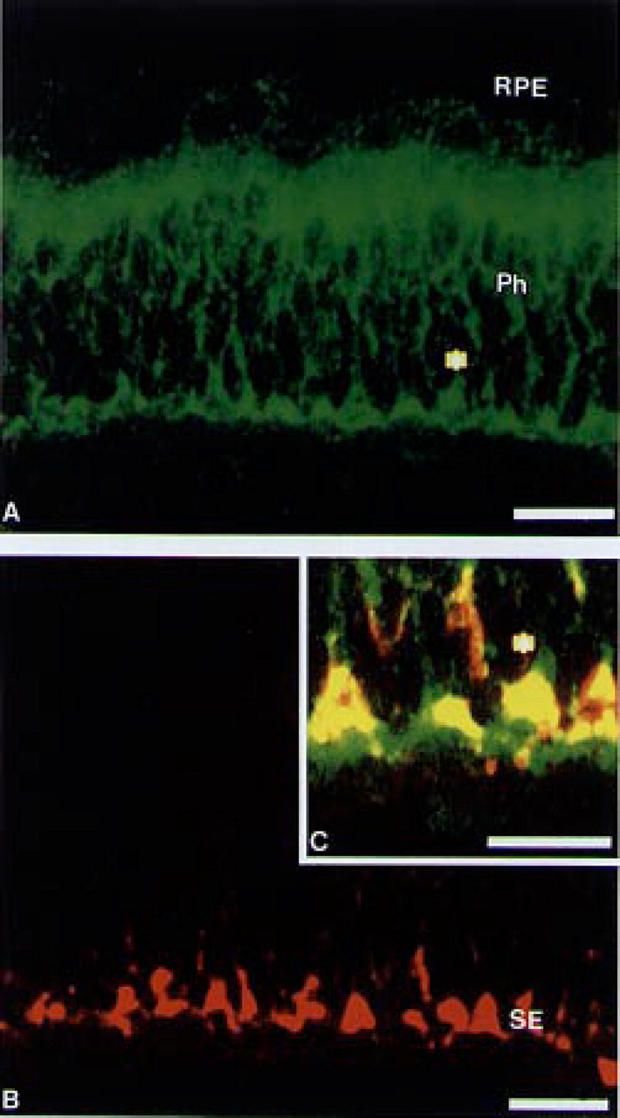
Figure 5 Double labeling of myosin VIIA and synaptic vesicle transmembrane protein in the E110 macaque retina. ( A ) ...
Notes:
Figure 5 Double labeling of myosin VIIA and synaptic vesicle transmembrane protein in the E110 macaque retina. ( A ) Myosin VIIA is present in both retinal pigment epithelium (RPE) and photoreceptor (Ph) cells. Myosin VIIA immunolabeling is concentrated in the cells apical tips and the synaptic endings of photoreceptor cells. ( B ) In the photoreceptor cells, the immunolabeling of the synaptic vesicle transmembrane protein is present only at the synaptic endings (SE). ( C ) The insert shows the co-localization of myosin VIIA and the synaptic vesicles. Confocal microscopy. Scale bar = 20 µm for (A, B) and 10 µm for (C).
Unless provided in the caption above, the following copyright applies to the content of this slide: © 1996 Oxford University Press

