Slide 1
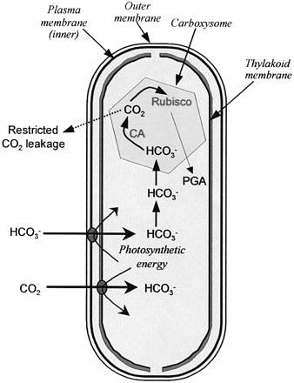
Fig. 1. A generalized model for the cyanobacterial CCM. Shown on the figure are the Rubisco‐containing ...
Notes:
Fig. 1. A generalized model for the cyanobacterial CCM. Shown on the figure are the Rubisco‐containing carboxysomes with the carboxysomal carbonic anhydrase (CA) and an associated diffusional resistance to CO2 efflux. The accumulation of HCO--3 in the cytosol is achieved through the action of a number of CO2 and HCO--3 uptake systems.
Unless provided in the caption above, the following copyright applies to the content of this slide:

Slide 2
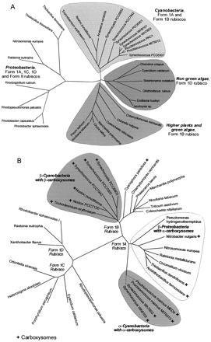
Fig. 2. Phylogenetic trees for (A). 16S ribosomal small subunit DNA sequences; (B) Rubisco Form 1 ...
Notes:
Fig. 2. Phylogenetic trees for (A). 16S ribosomal small subunit DNA sequences; (B) Rubisco Form 1 (L8S8) large subunit protein sequences. Sequences are shown for photosynthetic and chemo‐autotrophic bacteria, algae and embryophytes (including higher plants). Phylogenies are based on either DNA (A) or protein (B) sequences that were aligned using the program ClustalW version 1.7 (Thompson et al., 1994). The phylogenetic trees are unrooted and were generated using the program PHYLIP version 3.6 alpha (J Felsenstein, University of Washington, Seattle, USA). All trees were generated using the Neighbor–Joining method, but they did not differ significantly from maximum likelihood parsimony analyses with respect to the conclusions drawn in the text. Ribosomal sequences were aligned using the online resources of the Ribosomal Database Project (http://rdp.cme.msu.edu/html/ (Maidak et al., 2001)) and analyses were based on 942 positions common to all sequences. Genbank accession numbers are as follows: Trichodesmium erythraeum (AF013030), Nostoc punctiforme (AF027655), Anabaena variabilis (AB016520), Synechocystis PCC6803 (D64000), Synechococcus PCC7942 (D88288), Synechococcus PCC6301 (X03538), Synechococcus WH8101 (AF001480), Synechococcus PCC7803 (AF081834), Prochlorococcus PAC1 (AF001471), Prochlorococcus MIT9313 (AF053399), Synechococcus PCC6307 (AF001477), Chondrus crispus (Z29521), Cyanidium caldarum (X52985), Skeletonema costatum (X82154), Olisthodiscus luteus (M82860), Emilyania huxleyi (X82156), Ischrysis sp. (X75518), Chlamydomonas reinhardtii (J01395), Chlorella vulgaris (D11347), Coleochaete orbicularis (U24579), Marchantia polymorpha (X04465), Oryza sativa (X15901), Nicotiana tabacum (U12813), Pisum sativum (X51598), Rhodobacter sphaeroides (D16425), Rhodobacter capsulatus (M34129), Rhodopseudomonas palustris (M59068), Rhodospirillum rubrum (M32020), Ralstonia eutropha (M32021), Nitrosomonas europaea (AF037106), Thiobacillus thiooxidans (M79401), Thiobacillus ferro‐oxidans (X75266). Rubisco large subunit protein sequences references are as follows: Synechococcus WH8102, Prochlorococcus MIT9313, Prochlorococcus MED4, Nostoc punctiforme, Trichodesmium erythraeum, Nitrosomonas europaea, Ralstonia metallidurans, Rhodobacter sphaeroides I, Rhodopseudomonas palustris were retrieved from the DOE Joint Genome Project accessed through the Genome Channel (http://compbio.ornl.gov/channel/) and Nostoc PCC7120 from Cyanobase (http://www.kazusa.or.jp/cyanobase/). The PID numbers for other sequences were: Synechococcus PCC7803 (g1850939), Pseudomonas hydrogenothermophila (g3183144), Nitrobacter vulgaris (g349304), Thiobacillus ferro‐oxidans (g4836660), Thiobacillus denitrificans (g3183147), Chromatium vinosum (g131893), Coleochaete nitellarum (g5738990), Phaeoceros laevis (g12583955), Triticum aestivum (g132065), Nicotiana tabacum (g11841), Marchantia polymorpha (g131990), Chlamydomonas reinhardtii (g68154), Cyanophora paradoxa (g1352755), Synechocystis PCC6803 (g16331392), Synechococcus PCC6301 (g68159), Ralstonia eutropha (g6093905), Rhodobacter sphaeroides (g68170), Xanthobacter flavus (g68169), Porphyridium aerugineum (g730477), Heterosigma akashiwo (g11928), Odontella sinensis (g7436569), Cyanidium caldarium (g131941).
Unless provided in the caption above, the following copyright applies to the content of this slide:

Slide 3
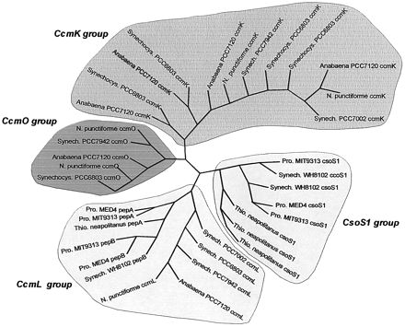
Fig. 3. A phylogenetic tree for CcmK‐like proteins from α and β carboxysome‐containing cyanobacteria and ...
Notes:
Fig. 3. A phylogenetic tree for CcmK‐like proteins from α and β carboxysome‐containing cyanobacteria and proteobacteria. Phylogenetic trees were constructed from aligning complete protein sequences as described in Fig. 2. Protein sequences for Prochlorococcus MED4 (peptide A, peptide B, CsoS1), Prochlorococcus MIT9313 (peptide A, peptide B, CsoS1), Synechococcus WH8102 (peptide B, 2 CsoS1 genes), Nostoc punctiforme (CcmO, 2 CcmK genes, CcmL) were retrieved from the DOE Joint Genome Project accessed through the Genome Channel (http://compbio.ornl.gov/channel/). Protein sequences for Synechocystis PCC6803 (CcmO, 4 CcmK genes, CcmL) and Anabaena PCC7120 (CcmO, 4 CcmK genes, CcmL) were retrieved from Cyanobase (http://www.kazusa.or.jp/cyano/). The PID numbers for other sequences were: Synechococcus PCC7002 CcmK (g3182943), CcmO (g2331051); Synechococcus PCC7942 ccmK (g416773), CcmO (g1176828), CcmL (g416774); Thiobacillus neapolitanus CsoS1 (g1169111, g1169109, g6014734), peptide A (g1176828).
Unless provided in the caption above, the following copyright applies to the content of this slide:

Slide 4
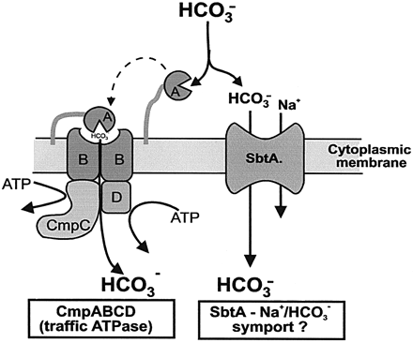
Fig. 4. Models of two HCO⁻⁻₃ transport systems identified in β‐cyanobacteria. BCT1, the ...
Notes:
Fig. 4. Models of two HCO--3 transport systems identified in β‐cyanobacteria. BCT1, the high‐affinity traffic ATPase is shown on the left. SbtA (SLR1512), a potential Na+/HCO--3 symport system is shown on the right. Further explanation about the operation of each system is described in the text.
Unless provided in the caption above, the following copyright applies to the content of this slide:

Slide 5
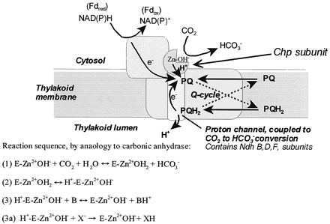
Fig. 5. A speculative model for the functioning of a specialized NDH‐1_{3/4}‐type complex to hydrate ...
Notes:
Fig. 5. A speculative model for the functioning of a specialized NDH‐13/4‐type complex to hydrate CO2 to HCO--3. The hydration is coupled to electron flow such as that supported by PSI cyclic electron transport. The model is based on the proposal of Price et al. (2002). It is postulated that ChpX and Y subunits are CO2 hydration proteins bound to the cytoplasmic face of NDH‐13/4 complexes. The NdhF4/F3 and NdhD4/D3 subunits form part of the proton translocation channel. This specialized NDH‐1 complex is proposed to drive the net hydration of CO2 to HCO--3 when coupled to photosynthetic electron transport. Here both NADPH and Fdred are depicted as being potential electron donors to the NDH‐13/4 complexes. The energetics of CO2 conversion may be further improved through the operation of a Q cycle similar to that operating in the bf complex. Equations 1–3 describe the reaction sequence proposed to occur in conventional CA enzymes (E) (Silverman, 2000; Smith et al., 2000); the steps are (1) generation of a reactive hydroxyl group combined with spontaneous conversion of CO2 to HCO--3, (2) binding a water molecule to Zn and (3) abstraction of a protons to a nearby His residue and then conduction along a proton wire to a buffer molecule (B) in the bulk medium. The essential part of this proposal is that the last step (3a) be coupled to electron‐driven translocation of protons to the thylakoid lumen, making hydroxyl‐mediated net hydration of CO2 largely irreversible in the light.
Unless provided in the caption above, the following copyright applies to the content of this slide:

Slide 6
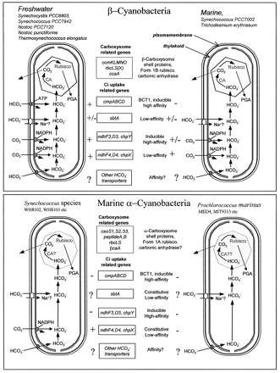
Fig. 6. Diversity in components of the cyanobacterial CCM. Depicted are four types of cyanobacterial cells, ...
Notes:
Fig. 6. Diversity in components of the cyanobacterial CCM. Depicted are four types of cyanobacterial cells, currently identifiable from genome sequencing projects. The groups are differentiated by the presence of either α or β‐carboxysomes, and the complement of Ci transporters present. The two β‐cyanobacterial groups are freshwater and marine types. For the marine α‐cyanobacteria, there are two groups typified by either Synechococcus WH8102 or Prochlorococcus species. The species used to derive the groups are listed on the figure.
Unless provided in the caption above, the following copyright applies to the content of this slide:

Slide 7
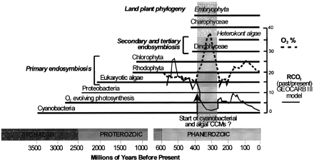
Fig. 7. The evolution of photosynthetic cyanobacteria, algae, higher plants, and chemoautotrophic ...
Notes:
Fig. 7. The evolution of photosynthetic cyanobacteria, algae, higher plants, and chemoautotrophic proteobacteria over the past 3.5 billion years. (drawn with reference to Raven, 1997b, and Badger et al., 2002). Also shown on the graph are the proposed changes in CO2 and O2 during the Phanerozoic period (Berner, 2001; Berner and Kothavala, 2001). CO2 is shown as the ratio of past to present levels (RCO2) while O2 is shown as percentage content. The shaded section indicates the period of CO2 limitation combined with O2 increase that may have initiated the development of CCMs in aquatic photosynthetic organisms.
Unless provided in the caption above, the following copyright applies to the content of this slide:

Slide 8
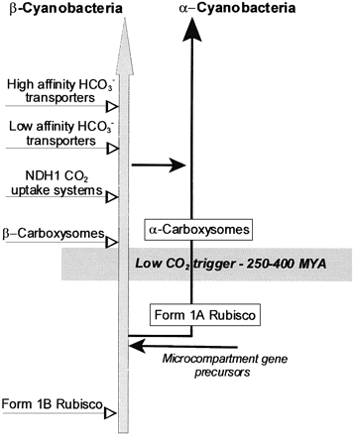
Fig. 8. A speculative pathway for the evolution of the CCM and its components in α and β‐cyanobacteria. ...
Notes:
Fig. 8. A speculative pathway for the evolution of the CCM and its components in α and β‐cyanobacteria. (Drawn after Badger et al., 2002.)
Unless provided in the caption above, the following copyright applies to the content of this slide:

