Slide 1
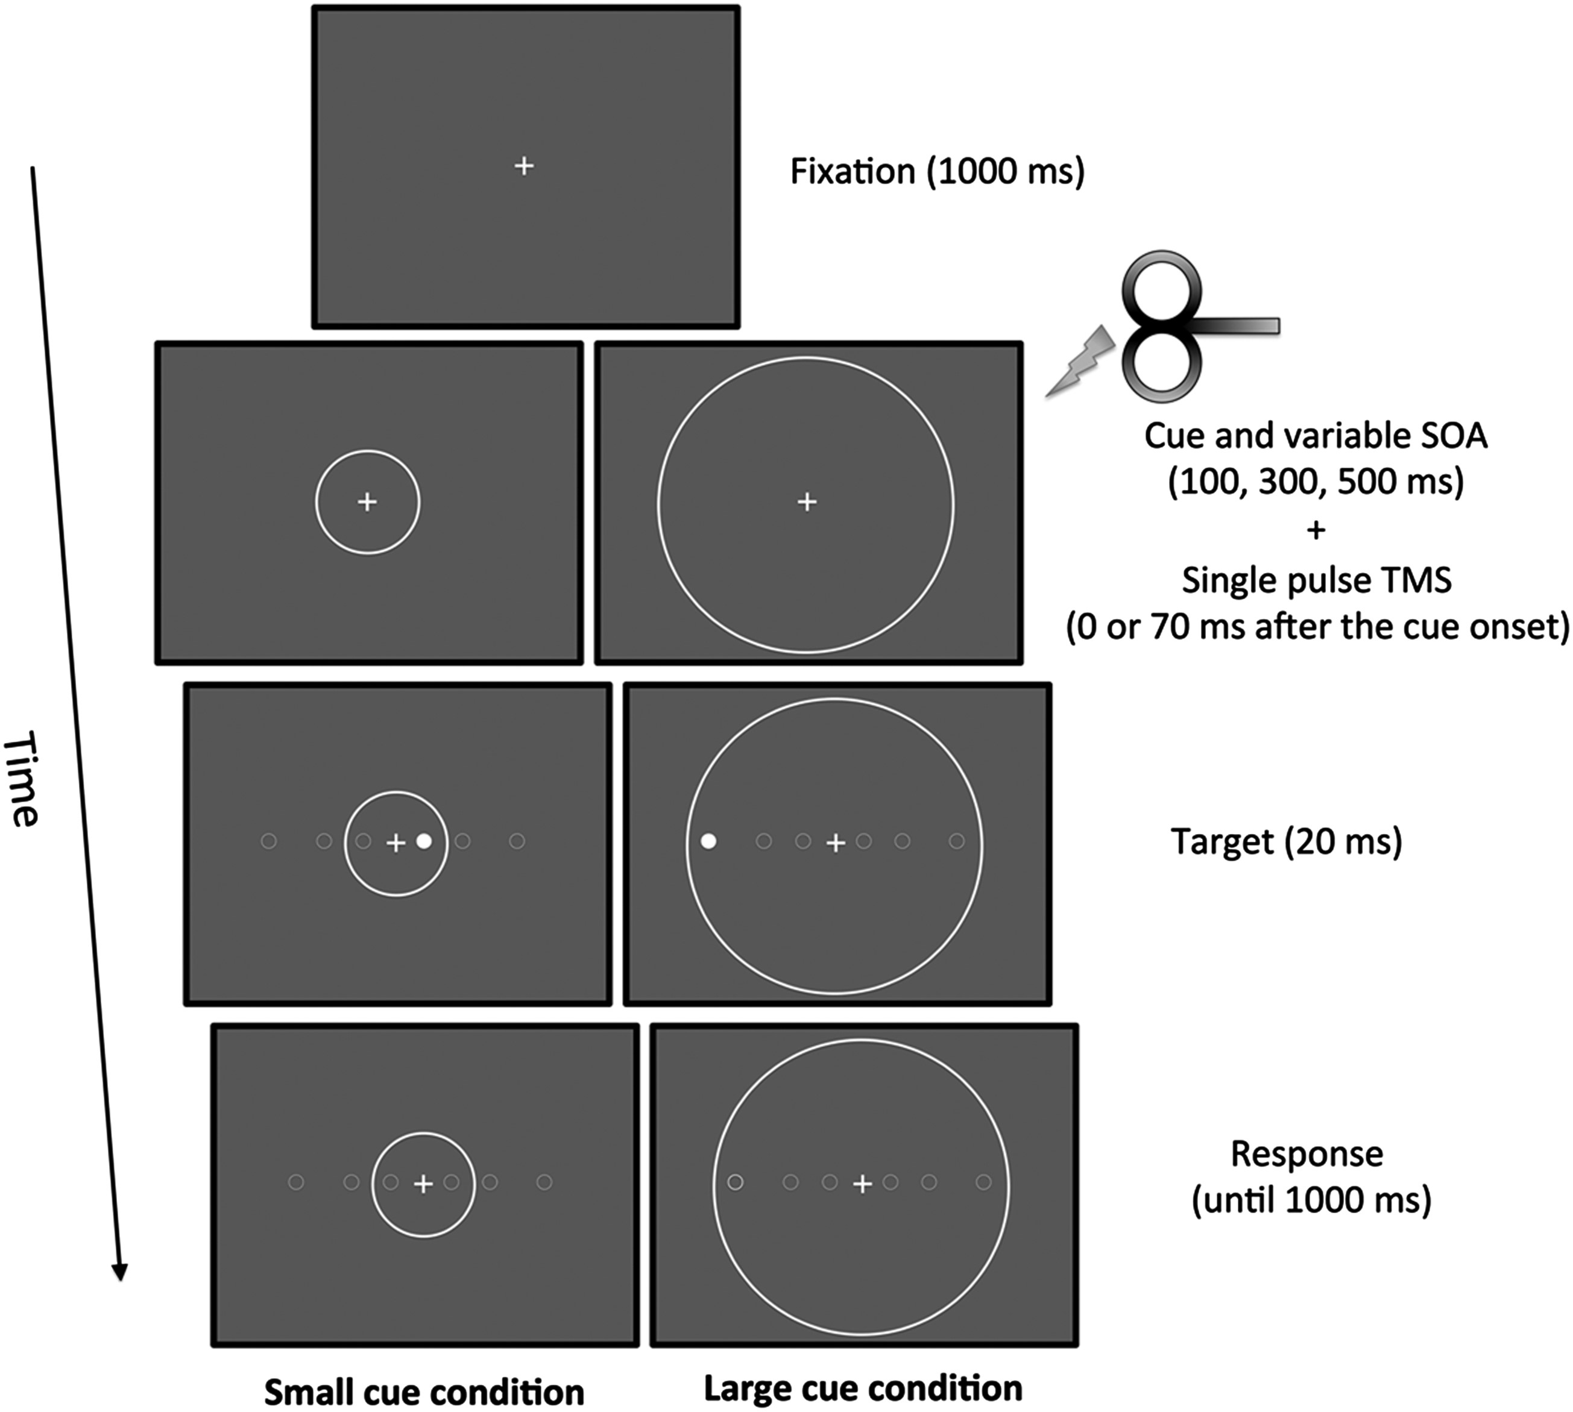
Figure 1. Schematic illustration of the task design (SOAs, stimulus onset asynchronies; TMS, transcranial magnetic ...
Notes:
Figure 1. Schematic illustration of the task design (SOAs, stimulus onset asynchronies; TMS, transcranial magnetic stimulation). Target appeared randomly in 1 of the 6 positions depicted along the horizontal axis (not shown while participants performed the task).
Unless provided in the caption above, the following copyright applies to the content of this slide: © The Author 2012. Published by Oxford University Press. All rights reserved. For Permissions, please e-mail: journals.permissions@oup.com

Slide 2
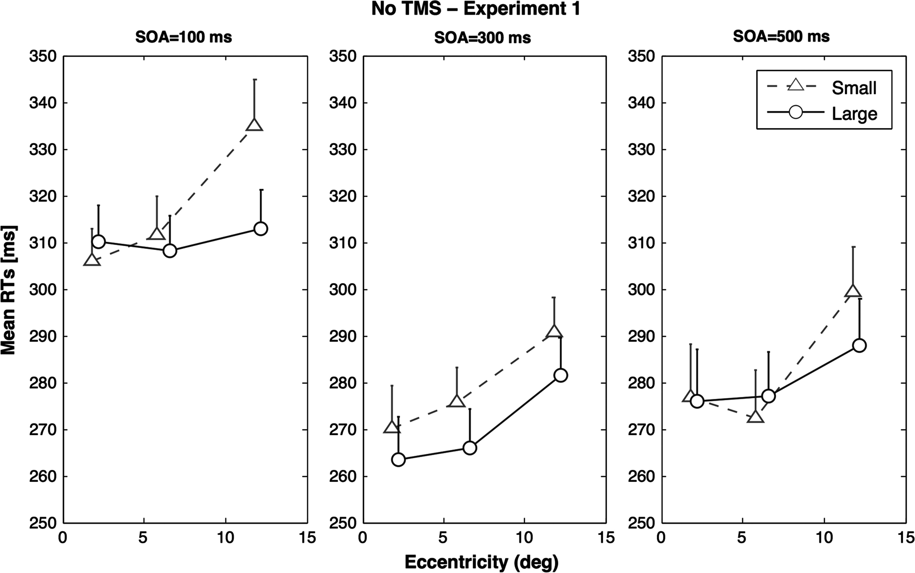
Figure 2. Results of the behavioral experiment (Experiment 1), showing mean RTs as a function of the Cue (small vs. ...
Notes:
Figure 2. Results of the behavioral experiment (Experiment 1), showing mean RTs as a function of the Cue (small vs. large), Eccentricity (2, 6, and 12°) and stimulus onset asynchronies (SOAs: 100, 300, and 500 ms). Error bars represent the SEM.
Unless provided in the caption above, the following copyright applies to the content of this slide: © The Author 2012. Published by Oxford University Press. All rights reserved. For Permissions, please e-mail: journals.permissions@oup.com

Slide 3
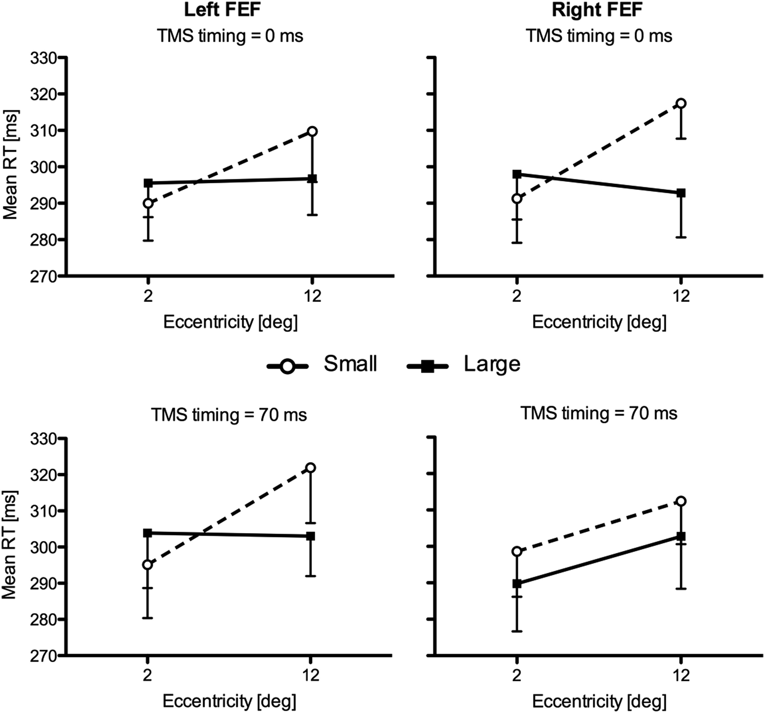
Figure 3. The mean raw RTs are depicted as a function of TMS sites (left FEF vs. right FEF), cue (small vs. large), and ...
Notes:
Figure 3. The mean raw RTs are depicted as a function of TMS sites (left FEF vs. right FEF), cue (small vs. large), and eccentricity (2 vs. 12°). Error bars represent the SEM.
Unless provided in the caption above, the following copyright applies to the content of this slide: © The Author 2012. Published by Oxford University Press. All rights reserved. For Permissions, please e-mail: journals.permissions@oup.com

Slide 4
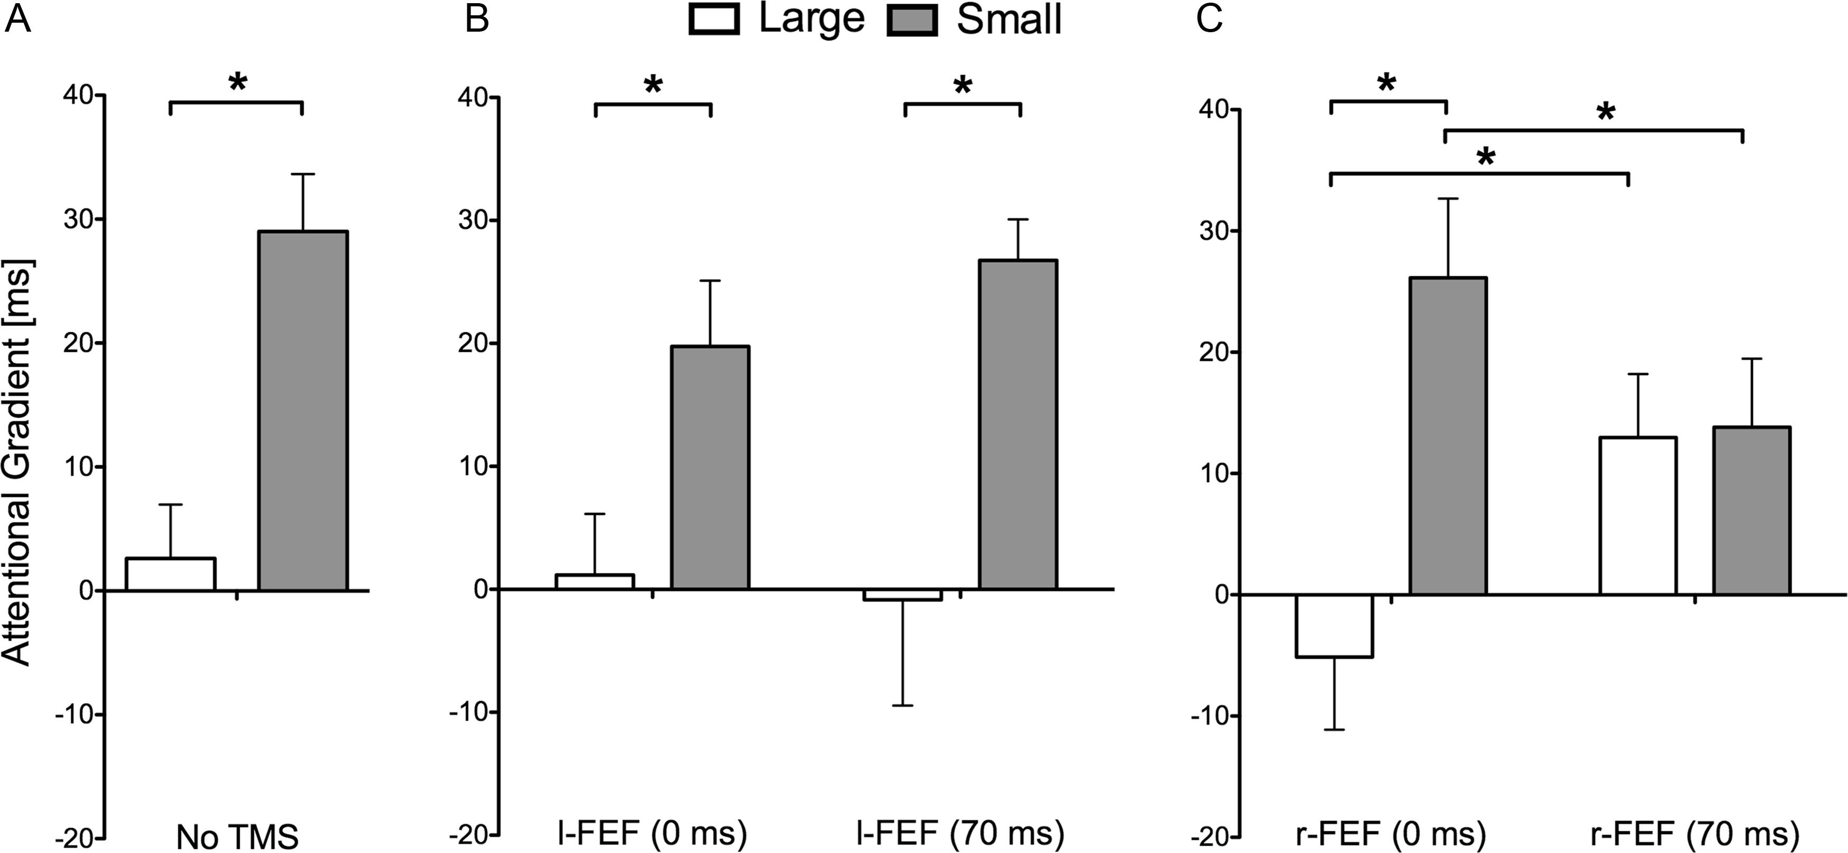
Figure 4. The mean attentional gradient (AG; i.e., difference between RTs at Eccentricity 3 [12°] and RTs at ...
Notes:
Figure 4. The mean attentional gradient (AG; i.e., difference between RTs at Eccentricity 3 [12°] and RTs at Eccentricity 1 [2°]) is depicted as a function of cue and TMS condition: (A) No TMS, (B) TMS on the left FEF (control site) and (C) TMS on the right FEF. Error bars represent the SEM. Asterisk indicates a significant difference as revealed by planned comparisons (P < 0.05).
Unless provided in the caption above, the following copyright applies to the content of this slide: © The Author 2012. Published by Oxford University Press. All rights reserved. For Permissions, please e-mail: journals.permissions@oup.com

