Slide 1
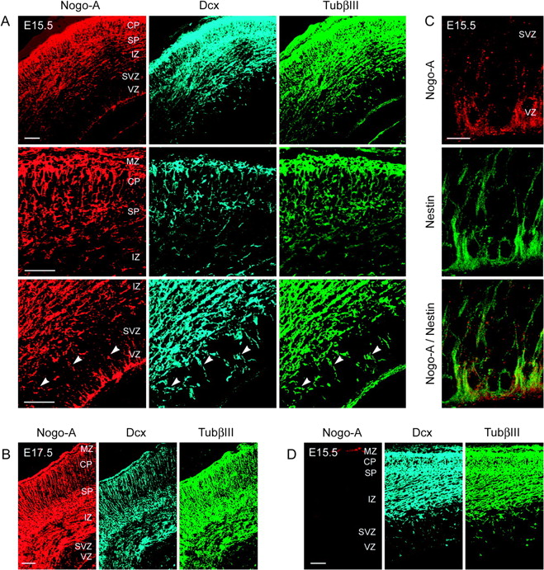
Figure 1. Nogo-A is expressed in radial glial cells, migrating postmitotic as well as postmigratory neurons of the ...
Notes:
Figure 1. Nogo-A is expressed in radial glial cells, migrating postmitotic as well as postmigratory neurons of the embryonic mouse cortex. Colocalization of Nogo-A (red), Dcx (blue), and TubβIII (green) in radially (arrowheads) and tangentially migrating postmitotic and in postmigratory neurons of the E15.5 (A) and E17.5 (B) mouse cortex. (C) Colocalization of Nogo-A (red) and nestin (green) in radial glial cells within the VZ and SVZ of the E15.5 mouse cortex. (D) Absence of anti-Nogo-A immunostaining in the E15.5 Nogo-A KO mouse cortex showing the specificity of the immunostaining procedure. Scale bars: A, B, and D = 100 μm; C = 50 μm.
Unless provided in the caption above, the following copyright applies to the content of this slide: © The Authors 2010. Published by Oxford University Press.This is an Open Access article distributed under the terms of the Creative Commons Attribution Non-Commercial License (http://creativecommons.org/licenses/by-nc/2.5), which permits unrestricted non-commercial use, distribution, and reproduction in any medium, provided the original work is properly cited.

Slide 2
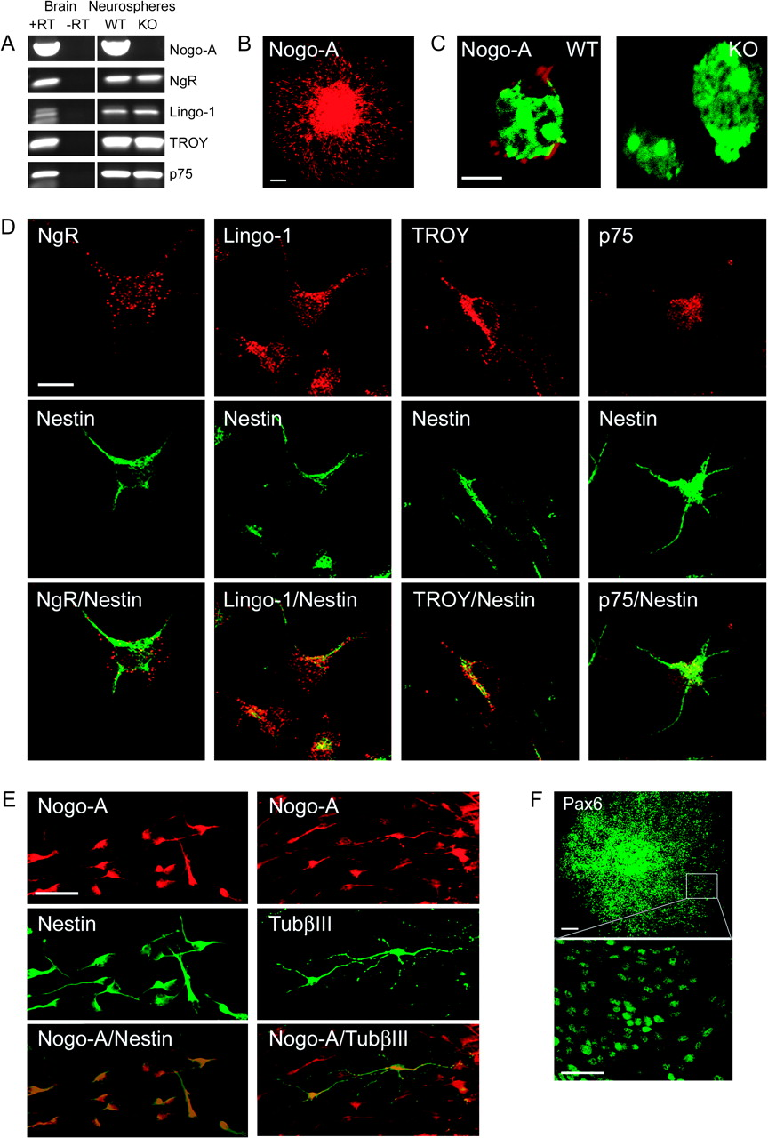
Figure 2. Nogo-A and the Nogo receptor components NgR, Lingo-1, TROY, and p75 are expressed by embryonic mouse ...
Notes:
Figure 2. Nogo-A and the Nogo receptor components NgR, Lingo-1, TROY, and p75 are expressed by embryonic mouse forebrain–derived neurospheres. (A) Transcripts for Nogo-A, NgR, Lingo-1, TROY, and p75 are all detected by RT-PCR in E15.5 mouse forebrain–derived neurospheres (passage 5). Nogo-A is absent in Nogo-A KO mouse forebrain–derived neurospheres, but the receptor components persist. Total messenger RNA from neonatal mouse brain was used as a positive control. “+RT” and “−RT” indicate performance of reverse transcription with and without reverse transcriptase, respectively. (B) Nogo-A (red) immunoreactivity is found in precursor cells of a plated neurosphere cultured for 1 day without growth factors. Note the halo of migrating Nogo-A+ cells surrounding the sphere. (C) Localization of Nogo-A (red) on the cell surface of WT mouse neurosphere-derived cells. No immunostaining was observed on cells derived from Nogo-A KO mouse embryos. Nuclei are counterstained with green fluorescent Nissl stain. (D) Colocalization of NgR, Lingo-1, TROY, or p75 (red) and nestin (green) in migrating precursor cells emanating from plated neurospheres. (E) Colocalization of Nogo-A (red) and nestin (green) or TubβIII (green) in migrating precursor cells emanating from plated neurospheres. Approximately 1% of migrating cells are positive for TubβIII. (F) Expression of the radial cell glial marker Pax6 (green) in almost all neurosphere-derived cells. Scale bars: B = 100 μm; C = 10 μm; D = 10 μm; E = 50 μm; F = 100 μm, 50 μm.
Unless provided in the caption above, the following copyright applies to the content of this slide: © The Authors 2010. Published by Oxford University Press.This is an Open Access article distributed under the terms of the Creative Commons Attribution Non-Commercial License (http://creativecommons.org/licenses/by-nc/2.5), which permits unrestricted non-commercial use, distribution, and reproduction in any medium, provided the original work is properly cited.

Slide 3
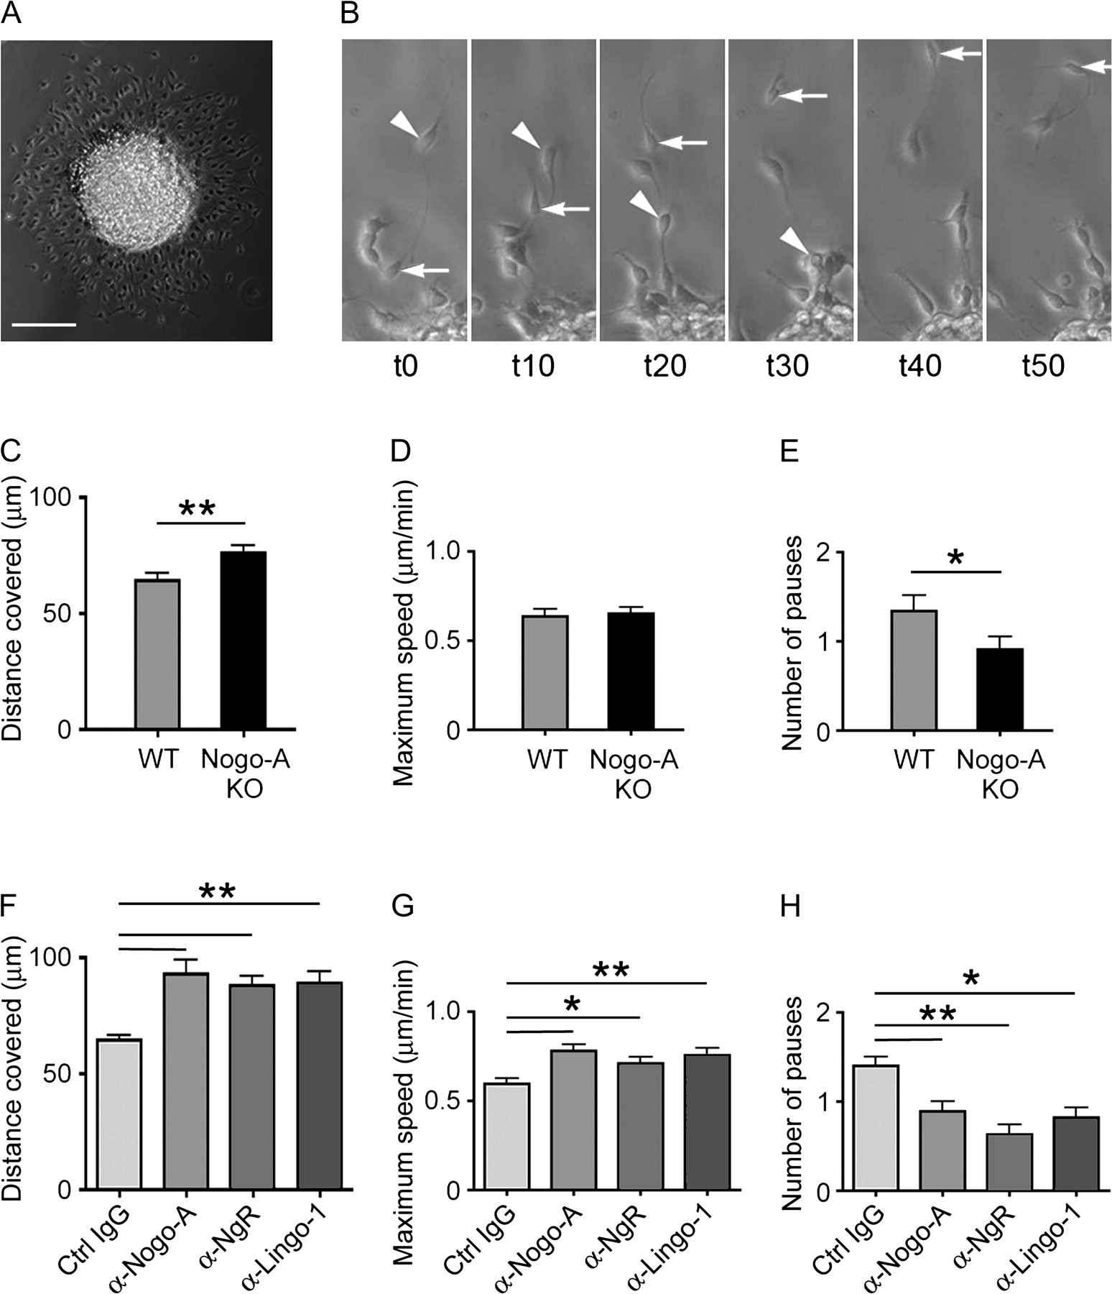
Figure 3. Surface Nogo-A and some Nogo-A receptor components negatively regulate the motility of migrating ...
Notes:
Figure 3. Surface Nogo-A and some Nogo-A receptor components negatively regulate the motility of migrating neurosphere-derived cells. (A) Phase contrast picture of a plated neurosphere cultured without growth factors for 1 day. Note the halo of migrating cells surrounding the sphere. (B) Example of a cell migrating away from the neurosphere (arrow) and of an emanated cell moving back toward the sphere (arrowhead). Time period from t0 to t10 = 5000 s. (C–E) Quantification of the average distance (C) covered by migrating WT or Nogo-A KO mouse neurosphere cells, the maximum speed (D), and the number of pauses (no movement for at least 500 s) (E). Bars represent mean ± SEM of 4 independent experiments (number of cells analyzed: WT: n = 71; Nogo-A KO: n = 72); **P < 0.01 and *P < 0.05, unpaired Student’s t-test. (F–H) Quantification of the average distance (F) covered by migrating WT neurosphere cells treated with function-blocking anti-Nogo-A, anti-Lingo-1, anti-NgR, or control IgG (ctrl IgG) antibodies; the maximum speed (G); and the number of pauses (H). Bars represent mean ± SEM of 3 independent experiments (number of cells analyzed: anti-Nogo-A: n = 55; anti-Lingo-1: n = 57; anti-NgR: n = 60; and control IgG: n = 154); **P < 0.01 and *P < 0.05, analysis of variance, Tukey’s test. Scale bar = 100 μm.
Unless provided in the caption above, the following copyright applies to the content of this slide: © The Authors 2010. Published by Oxford University Press.This is an Open Access article distributed under the terms of the Creative Commons Attribution Non-Commercial License (http://creativecommons.org/licenses/by-nc/2.5), which permits unrestricted non-commercial use, distribution, and reproduction in any medium, provided the original work is properly cited.

Slide 4
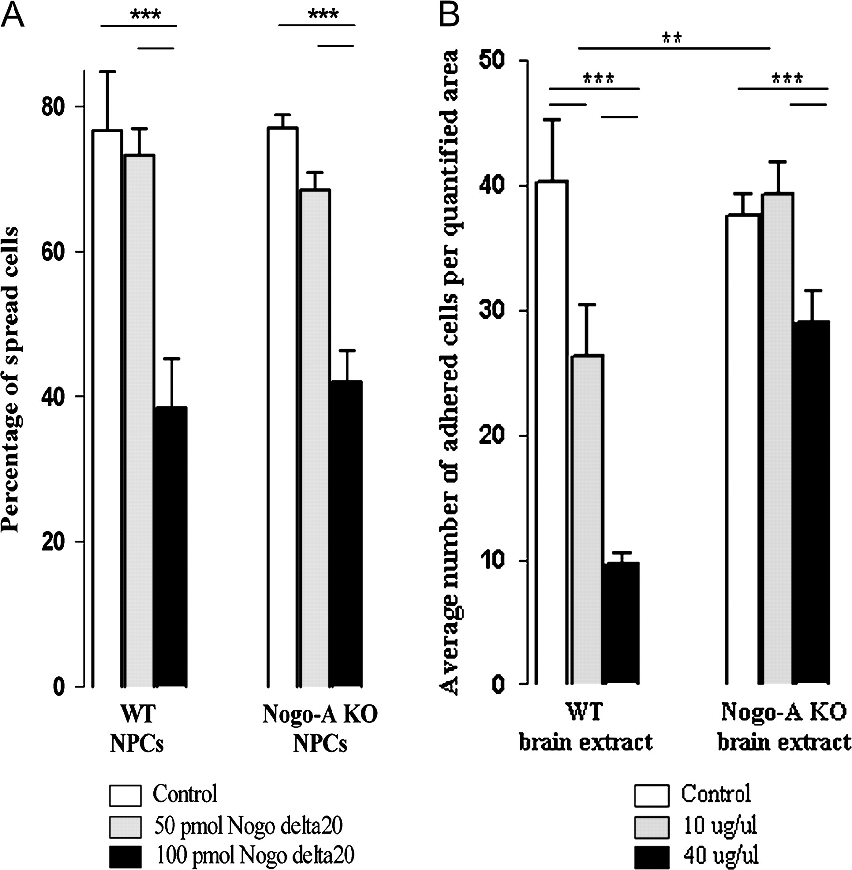
Figure 4. Nogo-A negatively regulates adhesion and spreading of embryonic neural precursor cells. Quantification of the ...
Notes:
Figure 4. Nogo-A negatively regulates adhesion and spreading of embryonic neural precursor cells. Quantification of the proportions of WT and Nogo-A KO neural precursor cells plated on different concentrations of Nogo-delta20 or fresh brain extract from WT or Nogo-A KO mouse embryos. (A) Cells on control substrate (PDL) or on 50 pmol Nogo-delta20 showed normal spreading behavior after 1 h, while WT as well as Nogo-A KO precursor cells plated on a higher concentration of 100 pmol Nogo-delta20 showed a significant decrease in spreading. (B) A concentrations of 10 μg/μL WT brain extract caused a significant decrease in cell adhesion of WT and Nogo-A KO precursor cells compared with control substrate. Ten micrograms per microliter Nogo-A KO brain extract, however, did not inhibit spreading of WT precursor cells. At 40 μg/μL, WT brain extract had a very strong inhibitory effect on precursor cell adhesion for both genotypes, whereas Nogo-A KO mouse brain extract impaired adhesion only mildly, probably through other repulsive molecules present in the extract. Bars represent mean ± SEM; ***P < 0.001 and **P < 0.01, unpaired Student’s t-test.
Unless provided in the caption above, the following copyright applies to the content of this slide: © The Authors 2010. Published by Oxford University Press.This is an Open Access article distributed under the terms of the Creative Commons Attribution Non-Commercial License (http://creativecommons.org/licenses/by-nc/2.5), which permits unrestricted non-commercial use, distribution, and reproduction in any medium, provided the original work is properly cited.

Slide 5
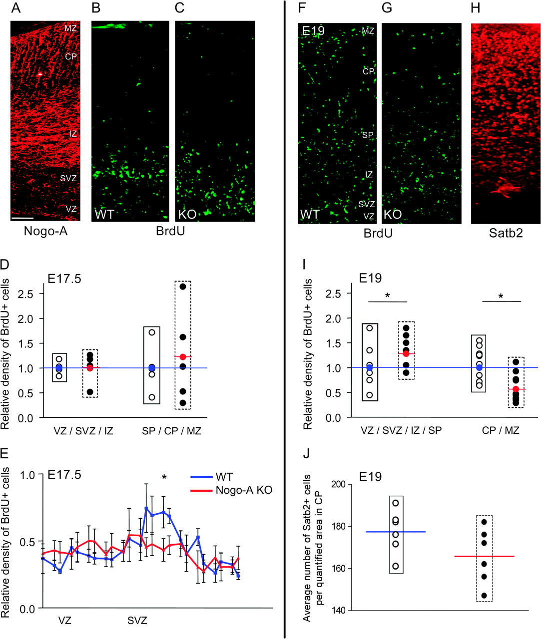
Figure 5. Nogo-A regulates the radial migration of cortical neurons in vivo. (A–C) E17.5 mouse cortices: Nogo-A ...
Notes:
Figure 5. Nogo-A regulates the radial migration of cortical neurons in vivo. (A–C) E17.5 mouse cortices: Nogo-A expression pattern in a WT cortex (A), distribution of radially migrating neuronal precursor cells labeled with BrdU at E15.5 in WT (B), and Nogo-A KO (C). At E17.5, the accumulation of BrdU+ cells in a band between the VZ and IZ, where postmitotic cells strongly express Nogo-A, was only detectable in the WT mouse cortex. In the Nogo-A KO mouse cortex, the newborn precursor cells were more dispersed in the SVZ and IZ. (D and E) Quantification of the distribution of BrdU+ cells within the cortex at E17.5. (D) The number of BrdU+ cells in both regions analyzed (VZ/SVZ/IZ and SP/CP/MZ) was not significantly different between the genotypes. (E) When we analyzed the distribution of BrdU+ cells in the VZ and SVZ at higher resolution, we detected a significantly higher density of cells in the WT SVZ at E17.5. (F and G) E19 mouse cortices showing the distribution of radially migrating neuronal precursor cells labeled with BrdU at E15.5 in WT (F) and Nogo-A KO (G) embryos and Satb2 expression pattern in the WT cortex (H). (I) Densitometric measurements of BrdU+ cells at E19 revealed that in the Nogo-A KO mouse, significantly less cells reached the upper cortical layers (CP/MZ); at the same time, more BrdU+ cells remained in the lower layers (VZ/SVZ/IZ/SP) reflecting a delay in radial migration. (J) Cell counts in the upper CP show that the number of Satb2+ cells tends to be lower in Nogo-A KO compared with WT mouse embryos at E19. Black circles represent individual Nogo-A KO animals as relative values compared with the average of the WT animals (open circles; average set to 1, blue line). The red circle and line represent the average density for the Nogo-A KO mice (black circles) at the given distance. Bars and curves represent mean ± SEM; *P < 0.05, unpaired Student’s t-test. Scale bar = 100 μm.
Unless provided in the caption above, the following copyright applies to the content of this slide: © The Authors 2010. Published by Oxford University Press.This is an Open Access article distributed under the terms of the Creative Commons Attribution Non-Commercial License (http://creativecommons.org/licenses/by-nc/2.5), which permits unrestricted non-commercial use, distribution, and reproduction in any medium, provided the original work is properly cited.

