Slide 1
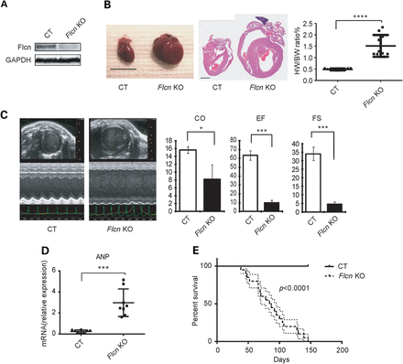
Figure 1. Flcn inactivation in the heart causes dilated cardiomyopathy. (A) Representative western blot image of Flcn ...
Notes:
Figure 1. Flcn inactivation in the heart causes dilated cardiomyopathy. (A) Representative western blot image of Flcn f/f littermate control (CT) heart and Flcn f/f, CKM-Cre (Flcn KO) heart at 6 weeks of age shows the inactivation of Flcn in the mouse heart. (B) Representative gross morphology (left panel) and H&E staining (middle panel) of hearts and heart weight-to-body weight (%HW/BW) ratio (right panel) from Flcn f/f littermate control (CT) mice and Flcn f/f, CKM-Cre (Flcn KO) mice at 6 weeks of age. Scale bars = 10 mm (left panel) and 1 mm (middle panel). Heart weight-to-body weight (%HW/BW) ratio was greater in Flcn KO mice (mean = 1.67%) than in CT mice (mean = 0.45%). Bar, mean ± SD, P<0.0001, unpaired t-test with Welch's correction. (C) Representative echocardiographs (left panel) and parameters obtained in echocardiographs (right panel) for CT and Flcn KO mice at 6 weeks of age. Flcn KO mice showed severely decreased contractile function including decreased CO, EF and FS (t-test: CO, P = 0.043; EF, P = 0.0044; FS, P = 0.0044). Three animals per group were analyzed. (D) mRNA expression for ANP relative to 36B4 in CT and Flcn KO mouse hearts (t-test:P = 0.0002; n = 8 per group). (E) Kaplan–Meier survival analysis demonstrated shortened life span for Flcn KO mice. Median survival was 85.5 days for Flcn KO mice and undetermined for CT mice (n = 20 for each group, P < 0.0001).
Unless provided in the caption above, the following copyright applies to the content of this slide: Published by Oxford University Press 2014. This work is written by (a) US Government employee(s) and is in the public domain in the US.

Slide 2
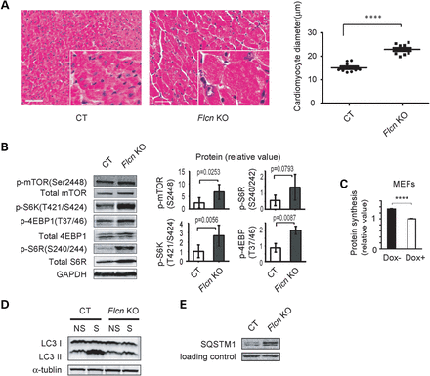
Figure 2. Cardiac hypertrophy phenotype in the Flcn KO heart and up-regulation of mTORC1 signaling under FLCN ...
Notes:
Figure 2. Cardiac hypertrophy phenotype in the Flcn KO heart and up-regulation of mTORC1 signaling under FLCN deficiency. (A) H&E staining of cross-sectional cardiac muscle (left panel, scale bar = 50 mm) and muscle fiber diameter (right panel) of Flcn f/f (CT) and Flcn f/f, CKM-Cre (Flcn KO) hearts. Muscle fiber diameter of Flcn KO heart was significantly greater than CT heart (P < 0.0001, unpaired t-test with Welch's correction). (B) Western blotting showed activation of downstream components of the mTOR signaling pathway in the Flcn KO heart relative to the CT heart. Protein levels of three independent experiments were quantified by Odyssey imager (Li-Cor) and shown as mean values (±SD) in right panels. (C) Protein synthesis of Flcn-null MEFs (Dox-) and doxycycline-induced FLCN-expressing MEFs (Dox+; cultured with doxycycline for 24 h) was determined by BCA method and shown as mean values + SD. Flcn-null MEFs (Dox−) showed increase protein synthesis compared with FLCN-expressing MEFs (Dox+). n = 3, ****Significance at P < 0.0001; unpaired t-test. (D) CT and Flcn KO mice were starved for 24 h and autophagic activity in the hearts was investigated. Induction of LC3 II, an indicator of autophagic activity was suppressed in Flcn KO mice (NS, non-starved; S, starved). (E) Aberrant accumulation of SQSTM1, which monitors autophagic degradation, was observed in Flcn-deficient heart.
Unless provided in the caption above, the following copyright applies to the content of this slide: Published by Oxford University Press 2014. This work is written by (a) US Government employee(s) and is in the public domain in the US.

Slide 3
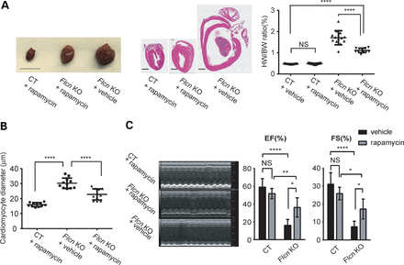
Figure 3. Rapamycin treatment significantly reduces heart size and improves cardiac function of the Flcn KO heart. (A) ...
Notes:
Figure 3. Rapamycin treatment significantly reduces heart size and improves cardiac function of the Flcn KO heart. (A) Representative gross morphology (left panel) and H&E staining (middle panel) of hearts, and heart weight-to-body weight (%HW/BW) ratio (right panel) from rapamycin-treated Flcn f/f (CT + rapamycin) mice, rapamycin-treated Flcn f/f, CKM-Cre (Flcn KO + rapamycin) mice and vehicle-treated Flcn f/f, CKM-Cre (Flcn KO + vehicle) mice. Scale bars = 10 mm (left panel) and 1 mm (middle panel). Rapamycin treatment significantly decreased HW/BW ratio in Flcn KO hearts (P < 0.0001), but had no effect on CT hearts (NS, non-significance; one-way ANOVA). (B) The average cardiac muscle diameter was reduced in rapamycin-treated Flcn KO mice. (C) Representative echocardiographs (left panel) and parameters obtained in echocardiographs (right panel) for rapamycin-treated Flcn CT and KO mice, and vehicle-treated Flcn KO mice at 6 weeks of age. Rapamycin treatment significantly improved cardiac function of Flcn KO mice. EF and FS are shown here. *Significance at P < 0.05; **Significance at P < 0.01; ****Significance at P < 0.0001; one-way ANOVA. At least three animals per group were analyzed.
Unless provided in the caption above, the following copyright applies to the content of this slide: Published by Oxford University Press 2014. This work is written by (a) US Government employee(s) and is in the public domain in the US.

Slide 4
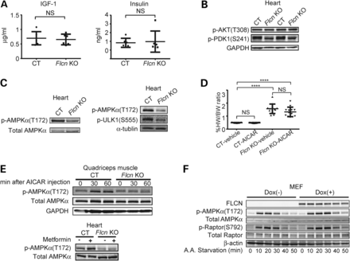
Figure 4. Impaired phosphorylation of AMPKα at T172 under FLCN deficiency. (A) IGF-1 and insulin in mouse serum were ...
Notes:
Figure 4. Impaired phosphorylation of AMPKα at T172 under FLCN deficiency. (A) IGF-1 and insulin in mouse serum were measured using ELISA and radioimmunoassay (RIA), respectively. There was no significant difference between Flcn f/f, CKM-Cre (Flcn KO) mice and Flcn f/f littermate control (CT) mice (NS, non-significance; one-way ANOVA, n = 6). (B) Signaling molecules in PI3K-AKT pathway in Flcn KO hearts were investigated by immunoblotting. AKT was not up-regulated whereas PDK1 was down-regulated, indicating a potential negative feedback loop from increased mTORC1 activity. (C) Western blotting showed decreased phospho-AMPKα (T172) in Flcn KO heart relative to CT heart. Immunoblotting revealed decreased p-ULK1 (S555), a direct target of AMPK, in Flcn KO heart relative to CT heart as shown in the right panel. (D) AICAR treatment had no effect on heart size in CT or Flcn KO mice. ****Significance at P < 0.0001; NS, non-significance; one-way ANOVA, n = 12. (E) Immunoblotting of quadriceps muscle showed AICAR treatment increased phospho-AMPKα (T172) in CT mice, but not in Flcn KO mice (upper panel). Immunoblotting of heart lysates showed metformin treatment increased phospho-AMPKα (T172) in CT mice, but not in Flcn KO mice (lower panel). (F) Maximum stimulation of phospho-AMPKα (T172) and its downstream phospho-Raptor (S792) activation by amino acid starvation was reduced in Flcn-null MEFs (Dox−) compared with FLCN-expressing MEFs (Dox+).
Unless provided in the caption above, the following copyright applies to the content of this slide: Published by Oxford University Press 2014. This work is written by (a) US Government employee(s) and is in the public domain in the US.

Slide 5
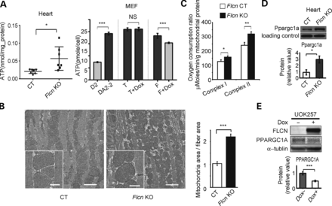
Figure 5. FLCN deficiency leads to increased PPARGC1A expression and mitochondrial biogenesis leading to overproduction ...
Notes:
Figure 5. FLCN deficiency leads to increased PPARGC1A expression and mitochondrial biogenesis leading to overproduction of ATP. (A) ATP content was measured in Flcn f/f (CT) and Flcn f/f, CKM-Cre (Flcn KO) hearts (left panel, n = 7, *at P < 0.05, unpaired t-test with Welch's correction), and in MEFs (right panel, D2, Flcn f/d MEF (Flcn+); DA2-2, Flcn d/d MEF (Flcn−); T, DA2-2 only with tet regulator (Flcn−); T + Dox, T treated with doxycycline (Flcn-); F, T with wild-type FLCN cassette under tet promoter (Flcn-); F + Dox, F treated with doxycycline (FLCN+).) (NS, non-significance; ***at P < 0.001; unpaired t-test). (B) Representative electron micrograph images of cardiac muscle from CT and Flcn KO mice at 6 weeks of age (left panel). Flcn KO cardiac muscle has more mitochondrial mass (scale bar, 2 mm). Insert panels show well-preserved mitochondrial structure in both CT and Flcn KO hearts (scale bar, 500 nm). Bar graph shows the ratio of mitochondrial area to cardiac fiber area in CT and Flcn KO hearts (right panel). Three pairs of images from CT and Flcn KO hearts were analyzed using ImageJ software (P = 0.0002, unpaired t-test). (C) Maximum respiration capacity was measured with 1 mg of mitochondria isolated from Flcn f/f (CT) and Flcn f/f, CKM-Cre (Flcn KO) hearts using Seahorse XF96 analyzer. Bars represent mean + SD of four animals of each genotype (*at P < 0.05, **at P < 0.01, unpaired t-test). (D) Ppargc1a protein expression was increased in the Flcn KO heart relative to the CT littermate heart. Non-specific band was shown as a loading control (*at P < 0.05, unpaired t-test). (E) Restoration of wild-type FLCN in FLCN-null UOK257 cells (Dox+) decreased PPARGC1A protein expression compared with uninduced cells (Dox−). Lower panel represents densitometry of western blot bands from three independent experiments, indicated as mean values (±SD) (***at P < 0.001, unpaired t-test).
Unless provided in the caption above, the following copyright applies to the content of this slide: Published by Oxford University Press 2014. This work is written by (a) US Government employee(s) and is in the public domain in the US.

Slide 6
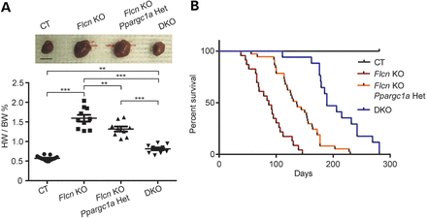
Figure 6. Inactivation of PPARGC1A decreased the heart size and prolonged the survival of Flcn KO mice. (A) ...
Notes:
Figure 6. Inactivation of PPARGC1A decreased the heart size and prolonged the survival of Flcn KO mice. (A) Muscle-targeted Flcn/Ppargc1a DKO mice show dramatic reduction in heart size. The HW/BW ratio of each genotype at 8 weeks of age. Mean ± SD are shown. Haploinsufficient effect was observed in Flcn f/f, Ppargc1a f/+, CKM-Cre mice (Flcn KO, Ppargc1a Het). Upper panel shows representative gross morphology of hearts for each genotype (scale bar = 1 cm). ***Significance at P < 0.001, **significance at P < 0.01, NS, non-significance; one-way ANOVA. (B) Kaplan–Meier survival analysis shows prolonged survival for DKO mice compared with Flcn f/f, CKM-Cre (Flcn KO) mice. Median survival for each of the genotypes is as follows: Flcn f/f (CT) = undefined; Flcn f/f, CKM-Cre (Flcn KO) = 87 days; Flcn f/f, Ppargc1a f/+, CKM-Cre (Flcn KO, Ppargc1a Het) = 136 days and Flcn f/f, Ppargc1a f/f, CKM-Cre (DKO) = 189 days, respectively (P = 17).
Unless provided in the caption above, the following copyright applies to the content of this slide: Published by Oxford University Press 2014. This work is written by (a) US Government employee(s) and is in the public domain in the US.

Slide 7
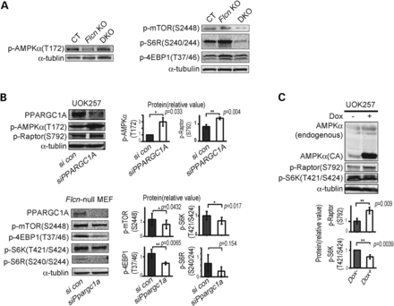
Figure 7. Inactivation of PPARGC1A reactivates AMPK and suppresses mTORC1 in the Flcn KO heart and FLCN-null cells. (A) ...
Notes:
Figure 7. Inactivation of PPARGC1A reactivates AMPK and suppresses mTORC1 in the Flcn KO heart and FLCN-null cells. (A) Western blotting of the heart lysates shows AMPK was reactivated (left panel) and mTOR signaling was suppressed (right panel) in muscle-targeted Flcn/Ppargc1a DKO mice. (B) FLCN-null UOK257 cells were transfected with siPPARGC1A or scrambled control (con) and harvested after 48 h, and showed up-regulation of phospho-AMPKα (T172) and phospho-Raptor (S792) (upper panel). Suppression of Ppargc1a for 72 h resulted in suppression of mTOR downstream components in Flcn-null MEFs (lower panel). Protein levels of three independent experiments were quantified by Odyssey imager (Li-Cor) and shown as mean values (±SD) in right panels. (C) Overexpression of doxycycline-induced constitutively active (CA) AMPKα, which is a truncated form of AMPKα at residue 312 and therefore retains significant kinase activity, in FLCN-null UOK257 cells suppressed mTOR signaling by phosphorylating Raptor. Both AMPKα and AMPKα (CA) were blotted with AMPKα antibody in the same membrane. Protein levels of three independent experiments were quantified by Odyssey imager (Li-Cor) and shown as mean values (±SD) in lower panels.
Unless provided in the caption above, the following copyright applies to the content of this slide: Published by Oxford University Press 2014. This work is written by (a) US Government employee(s) and is in the public domain in the US.

Slide 8
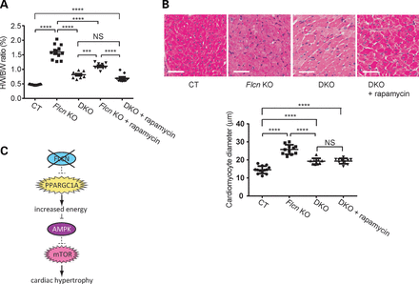
Figure 8. Cardiac hypertrophy of Flcn KO mice associated with increased mTORC1 is PPARGC1A dependent. (A) Inhibition of ...
Notes:
Figure 8. Cardiac hypertrophy of Flcn KO mice associated with increased mTORC1 is PPARGC1A dependent. (A) Inhibition of mTOR by rapamycin had no additional effect on heart size of muscle-targeted Flcn/Ppargc1a knockout (DKO) mice. No significant difference was seen in HW/BW ratio between DKO and rapamycin-treated DKO mice (NS, non-significance; ****P < 0.0001, ***P < 0.001, one-way ANOVA). (B) Histologic analysis of DKO hearts with and without rapamycin treatment revealed no change in muscle fiber thickness. Scale bar = 50 mm. (NS, non-significance; **** P < 0.0001, one-way ANOVA). (C) Hypothetical scheme showing how FLCN inactivation leads to cardiac hypertrophy.
Unless provided in the caption above, the following copyright applies to the content of this slide: Published by Oxford University Press 2014. This work is written by (a) US Government employee(s) and is in the public domain in the US.

