Slide 1
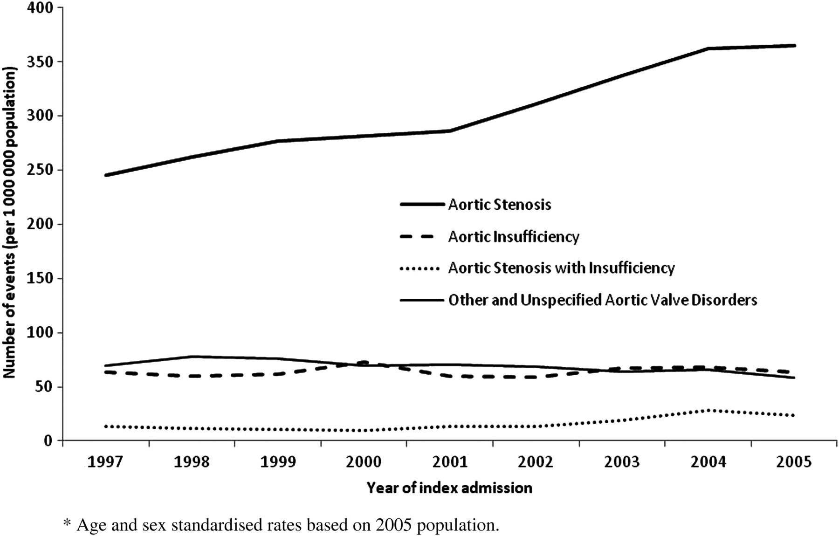
Figure 1 Temporal trends for hospitalization with a first report of aortic stenosis (ICD code I350), aortic ...
Notes:
Figure 1 Temporal trends for hospitalization with a first report of aortic stenosis (ICD code I350), aortic insufficiency (ICD code I351), mixed aortic valve disease (ICD code I352), and other and unspecified forms of aortic valve disease (ICD codes I358 and I359) from 1 January 1997 to 31 December 2005.
Unless provided in the caption above, the following copyright applies to the content of this slide: Published on behalf of the European Society of Cardiology. All rights reserved. © The Author 2012. For permissions please email: journals.permissions@oup.com.

Slide 2
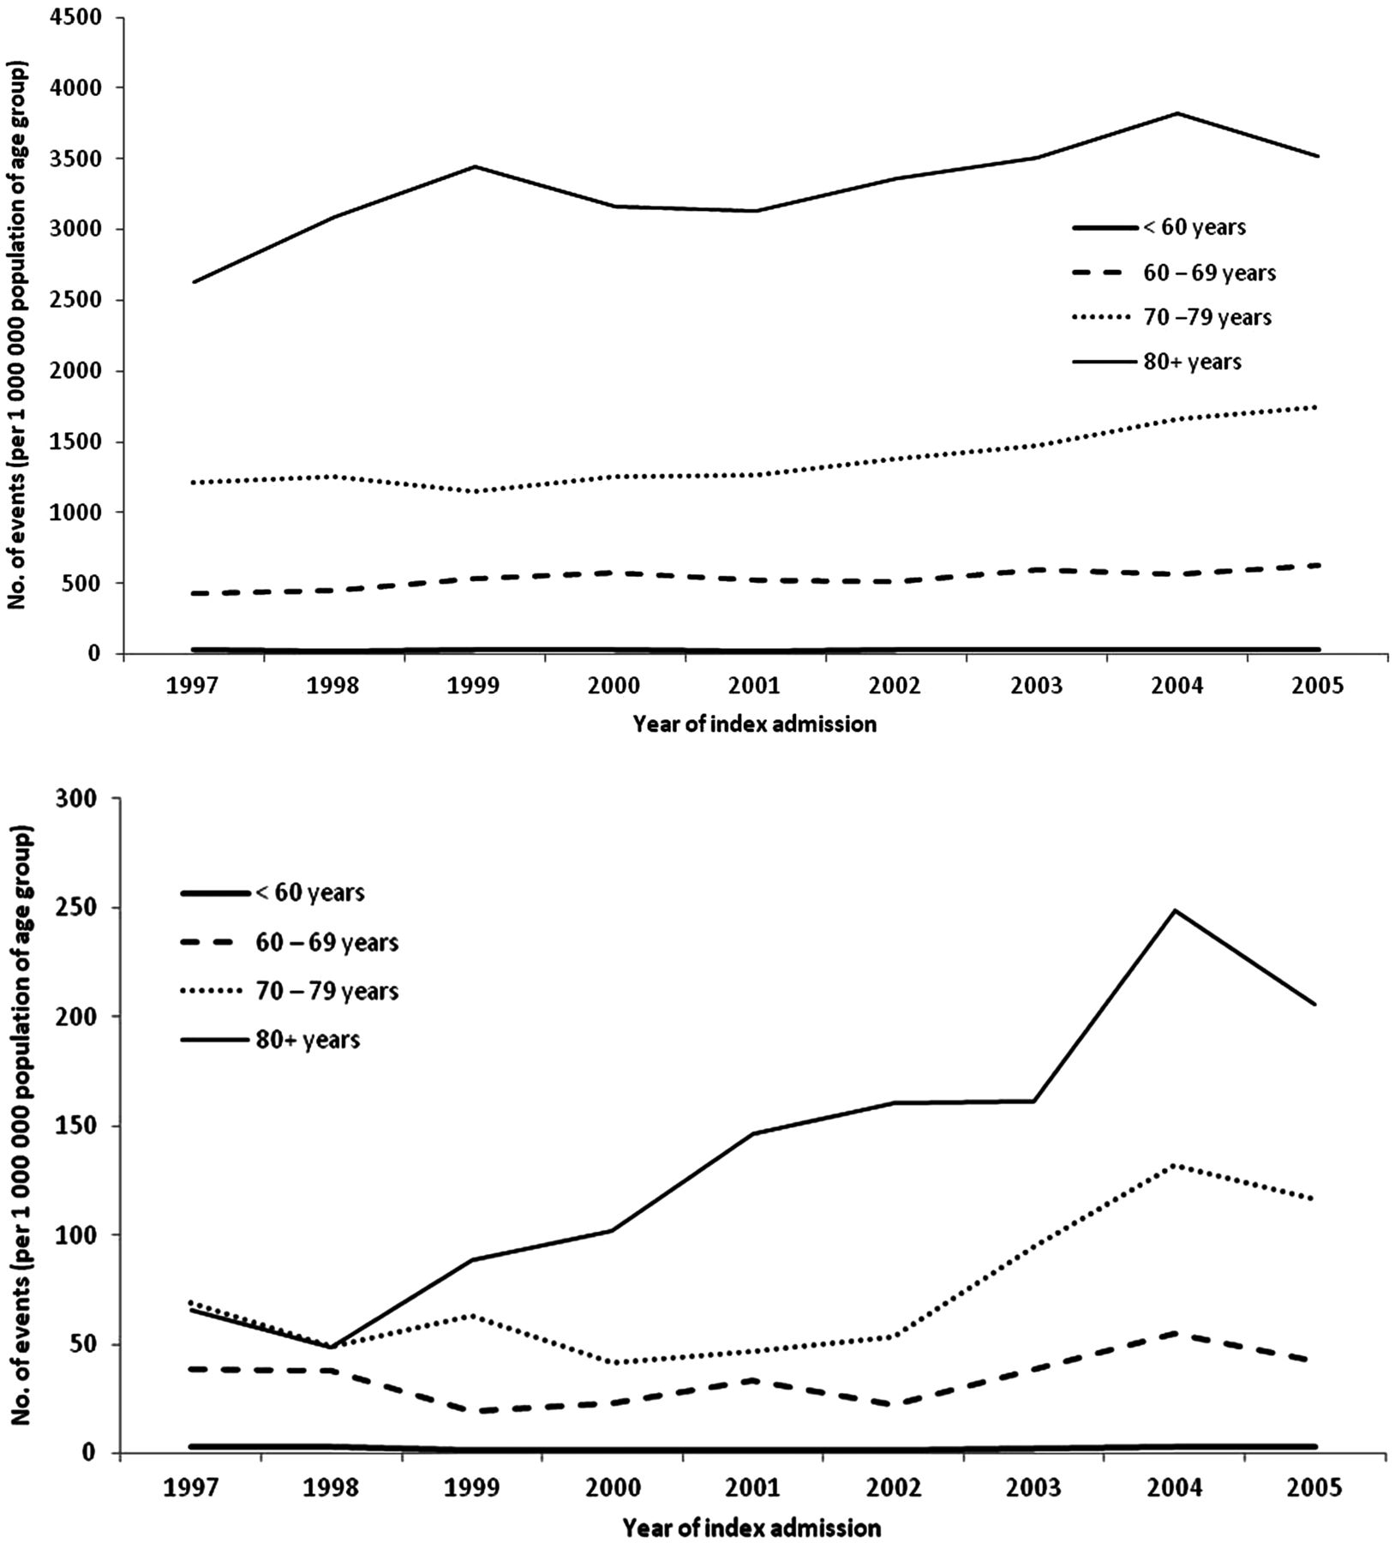
Figure 2 Temporal trends for hospitalization with a first report of aortic stenosis (upper figure) or aortic stenosis ...
Notes:
Figure 2 Temporal trends for hospitalization with a first report of aortic stenosis (upper figure) or aortic stenosis with insufficiency (lower figure) according to age category.
Unless provided in the caption above, the following copyright applies to the content of this slide: Published on behalf of the European Society of Cardiology. All rights reserved. © The Author 2012. For permissions please email: journals.permissions@oup.com.

Slide 3
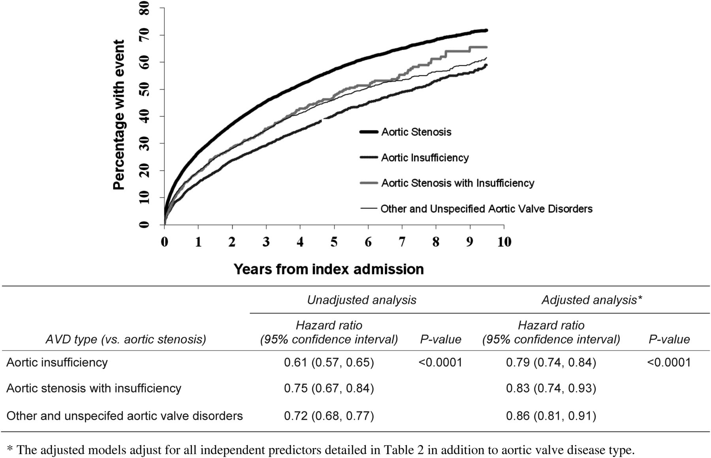
Figure 3 Kaplan-Meier plot for all-cause mortality by type of aortic valve disease. The hazard ratios (95% confidence ...
Notes:
Figure 3 Kaplan-Meier plot for all-cause mortality by type of aortic valve disease. The hazard ratios (95% confidence interval) for all-cause mortality for aortic insufficiency, aortic stenosis with insufficiency, and other/unspecified aortic valve disease compared with aortic stenosis are shown beneath the figure. Hazard ratios (95% confidence interval) are shown unadjusted and adjusted for other predictors of mortality (Table 2), including deprivation.
Unless provided in the caption above, the following copyright applies to the content of this slide: Published on behalf of the European Society of Cardiology. All rights reserved. © The Author 2012. For permissions please email: journals.permissions@oup.com.

Slide 4
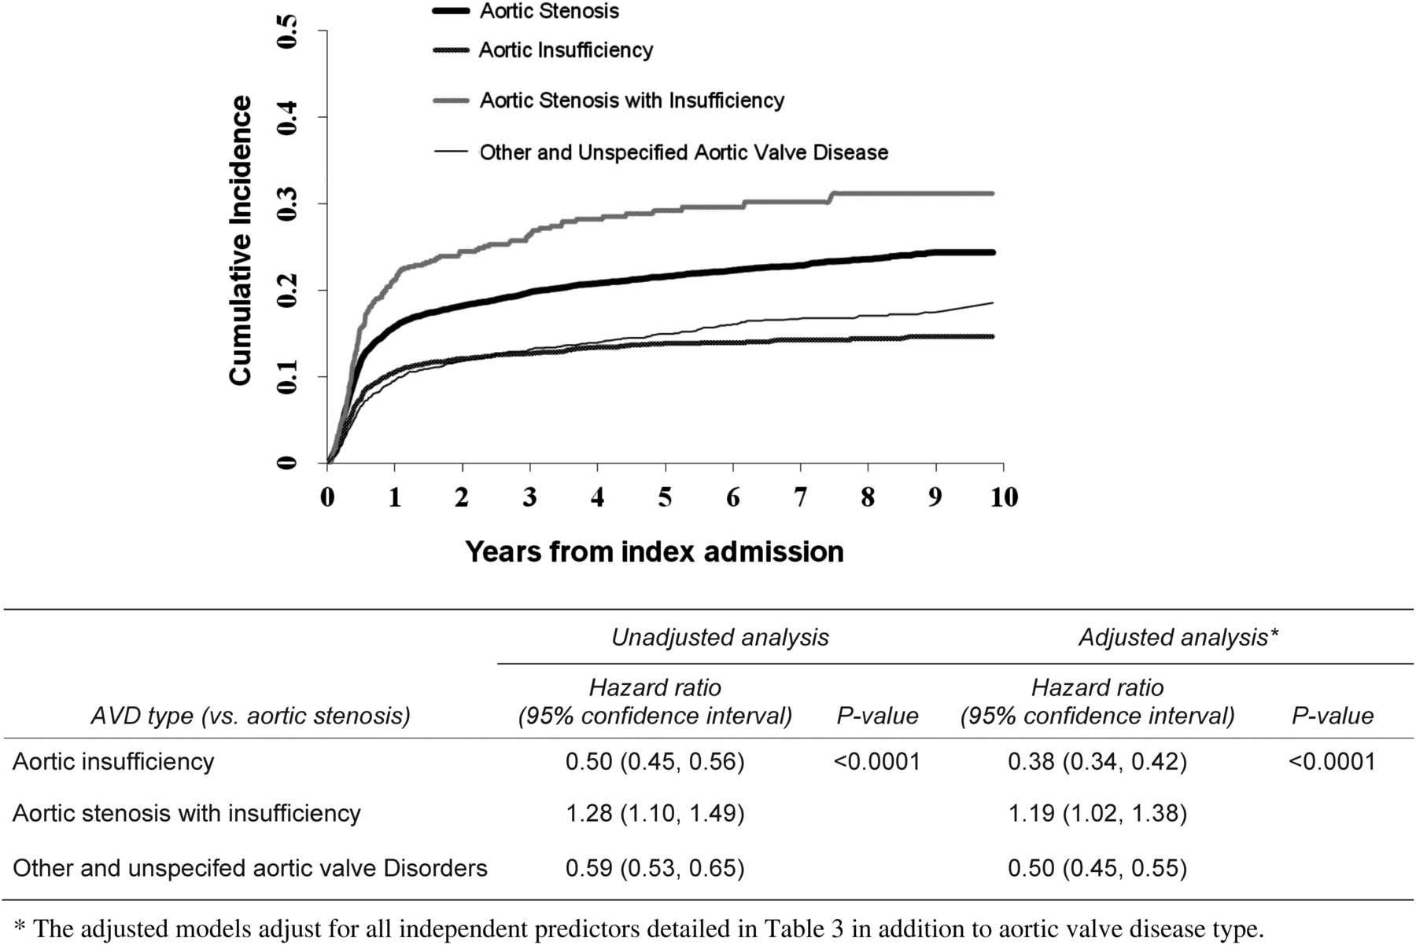
Figure 4 Cumulative incidence plot for aortic valve replacement by type of aortic valve disease. The hazard ratios ...
Notes:
Figure 4 Cumulative incidence plot for aortic valve replacement by type of aortic valve disease. The hazard ratios (95% confidence interval) for all-cause mortality for aortic insufficiency, aortic stenosis with insufficiency, and other/unspecified aortic valve disease compared with aortic stenosis are shown beneath the figure.
Unless provided in the caption above, the following copyright applies to the content of this slide: Published on behalf of the European Society of Cardiology. All rights reserved. © The Author 2012. For permissions please email: journals.permissions@oup.com.

