Slide 1
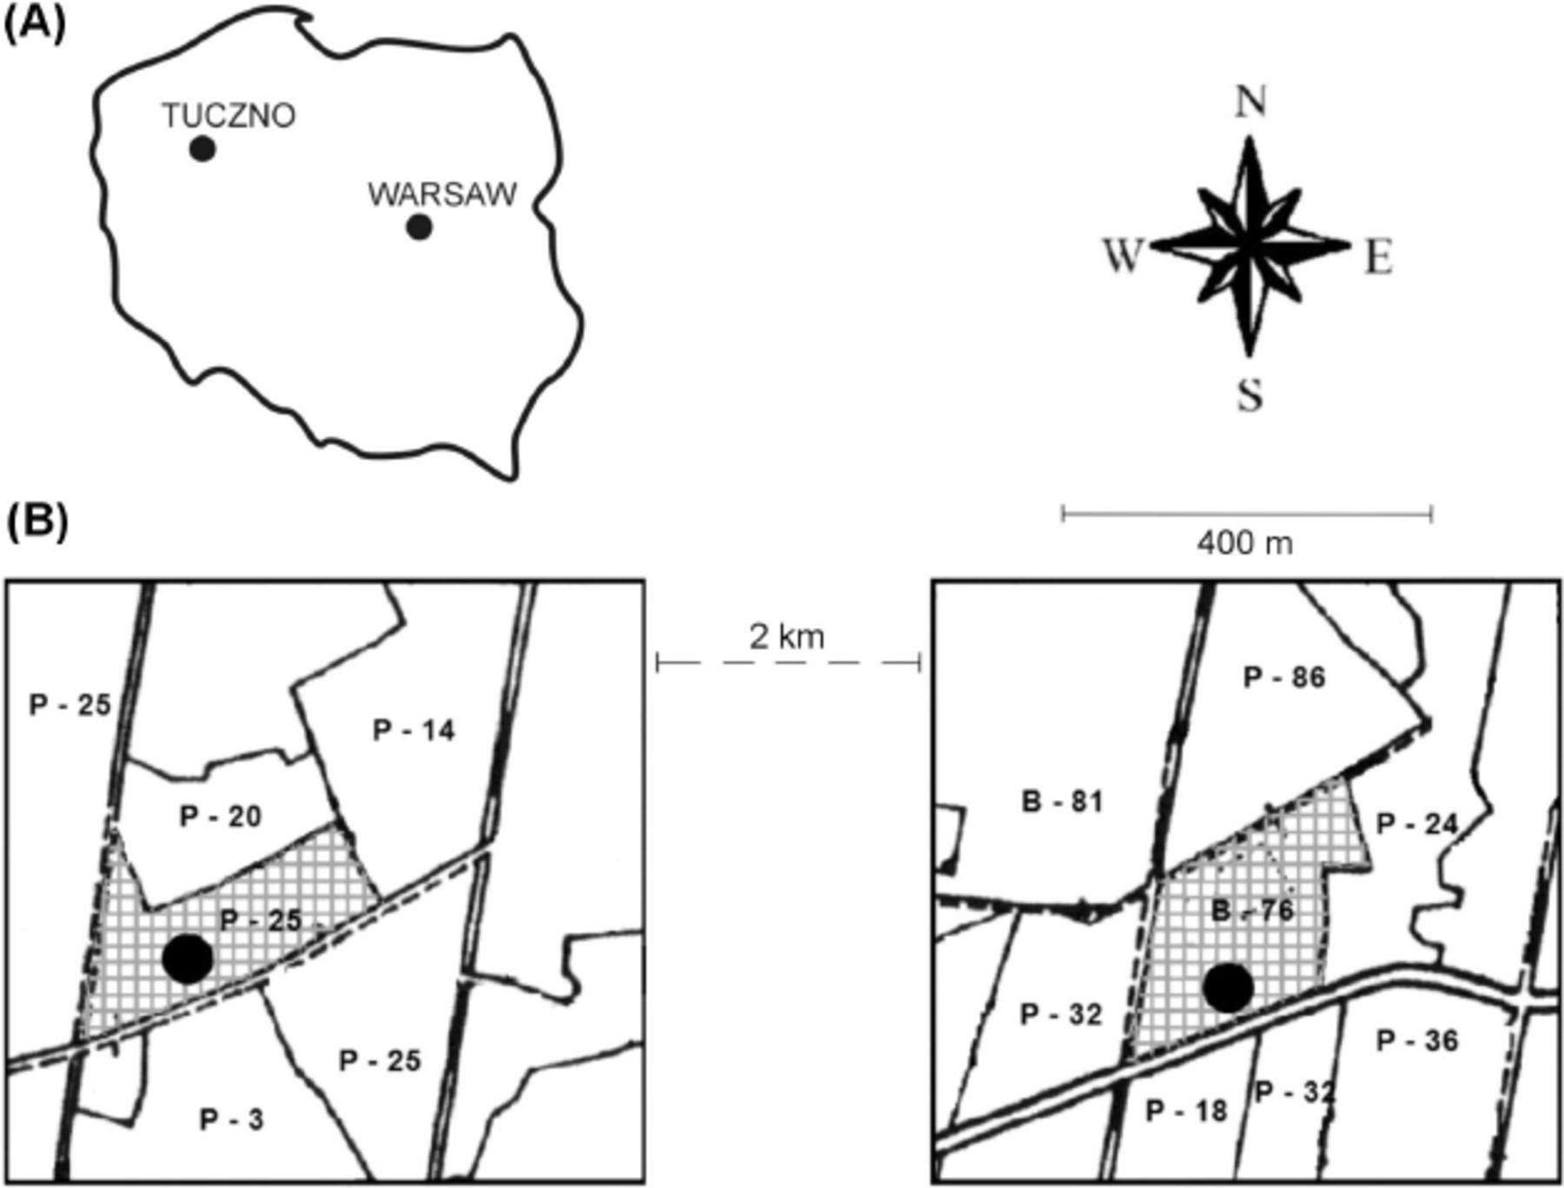
Fig. 1. Location of the forest stands (A, Tuczno, Poland). (B) Location of forest stands in the Forest Distinct of ...
Notes:
Fig. 1. Location of the forest stands (A, Tuczno, Poland). (B) Location of forest stands in the Forest Distinct of Tuczno. P, pine; B, beech; number, age of stand; and black circle, place of study.
Unless provided in the caption above, the following copyright applies to the content of this slide: © 2004 Entomological Society of AmericaThis is an Open Access article distributed under the terms of the Creative Commons Attribution Non-Commercial License (http://creativecommons.org/licenses/by-nc/3.0/), which permits non-commercial reuse, distribution, and reproduction in any medium, provided the original work is properly cited. For commercial re-use, please contact journals.permissions@oup.com

