Slide 1
Figure 1. Electrode placement and training scheme. (A) Placement location of the array of electrodes used for ...
Notes:
Figure 1. Electrode placement and training scheme. (A) Placement location of the array of electrodes used for electrical microstimulation is indicated by the black circles. Separation between electrodes in the visual and somatosensory cortex was at least 1 mm. The cortical regions were drawn based on Paxinos and Watson (1998). S1BF, somatosensory area barrel field; V1B, primary visual cortex, binocular; V1M, primary visual cortex, monocular. Asterisk indicates the bregma. Numbers will be used as reference for the rest of the figures. (B) Timing scheme for training. During training, rats had to press 1 of 2 levers, cued by the onset of a light located above the levers, in combination with the application of one microstimulation pattern. (C) Timing scheme for testing. Here, rats were forced to choose between left or right levers based only on the consequence of electric microsimulation applied through the implanted electrodes.
Unless provided in the caption above, the following copyright applies to the content of this slide: © The Author 2012. Published by Oxford University Press. All rights reserved. For Permissions, please e-mail: journals.permissions@oup.com

Slide 2
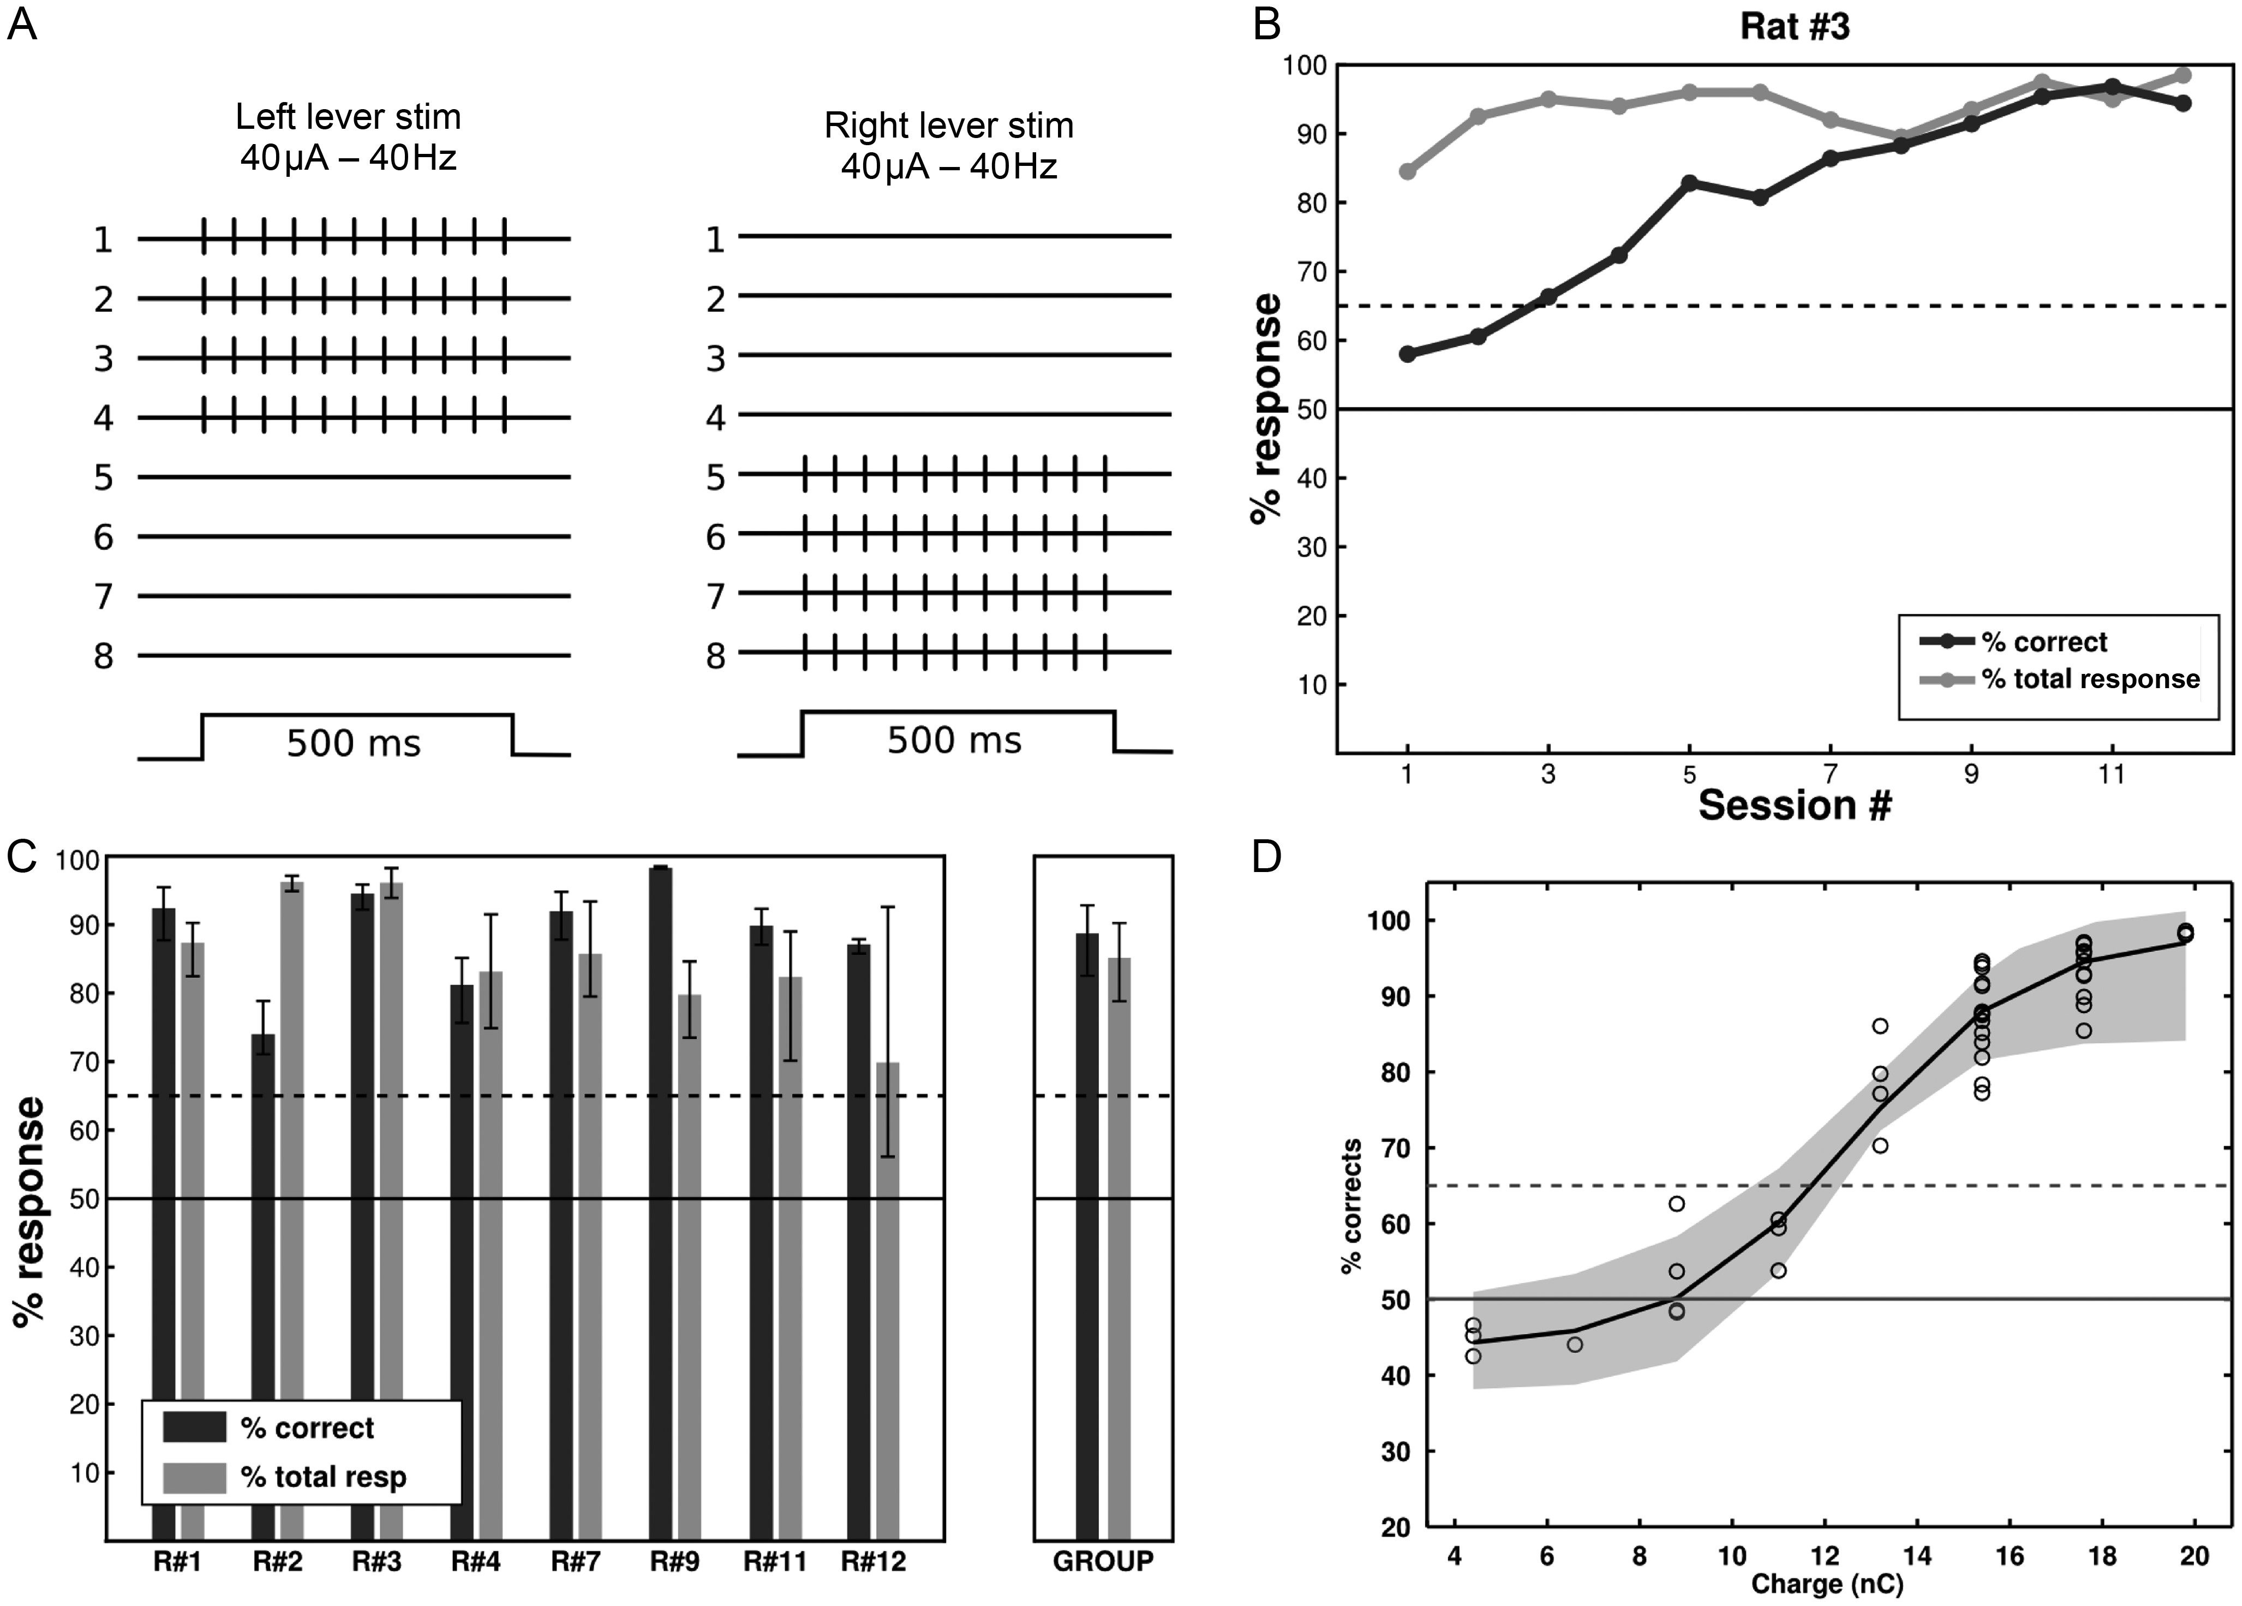
Figure 2. Performance of rats trained to discriminate between electrical microsimulation applied to electrodes inserted ...
Notes:
Figure 2. Performance of rats trained to discriminate between electrical microsimulation applied to electrodes inserted to each cerebral hemisphere. (A) Stimulus configuration. Electrodes 1–4 were implanted in the right hemisphere and electrodes 5–8 in the left hemisphere. In each trial, 20 synchronous square pulses (40 µA, 40 Hz, 500 ms) were applied to either one of the hemispheres at a time, and instructed the animal to choose one of the levers (right or left). (B) Time course of performance of one rat to the discrimination of microstimulation to different hemispheres. For each session of 200 trials, the percentage of total (correct + incorrect) responses is shown in gray and of those; the percentage of correct responses is shown in black. This animal and the other quickly and consistently showed performances above the learning criteria (65%, dashed line). (C) Average performance for 4 consecutive sessions—fter reaching learning criteria—for the 8 rats trained in this task, and for the group. Correct responses shown in black exceeded 65% in all cases. The % of total responses is shown in gray. Error bars depict 95% CI. (D) Psychophysical curve of detection of current. Gray area shows the 95% prediction bounds.
Unless provided in the caption above, the following copyright applies to the content of this slide: © The Author 2012. Published by Oxford University Press. All rights reserved. For Permissions, please e-mail: journals.permissions@oup.com

Slide 3
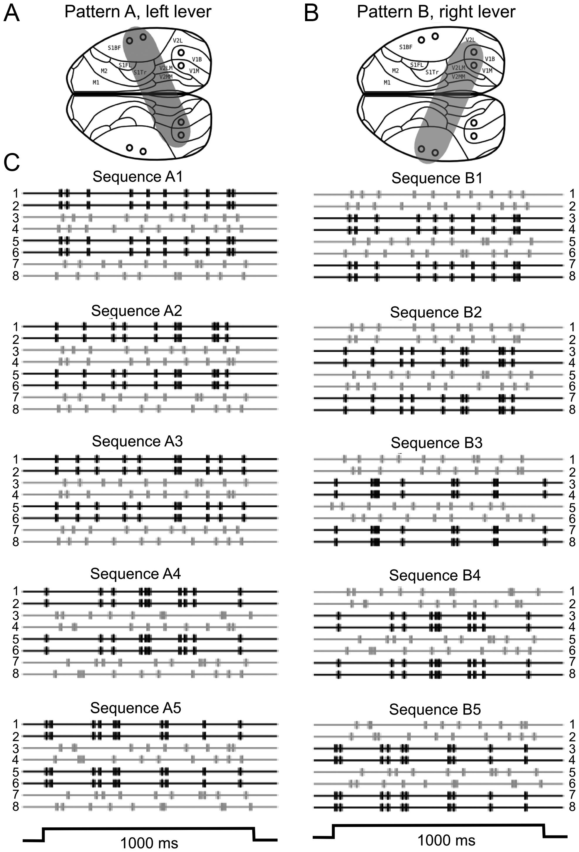
Figure 3. Discrimination between 2 synchronization configurations. (A) Artificial synchronization between right ...
Notes:
Figure 3. Discrimination between 2 synchronization configurations. (A) Artificial synchronization between right somatosensory cortex and left visual cortex (gray patch) instructed the rats to press the left lever. (B) The opposite pattern (left somatosensory cortex and right visual cortex), instructed rats to choose the right lever. (C) For each session, a new set of 5 versions of each pattern were constructed to ensure that discriminations relied only on the pattern and not in the specific temporal sequence. Parameters: Square pulses, 150 µA, 0.5 ms pulse width, negative first, 1000 ms train duration.
Unless provided in the caption above, the following copyright applies to the content of this slide: © The Author 2012. Published by Oxford University Press. All rights reserved. For Permissions, please e-mail: journals.permissions@oup.com

Slide 4
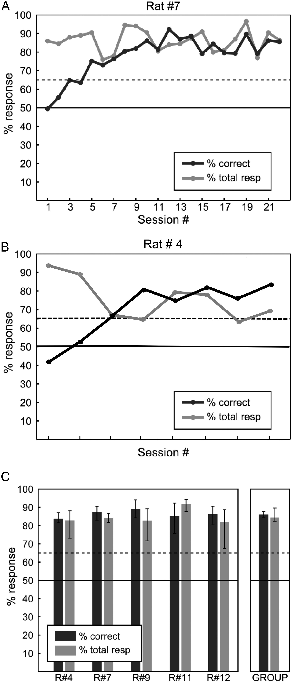
Figure 4. Rats reliably discriminate between different synchronization configurations. Rats had to discriminate between ...
Notes:
Figure 4. Rats reliably discriminate between different synchronization configurations. Rats had to discriminate between artificial synchronization applied in different configurations (see Fig. 3). (A and B) Example learning curves for 2 rats. In every session, a completely new set of stimuli was constructed. (C) Average performance for 5 rats trained in this task. All of them showed reliable performance levels according to defined learning criteria. The group statistics (mean and 95% CIs) are shown in the graph on the right. Continuous line: 50% chance level. Dashed line: 65% learning criteria.
Unless provided in the caption above, the following copyright applies to the content of this slide: © The Author 2012. Published by Oxford University Press. All rights reserved. For Permissions, please e-mail: journals.permissions@oup.com

Slide 5
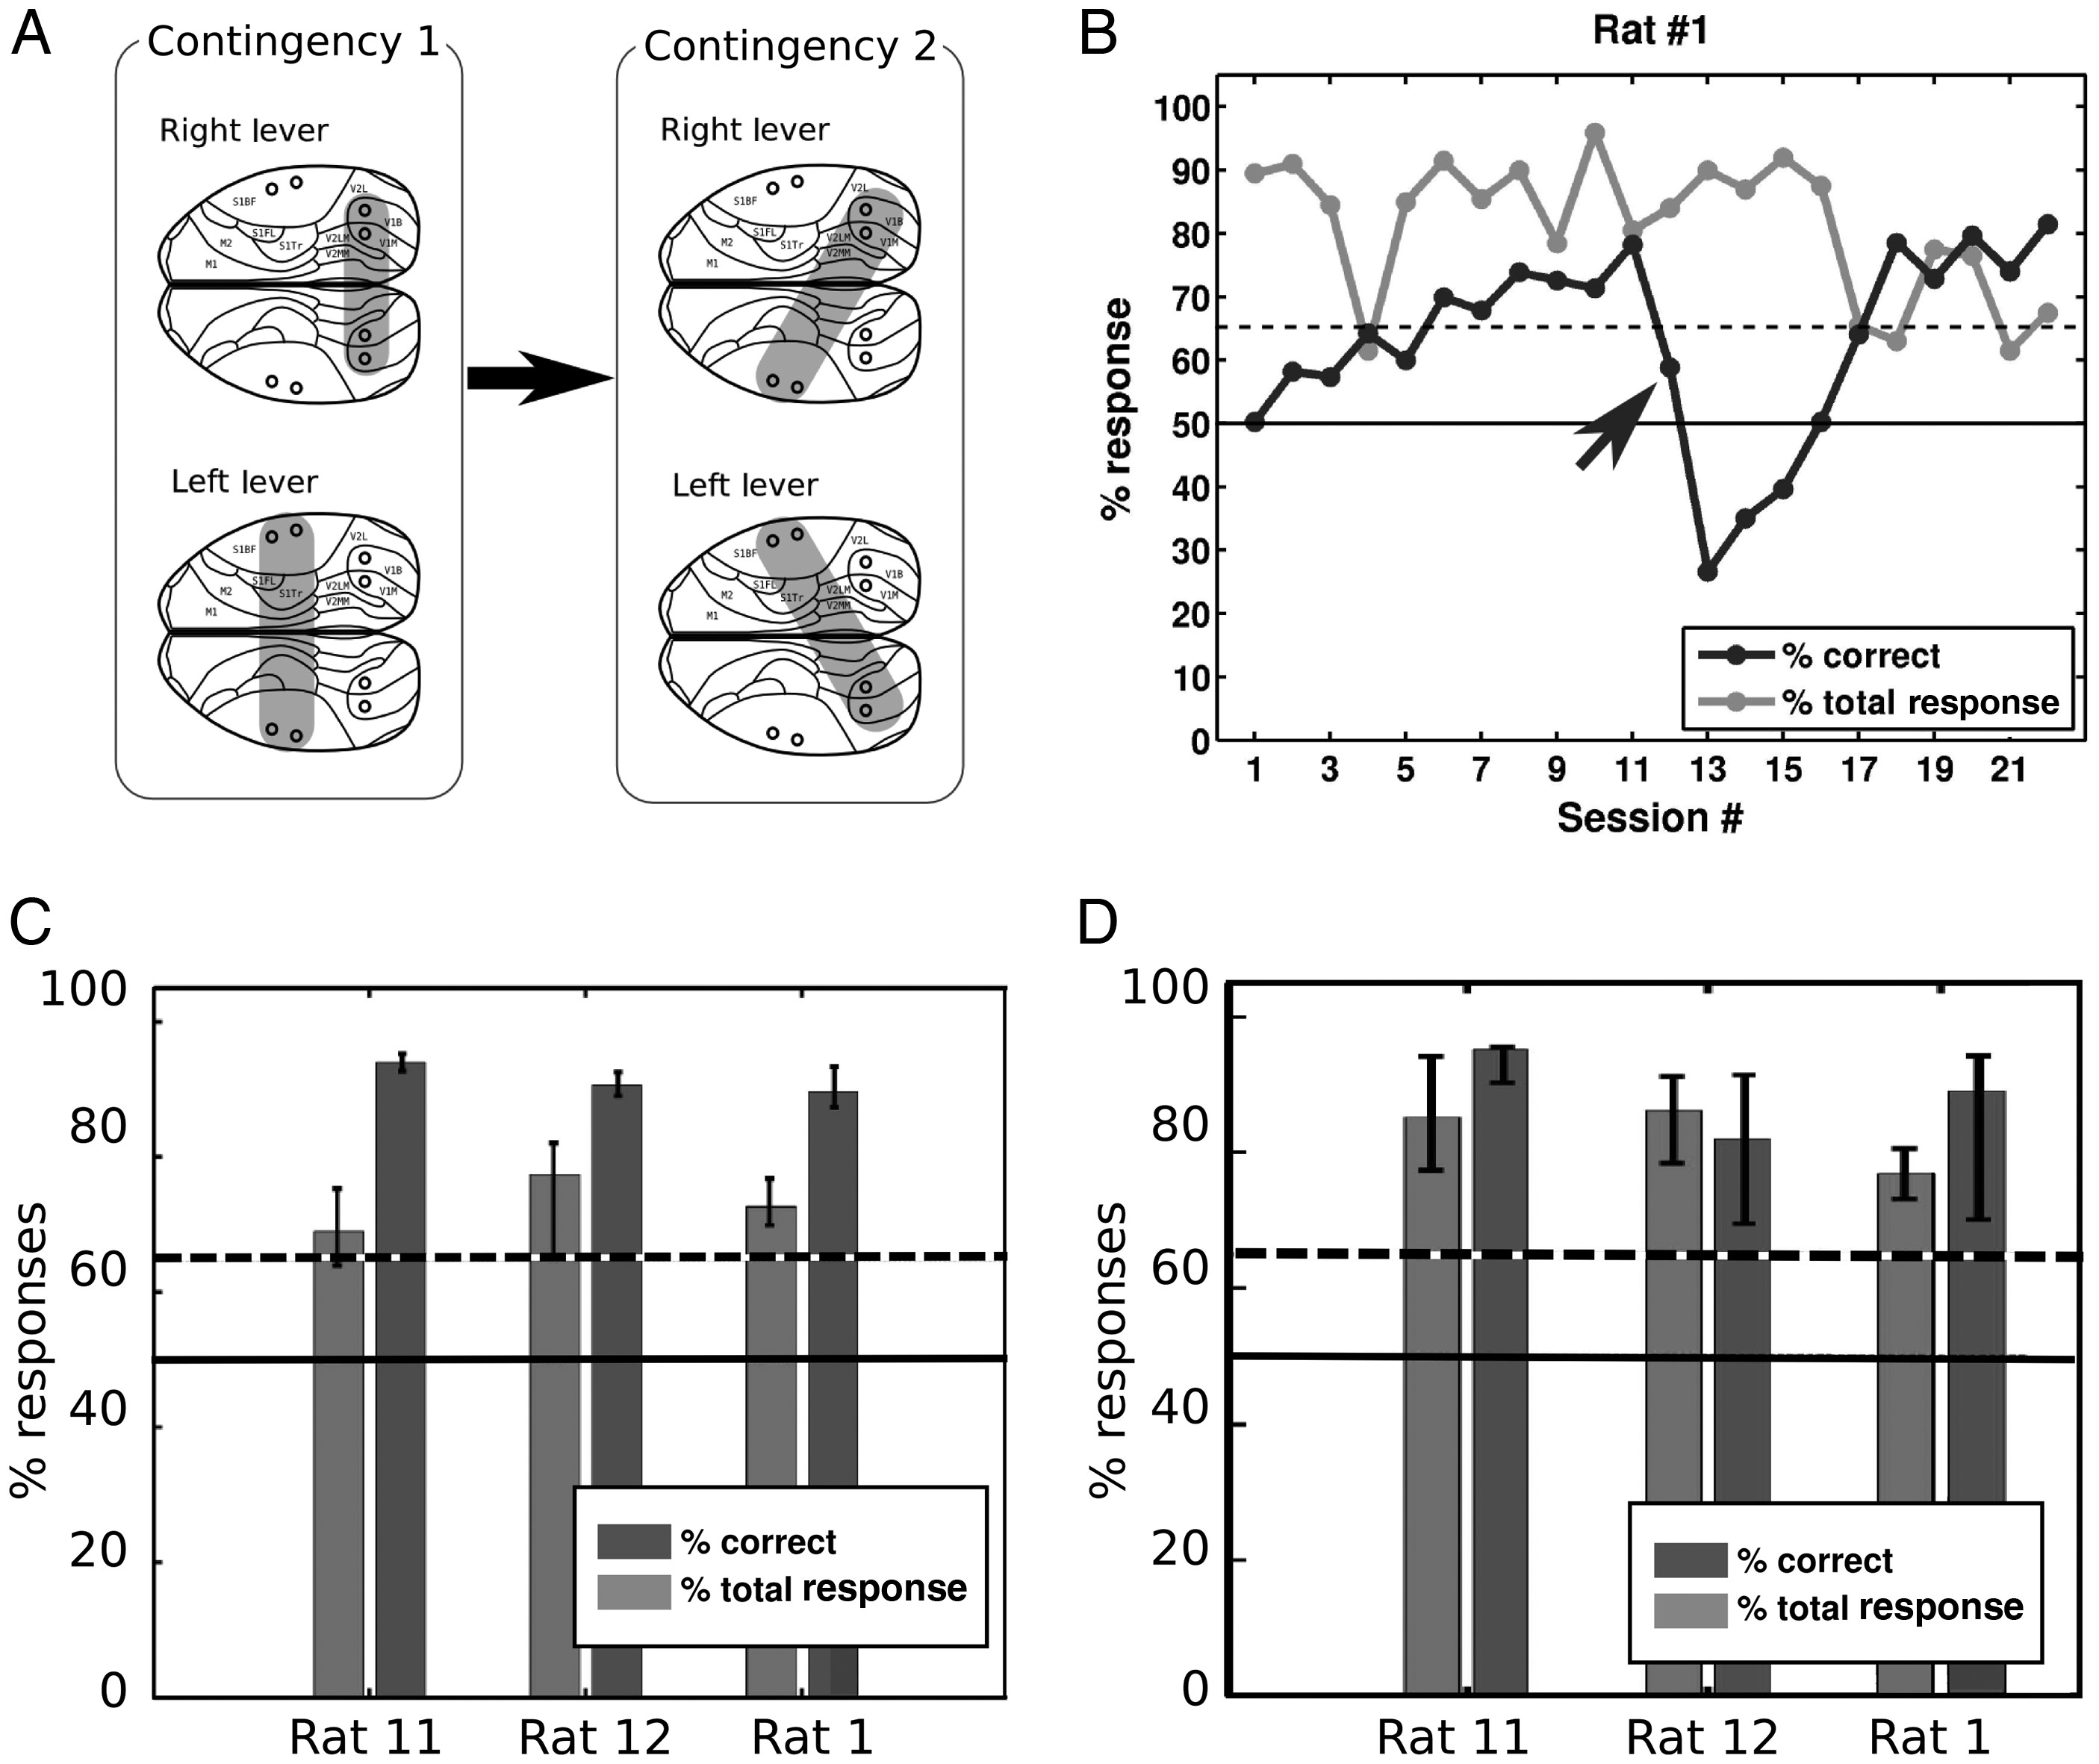
Figure 5. Rats can discriminate different microstimulation patterns after a change in contingency (A) The rats were ...
Notes:
Figure 5. Rats can discriminate different microstimulation patterns after a change in contingency (A) The rats were first trained in a right visual + left visual, versus right somatosensory + left somatosensory discrimination (Contingency 1). After reaching the learning criteria for 4 sessions, the pattern was switched to a right visual + left somatosensory synchronization, versus the complementary pattern (Contingency 2). Parameters: Square pulses, 150 µA, 0.5 ms pulse width, negative first, 1000 ms train duration. (B) Learning curve for one animal trained in this task. The arrow indicates the first session in which pattern 2 was applied. Continuous line: 50% chance level. Dashed line: 65% arbitrary learning criteria. (C) Average performance for 3 rats trained on contingency 1. (D) Average performance for the same rats trained to switch between contingency 1 to contingency 2.
Unless provided in the caption above, the following copyright applies to the content of this slide: © The Author 2012. Published by Oxford University Press. All rights reserved. For Permissions, please e-mail: journals.permissions@oup.com

Slide 6
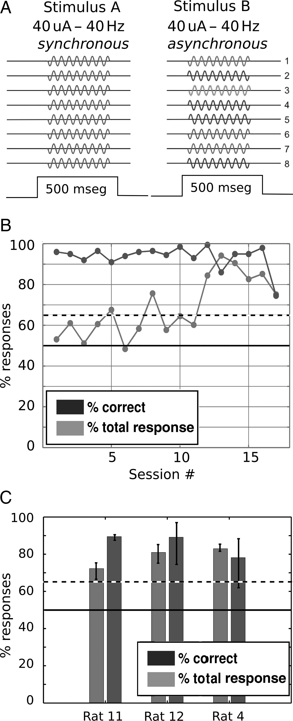
Figure 6. Rats can be trained to discriminate between sinusoidal synchronous versus asynchronous current patterns. (A) ...
Notes:
Figure 6. Rats can be trained to discriminate between sinusoidal synchronous versus asynchronous current patterns. (A) Sinusoidal stimulus configuration. Two current patterns were applied to all 8 electrodes. Stimulus A (synchronous) featured 0-phase lag sinusoidal waveforms, while stimulus B also contained sinusoidal waveforms, but with random phase lag, to avoid any pair of electrodes with the same oscillatory phase. Ten versions of stimulus B were built in each training session, to avoid phase locking (see text). (B) Learning curve for one rat showing a performance over 80% after the 11th training session. Dark gray: % of correct response, light gray: % of total response (see text). (C) Average performance for 3 rats trained in this task. All of them showed reliable performance levels according to defined learning criteria. Error bars represent the 95% CI. Continuous line: 50% chance level. Dashed line: 65% learning criteria.
Unless provided in the caption above, the following copyright applies to the content of this slide: © The Author 2012. Published by Oxford University Press. All rights reserved. For Permissions, please e-mail: journals.permissions@oup.com

Slide 7
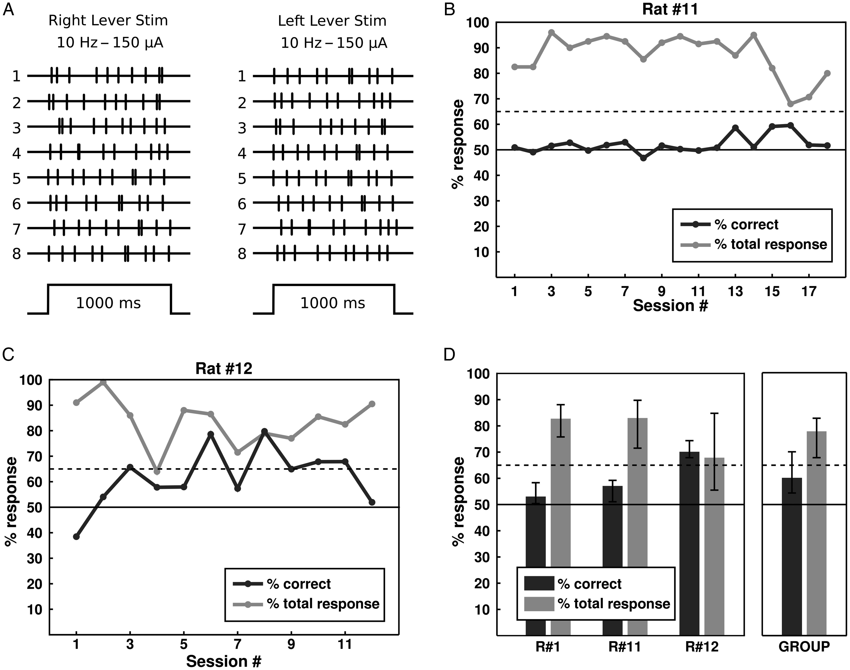
Figure 7. Rats have difficulties in distinguishing between 2 asynchronous pulse trains, even when they are stimulated ...
Notes:
Figure 7. Rats have difficulties in distinguishing between 2 asynchronous pulse trains, even when they are stimulated with the same temporal sequence in each trial. (A) Each stimulus (150 µA, 1000 ms) was constructed with pulses at a random sequence, with an average firing rate of 10 Hz. Each sequence was the same for every training session. (B and C) Example learning curve for 2 of rats (#1 and #12) trained in this task. (D) Average performance for each of the 3 rats trained in this task, and for the group. (B–D) Error bars show the 95% CI. Continuous line: 50% chance level. Dashed line: 65% arbitrarily established learning criteria.
Unless provided in the caption above, the following copyright applies to the content of this slide: © The Author 2012. Published by Oxford University Press. All rights reserved. For Permissions, please e-mail: journals.permissions@oup.com

Slide 8
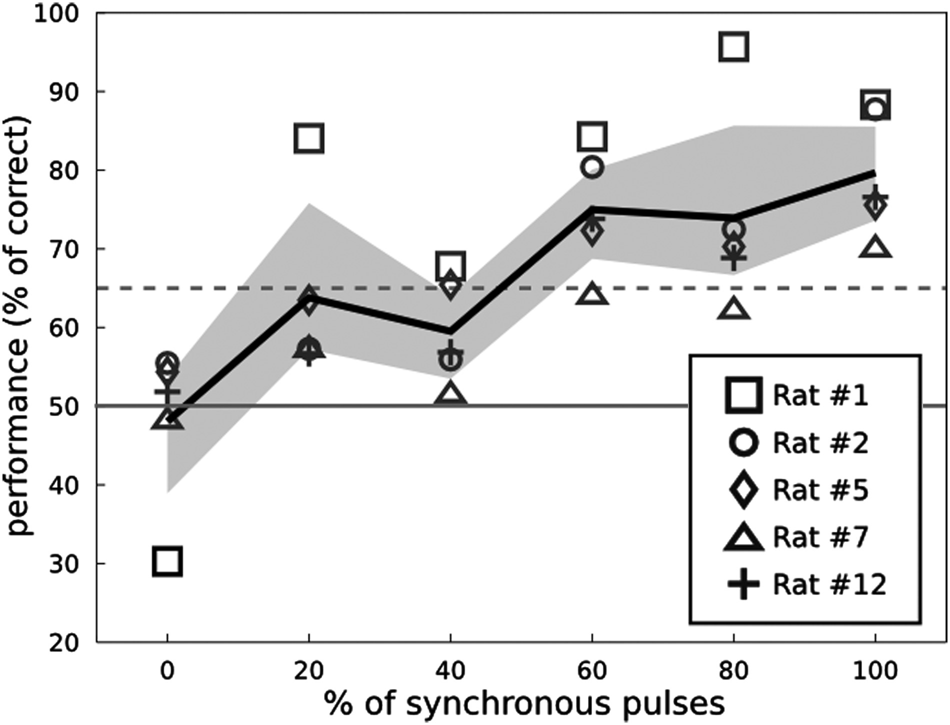
Figure 8. The performance of rats is directly proportional to the percentage of synchronous pulses contained in the ...
Notes:
Figure 8. The performance of rats is directly proportional to the percentage of synchronous pulses contained in the stimulus patterns. The graph depicts the performance of 5 rats in the discrimination of different levels of synchronization. Continuous black line shows the group average, and the shaded area depicts the 95% CI for the mean. Continuous gray line, 50% chance level; dashed line, 65% arbitrary learning criteria.
Unless provided in the caption above, the following copyright applies to the content of this slide: © The Author 2012. Published by Oxford University Press. All rights reserved. For Permissions, please e-mail: journals.permissions@oup.com

