Slide 1
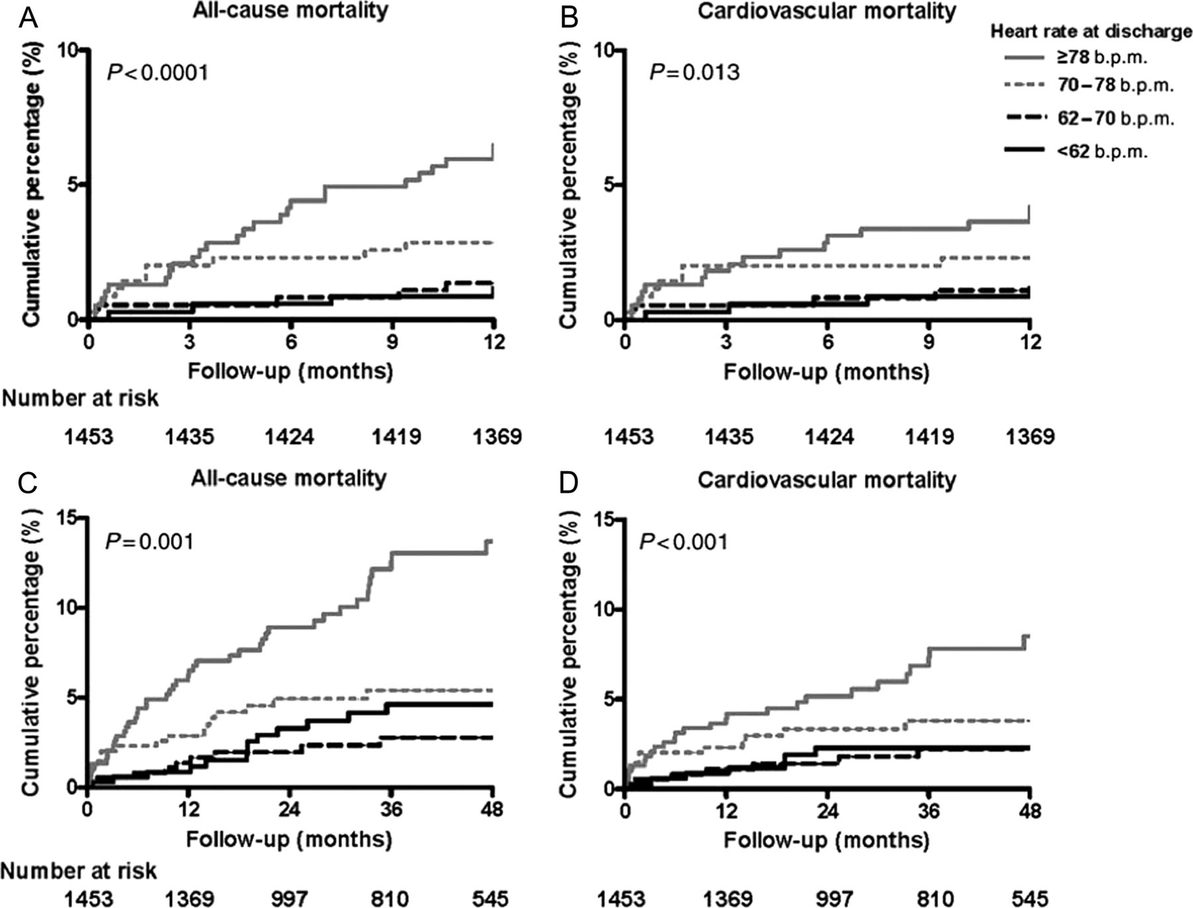
Figure 1 Kaplan–Meier time-to-event plots for heart rate at discharge divided by quartiles and all-cause mortality (A ...
Notes:
Figure 1 Kaplan–Meier time-to-event plots for heart rate at discharge divided by quartiles and all-cause mortality (A and C) and cardiovascular mortality (B and D) at 1-year (A and B) and 4-year (C and D) follow-up, demonstrating relationship between discharge heart rate and mortality after PPCI for STEMI. Modified from Antoni et al.9
Unless provided in the caption above, the following copyright applies to the content of this slide: Published on behalf of the European Society of Cardiology. All rights reserved. © The Author 2013. For permissions please email: journals.permissions@oup.com

Slide 2
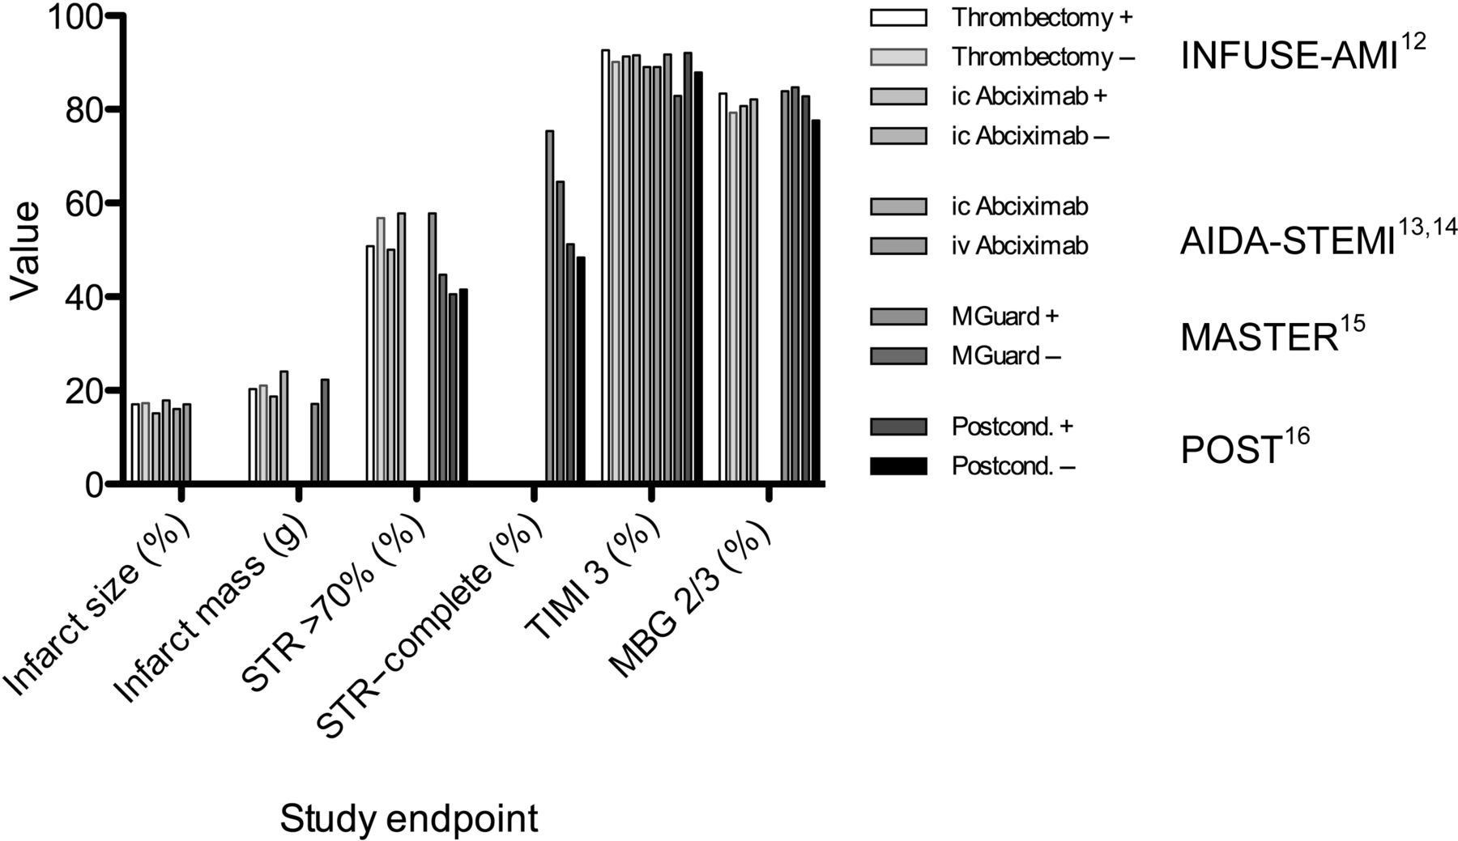
Figure 2 Comparison of study endpoints for reduction in infarct size in STEMI. Study endpoints listed on the x-axis. ...
Notes:
Figure 2 Comparison of study endpoints for reduction in infarct size in STEMI. Study endpoints listed on the x-axis. STR, ST-segment resolution; TIMI 3, thrombolysis in myocardial infarction grade 3 antegrade flow; MBG 2/3, myocardial blush grade 2/3.
Unless provided in the caption above, the following copyright applies to the content of this slide: Published on behalf of the European Society of Cardiology. All rights reserved. © The Author 2013. For permissions please email: journals.permissions@oup.com

