Slide 1
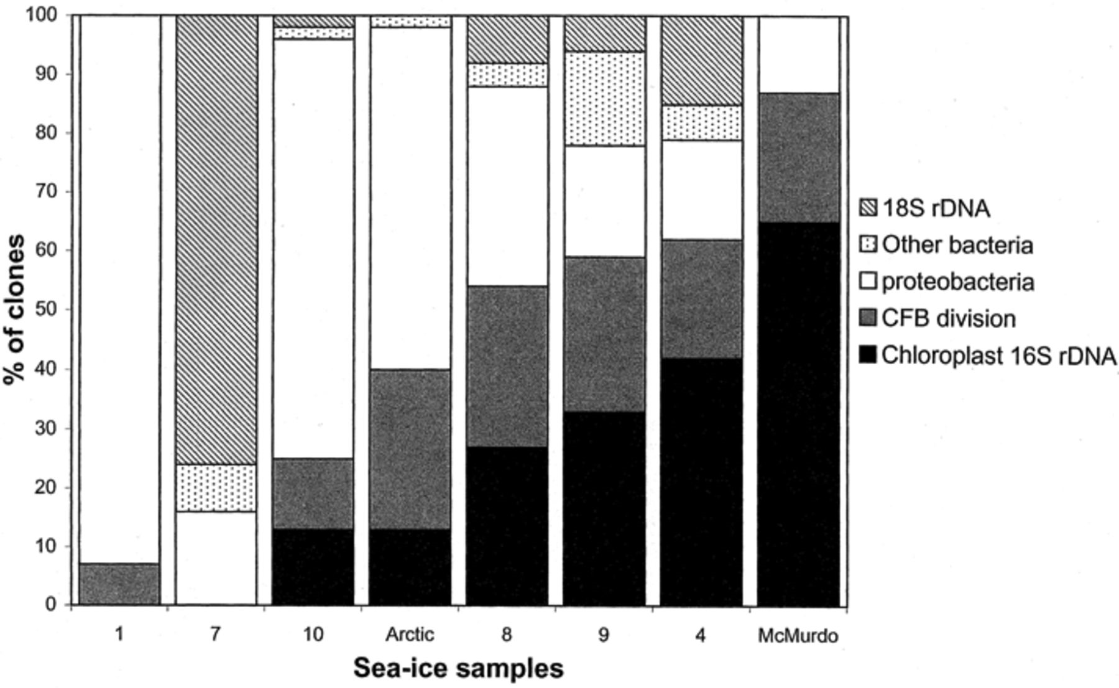
1 Phylogenetic distribution of sea-ice clones derived from universal 16S rDNA clone libraries with sea-ice ...
Notes:
1 Phylogenetic distribution of sea-ice clones derived from universal 16S rDNA clone libraries with sea-ice samples arranged in order of increasing phytoplanktonic density.
Unless provided in the caption above, the following copyright applies to the content of this slide: © 2001 Federation of European Microbiological Societies. Published by Elsevier Science B.V. All rights reserved.

Slide 2
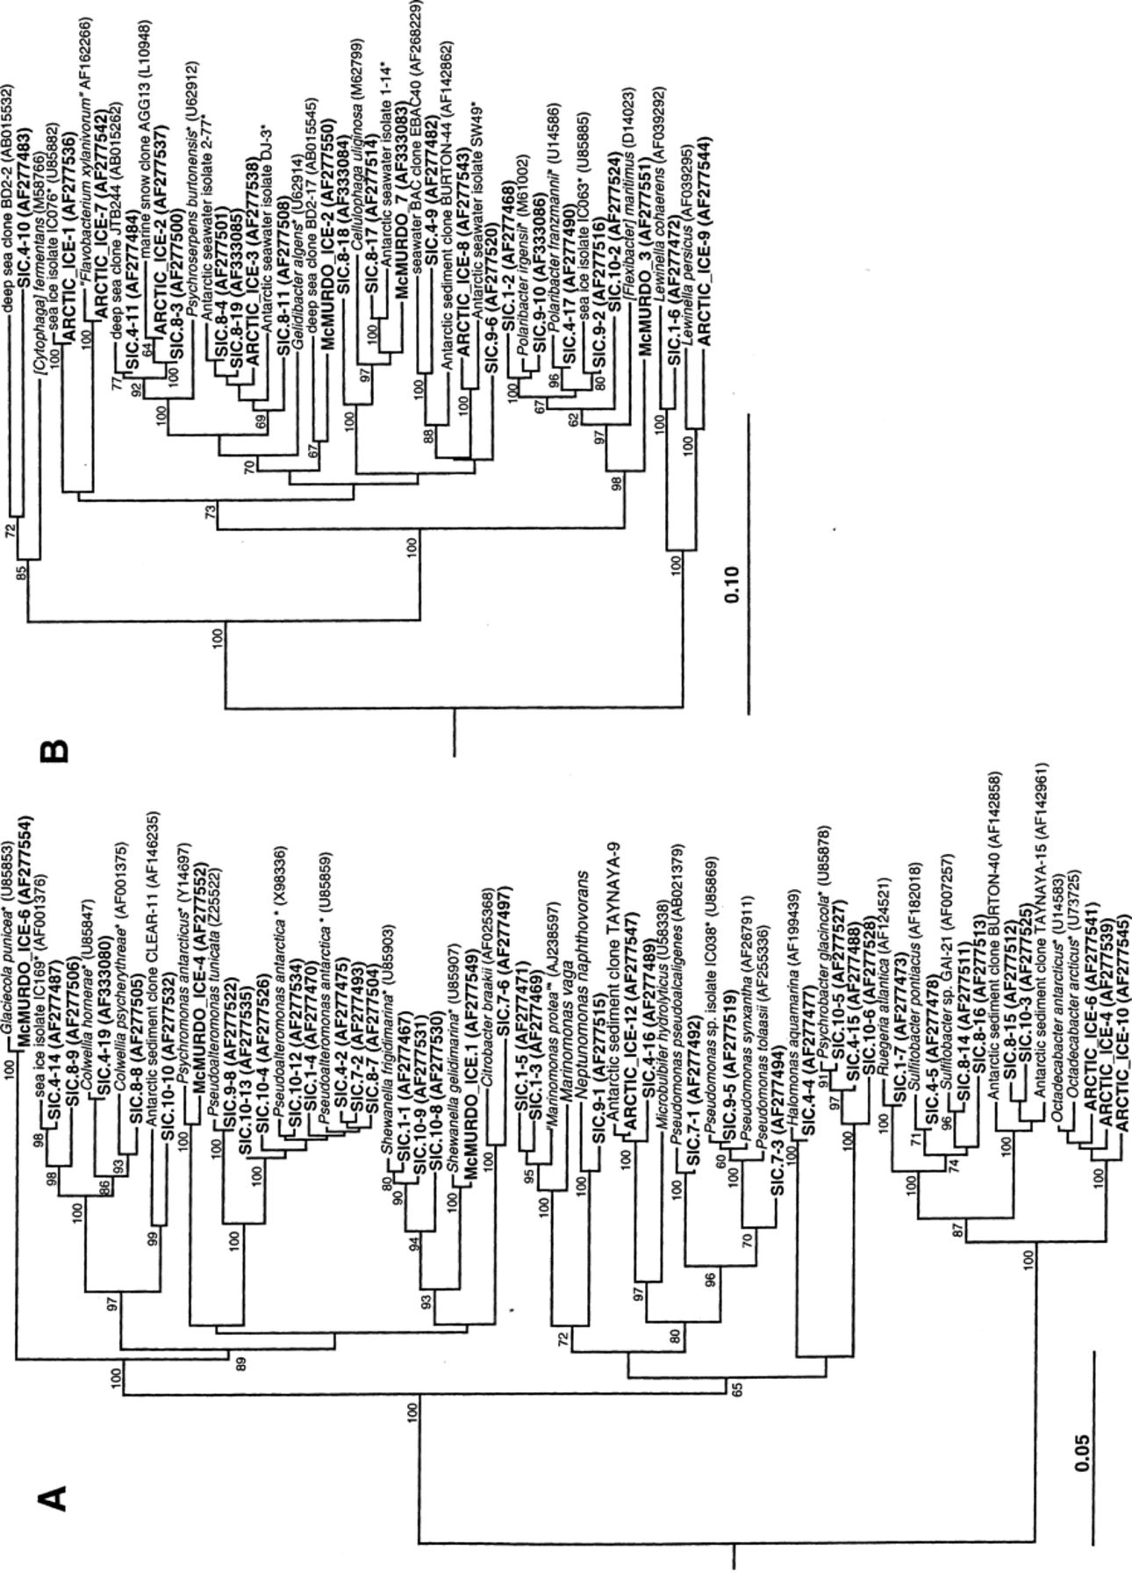
2 Phylogenetic trees (clustered by Neighbor-joining of maximum likelihood values) showing positions of sea-ice ...
Notes:
2 Phylogenetic trees (clustered by Neighbor-joining of maximum likelihood values) showing positions of sea-ice phylotypes to closest related 16S rDNA sequences from either cultivated or cloned sources. Clones are indicated in bold-type (SIC clones include those from Southern Ocean sites). Species flagged with asterisks have been isolated from polar sea ice and from other Antarctic samples including seawater and sediment. Species indicated in quotation marks are currently not nomenclaturally valid names. Some sediment and seawater Antarctic isolates come from unpublished data. Numbers at branch nodes are bootstrap values (only values of 60% and greater are shown). Phylogenetic groups depicted: (A) γ and α proteobacteria; (B) CFB division; (C) other bacterial divisions/groups including Verrucomicrobia, Chlamydiales, mitochondrial 16S rDNA, chloroplast rDNA and Gram-positives; and (D) eukaryotes (18S rDNA).
Unless provided in the caption above, the following copyright applies to the content of this slide: © 2001 Federation of European Microbiological Societies. Published by Elsevier Science B.V. All rights reserved.

Slide 3
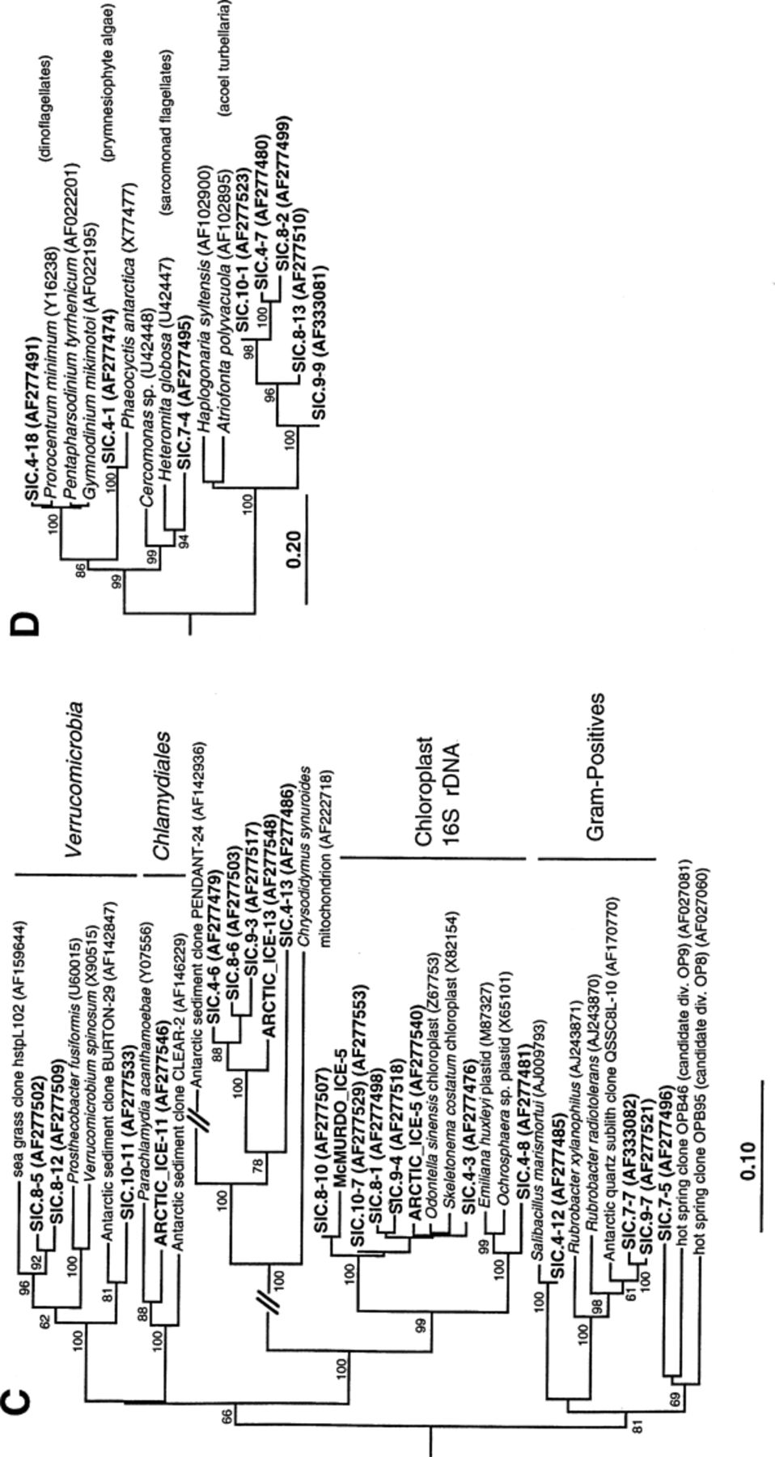
2 Phylogenetic trees (clustered by Neighbor-joining of maximum likelihood values) showing positions of sea-ice ...
Notes:
2 Phylogenetic trees (clustered by Neighbor-joining of maximum likelihood values) showing positions of sea-ice phylotypes to closest related 16S rDNA sequences from either cultivated or cloned sources. Clones are indicated in bold-type (SIC clones include those from Southern Ocean sites). Species flagged with asterisks have been isolated from polar sea ice and from other Antarctic samples including seawater and sediment. Species indicated in quotation marks are currently not nomenclaturally valid names. Some sediment and seawater Antarctic isolates come from unpublished data. Numbers at branch nodes are bootstrap values (only values of 60% and greater are shown). Phylogenetic groups depicted: (A) γ and α proteobacteria; (B) CFB division; (C) other bacterial divisions/groups including Verrucomicrobia, Chlamydiales, mitochondrial 16S rDNA, chloroplast rDNA and Gram-positives; and (D) eukaryotes (18S rDNA).
Unless provided in the caption above, the following copyright applies to the content of this slide: © 2001 Federation of European Microbiological Societies. Published by Elsevier Science B.V. All rights reserved.

