Slide 1
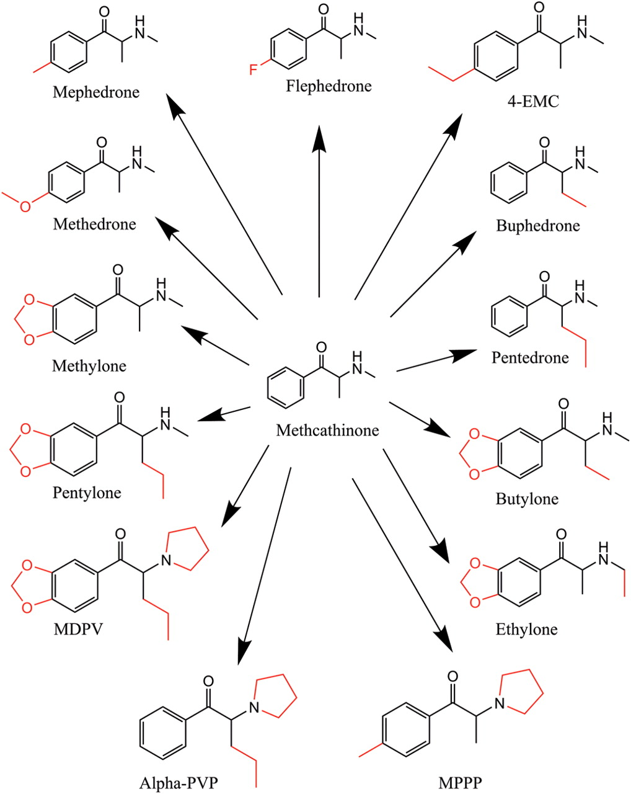
Figure 2. The analogous nature of synthetic stimulants - not all monitored analytes represented.
Notes:
Figure 2. The analogous nature of synthetic stimulants - not all monitored analytes represented.
Unless provided in the caption above, the following copyright applies to the content of this slide: © The Author [2012]. Published by Oxford University Press. All rights reserved. For Permissions, please email: journals.permissions@oup.com

Slide 2
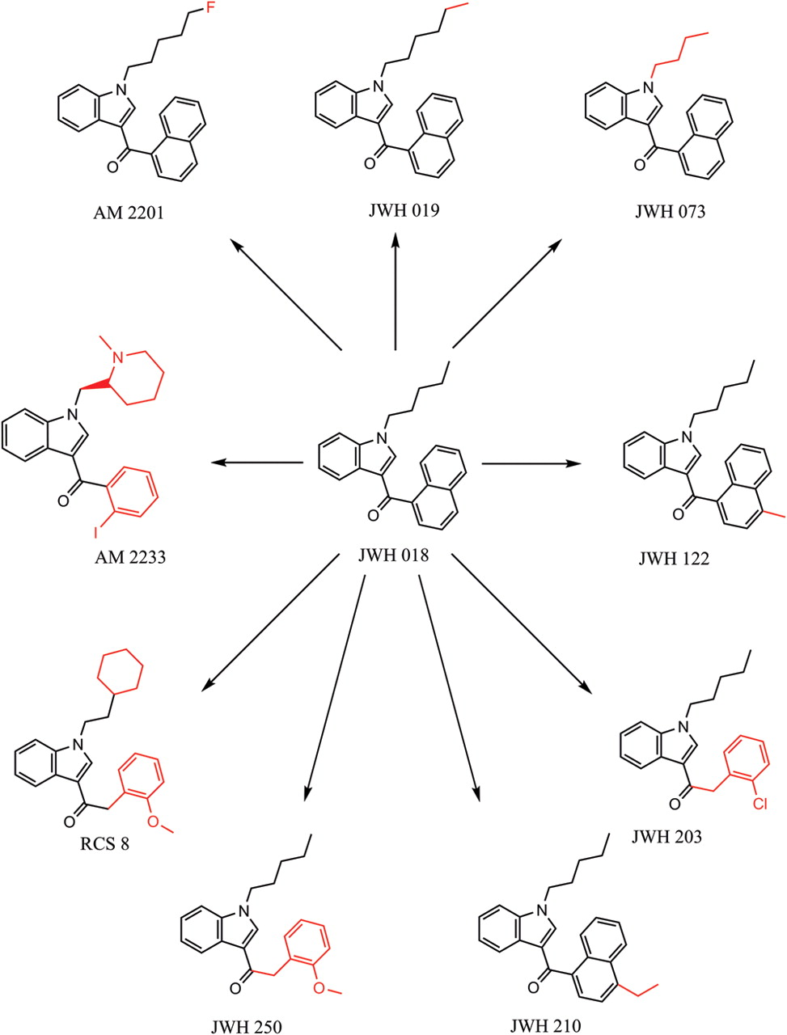
Figure 1. The analogous nature of synthetic cannabinoids - not all monitored analytes represented.
Notes:
Figure 1. The analogous nature of synthetic cannabinoids - not all monitored analytes represented.
Unless provided in the caption above, the following copyright applies to the content of this slide: © The Author [2012]. Published by Oxford University Press. All rights reserved. For Permissions, please email: journals.permissions@oup.com

Slide 3
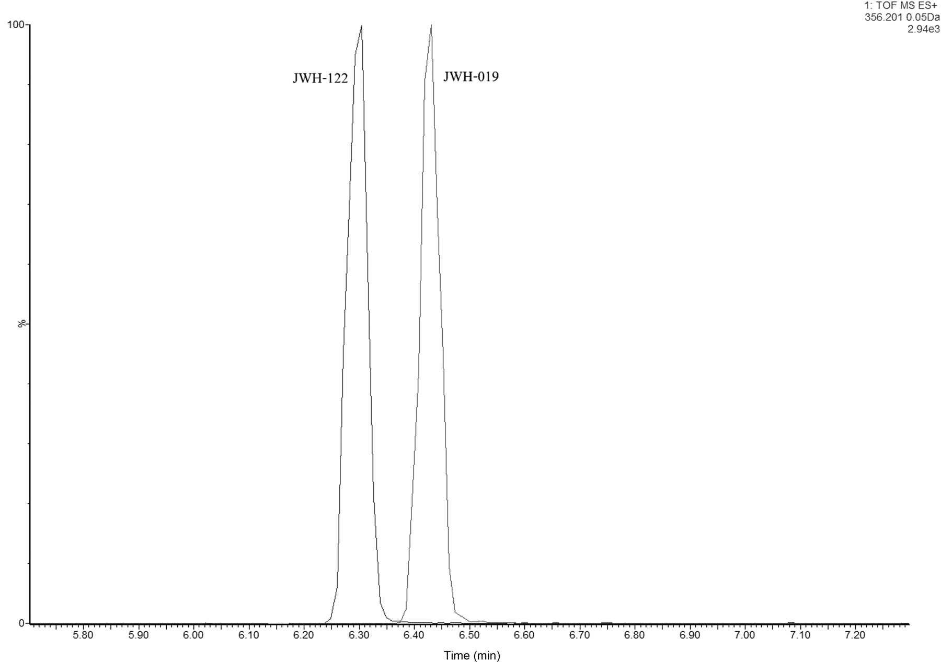
Figure 5. Chromatographic resolution between isobaric compounds: JWH-019 and JWH-122.
Notes:
Figure 5. Chromatographic resolution between isobaric compounds: JWH-019 and JWH-122.
Unless provided in the caption above, the following copyright applies to the content of this slide: © The Author [2012]. Published by Oxford University Press. All rights reserved. For Permissions, please email: journals.permissions@oup.com

Slide 4
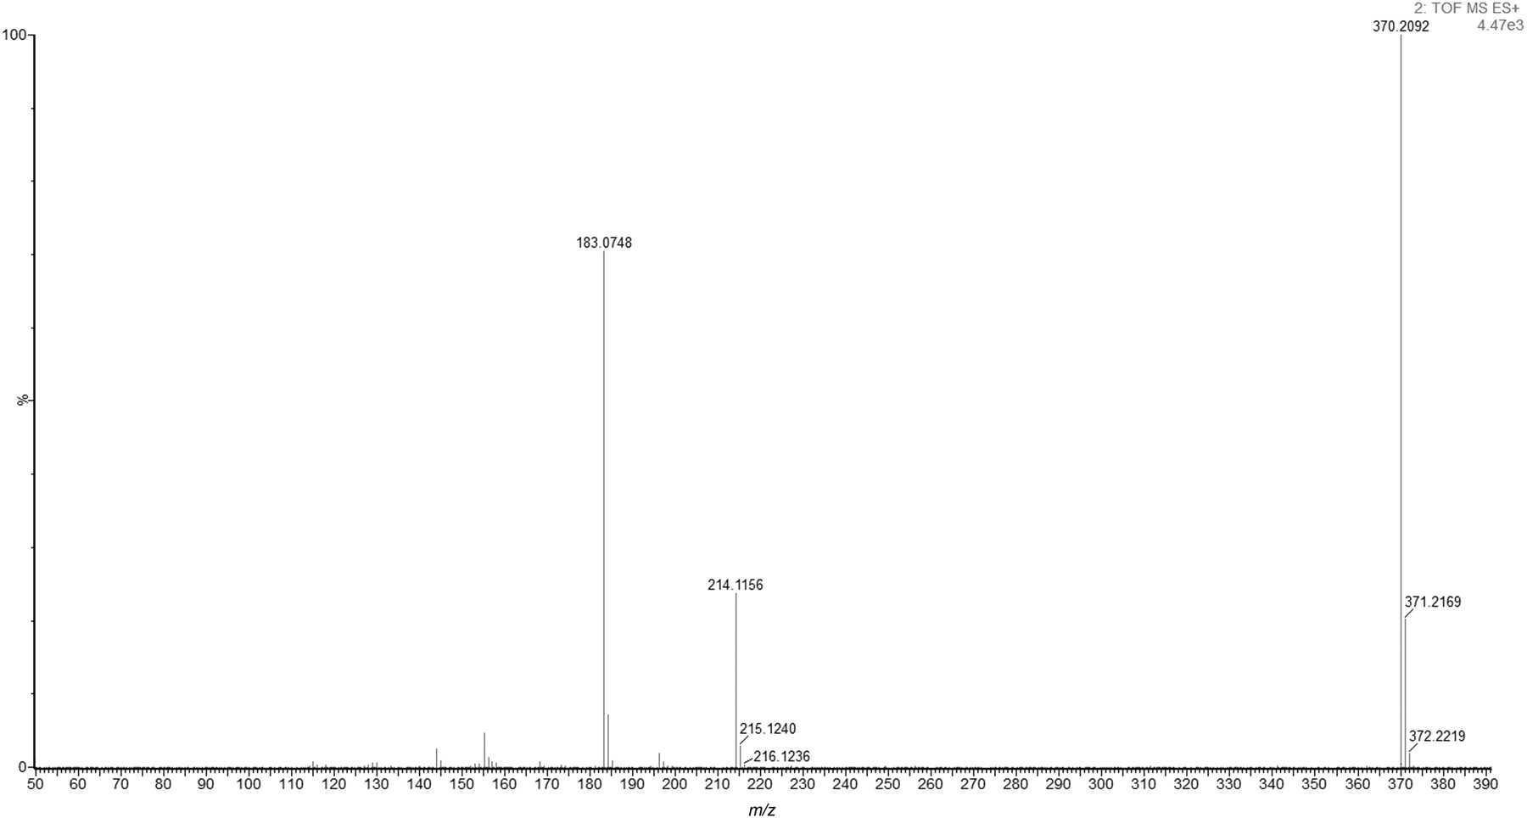
Figure 6. Extracted ion spectrum of JWH-210 detected in an authentic herbal blend product.
Notes:
Figure 6. Extracted ion spectrum of JWH-210 detected in an authentic herbal blend product.
Unless provided in the caption above, the following copyright applies to the content of this slide: © The Author [2012]. Published by Oxford University Press. All rights reserved. For Permissions, please email: journals.permissions@oup.com

Slide 5
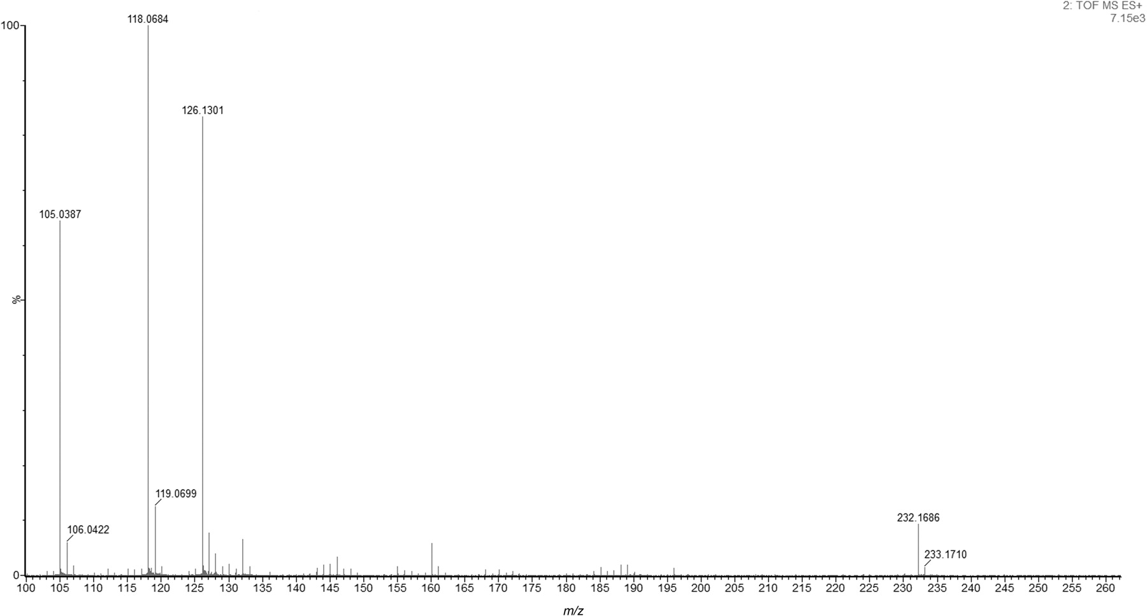
Figure 8. Extracted ion spectrum of Alpha-PVP detected in an authentic legal high product.
Notes:
Figure 8. Extracted ion spectrum of Alpha-PVP detected in an authentic legal high product.
Unless provided in the caption above, the following copyright applies to the content of this slide: © The Author [2012]. Published by Oxford University Press. All rights reserved. For Permissions, please email: journals.permissions@oup.com

Slide 6
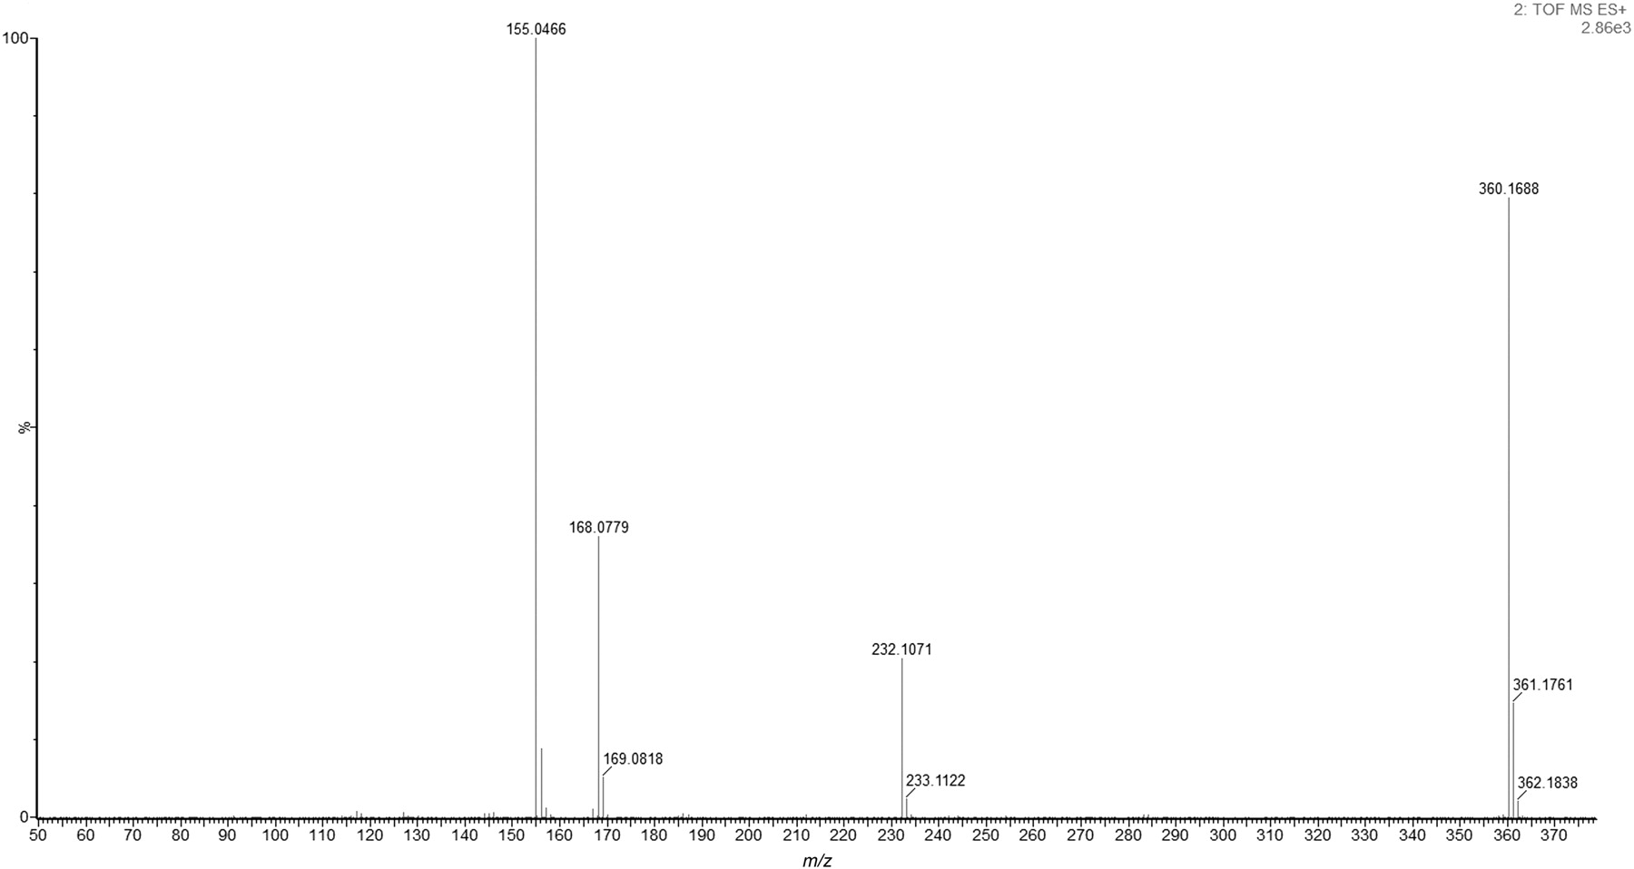
Figure 3. Extracted ion spectrum of AM-2201 detected in an authentic herbal blend product.
Notes:
Figure 3. Extracted ion spectrum of AM-2201 detected in an authentic herbal blend product.
Unless provided in the caption above, the following copyright applies to the content of this slide: © The Author [2012]. Published by Oxford University Press. All rights reserved. For Permissions, please email: journals.permissions@oup.com

Slide 7
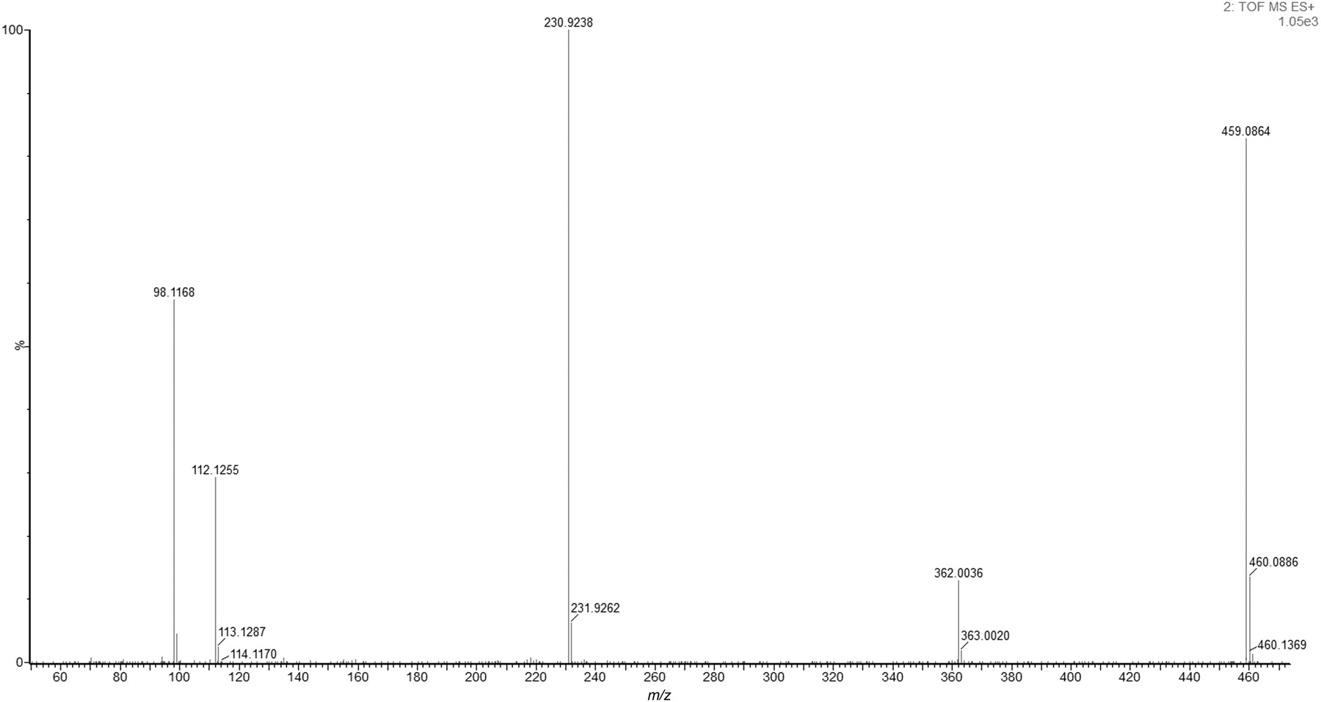
Figure 4. Extracted ion spectrum of AM-2233 detected in an authentic herbal blend product.
Notes:
Figure 4. Extracted ion spectrum of AM-2233 detected in an authentic herbal blend product.
Unless provided in the caption above, the following copyright applies to the content of this slide: © The Author [2012]. Published by Oxford University Press. All rights reserved. For Permissions, please email: journals.permissions@oup.com

Slide 8
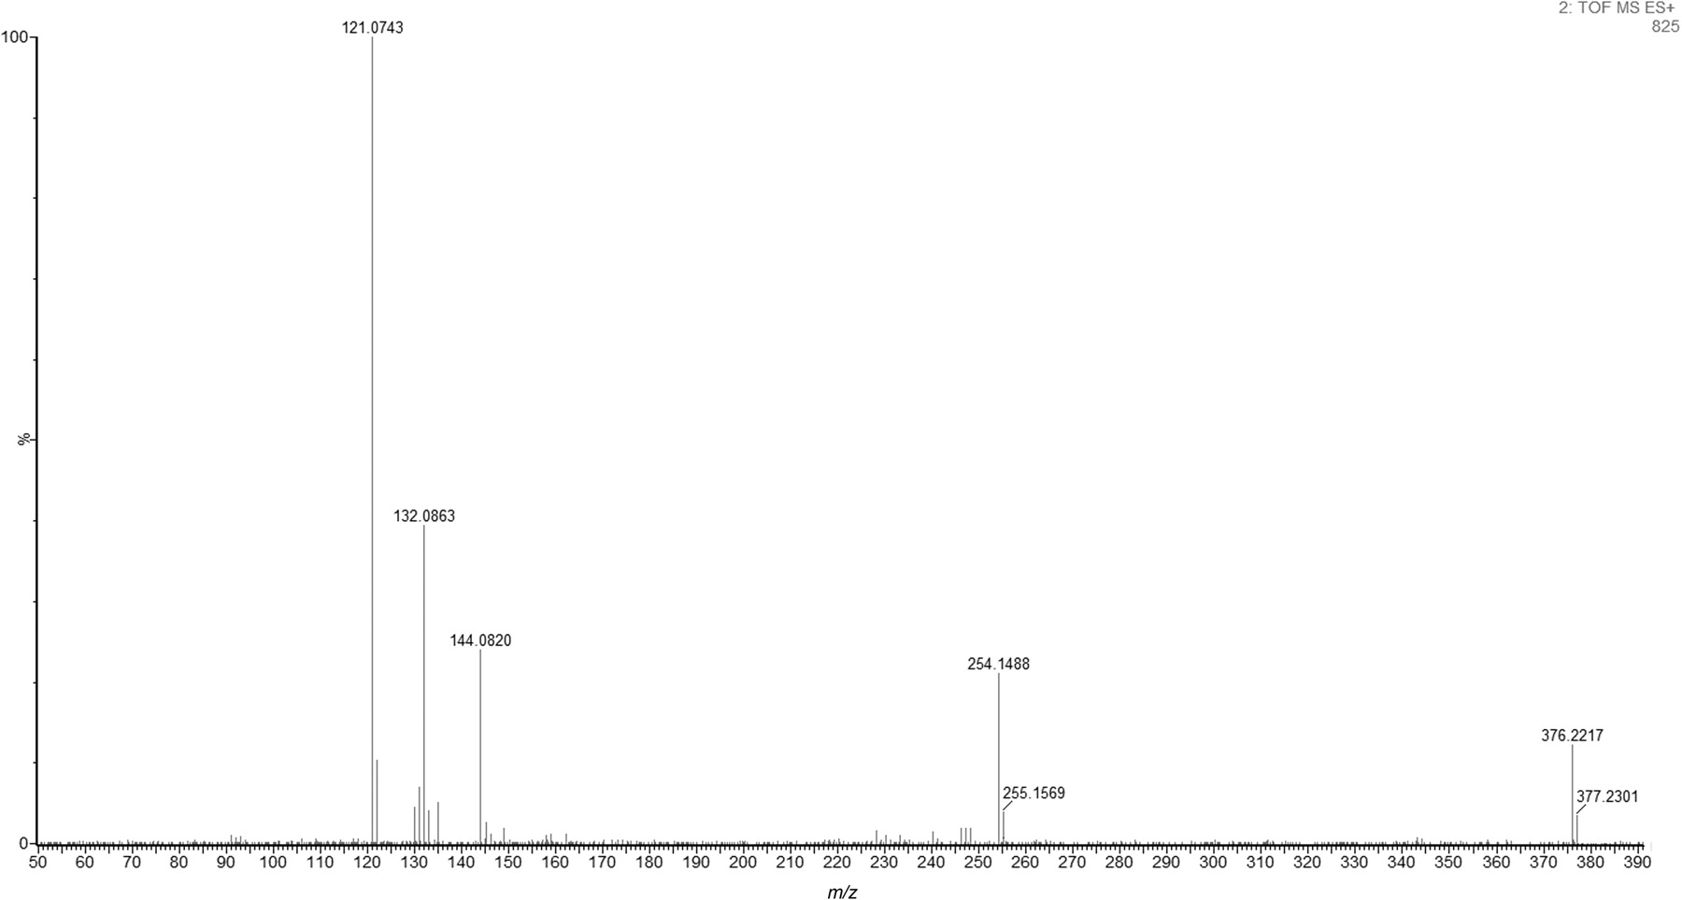
Figure 7. Extracted ion spectrum of RCS-8 detected in an authentic herbal blend product.
Notes:
Figure 7. Extracted ion spectrum of RCS-8 detected in an authentic herbal blend product.
Unless provided in the caption above, the following copyright applies to the content of this slide: © The Author [2012]. Published by Oxford University Press. All rights reserved. For Permissions, please email: journals.permissions@oup.com

