Slide 1
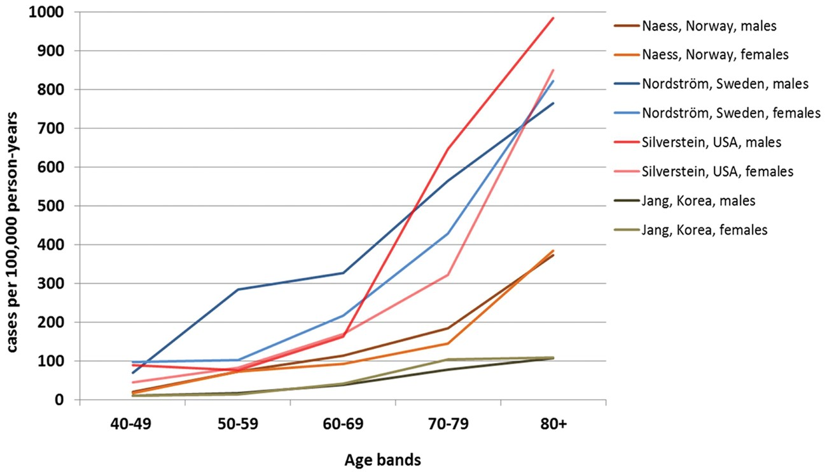
Figure 1 Venous thromboembolism incidence according to age group.
Notes:
Figure 1 Venous thromboembolism incidence according to age group.
Unless provided in the caption above, the following copyright applies to the content of this slide: Published on behalf of the European Society of Cardiology. All rights reserved. © The Author 2017. For permissions, please email: journals.permissions@oup.com.This article is published and distributed under the terms of the Oxford University Press, Standard Journals Publication Model (https://academic.oup.com/journals/pages/open_access/funder_policies/chorus/standard_publication_model)

Slide 2
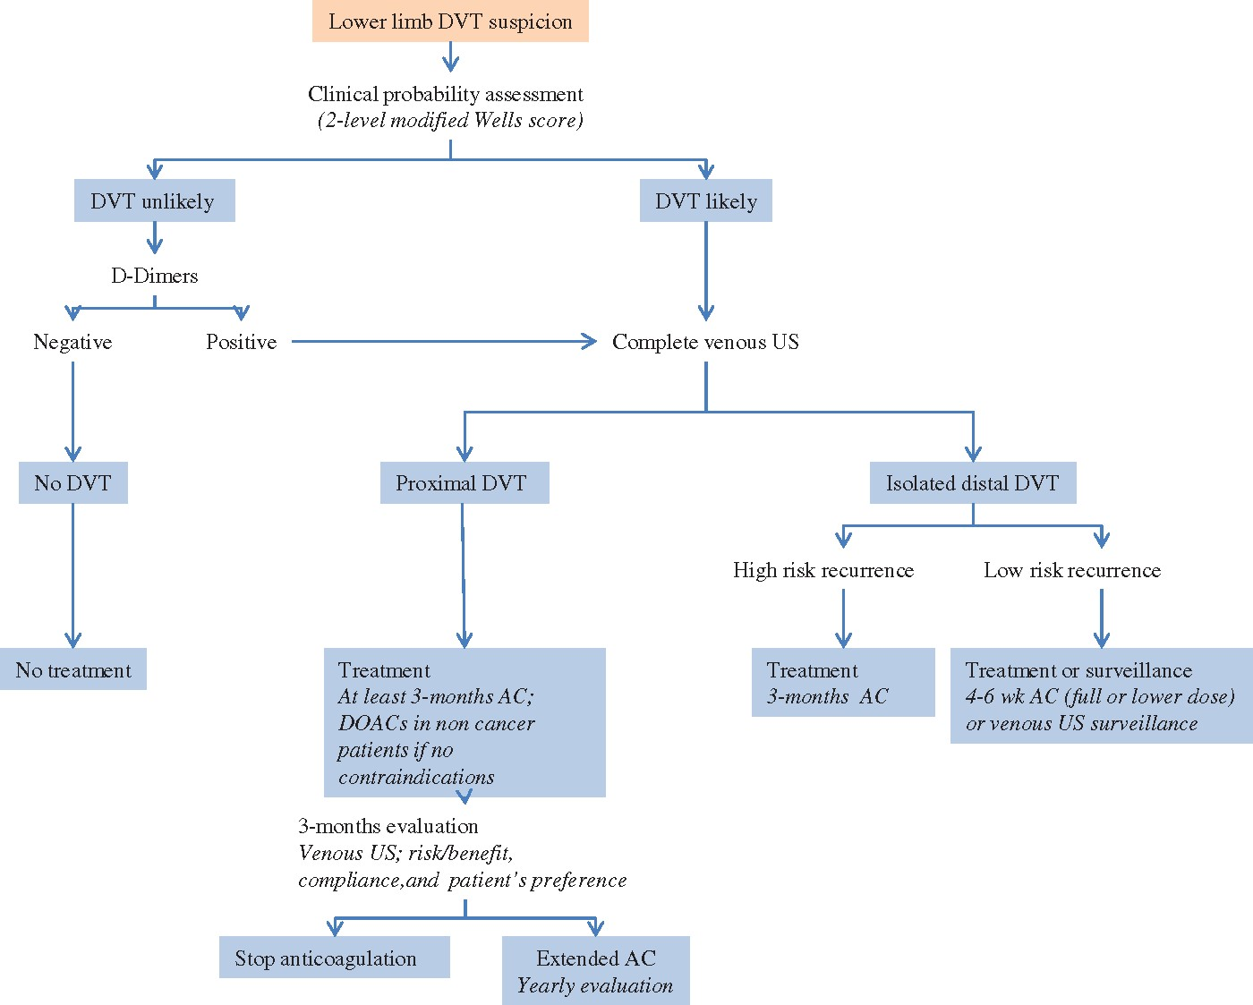
Figure 2 Proposed deep vein thrombosis diagnostic and management algorithm. AC, anticoagulation; DOAC, direct oral ...
Notes:
Figure 2 Proposed deep vein thrombosis diagnostic and management algorithm. AC, anticoagulation; DOAC, direct oral anticoagulant.
Unless provided in the caption above, the following copyright applies to the content of this slide: Published on behalf of the European Society of Cardiology. All rights reserved. © The Author 2017. For permissions, please email: journals.permissions@oup.com.This article is published and distributed under the terms of the Oxford University Press, Standard Journals Publication Model (https://academic.oup.com/journals/pages/open_access/funder_policies/chorus/standard_publication_model)

Slide 3
Figure 3 Deep vein thrombosis treatment phases. ClCreat: creatinine clearance; LMWH: low molecular weight heparin; P-P ...
Notes:
Figure 3 Deep vein thrombosis treatment phases. ClCreat: creatinine clearance; LMWH: low molecular weight heparin; P-P inhibitors: proton pump inhibitors; VKA: vitamin K antantagonist.
Unless provided in the caption above, the following copyright applies to the content of this slide: Published on behalf of the European Society of Cardiology. All rights reserved. © The Author 2017. For permissions, please email: journals.permissions@oup.com.This article is published and distributed under the terms of the Oxford University Press, Standard Journals Publication Model (https://academic.oup.com/journals/pages/open_access/funder_policies/chorus/standard_publication_model)

Slide 4
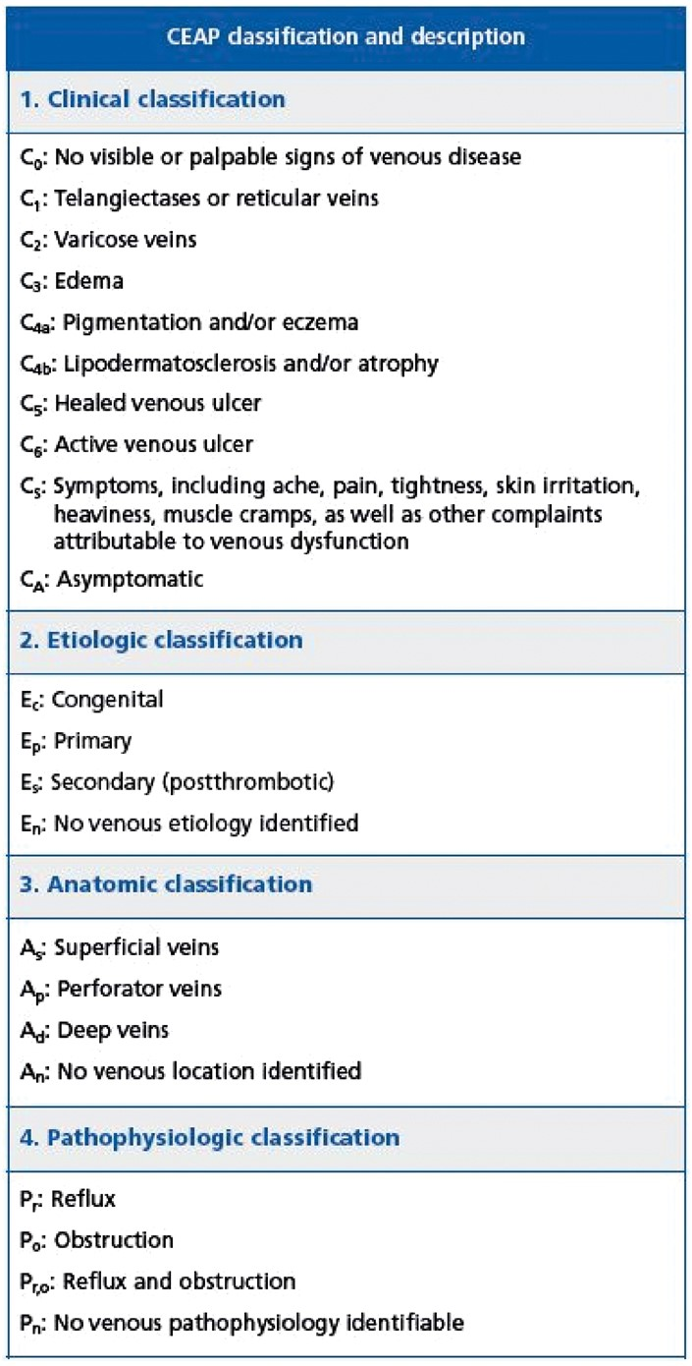
Figure 4 Chronic venous disorders clinical classification (CEAP).
Notes:
Figure 4 Chronic venous disorders clinical classification (CEAP).
Unless provided in the caption above, the following copyright applies to the content of this slide: Published on behalf of the European Society of Cardiology. All rights reserved. © The Author 2017. For permissions, please email: journals.permissions@oup.com.This article is published and distributed under the terms of the Oxford University Press, Standard Journals Publication Model (https://academic.oup.com/journals/pages/open_access/funder_policies/chorus/standard_publication_model)

